Slide 1
Kickstarter
Understanding Successful Projects
Patrick Georgi

Slide 2
What and Why?
Everyone probably knows about Kickstarter by now, as it has become one of the largest crowdfunding platforms, raising over $2 billion since its launch in 2009
Matching the theory of crowdfunding with the reach and accessibility of the internet has led to many websites that aim to raise money for various types of projects
As opposed to more charity based crowdfunding (Kiva, DonorsChoose, etc.), Kickstarter is mainly product based and therefore I’ve always thought that makes it better suited to understanding it’s consumer’s behavior
One aspect of Kickstarter that has really interested me, is that it seems to be a non-deceitful way to price-discriminate

Slide 3
Steps of the project
Main goal was to explore the data to understand characteristics of very successful projects
Seeing what impact the location of project’s has on the campaign
Exploring if there is any evidence in the data to suggest price-discrimination
Finally, creating a model to predict how much funding a project will receive based on certain features
What are the limitations of the model, and where can I go from here?

Slide 4
The data
The data was scraped from Kickstarter’s website (I used someone else’s scraped data, but would like to scrape my own in the future)
Data was pretty clean in terms of null values, however many of the variables that looked like there were numeric were strings, so required a lot of format adjusting
Includes the top 4000 most backed projects that were funded on Kickstarter
Original variables include:
Amount pledged
Project’s pitch
Project’s founder (person, group of people, or company name)
Project category
Currency
Original pledge goal
Location
Total number of backers
Pledge tiers in USD
Number of backers corresponding to the pledge amount in pledge tier
Project title
Project url

Slide 5
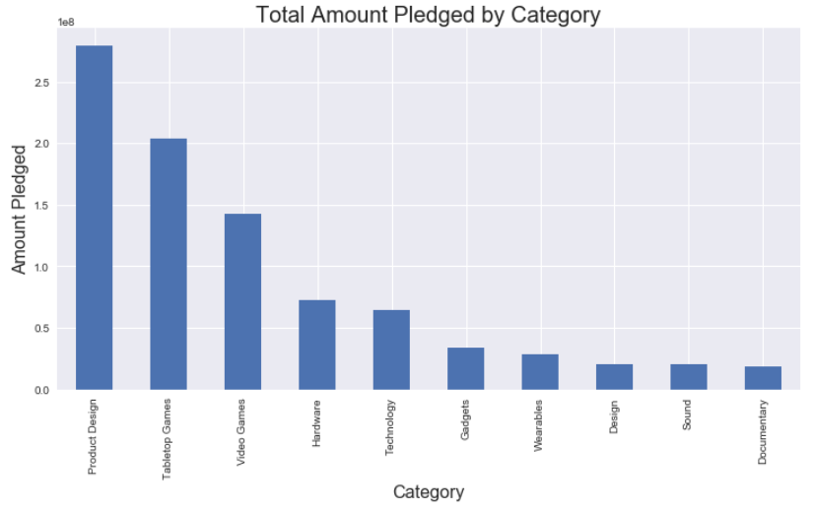
Learning about Successful Projects
My project was pretty heavy on EDA/pandas to learn about various attributes of successful campaigns
Product Design was the most common project in the dataset, with 772 projects, followed closely by Tabletop Games (741) and Videogames (524), and next highest was Hardware (182)
Video games attracted the highest number of overall backers, with product design coming in second (however if you took away the Pebble Smartwatch products, the category would represent a significantly lower portion of the dataset)

Slide 6
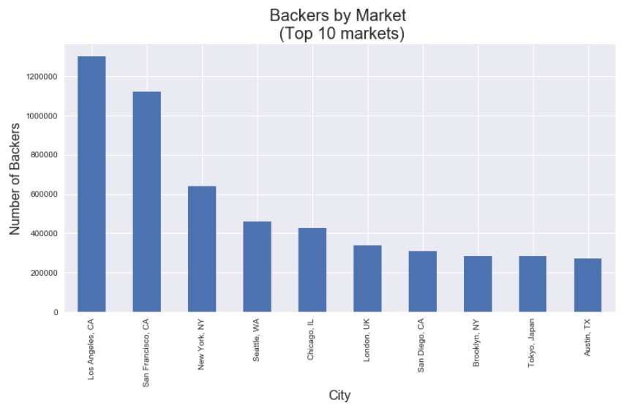
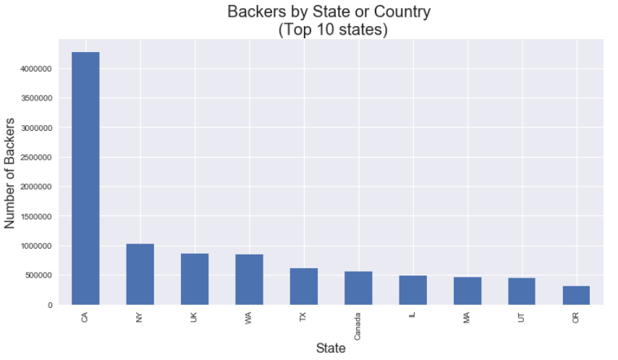
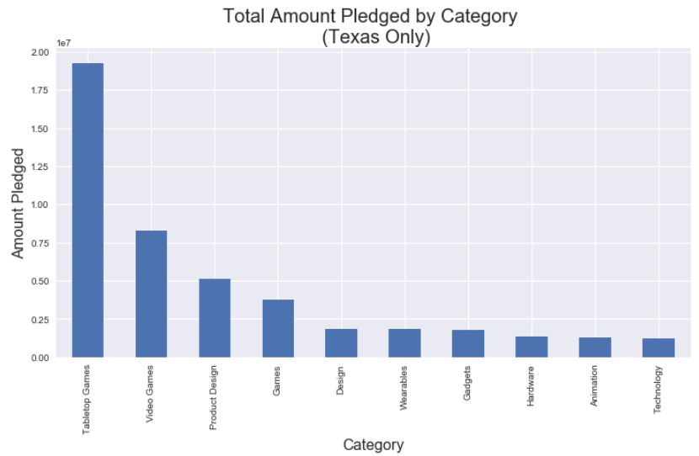
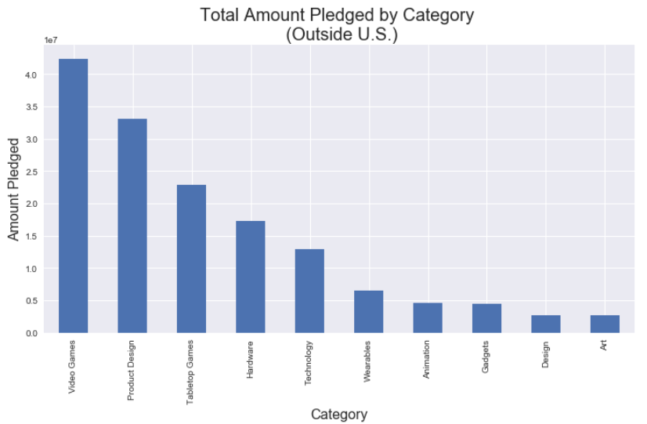

Slide 7
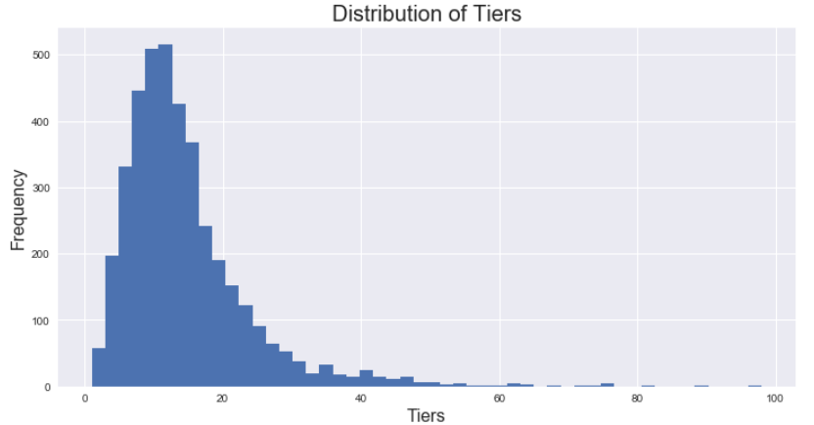
Pledge Tiers: Do they matter?
I wanted to explore whether the number of pledge tiers (and their respective pledge amounts) for a given project had an impact on its funding
Created a new variable the showed the number of tiers, as well as a variable that calculated the percent of the project’s total funding by pledge tier
Most projects have between 5-15 tiers, with the most popular is around 10

Slide 8
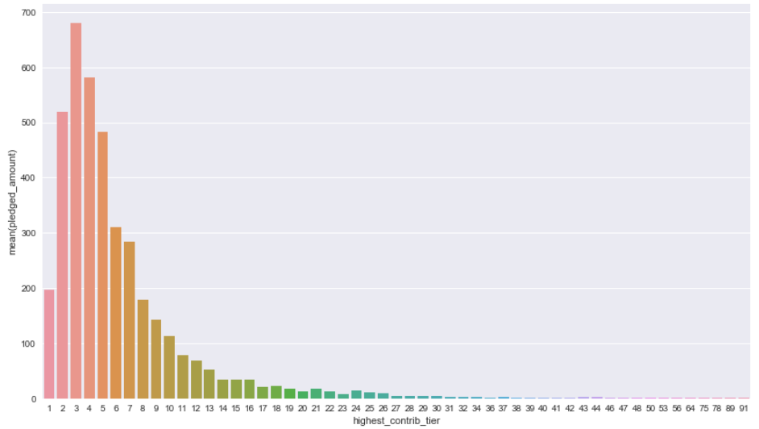
Highest Contributing Tiers
Median = Tier 5
It seems that the most often pledged tiers are around the median for each project, suggesting that for these products that don’t exist and have a known price point, people might default to the median price offered by the project

Slide 9
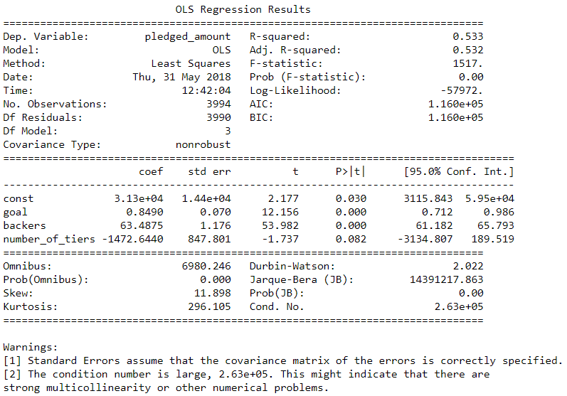
It’s all about the money
Regression: Predicting how much money a project will get based on features
Dependent Variable: Total amount pledged
Independent Variables: Project funding goal, number of backers, number of pledge tiers
RMSE = $487,367
Mean = $290,072
So linear regression was not great
K-folds with 5 folds did not improve model very much

Slide 10
Limitations and Future Work
There are definitely omitted variables related to a Kickstarter’s success. These could include how often a project is providing updates on their page, general media presence (social media as well as blogs/publications reporting on a project), and even a project founder’s previous successful projects
Would like to do more work with location, possibly attempt to predict a certain project category does better overall in certain locations.
Create more classification models with the data using the other categorical data that wasn’t used in the regression
Some NLP using the project’s pitch, see if any specific words or phrases are tied to higher funding levels
In terms of the price discrimination, I think it would be interesting to compare what the average pledge price is during the campaign to what the product ultimately sells for

Slide 11
Questions?
Thanks for listening!

