Slide 1
Google's PageRank and Beyond:
the science of search engine rankings
CS734/834
2019-04-02
Puneeth Bikkasandra
Old Dominion University

Slide 2
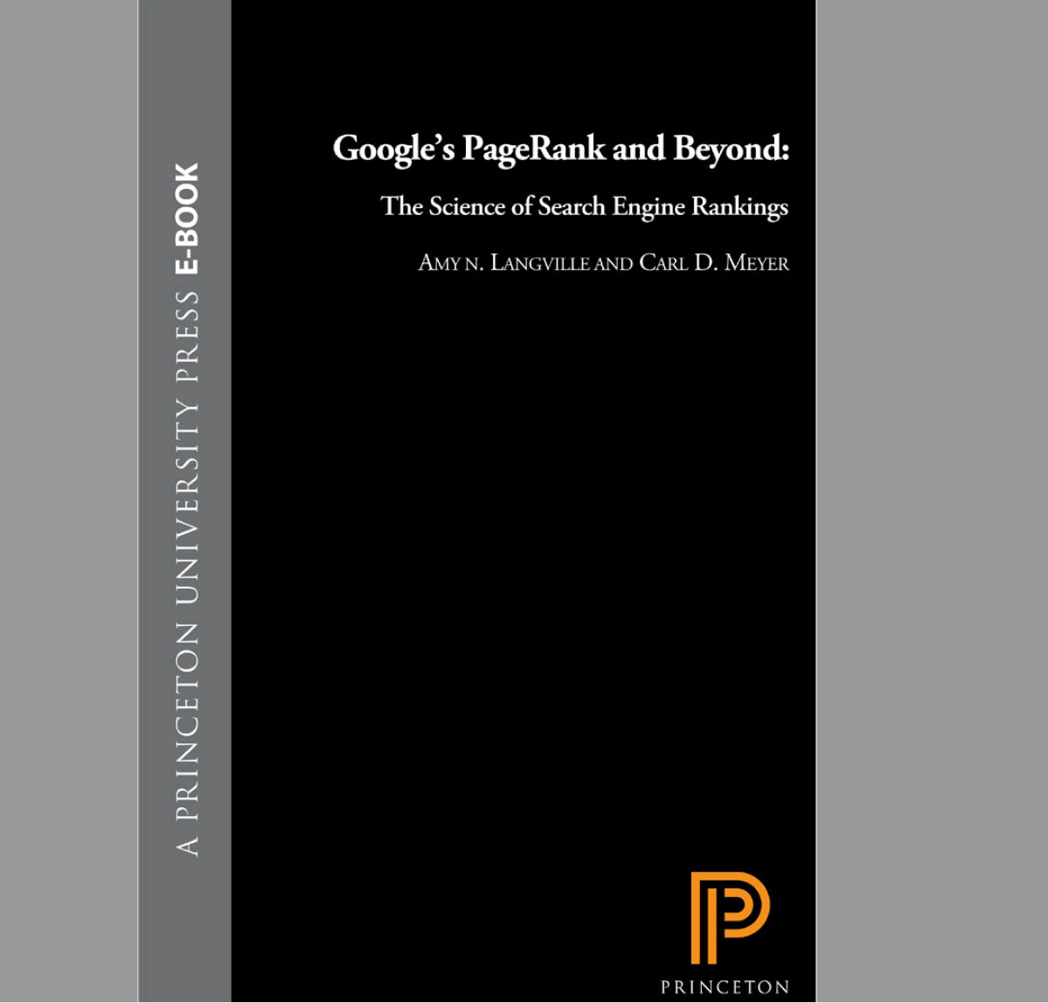

Slide 3
What is web?
“The World Wide Web (WWW), commonly known as the Web, is an information space where documents and other web resources are identified by Uniform Resource Locators (URLs, such as https://www.example.com/), which may be interlinked by hypertext, and are accessible over the Internet.^{[1]} The resources of the WWW may be accessed by users by a software application called a web browser.”
https://en.wikipedia.org/wiki/World_Wide_Web

Slide 4

Link Analysis Models
Ranking relevant pages on content score and popularity scores.
Makes use of the information in the web’s hyperlink structure.
Introduction to PageRank and HITS.

Slide 5
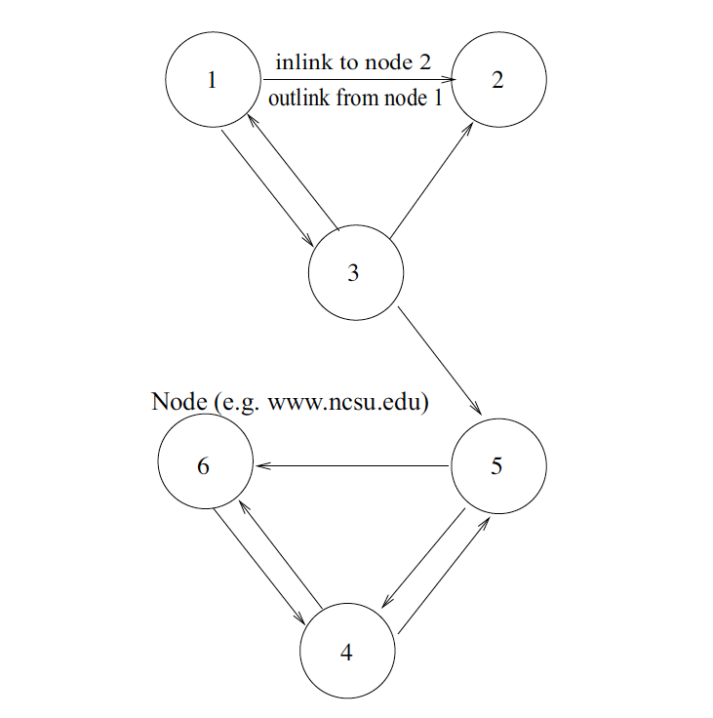
Hyperlink Structure of the Web
Node (webpages)
Hyperlink
Inlinks: hyperlinks pointing in to a node.
Outlink: hyperlinks pointing out from nodes

Slide 6


Hypertext Induced Topic Search (HITS)
Inlinks and Outlinks to create two popularity scores for each page.
hubs - many outlinks,
authorities - many inlinks.
Query dependent.
PageRank:
Viewing hyperlink as a recommendation or endorsement of a page.
a page with more recommendations (inlinks) must be more important than a page with a few inlinks.
Query independent.
“A webpage is important if it is pointed to by other important pages”
Jon Kleinberg
Larry Page & Sergey Brin

Slide 7
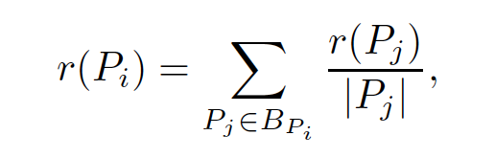
Mathematics of PageRank:
r(Pi) - PageRank of a page Pi
Sum of the pageranks of all pages pointing in to Pi
BPi - set of pages pointing into Pi
|Pj| - number of outlinks from page Pj

Slide 8
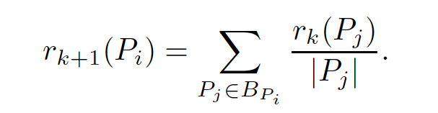
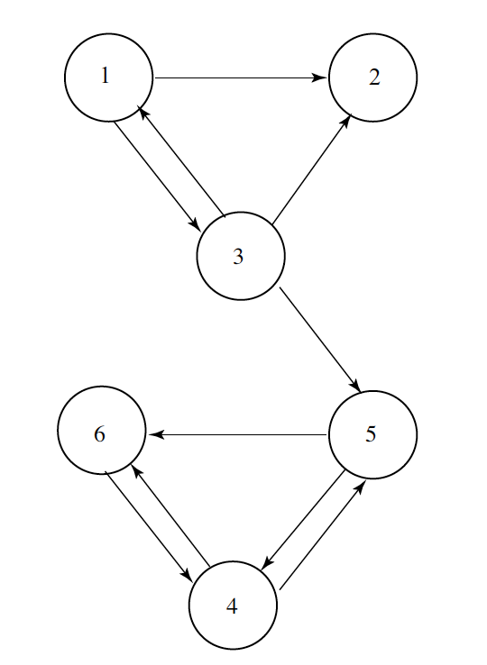
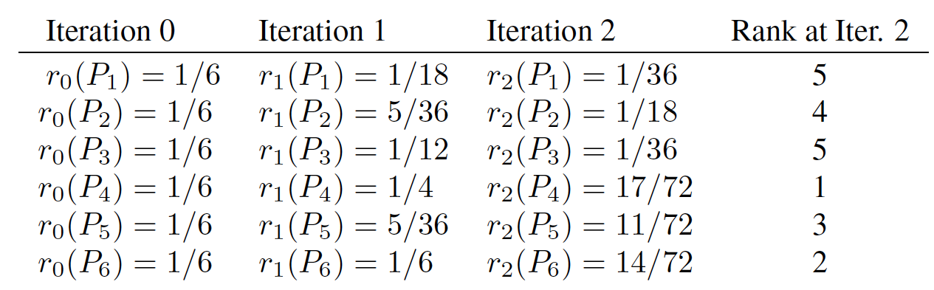
PageRank Computation on iteration
r0( Pi) = 1 /n for all pages Pi
Iterated till PageRank scores converge
Web Graph

Slide 9
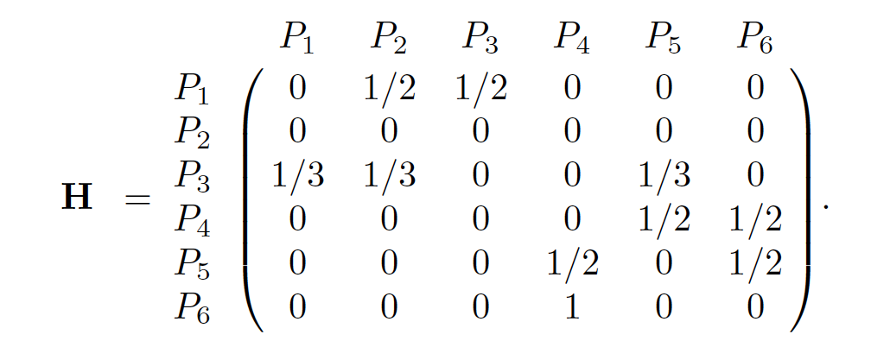
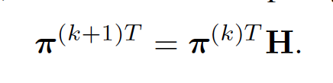
Matrix Representation of PageRank:
Hij = 1/|Pi| if there is a link from node i to node j, else 0 value
1 * n row vector πT
nonzero elements of row i is the outlinking pages of page i.

Slide 10
Observations recorded:
Each iteration involves one vector-matrix multiplication of O(n2) computation, where n is the size of the square matrix H.
H is a very sparse matrix because most web pages link to only a handful of other pages.
requires O(nnz(H)) computation, nnz(H) is the number of nonzeros in H.
average webpage has about 10 outlinks, which means that H has about 10n nonzeros, in contrast with n2 non zeroes.
vector-matrix multiplication reduces to O(n) effort.

Slide 11
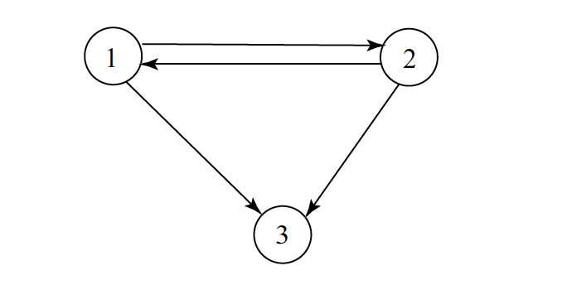
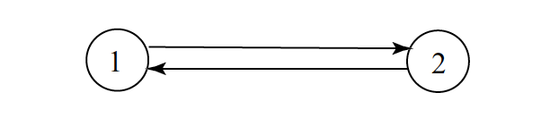
Problems with Iterative Process:
Pages that accumulate more and more PageRank at each iteration, monopolize the scores and refusing to share - rank sink.
π(0)T = (1 0). The iterates will not converge no matter how long the process is run - cycles
Iterations π(k)T flip-flop indefinitely between ( 1 0 ) when k is even and ( 0 1 ) when k is odd.

Slide 12

Following adjustments to PageRank model:
G - Google Matrix
α - time spent following the hyperlinks
S - combination of hyperlink matrix H and a rank-one matrix 1/n aeT

Slide 13
Sensitivity With Respect to α
For small α, PageRank is insensitive to slight variations in α.
As α becomes larger, PageRank becomes increasingly more sensitive to small perturbations in α.
For α close to 1, PageRank is very sensitive to small changes in α. The degree of sensitivity is governed by the degree to which S is nearly uncoupled.
Google uses α ≈ .85

Slide 14
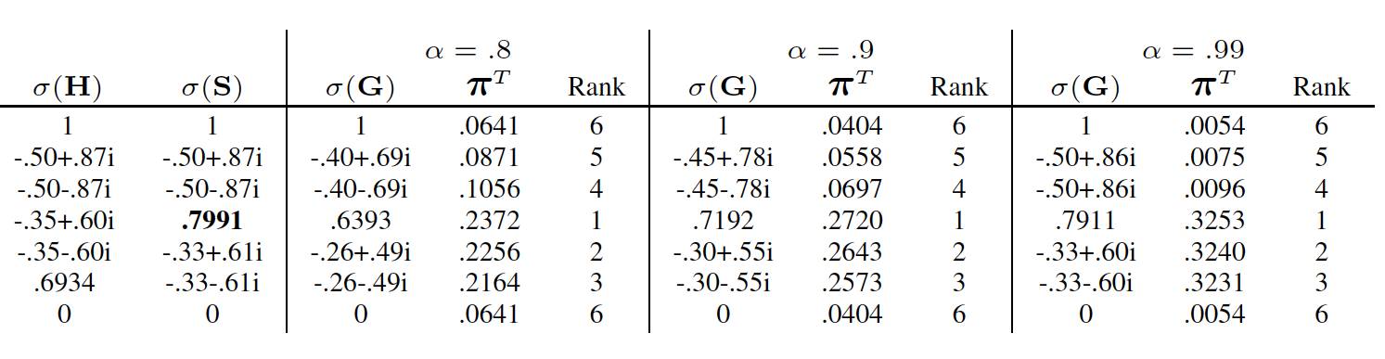
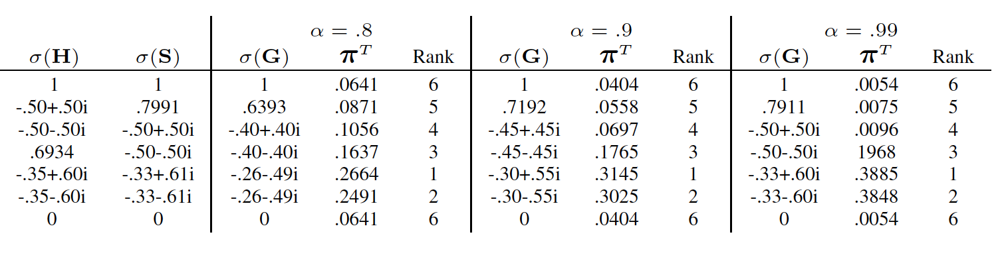
Example to sensitiveness (perturbance with a link):

Slide 15
Issues in Large-Scale Implementation of PageRank
Storage Issues:
Compress the data needed so that the compressed representation fits in main memory and implement PageRank.
Store the H (or L ) matrix in an adjacency list of the columns of the matrix
Keep the data in its uncompressed form and develop I/O-efficient implementations of the computations that must take place on the large, uncompressed data.

Slide 16
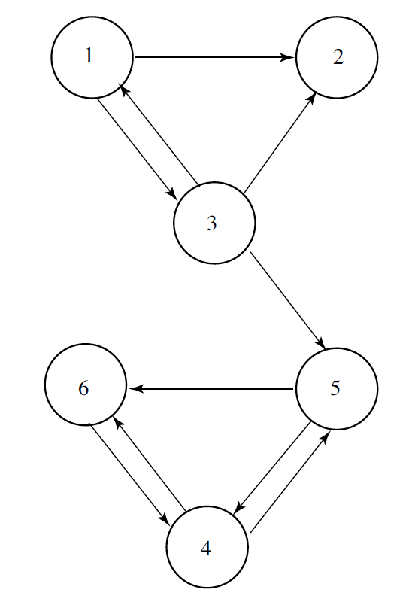
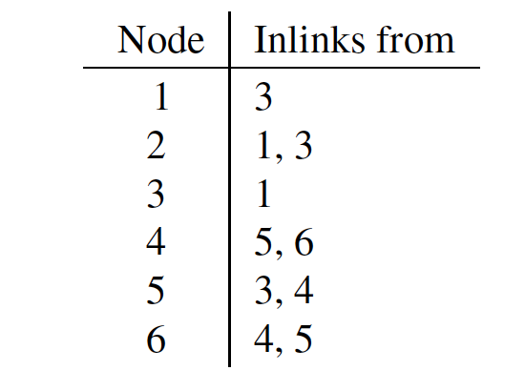
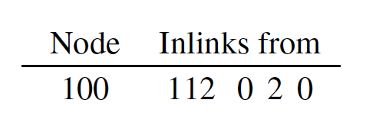
Storage Issues (Gap Method):

Slide 17
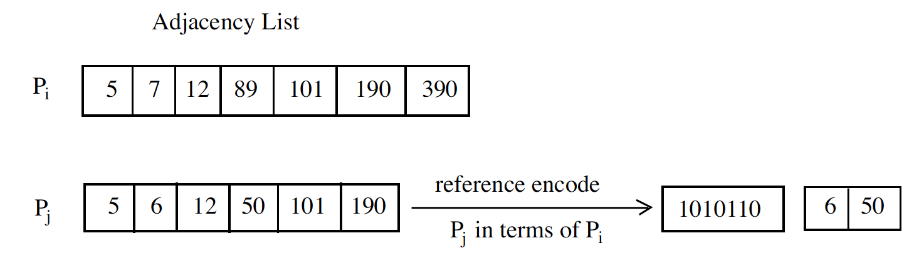
Graph Compression Method:
The sharing vector for Pj requires less storage than the adjacency list for Pj.
Pi is a good reference page for Pj if the overlap between the adjacency lists for the two pages is high.

Slide 18

Convergence Criterion:
Stop when the residual is less than some predetermined tolerance:
Otherwise, 10 iterations produced a good approximate ordering, competitive with traditional convergence measure.

