Slide 1
Project Proposal
Puneeth Bikkasandra
2019-03-07
CS734/834
Department of Computer Science
Old Dominion University

Slide 2
What is a Search Engine?
Search engine is a service that allows Internet users to search for content via the World Wide Web (WWW)
A user enters keywords or key phrases into a search engine and receives a list of Web content results in the form of websites, images, videos or other online data
The list of content returned via a search engine to a user is known as a search engine results page (SERP).
https://www.techopedia.com/definition/12708/search-engine-world-wide-web

Slide 3
Project: Search engine for Web-Archiving
Web Archiving:
“Web archiving is the process of gathering up data that has been recorded on the World Wide Web, storing it, ensuring the data is preserved in an archive, and making the collected data available for future research.”
Motivation:
Too Many archives
Search results not consistent
Possible archival attacks
robots.txt exclusion
http://www.dlib.org/dlib/march12/niu/03niu1.html

Slide 4










Ocean of archives:

Slide 5
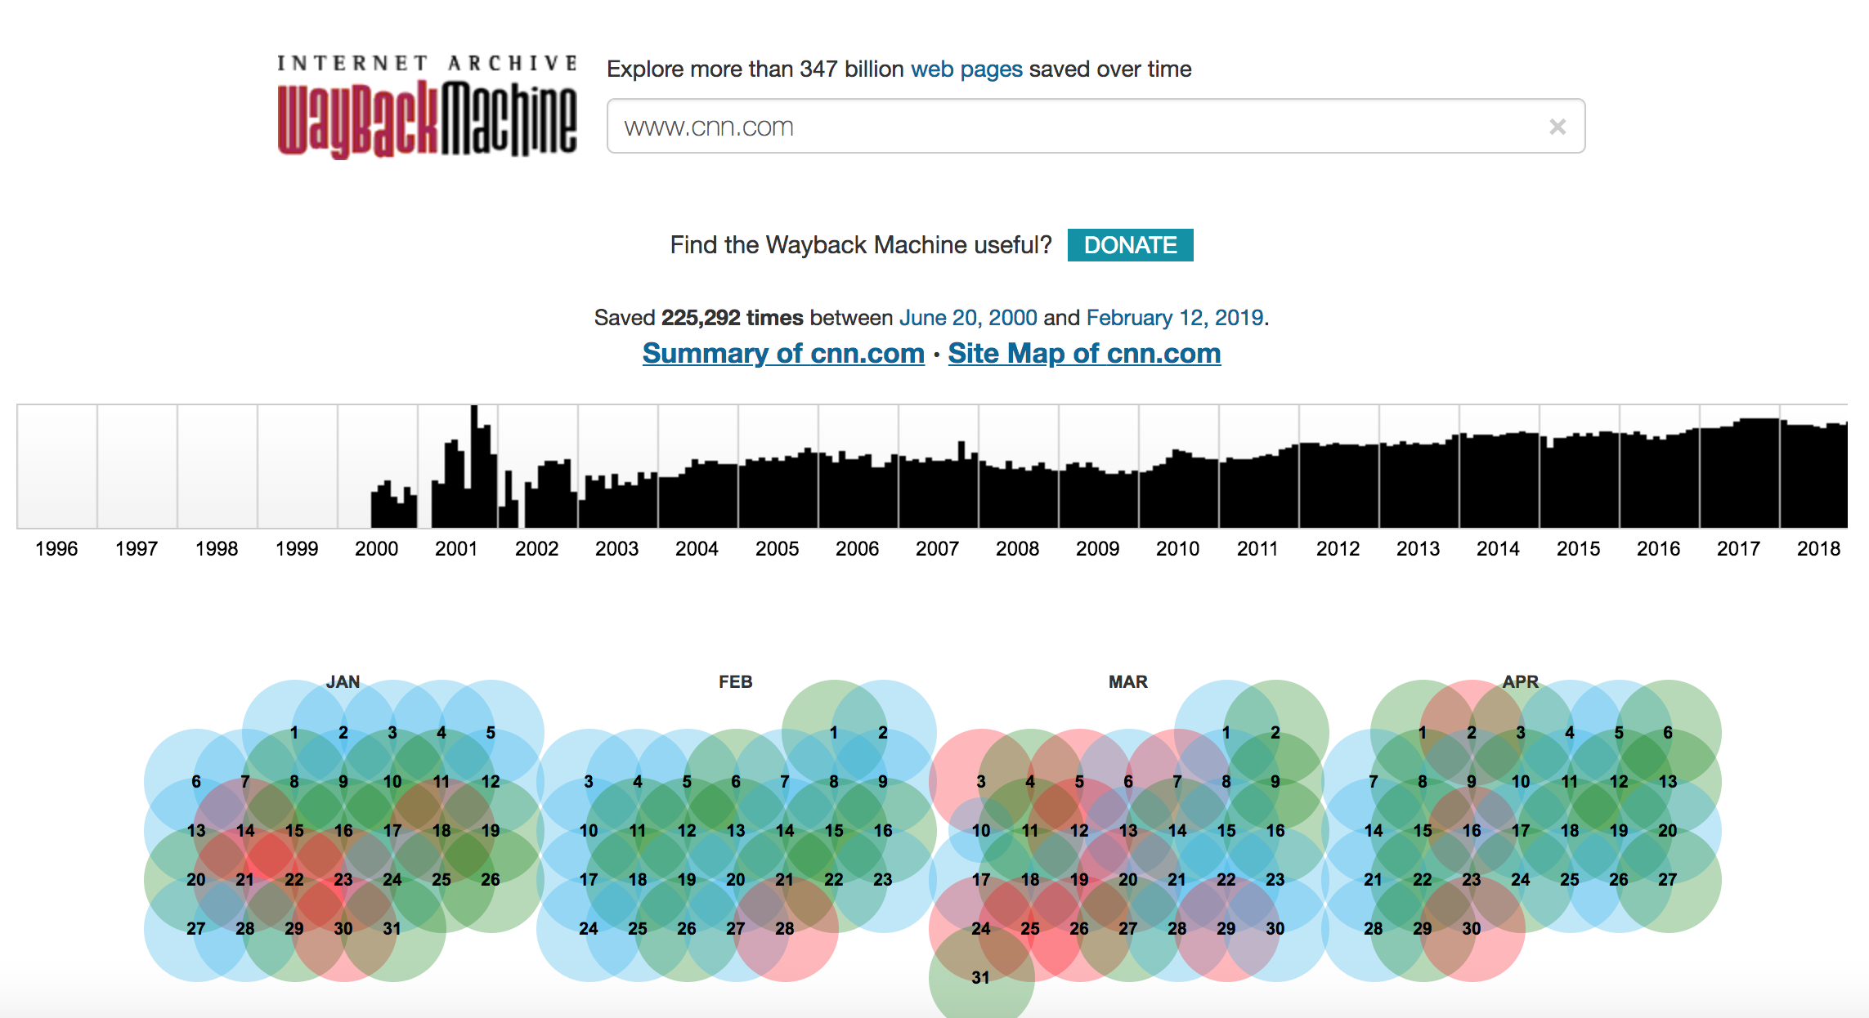
Search on Internet Archive
https://web.archive.org/web/*/cnn.com

Slide 6
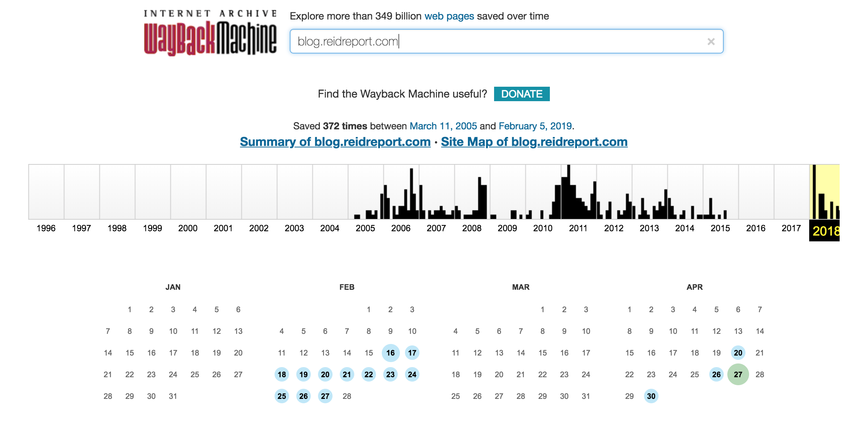
Curious Case of ‘Joy Ann Reid’
https://web.archive.org/web/20180801000000*/blog.reidreport.com

Slide 7
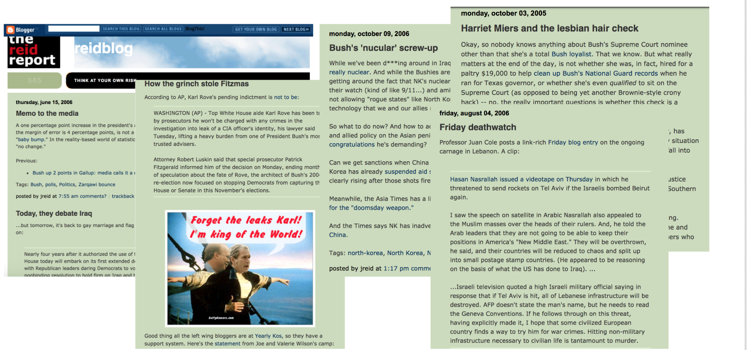
Proofs from other archives!
https://ws-dl.blogspot.com/2018/04/2018-04-24-why-we-need-multiple-web.html

Slide 8
Implementation Details:
User Query:
A website or a page under it.
An approximate date
Crawl Strategy:
To crawl top archiving platforms through a search bot/spider.
Extract results
Consolidate on nearest dates

Slide 9
Configuration:
A possible combination of a Crawler and a scraper.
Crawler: Heritrix (Internet Archive)
Scrapper: Scrapy (Scrapinghub)
ElasticSearch (v6.6.1)
Virtual Machine:
2 cores, 6GB RAM
60GB disk space
https://www.scrapehero.com/open-source-web-scraping-frameworks-and-tools/
https://en.wikipedia.org/wiki/Web_crawler#Open-source_crawlers

