Slide 1
Search Engine: Research Articles
Source: arXiv.org
2019-04-09
CS734/834
Puneeth Bikkasandra
Old Dominion University

Slide 2
Target:
A search engine for latest Research Documents.
Crawlable URLs : 5000 ; source: arXiv.org
User Experience:
Web Page where a user can input and submit an ‘Information Need’
Less Turnaround time
Returns latest research documents in the area of Computer Science.

Slide 3
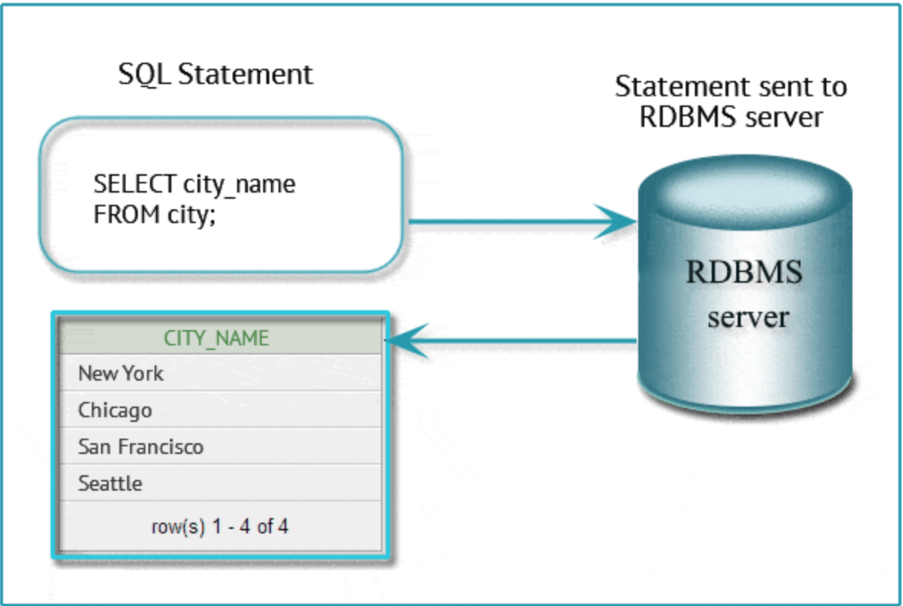
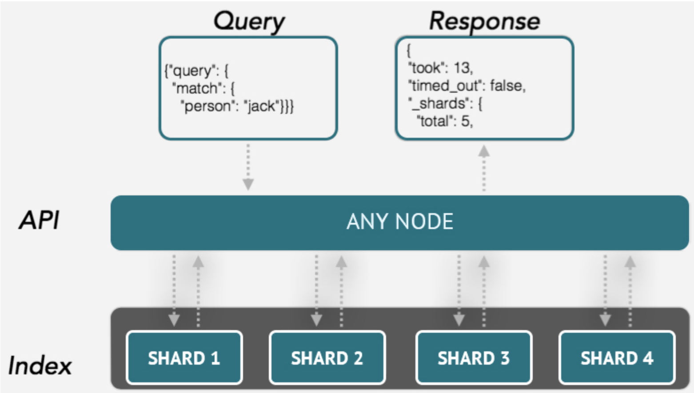
Architecture:
Traditional Client-Server Model VS. ElasticSearch
https://www.marutitech.com/elasticsearch-can-helpful-business/

Slide 4
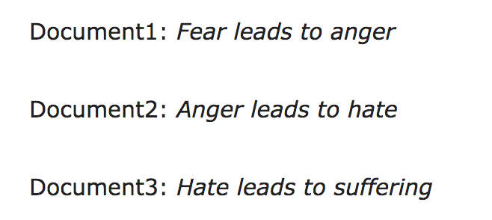
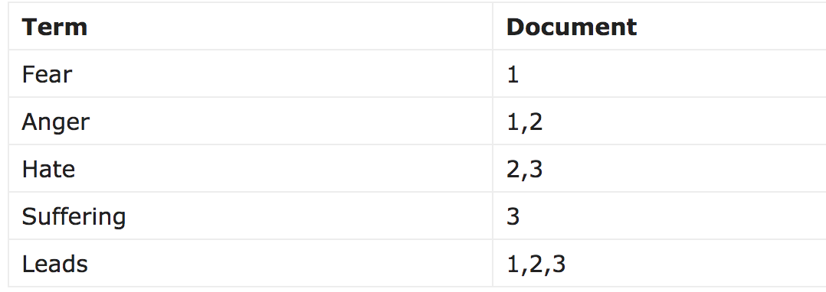
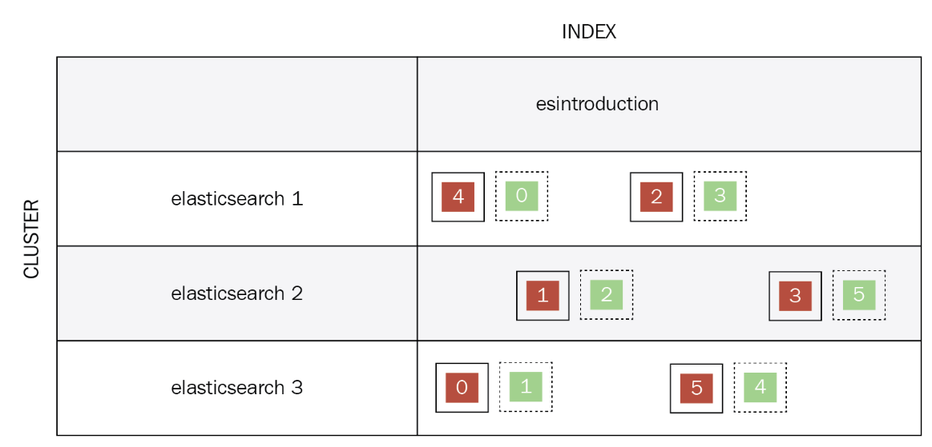
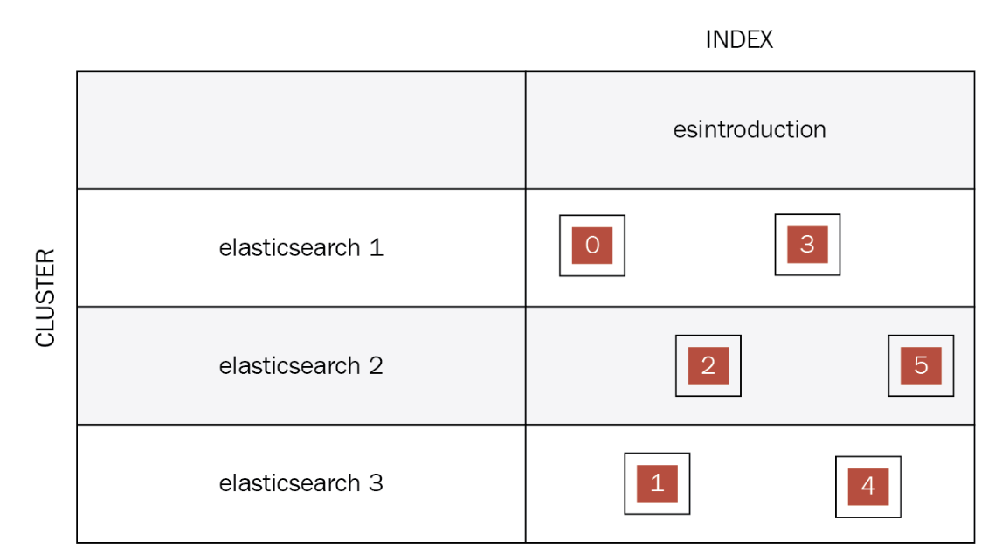
Inverted Index in ElasticSearch
https://hub.packtpub.com/how-does-elasticsearch-work-tutorial/

Slide 5
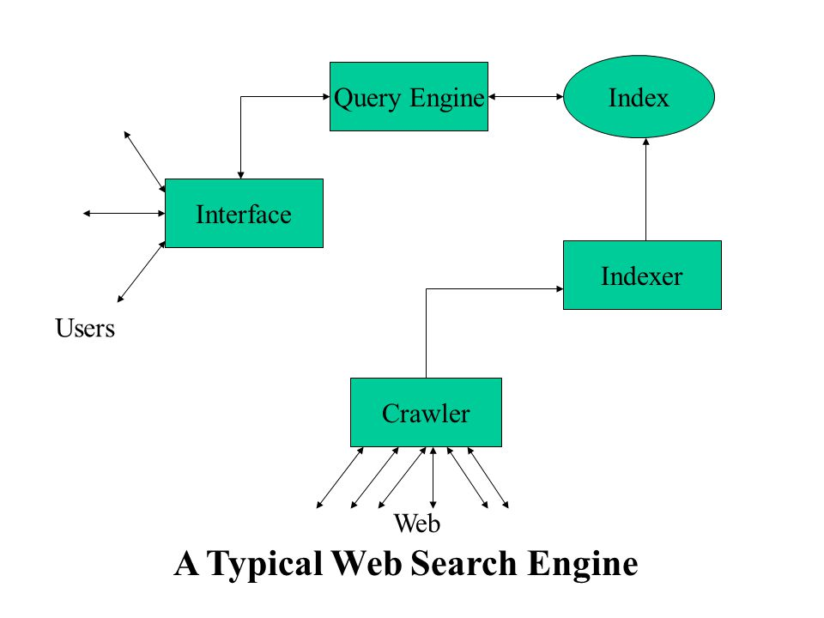
Design:
Infrastructure:
Software:
Scrapy - Crawler
ElasticSearch - Distributed DB
Data Source: arXiv.org
Seed Extraction: python libraries
(BeautifulSoup)
Hardware:
Virtual Machine:
Memory: 60 GB
2 cores, 6GB RAM

Slide 6
Progress:
Extraction of 5000 unique URLs from the source (arXiv.org) - python (BeautifulSoup).
Scrape necessary fields for indexing - Scrapy (crawler).
JSON file to have the extracted content from seed list.
Perform Indexing - Index API (ElasticSearch).
Challenges Faced:
Extracting specific fields for Indexing through Scrapy.
Obtaining PDF links from the web pages.

Slide 7
Future Goals:
To crawl all the remaining research docs supported by arXiv.org
Starting from year 2000 - Present.
Better UI design.
Kibana Integration for analytics.

