Slide 1
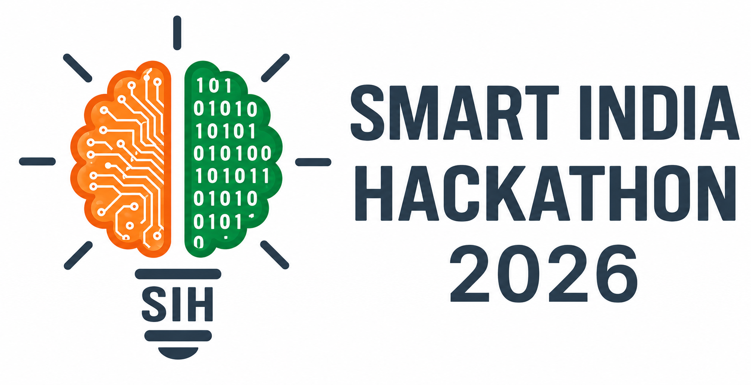
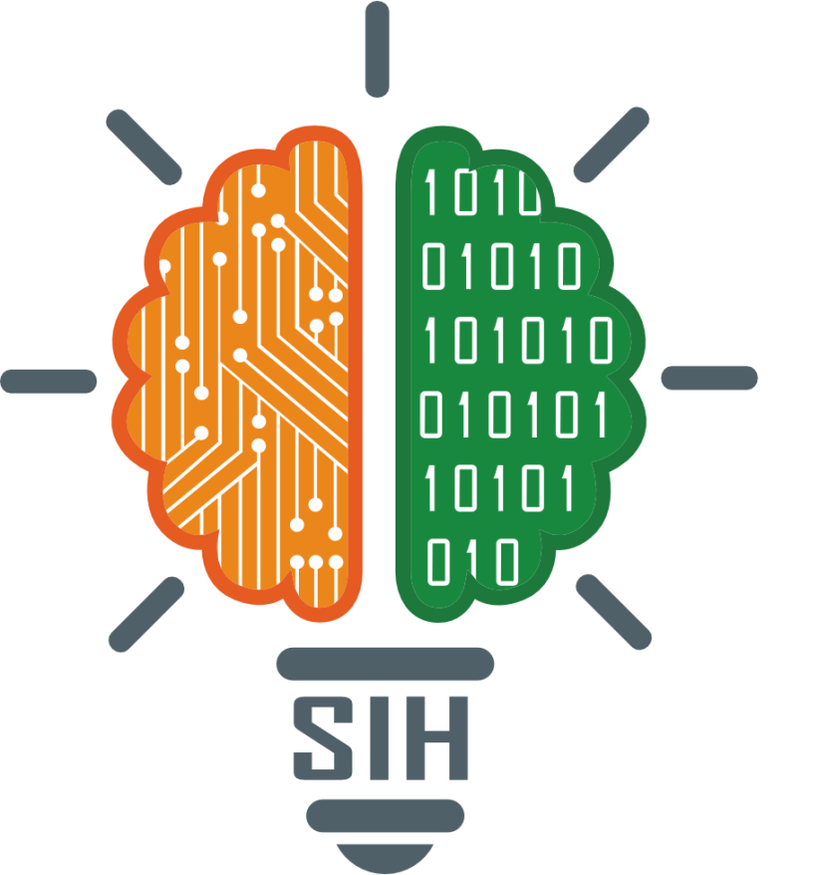
SMART INDIA HACKATHON 2026
TITLE PAGE
Problem Statement ID – [SIH0015]
Problem Statement Title – AI-Based Real-Time Elderly Fall Detection & Emergency Alert System
Theme – [OPEN INNOVATION]
PS Category – Software
Team ID – []
Team Name – The Prometheus

Slide 2
The Prometheus
PROBLEM STATEMENT
Why Elderly Fall Detection Needs a New Approach
Elderly people living alone, in assisted living, or on hospital wards face life-threatening delays when a fall or medical emergency goes unnoticed. Every minute without help raises the risk of serious complications — yet every existing safety approach leaves a critical gap.
Why current safety systems fall short
Wearables
Need a manual button press — impossible to make mid-fall or if the person is unconscious.
684,000
W
deaths per year worldwide from falls
2nd leading cause of unintentional injury death — many go undiscovered for critical minutes
— World Health Organization (WHO)
Traditional CCTV
Only records footage; it never understands or flags an emergency in real time.
C
Generic AI Systems
Single-frame analysis triggers frequent false alarms, eroding caregiver trust.
A
@SIH Idea submission- Template
2

Slide 3
The Prometheus
SANJEEVANI AI
Proposed Solution (Idea / Solution / Prototype)
Detailed explanation: Sanjeevani AI is a real-time, non-contact elderly monitoring system built purely on computer vision. A live camera feed passes through human detection, pose estimation and feature extraction to a risk engine that continuously analyzes body angle, angular velocity and inactivity duration — detecting falls, abnormal posture and prolonged stillness without any wearable device.
How it closes the gap: Sanjeevani AI is non-contact, understands emergencies as they happen, alerts in real time, and keeps working even if the person is unconscious — solving every weakness of wearables, CCTV and generic AI at once.
Innovation and uniqueness: Temporal AI reasoning across frames (not single frames) fuses the four independent triggers shown alongside to cut false alarms — followed by automatic emergency recording and instant call/SMS alerts to caregivers.
Four Independent Triggers
F
Fall Detection
Sudden change in body angle & velocity
L
Lying-Still Danger
Flags prolonged inactivity after a fall
V
Voice Command
"Sanjeevani, need help" — hands-free
G
Hand Gesture
Manual gesture trigger for silent alerts
@SIH Idea submission- Template
3

Slide 4
The Prometheus
TECHNICAL APPROACH
Technologies to be used
Methodology / Process for Implementation
1
YOLOv8
Ultra-fast, real-time human detection & tracking in every frame
1
Live Camera Feed
MediaPipe
Pose estimation — extracts precise body-joint keypoints
2
Human Detection (YOLOv8)
2
3
Pose Estimation (MediaPipe)
3
OpenCV
Real-time video capture, frame processing & feature extraction
4
Feature Extraction (angle, velocity, inactivity)
4
Twilio API
Automated emergency call / SMS alerting to caregivers
5
Risk Engine — Fall / Danger Analysis
5
Speech Recognition
Hands-free voice-trigger detection ("Sanjeevani, need help")
6
Emergency Alert (Call / SMS / Dashboard)
6
Web Dashboard
Timestamped alert logs and live monitoring interface
@SIH Idea submission- Template
4

Slide 5
The Prometheus
FEASIBILITY AND VIABILITY
F
Feasibility
R
Challenges & Risks
M
Mitigation Strategies
Built entirely on proven, open-source tools (YOLOv8, MediaPipe, OpenCV) that run in real time on a standard camera plus a laptop or edge device.
No specialised or costly hardware and no wearables required.
Cloud alerting (Twilio) and a lightweight dashboard make the system easy to pilot in a single home and scale to multiple rooms, wards or care facilities.
Detection accuracy can be affected by poor lighting, camera angle or occlusion.
Visually similar postures (e.g. lying on a sofa vs. the floor) can create false positives.
Continuous video monitoring raises privacy considerations for residents.
Temporal reasoning across multiple frames (not a single frame) sharply reduces false alarms.
Four independent triggers add redundancy so one weak signal doesn't miss an emergency.
On-device / local processing and configurable camera placement address privacy concerns.
@SIH Idea submission- Template
5

Slide 6
The Prometheus
IMPACT AND BENEFITS
Potential impact on the target audience
Elderly people living alone, assisted-living residents and hospital/ward patients gain continuous, non-intrusive safety monitoring.
Caregivers and families receive instant, reliable alerts instead of relying on chance discovery of a fall.
S
Social
H
Health & Safety
684,000
Independent living with dignity for the elderly, and peace of mind for families.
Faster response after a fall — seconds saved can prevent life-threatening complications.
deaths per year worldwide from falls
2nd leading cause of unintentional injury death
— World Health Organization (WHO)
E
Economic
O
Operational
Reduces need for constant human monitoring; one system scales across many rooms via a single dashboard.
Reusable camera infrastructure with no disposable wearables; deployable across homes, hospitals and elder-welfare programs.
@SIH Idea submission- Template
6

Slide 7
The Prometheus
RESEARCH AND REFERENCES
World Health Organization
Falls Fact Sheet — global fall-related death and injury statistics.
UN DESA
World Population Ageing report — growth of the global population aged 60+.
W
U
Ultralytics YOLOv8
Official documentation for real-time object/human detection.
Google MediaPipe
Official documentation for the pose-estimation framework.
Y
M
OpenCV
Official documentation for real-time video and image processing.
Twilio
Official API documentation for programmable voice calls and SMS alerting.
O
T
@SIH Idea submission- Template
7

