Slide 1
How environmental priors bias dynamic structure learning
Bias #1: more attention to threat-related features
Bias #2: a stronger prior over the type of environment being dangerous (asymmetric reversal effect)
Bias #2 might explain Bias #1
Given resource limitations, the environment dictates what feature should be attended to more
Priors should bear on how hard it is to adapt to changing environments

Slide 2
Feature learning task
3 states each having a probability of encountering 3 possible features
The reward value of a feature is determined by reward function that is instructed each trial
Environment changes: More Safe or More Dangerous. Ratio (3:2:1)

Slide 3
Instructions
Welcome to the experiment.
Please read the instructions carefully. You will need to pass a quiz on them before you begin the task.

Slide 4



In this task, you will play a space-mineral trader.
The spaceship that you are on contains three doors (represented by fractal images, top right). Each door leads to a different part of space.
When you activate a door, you will encounter aliens (represented by solid-color circles, bottom right).
Some aliens will provide you with valuable space minerals. Other aliens will take space minerals away from you.
Your goal is to collect as many valuable space minerals as you can by choosing space doors that most often lead to aliens that provide space minerals and avoiding space doors that most often lead to aliens that take space minerals away.
Space ship doors
Each of these fractals is door you can choose to activate
Aliens
Each of these circles is an alien that can either provide or take away minerals.

Slide 5

There are three types of aliens: black, silver and gold aliens.
When you open a space door, there will be a certain chance that you encounter these aliens. Specifically, each time you need to decide which door to open, each door will have a certain chance of leading to each type of alien (example on right).
On the next screen, you can practice playing the door shown on the right (by pressing k) and observing which aliens it tends to lead to.
Try to track which aliens it tends to lead to. Note that this door will just be used in this example and won’t be used in the actual task.
25%
70%
50%
This example door has a 25% chance of leading to the black alien, a 70% chance of leading to the silver alien and a 50% chance of leading to the gold alien.

Slide 6
Practice playing a single alien…

Slide 7
Over the course of the task, the chances that you’ll encounter a certain type of alien after opening a certain door will change slowly.
You will gain the greatest number of space minerals by tracking the chances that each door leads to encountering each type of alien.
These chances will slowly drift.

Slide 8
Whether a given alien provides or takes away minerals, and how many it provides or takes away, might change on every decision.
Prior to every decision, you will be shown the number of minerals each alien would provide or take away if it were to be encountered.
Specifically, you will be shown 3 numbers. The black, silver, and gold numbers will respectively indicate the number of minerals that the black, silver and gold aliens will provide, if encountered on that decision.
Positive numbers indicate the number of minerals that alien would give you. Negative numbers indicate the number of minerals that alien would take away from you.
6
0
-3
On this example decision (between the 3 doors), encountering the black alien would provide 6 minerals, encountering the silver alien would provide no minerals, and encountering gold alien would take away 3 minerals.

Slide 9
After you choose a door, you will be shown which aliens are behind it.
Then, you will be shown the number of minerals each of those aliens provided as well as the total number of minerals you gained or lost.
6
-3
3
On this example decision, the right door was activated. The black and gold aliens were encountered. The black alien provided 6 minerals and the gold alien took away 3 minerals. In total, 3 minerals were collected (bottom right).

Slide 10
After receiving your minerals, you will be shown which aliens were behind the doors that you did not choose.
This information will not affect how many minerals you collect, but will provide an opportunity to observe which aliens were behind doors you did not choose to help you track where the aliens currently reside.
You can now practice a few full decisions. Try to earn the greatest number of minerals.
6
-3
3
On this example decision, if the left door had been activated, the gold and silver aliens would have been encountered. If the middle door had been activated, the black alien would have been encountered.

Slide 11
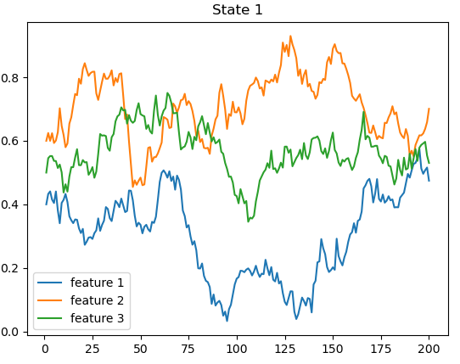
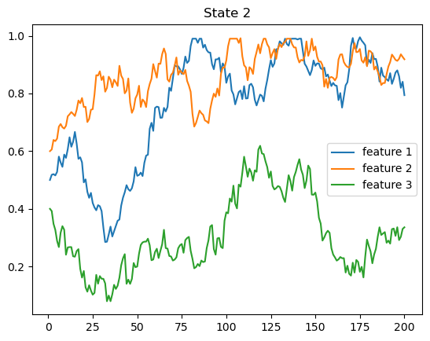
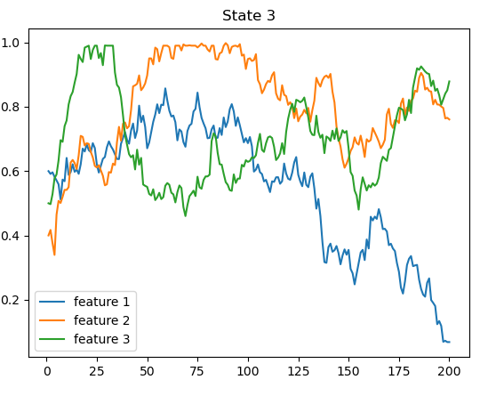
Feature probabilities: Reduced mutual information and roughly same mean probability
Safe Environment

Slide 12
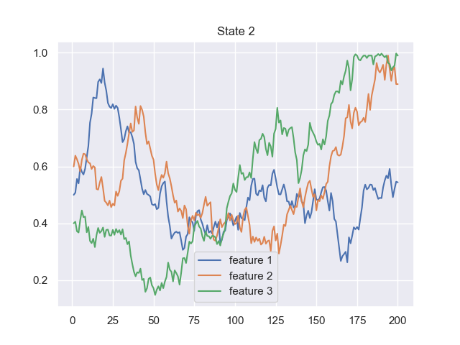
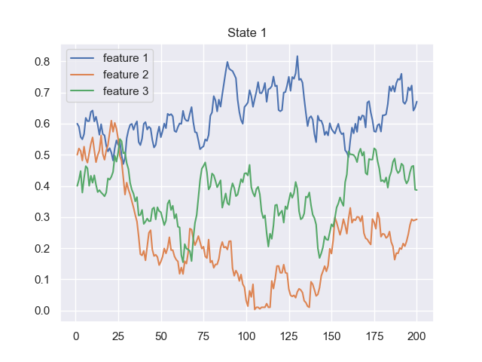
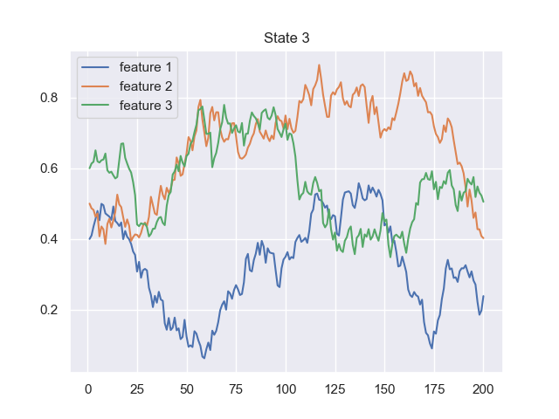
Feature probabilities: Reduced mutual information and roughly same mean probability
Dangerous Environment

Slide 13
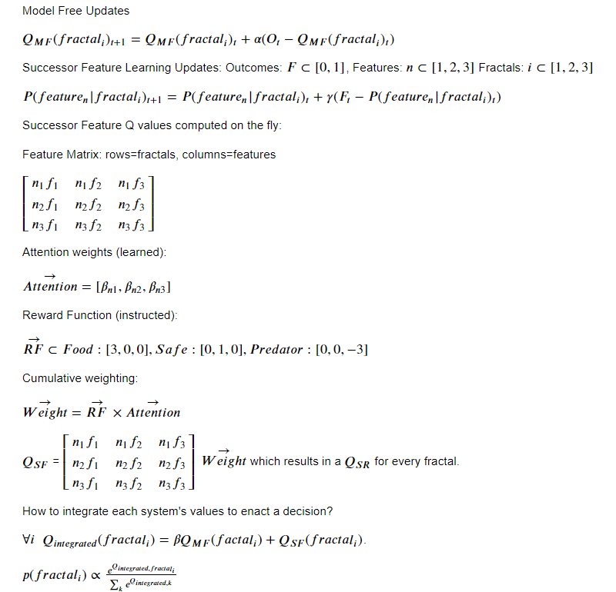
Learning algorithm
Parameter recovery good, need to compare to other models

Slide 14
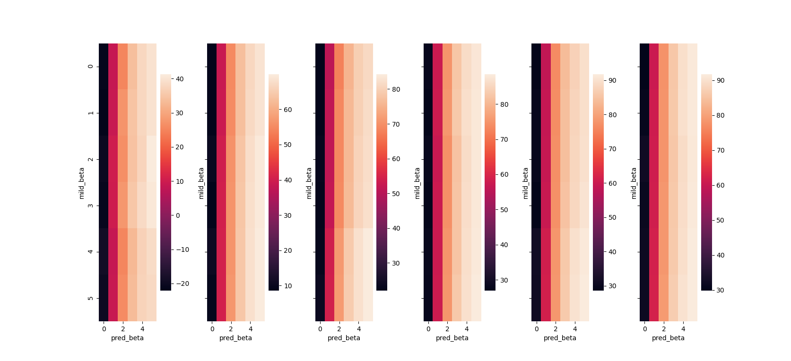
Simulations to determine how attentional weights ~ reward earned
Safe beta weights [0,5]

Slide 15
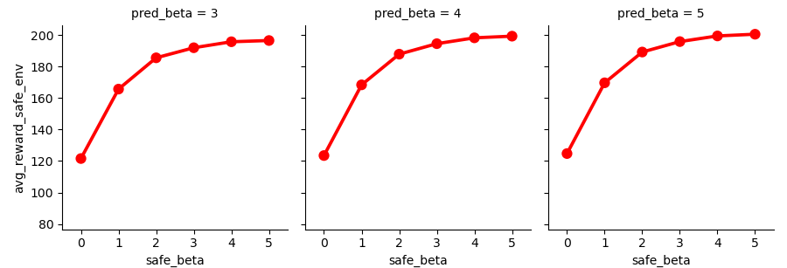
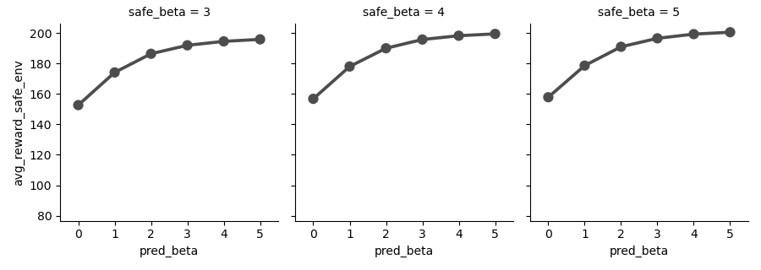
Under resource constraints, environment determines what’s better to attend to
Safe Environment
Δ = 75
Δ = 43

Slide 16
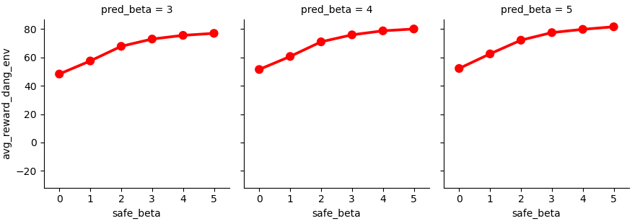
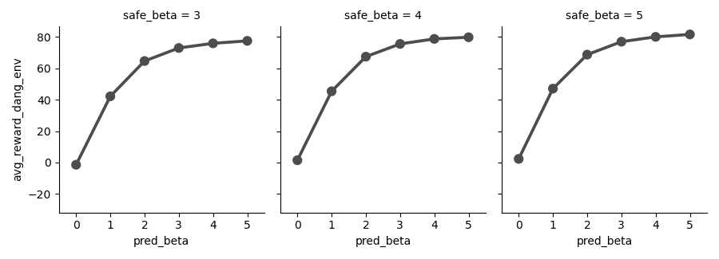
Under resource constraints, environment determines what’s better to attend to
Dangerous Environment
Δ = 29
Δ = 79
Agents played 500 times
Notes:
Parameter recover: correlation of 0.9167758974976977 for LR, p value 3.098719691511728e-10
correlation of 0.9287676975638335 for safes, p value 5.923443122418857e-11
correlation of 0.6764923525806191 for milds, p value 0.00028395395019095357
correlation of 0.9243398609456811 for preds, p value 1.1260722629069734e-10

Slide 17
Model-agnostic signature
Logistic regressions: 2 for safe/predator features
Switch/Stay on current trial predicted from
(1) presence of feature on last trial
(2) current reward function
(3) interaction of (1) and (2)

Slide 18
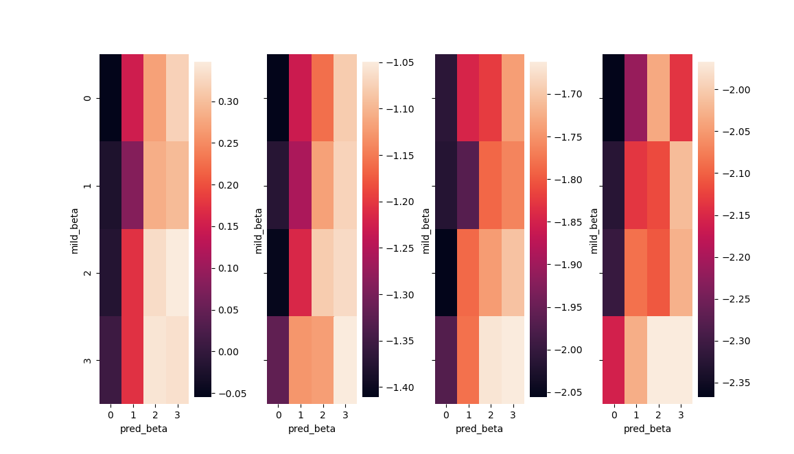
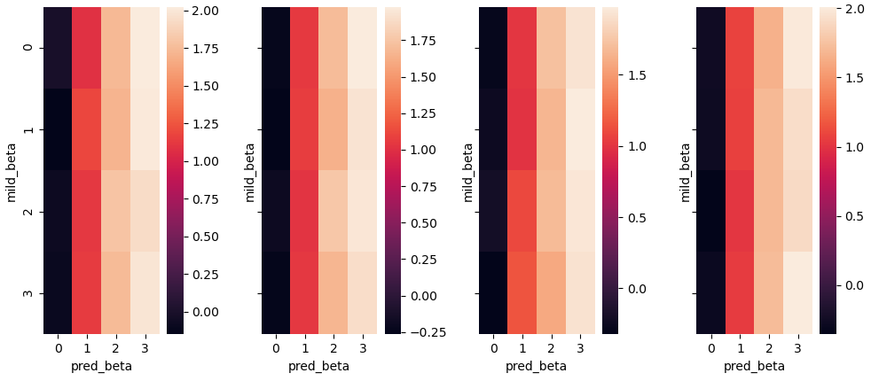
Safe Environment: Safe Features
Safe Environment: Predator Features

Slide 19
Task Design
280 Trials, reversal at 140 in terms of the abundance of “predators”
Subjects goal is to track feature probabilities in all states
Features that are “bad” do not transition to “good” – they are either 0 or good/bad, depending on the reward function.

Slide 20
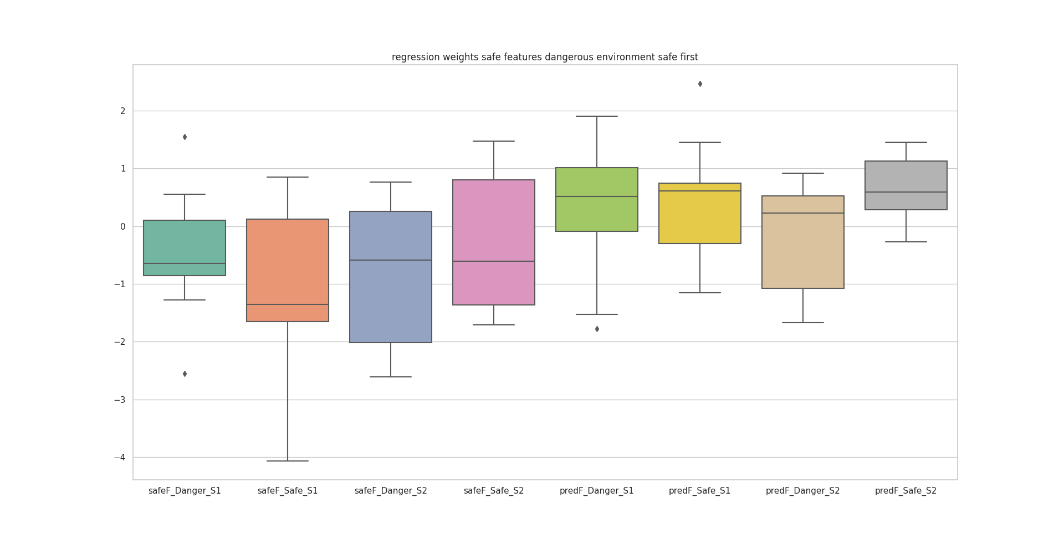
Preliminary results

Slide 21
At the end of the game, the computer will randomly select 5 decisions that you made, and will add together the minerals that you gained and subtract the minerals you lost on those trials.
The greater your total of minerals on these 5 trials, the more bonus money you will receive.
You will earn the highest bonus if you try your best to encounter aliens that will provide minerals and avoid aliens that take minerals away.
You will need to pass a quiz on the instructions to begin the task.

