Slide 1

Trends in IMDB Movie Dataset
Presented by Team Bazinga:
Arpit Chandra
Shashank Kava
Khushal Navani
Prerak Sheth
INST 627: Data Analytics for Information Professionals

Slide 2
Agenda
Introduction
Motivation
Research Questions
Statistical Test
Conclusions
Limitations

Slide 3
Introduction
We have selected an open dataset from https://www.kaggle.com
This dataset contains 5000+ movies scrapped from imdb website.
Data collected using python library, ‘scrapy’.

Slide 4
Motivation
Unlimited information about movies can lead to confusion and frustration.
Viewers can’t decide what to watch.
Production houses can’t decide which movie to invest for the same reason.
The challenge is to find a quantifiable value about how successful a movie could be.
This value can provide meaningful insights to think tanks.

Slide 5
Population and Sample
Population: The population consists of all the movies released across the world till date and listed on IMDB.
Sample: The sample is the set of 5043 movies collected using a “scrapy” library in python out of the population that consists of all the movies listed on IMDB

Slide 6
Methods
Sampling: Random Sampling
Type of Study: Observational
Level of Analysis: Observation of a movie i.e gross, imdb score, budget etc.

Slide 7
Research Question 1
Does higher number of Facebook likes for all the actors and directors suggest a higher gross revenue?
Independent Variables: FB likes for actor 1 (Ratio), FB likes for actor 2 (Ratio), FB likes for actor 3 (Ratio), FB likes for the entire cast (Ratio), FB likes for director (Ratio)
Dependent Variables: Gross Revenue (Ratio)
Multiple Regression

Slide 8
Research Question 1
Stating the hypothesis:
Null Hypothesis (Ho): There is no correlation between the outcome and the predictor variables.
Alternative Hypothesis (Ha): There exists a correlation between the outcome and at least one of the predictor variables.
Assumption: Due to high correlation between the IVs we have ruled out “likes for the entire cast” variable

Slide 9
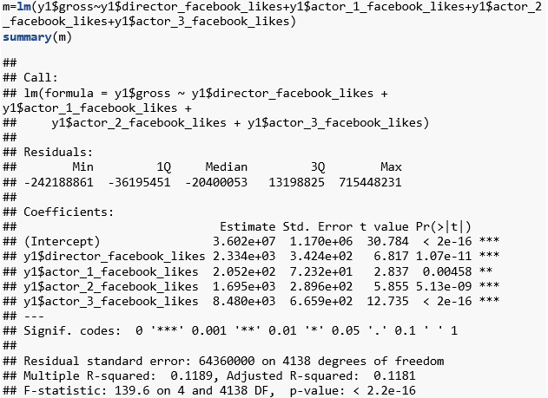
Research Question 1

Slide 10
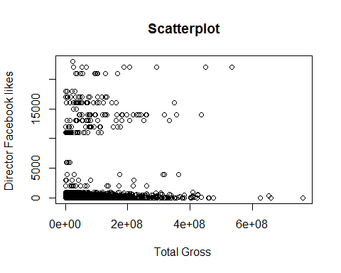
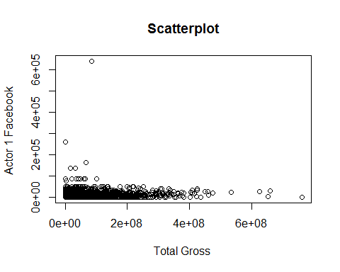
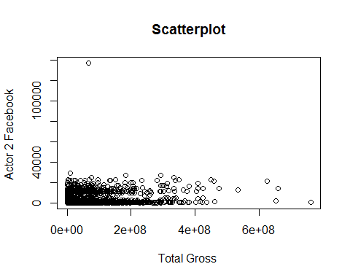
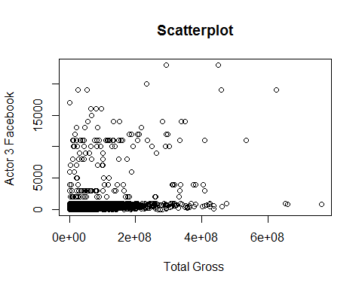

Slide 11
Research Question 1
Conclusion:
With an increase in the number of like for the director by 1, the gross revenue for the movie increases by 2334.
With an increase in the number of like for the first actor by 1, the gross revenue for the movie increases by 205.2.
With an increase in the number of like for the second actor by 1, the gross revenue for the movie increases by 1695.
With an increase in the number of like for the third actor by 1, the gross revenue for the movie increases by 8480.

Slide 12
Research Question 2
What is the effect of number of user and critic reviews on the IMDB score?
Independent Variables: Number of user reviews (Ratio), Number of critic reviews (Ratio)
Dependent Variables: IMDB Score (Interval)
Multiple Regression

Slide 13
Research Question 2
Null Hypothesis (Ho): There is no correlation between the IMDB score (outcome) and Number of user reviews, Number of critic reviews(Predictor).
Alternative Hypothesis (Ha): There exists a correlation between the outcome variable and predictor variable.
Assumption: Due to high correlation between the IVs we have ruled out “Number of user reviews” variable which makes our test a Linear Regression.

Slide 14
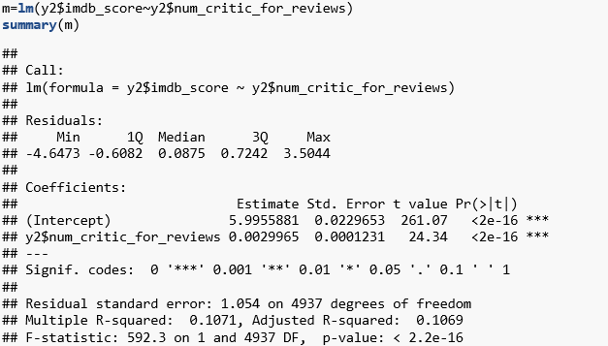
Research Question 2

Slide 15
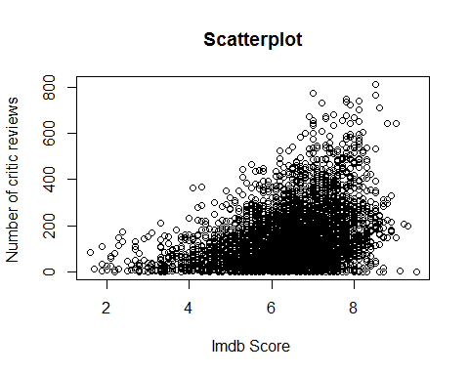
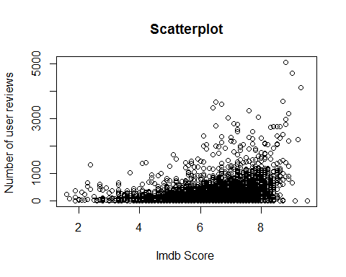

Slide 16
Research Question 2
Conclusion:
With an increase in the number of critic reviews by 1, there is an increase in the IMDB score by 2.057e-03.

Slide 17
Research Question 3
Does more number of genres for a movie appeal a larger audience (gross revenue)?
Dependent Variable: Gross (Ratio)
Independent Variable: Count Genres (interval as a zero value does not exist, a movie cannot not have a genre)
Correlation Test

Slide 18
Research Question 3
Null Hypothesis (Ho): There is no correlation between number of genres and its gross revenue earning i.e. r = 0
Alternate Hypothesis (Ha): There exists a correlation between the number of genres and its gross revenue earning i.e. r≠0

Slide 19
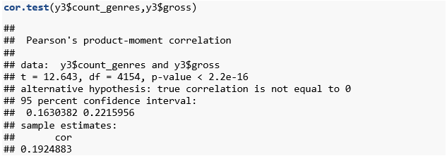
Research Question 3

Slide 20
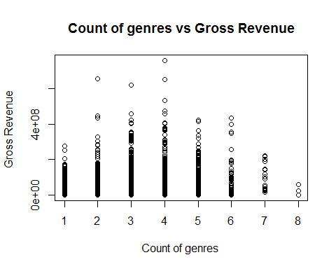

Slide 21
Research Question 3
Conclusion:
Comparing the p-value with the level of significance, we reject the Null Hypothesis. The gross earnings of a movie have a weak correlation i.e. directly related with the number of genres by a moderate positive correlation factor of 0.19

Slide 22
Limitations
Random data selection using third party tool Scrappy – as a result outlier movies have been selected
Temporal inconsistency of Facebook likes
Gross revenue and budget –currency conversion issues

Slide 23
Conclusion
Data Driven Decision Support System.
The two primary user of this system can be viewers/audience and production houses.
Help predict movie ratings prior to its release
Help production houses select a better cast
Optimize fund allocation and budgeting

Slide 24
Questions?

Slide 25
Thank you!

