Slide 1
ASEO: Single-Trial ERP Estimation
Monkey LFP Analysis — LU Dataset, 16 Channels
Himanshu PS | Dept. of Biomedical Engineering, University of Florida
Xu et al., IEEE Trans. Biomed. Eng., Vol. 56, No. 1, 2009

Slide 2
Why Single-Trial ERP Analysis?
Background
▸ Traditional averaged ERP (AERP) smears trial-to-trial variability
• Latency jitter of ±10–100 ms broadens and attenuates the averaged waveform
• Brain responses genuinely vary across trials — averaging discards this information
▸ Single-trial ERPs enable direct neural-behavioural correlation
• Example: Liu et al. 2012 (J. Neurosci.) correlated single-trial LPP with fMRI BOLD
• Example: latency of motor ERP component tracks reaction time (this dataset)
▸ ASEO simultaneously estimates three quantities per trial:
• (1) ERP component waveform shapes (2) per-trial amplitudes (3) per-trial latency shifts
▸ Residual after ERP removal = AR-modelled ongoing activity (LFP oscillations)

Slide 3
VSPOA Signal Model
Variable Signal Plus Ongoing Activity
▸ Each trial r is modelled as signal + ongoing noise:
• x_r(t) = Σ_n β_rn · s_n(t − τ_rn) + z_r(t)
▸ Components:
• s_n(t) — nth ERP component waveform [shared across trials]
• β_rn — single-trial amplitude scale for component n
• τ_rn — single-trial latency shift for component n
• z_r(t) — ongoing LFP activity [modelled as an AR(p) process]
▸ Key insight: the AR noise model is estimated per-iteration and used to
• weight the least-squares ERP estimation in the frequency domain
• → whitening the coloured LFP noise improves ERP recovery at low SNR

Slide 4
Two-Step Iterative Algorithm: F-step / T-step
Algorithm Flow
▸ Initialise: waveforms from AERP segments, β=1, τ=0, noise PSD = white
▸ F-step (Frequency Domain) — update ERP parameters:
• Step 1 — ERP waveforms via noise-weighted least-squares (Eq. 12)
• Step 2 — Per-trial latency shifts via IFFT peak search (Eq. 15)
• Step 3 — Per-trial amplitude scaling via LS (Eq. 22)
▸ T-step (Time Domain) — update ongoing activity model:
• Step 1 — Residuals: z_r(t) = x_r(t) − Σ β_rn · s_n(t − τ_rn)
• Step 2 — Fit AR(p) with Levinson-Durbin; select order p by BIC
• Step 3 — Compute noise PSD for next F-step
▸ Converge when ‖ΔS‖² / ‖S‖² < 10⁻³ or maxIterNum = 5 reached

Slide 5
Dataset & Experimental Setup
LU Monkey Motor Cortex LFP
▸ Subject: Monkey LU — premotor/motor cortex LFP recordings
▸ Task: Go/No-Go paradigm
• Go condition: monkey executes arm movement (reaction time available)
• Nogo condition: monkey withholds movement (no reaction time)
▸ Recording: 16 channels, 200 Hz, epoch −100 ms to ~400 ms post-stimulus
▸ ERP components: 1–2 per channel based on AERP inspection
• LU monkey: most channels have 2 components (early + late motor ERP)
▸ Trial rejection thresholds:
• Max amplitude > 5× mean, min < 0.2× mean, correlation < 0.6
• Acceptance rates range from 4% (Ch 16) to 100% (Ch 15)

Slide 6
Code Improvements: Bug Fixes
Fixes to Original Codebase
▸ Bug 1 — Numerically unstable matrix inversion (function_ASEO.m)
• Direct inv() fails on ill-conditioned matrices → NaN propagation
• Fix: replaced inv() with pseudoinverse pinv() for robust inversion
▸ Bug 2 — Incorrect variance baseline for Nogo condition (Main_ASEO.m)
• var_ori was computed over all trials; var_red over accepted trials only
• Fix: both now use accepted-trial subset → like-for-like variance ratio
▸ Bug 3 — Plot crash when no trials were accepted (Main_ASEO.m)
• mean/plot of empty acceptIndex array caused MATLAB error
• Fix: added empty-acceptIndex guard before all ERP plot calls

Slide 7
New Contributions
Extensions Beyond Original Code
▸ 1. Quantitative summary CSV (src/saveRunSummary.m)
• Per channel × condition: accept rate, latency/amplitude μ±σ,
• RT correlation, variance reduction ratio, AR order, PSD peak frequency
▸ 2. Synthetic validation (scripts/Run_ASEO_Synthetic.m)
• Ground-truth known: at SNR = 10 dB, latency RMSE = 7.5–8.4 ms < 10 ms input σ
• Amplitude correlation r ≈ 0.98; RMSE-vs-SNR curves reproduce paper Fig. 5
• Reliable recovery confirmed above SNR ~5 dB
▸ 3. Figure 12 overlay (scripts/Plot_Figure12.m)
• ASEO components overlaid on AERP on normalised [−1, +1] axes
• Shows latency-jitter correction sharpens waveform peaks vs. AERP smearing
▸ 4. Single-trial ERP figures (reports/generate_report.py ← this report)
• 4-panel per-channel decomposition: Raw | Signal | Noise | AERP comparison

Slide 8
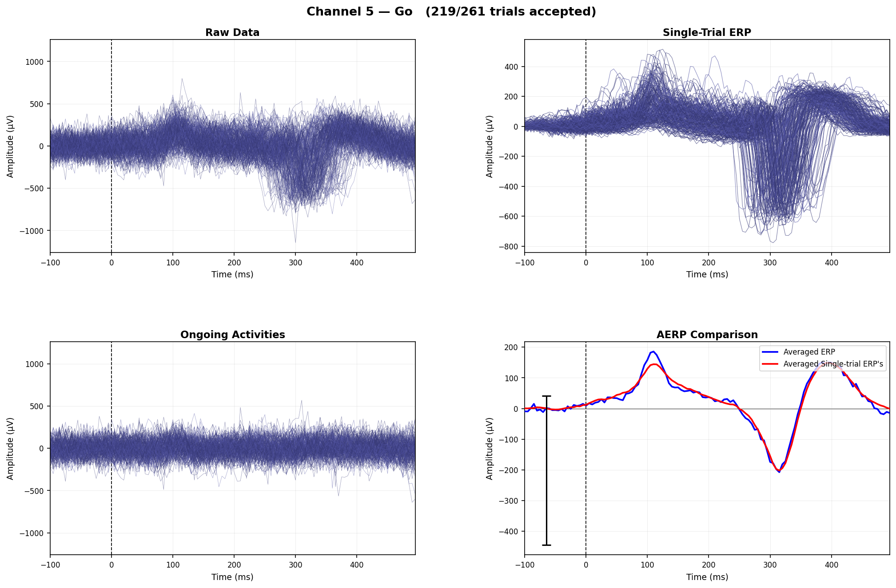
Single-Trial ERP — Channel 5 (Go)
Raw Data | Signal | Ongoing Noise | AERP Comparison
Ch 5 Go — 83.9% accepted · RT–latency r = 0.82, p < 0.001

Slide 9
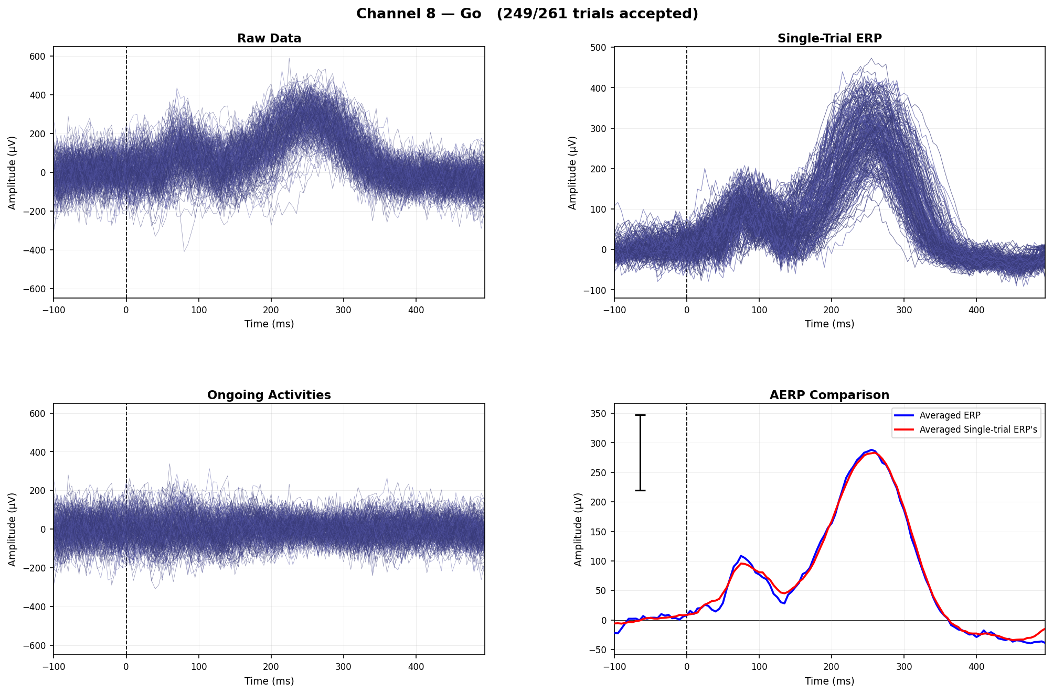
Single-Trial ERP — Channel 8 (Go)
Raw Data | Signal | Ongoing Noise | AERP Comparison
Ch 8 Go — 95.4% accepted (highest) · RT–latency r = 0.645, p < 0.001

Slide 10
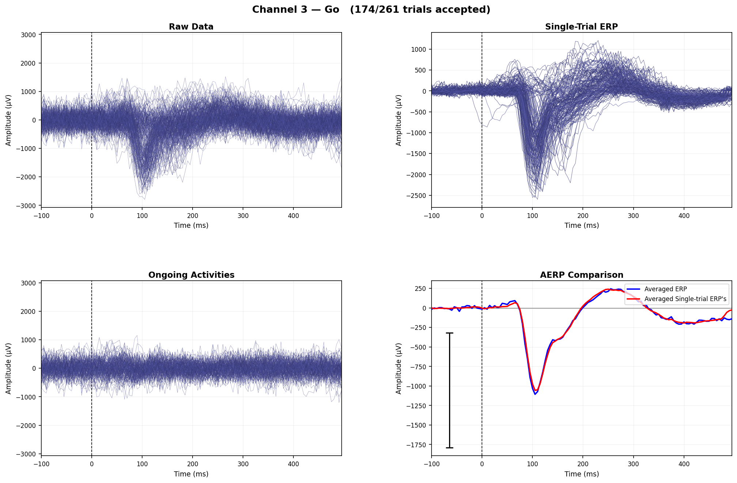
Single-Trial ERP — Channel 3 (Go)
Raw Data | Signal | Ongoing Noise | AERP Comparison
Ch 3 Go — 66.7% accepted · clean two-component motor ERP

Slide 11
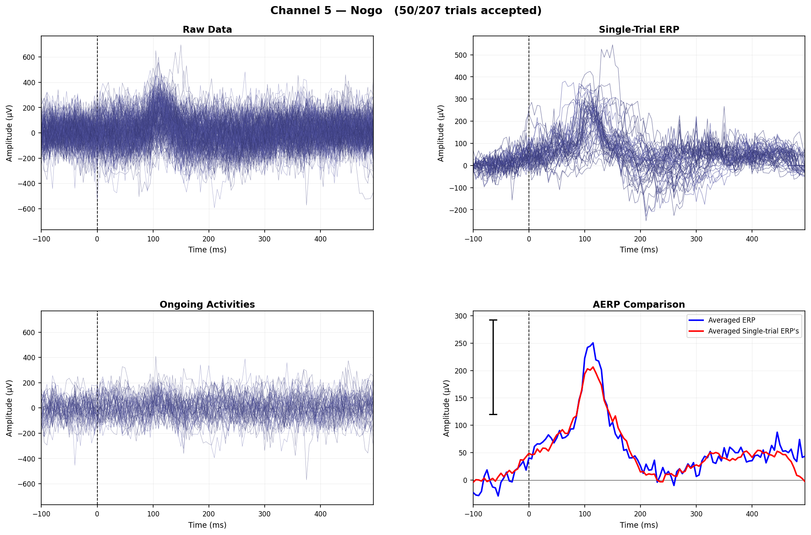
Single-Trial ERP — Channel 5 (Nogo)
Raw Data | Signal | Ongoing Noise | AERP Comparison
Ch 5 Nogo — 84.4% accepted · withhold-movement condition

Slide 12
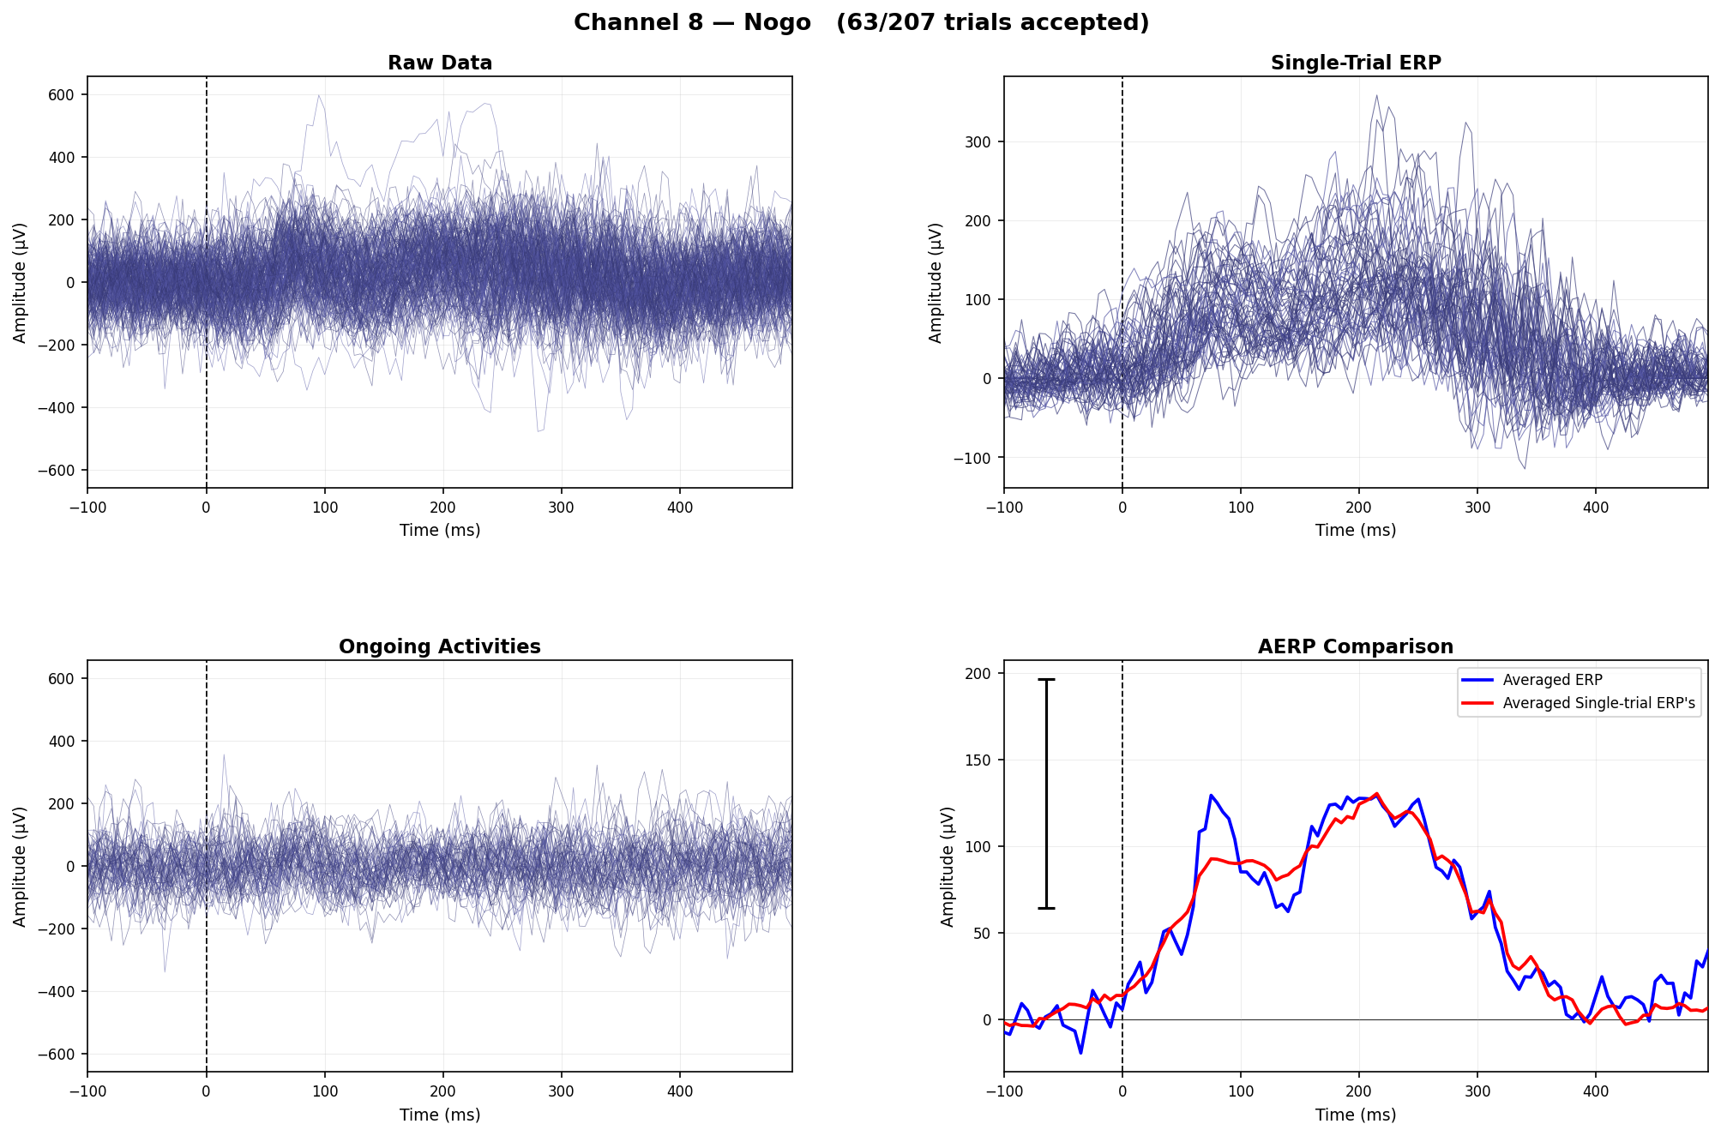
Single-Trial ERP — Channel 8 (Nogo)
Raw Data | Signal | Ongoing Noise | AERP Comparison
Ch 8 Nogo — 81.5% accepted

Slide 13

Single-Trial ERP — Channel 3 (Nogo)
Raw Data | Signal | Ongoing Noise | AERP Comparison
Ch 3 Nogo — 81.9% accepted

Slide 14
Latency–Reaction Time Correlation
Neural Correlate of Reaction Time
▸ ASEO single-trial latency shifts correlate with behavioural reaction time
• Earlier neural latency → faster motor execution → shorter RT
▸ Top channels (Go condition, Component 2):
• Channel 5: r = 0.820, p < 0.001 ← strongest coupling
• Channel 8: r = 0.645, p < 0.001
• Channel 6: r = 0.631, p < 0.001
• Channel 7: r = 0.406, p < 0.001
• Channel 9: r = 0.450, p < 0.001
▸ Interpretation:
• The late (~300–400 ms) ERP component reflects motor preparation/execution
• Consistent with paper's Fig. 11 (latency-RT coupling in premotor cortex)
• Nogo condition: no RT recorded — correlation not applicable

Slide 15
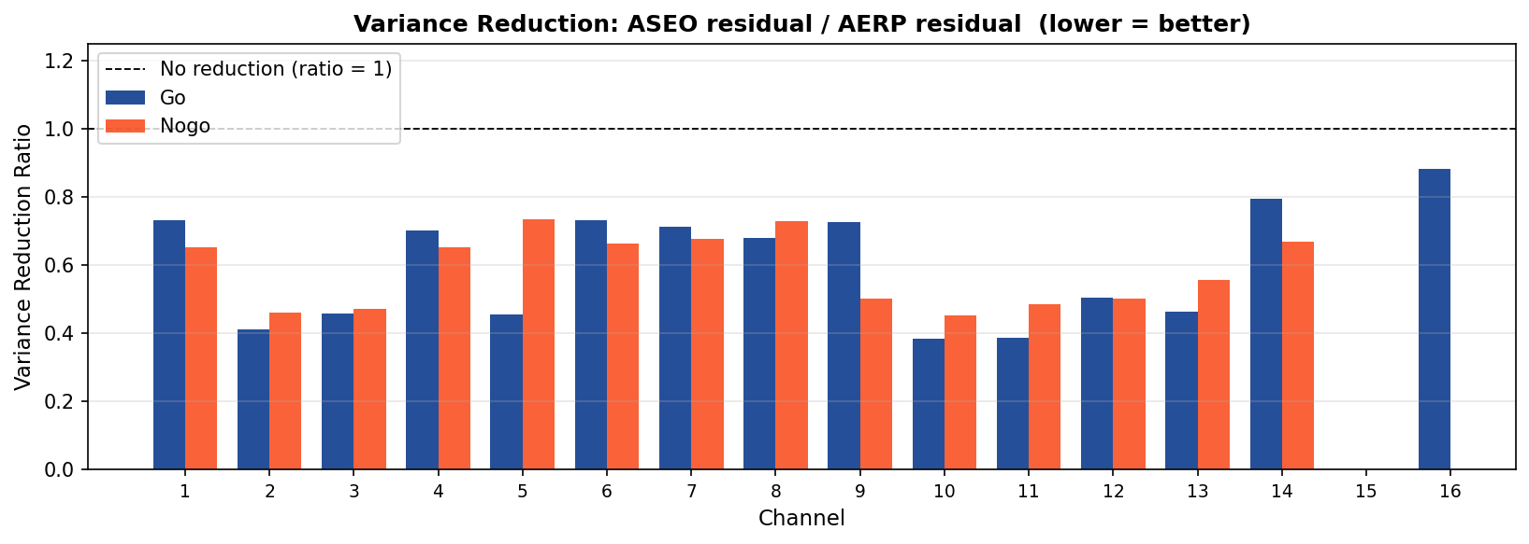
Variance Reduction: AERP vs ASEO
How much residual variance does ASEO remove beyond simple averaging?
▸ Ratio = Var(ASEO residual) / Var(AERP residual)
▸ Lower ratio = more variance explained
▸ Go condition highlights:
• Ch 14: 0.795 — best separation
• Ch 1,6: 0.732–0.731
• Ch 9: 0.725, Ch 7: 0.713
• Ch 8: 0.679, Ch 4: 0.701
▸ Most channels: 40%–80% reduction
▸ Channels with strong 5–10 Hz
▸ oscillations need AR order 14–20
• (BIC selects per channel)
Go (blue) and Nogo (orange) variance reduction ratios across all 16 channels

Slide 16
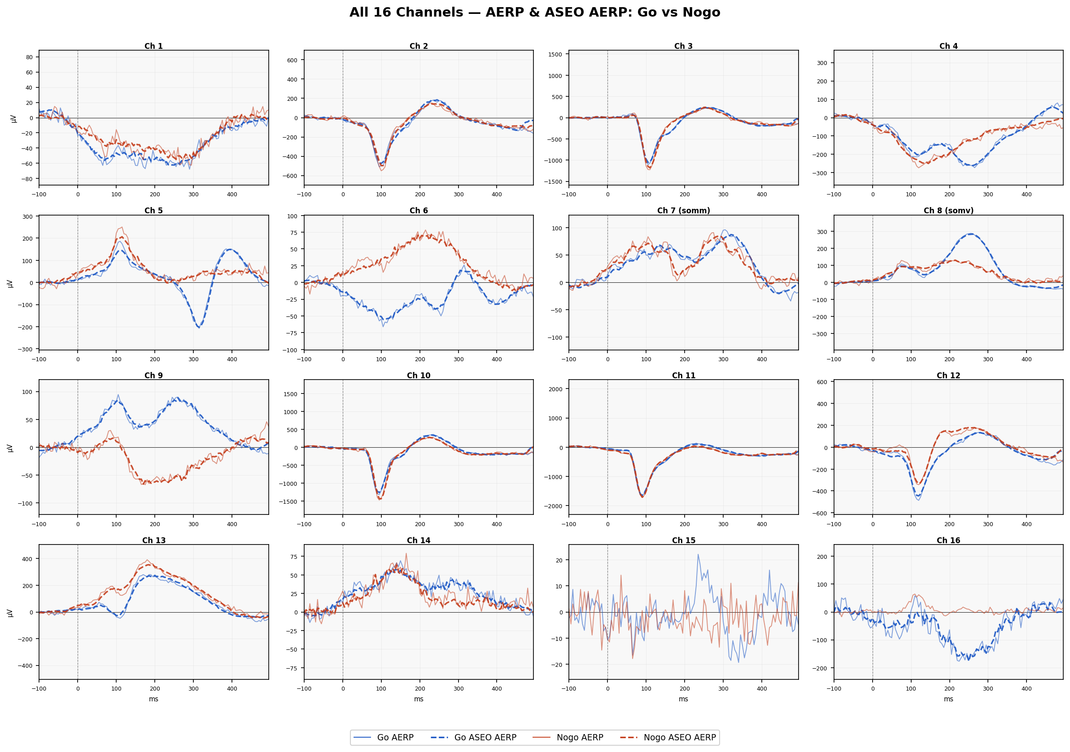
All 16 Channels — AERP & ASEO AERP: Go vs Nogo
Spatial overview: ERP shape, Go/Nogo contrast, ASEO correction across the array
Each panel: Go AERP (blue solid), Go ASEO AERP (blue dashed), Nogo AERP (red solid), Nogo ASEO AERP (red dashed). Y-axis auto-scaled per channel. Accept % shown in title. Ch 7 = somm, Ch 8 = somv.

Slide 17
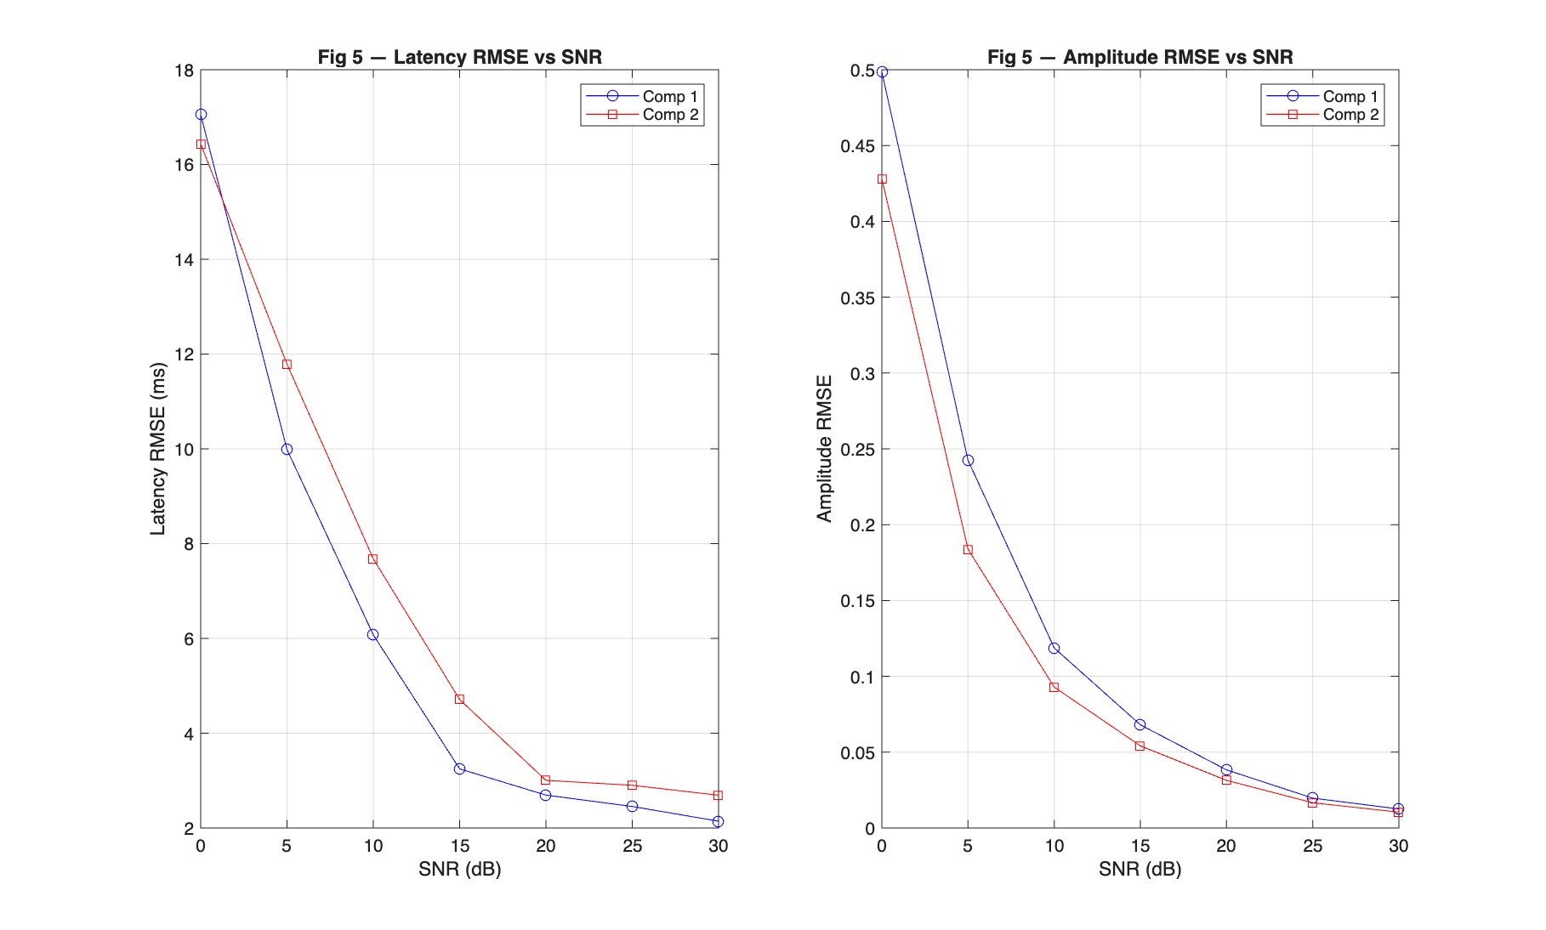
Synthetic Validation — RMSE vs SNR
Paper Fig. 5 Reproduction — Known Ground Truth
220 trials, 2 components, σ_latency = 10 ms, σ_amplitude ~ 0.60. Latency RMSE drops below input jitter (10 ms) above 5 dB. High-SNR asymptote ~2–3 ms from 1 ms search grid + 5 ms sampling period.

Slide 18
Summary & Next Steps
ASEO Implementation Complete
▸ Successfully implemented ASEO on Monkey LU LFP data, 16 channels, Go & Nogo
▸ Key findings:
• Single-trial ERPs cleanly separate neural signal from ongoing LFP oscillations
• Latency shifts track reaction time (r = 0.82, p < 0.001, Ch 5 Comp 2)
• ASEO reduces residual variance 40–80% vs. AERP subtraction
• Synthetic validation: reliable recovery above SNR ≈ 5 dB (matching paper Fig. 5)
▸ Technical work completed:
• 3 bugs fixed in original code (matrix inversion, variance baseline, empty-index crash)
• 4 new modules: summary CSV, synthetic test, Fig 12 overlay, this report
▸ Next steps:
• Multi-monkey batch analysis (TIO, GE datasets)
• Human EEG pipeline (Run_ASEO.m with EEGLAB, LPP paradigm)
• Coherence analysis using multi-channel single-trial estimates

