Slide 1
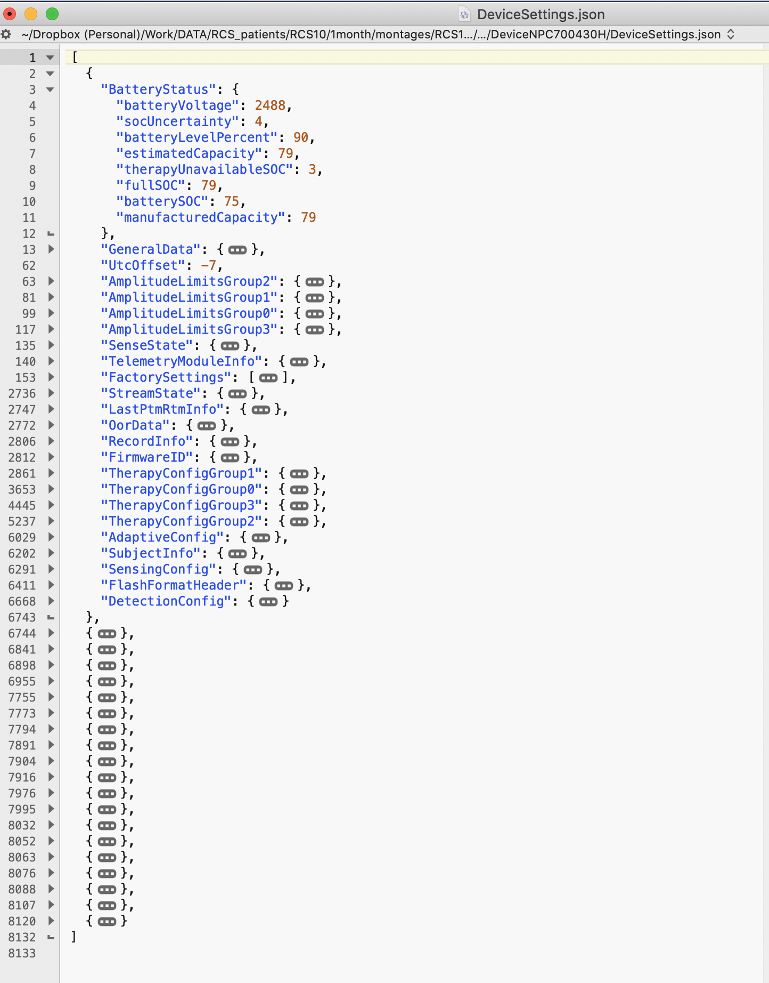
DeviceSettings.json
Highly dense log with lots of infos
Parsing done via
loadDeviceSettings.m
…

Slide 2
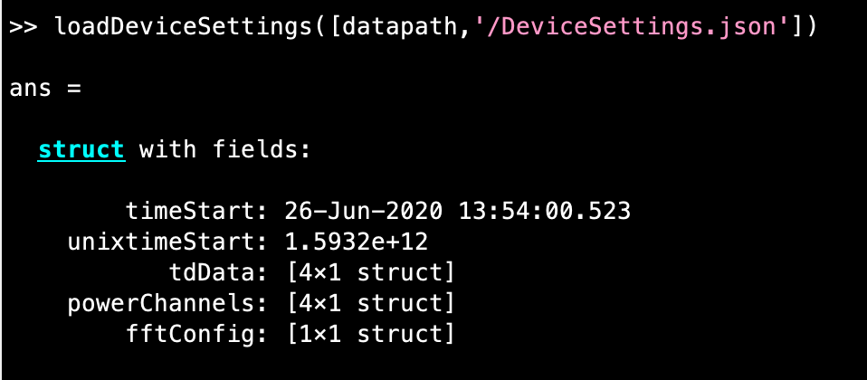
loadDeviceSettings.m

Slide 3
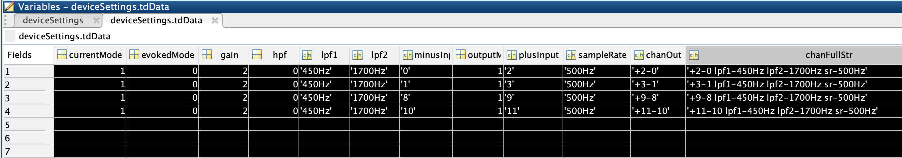
deviceSettings.tdData

Slide 4
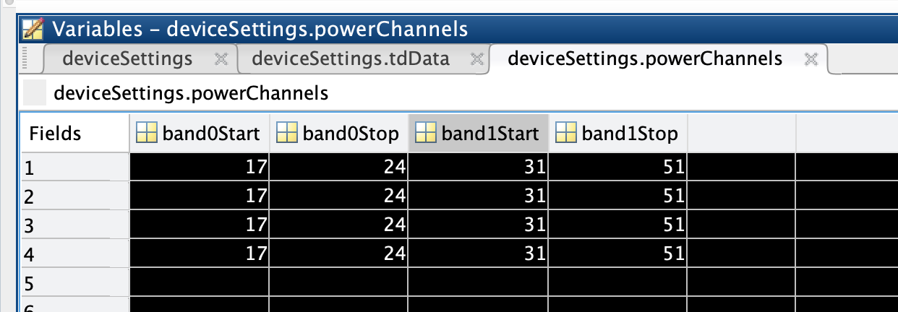
deviceSettings.powerChannels

Slide 5
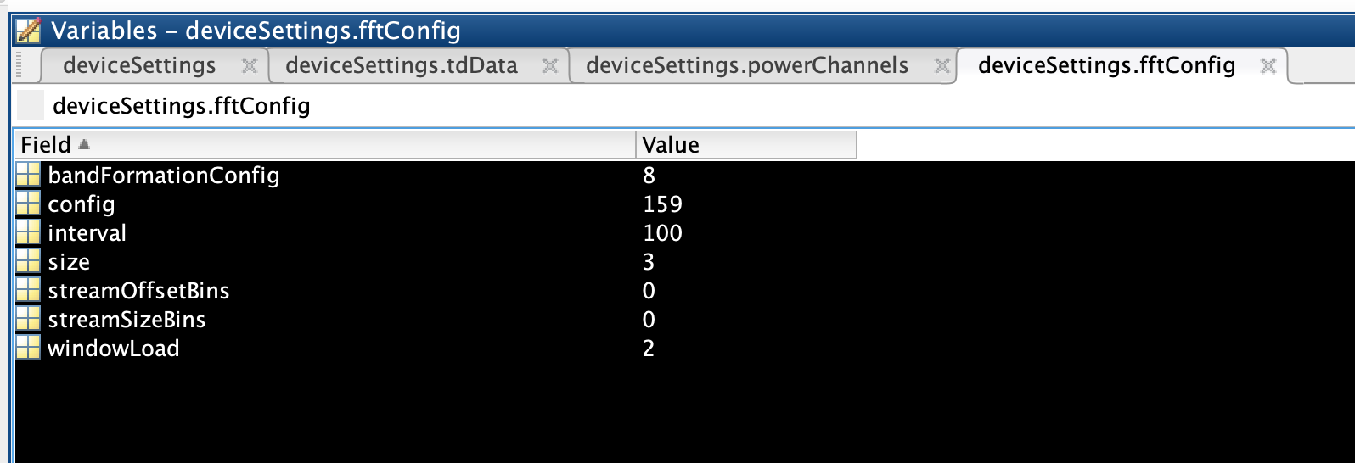
deviceSettings.fftConfig

Slide 6
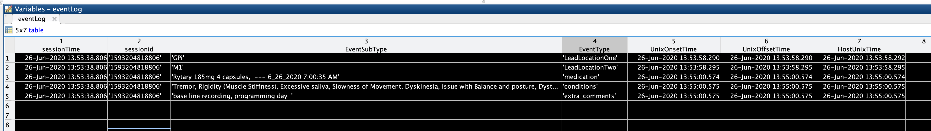
loadEventLog.m

Slide 7
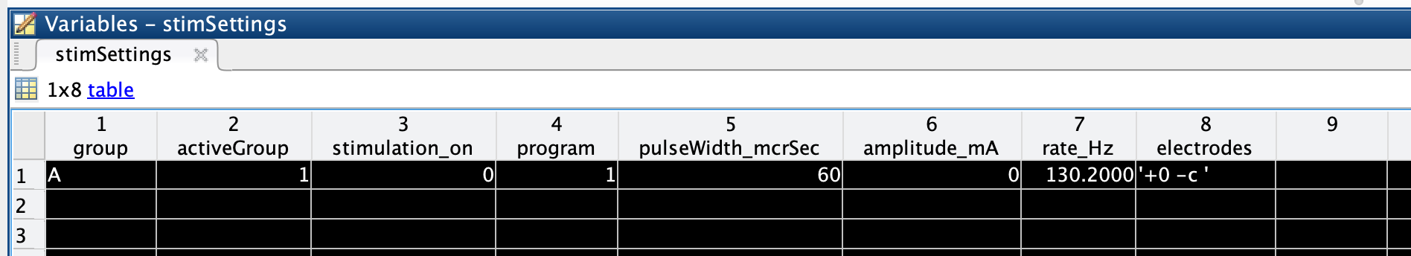
loadStimulationSettings.m (loadDeviceSettingsForMontage.m, rcsanalysis)

Slide 8
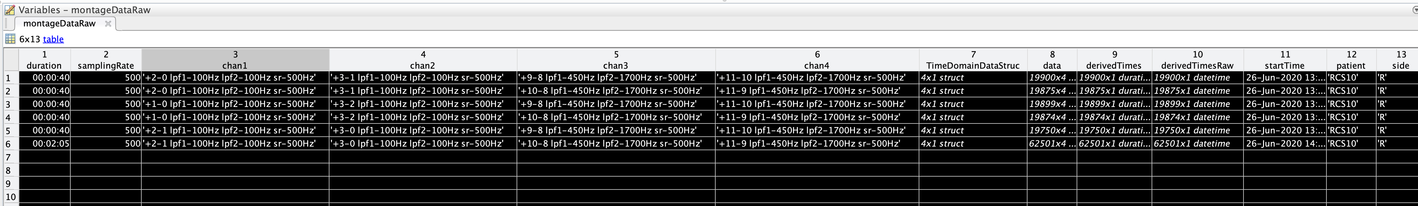
open_and_save_montage_data_in_sessions_directory(datapath)
rawMontageData.mat

