Slide 1
Sauk Sediment Model Update 04/25/2018 Claire Beveridge, Christina Bandargoda, Erkan Istanbulluolu

Slide 2
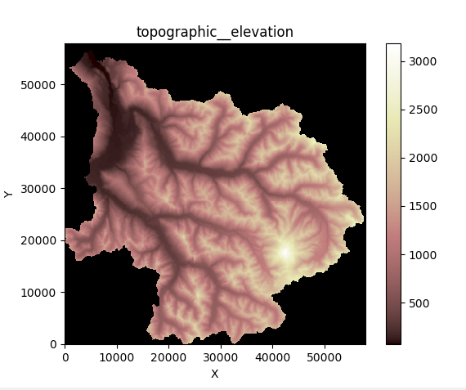
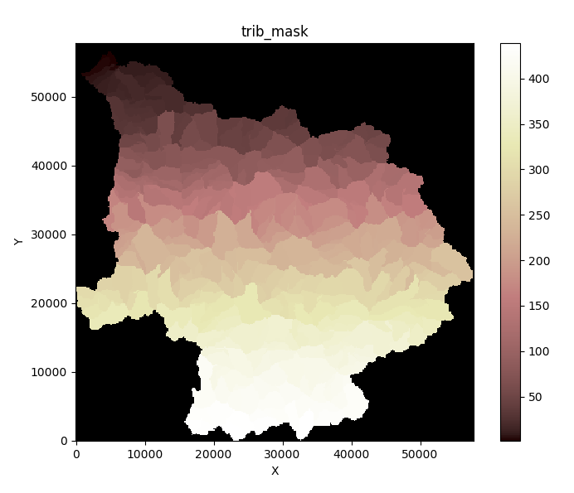
Landlab Model Grid
429 Stream Links
14 Locations of Interest
1 outlet
6 stream gauges
7 glaciers

Slide 3
Sauk Locations of Interest (DHSVM 2018)
LOI | Stream Link | Location
1 | 1 | outlet
2 | 19 | 12189500
3 | 187 | 12187500
4 | 224 | 12187000
5 | 257 | 12186500
6 | 274 | ErmineGlacier
7 | 279 | 12186000
8 | 295 | VistaGlacier
9 | 317 | DustyGlacier
10 | 329 | ChocolateGlacier
11 | 349 | CoolGlacier
12 | 363 | 12185000
13 | 368 | SuiattleGlacier
14 | 371 | HoneycombGlacier

Slide 4
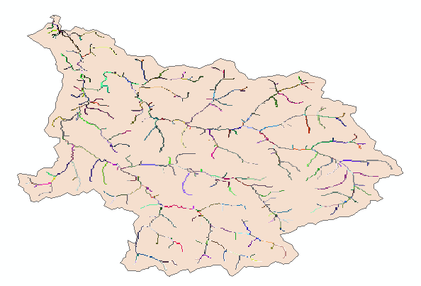
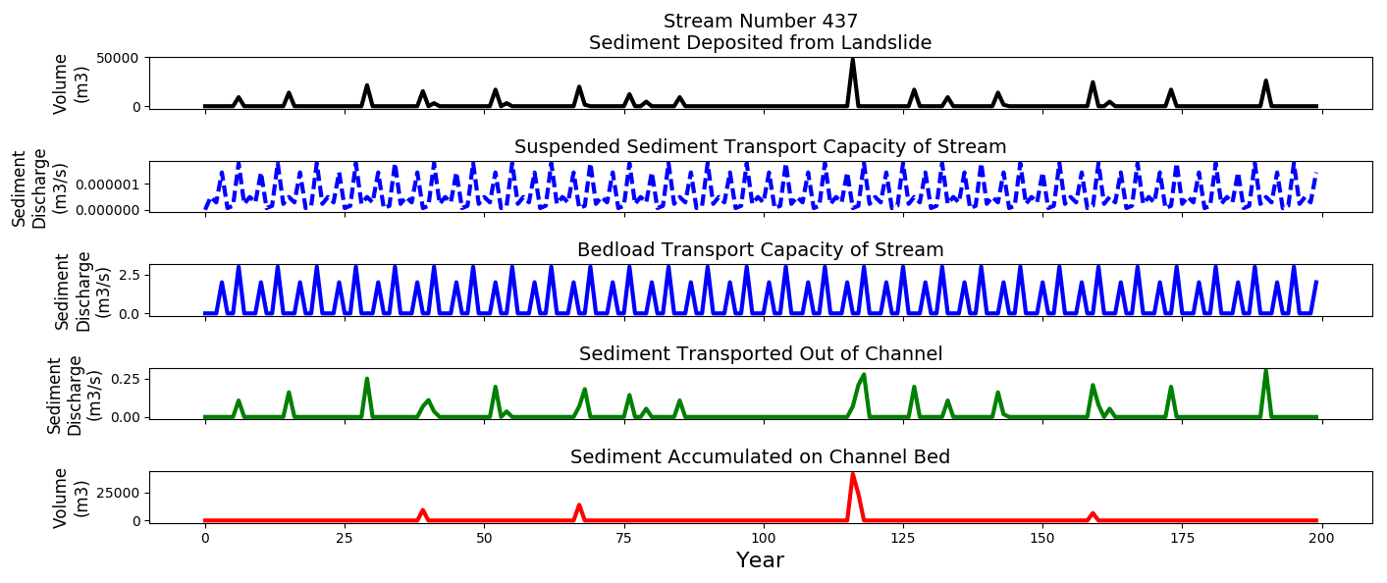
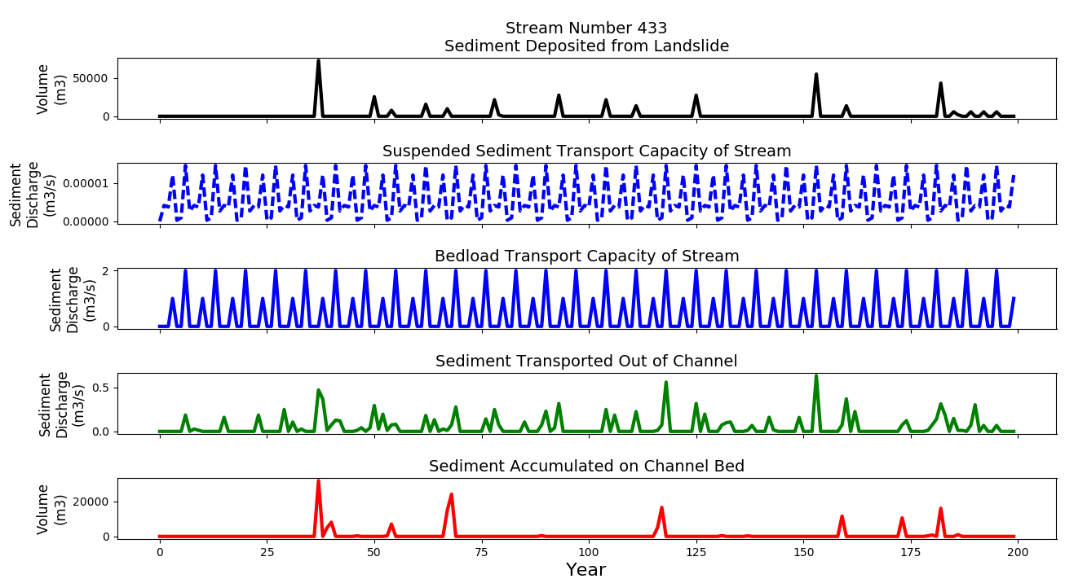
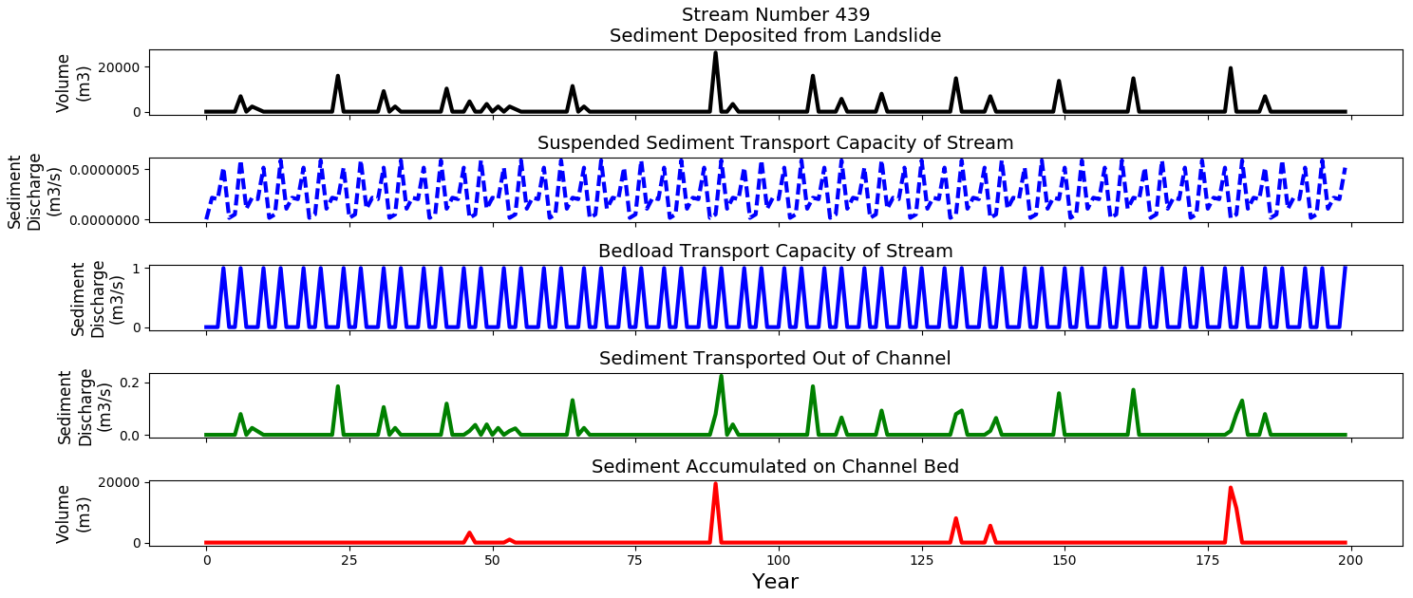
Upper Watershed Streams
Model Run: 2017-10-12_0757

Slide 5
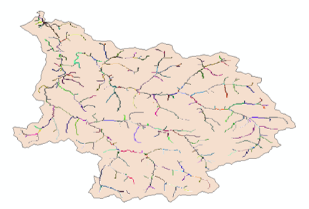
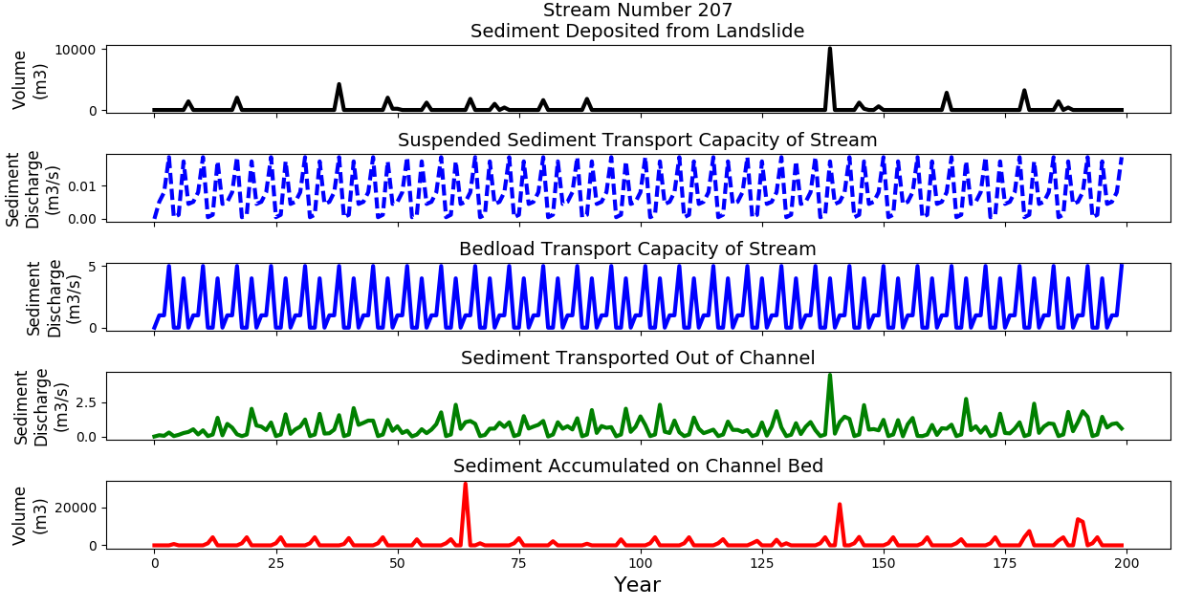
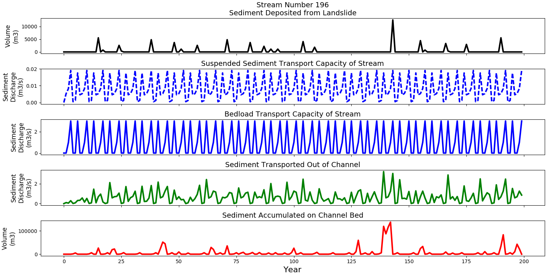
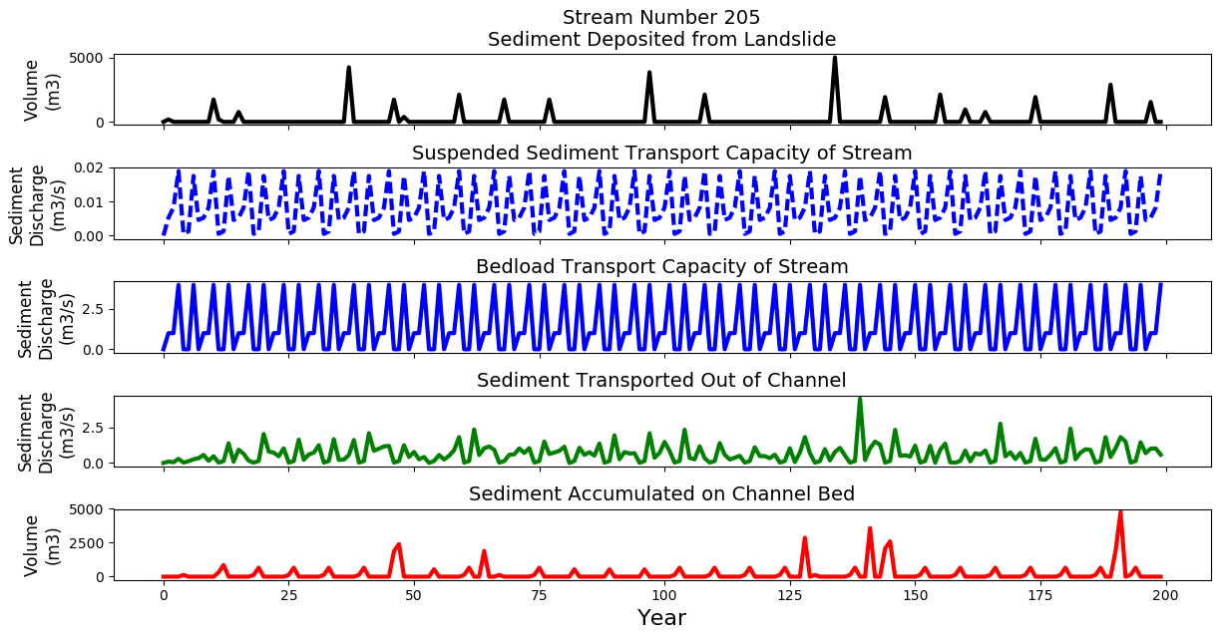
Mid Watershed Streams
Model Run: 2017-10-12_0757

Slide 6
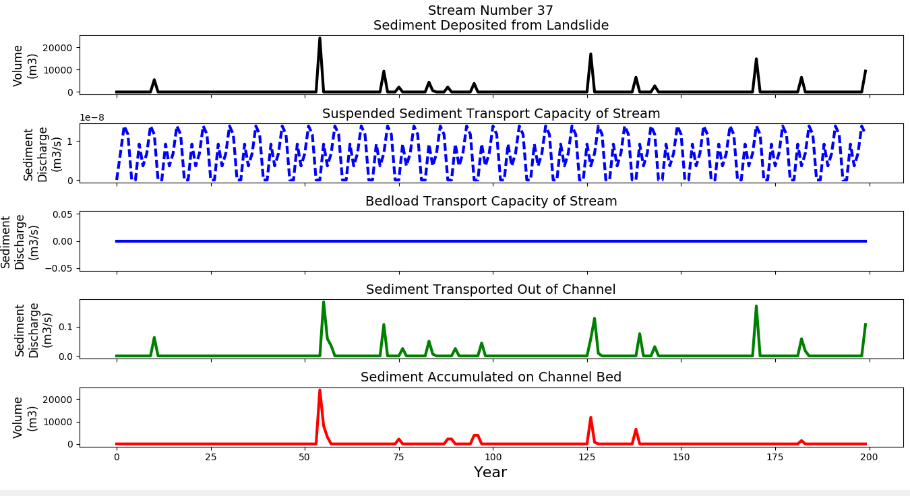
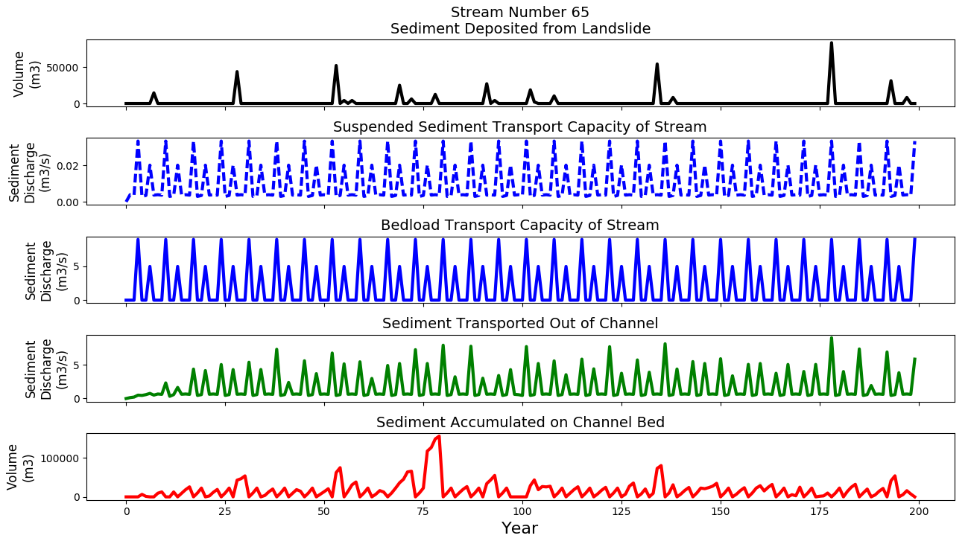
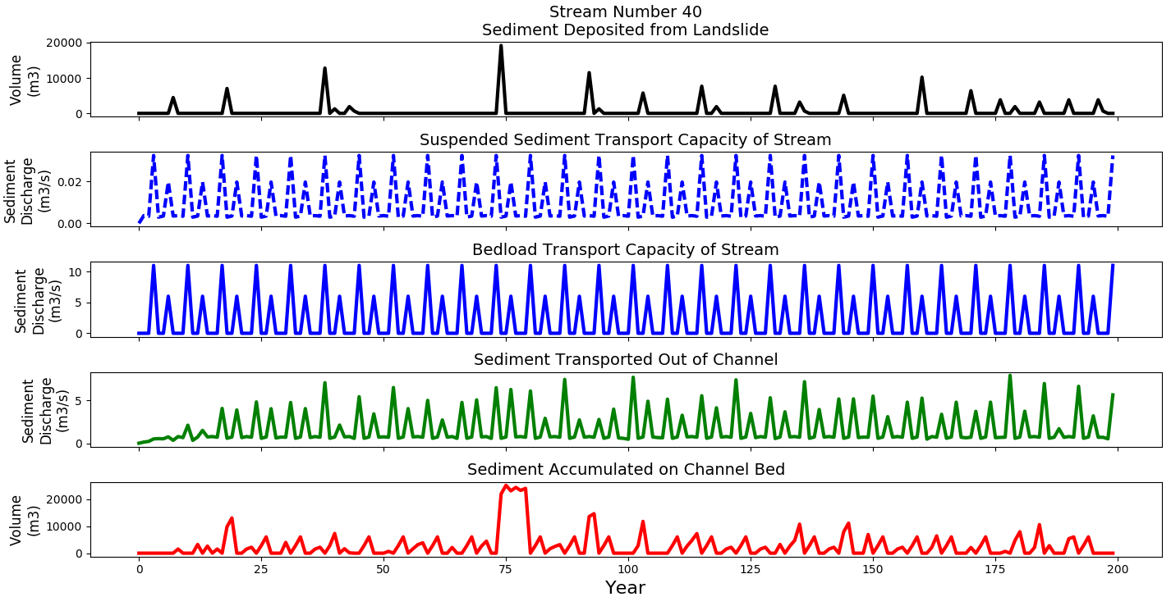
Lower Watershed Streams
Model Run: 2017-10-12_0757

Slide 7
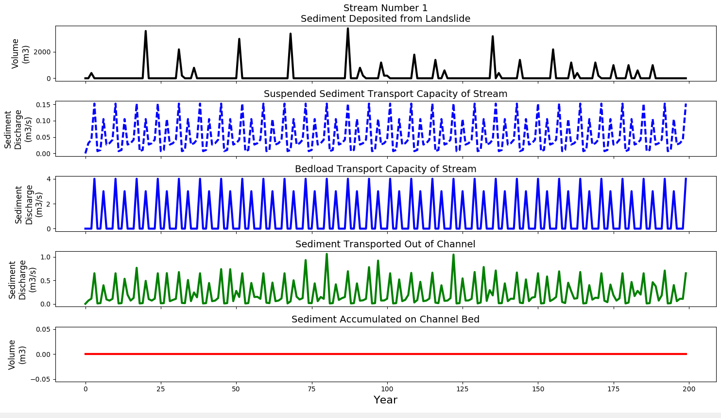
Outlet
Model Run: 2017-10-12_0757

Slide 8
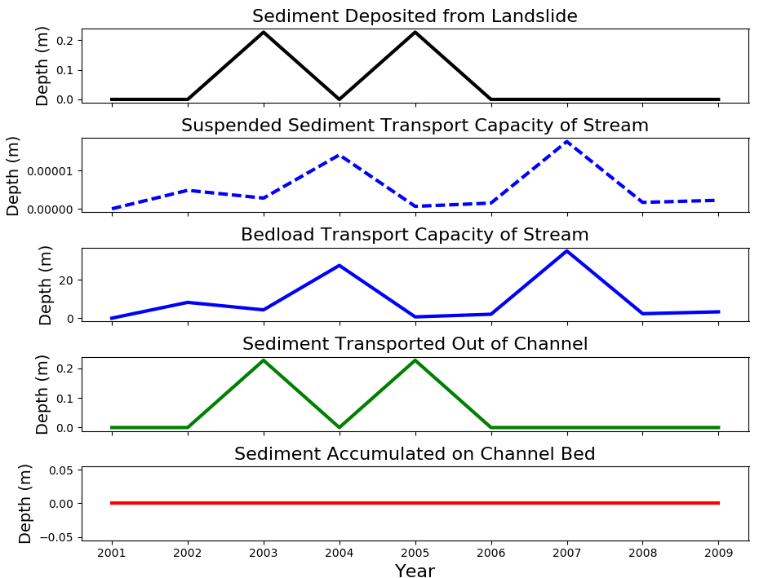
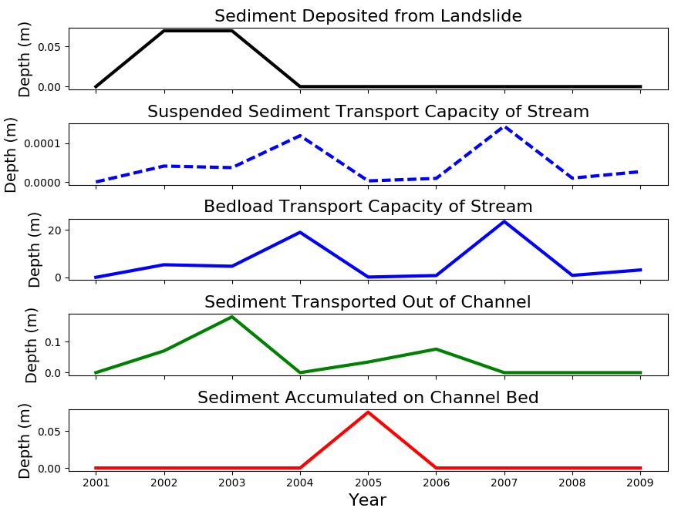
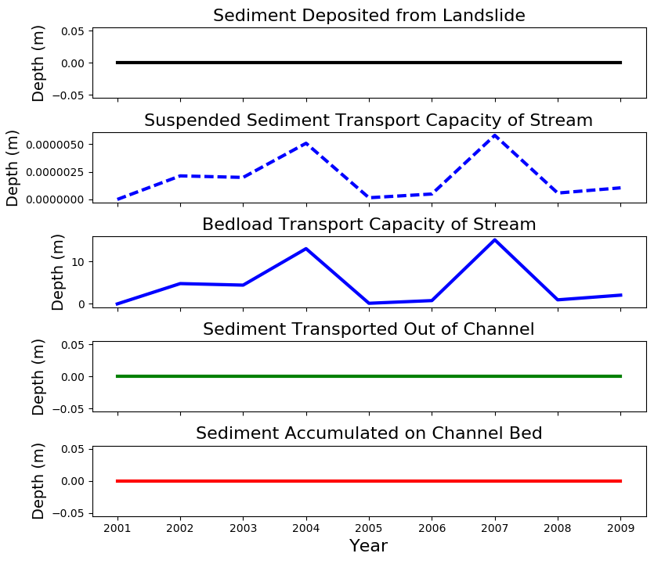
Upper Watershed Streams
Feeder Streams
Stream=433
Stream=437
Stream=439
Model Run: 2017-10-11_1132

Slide 9
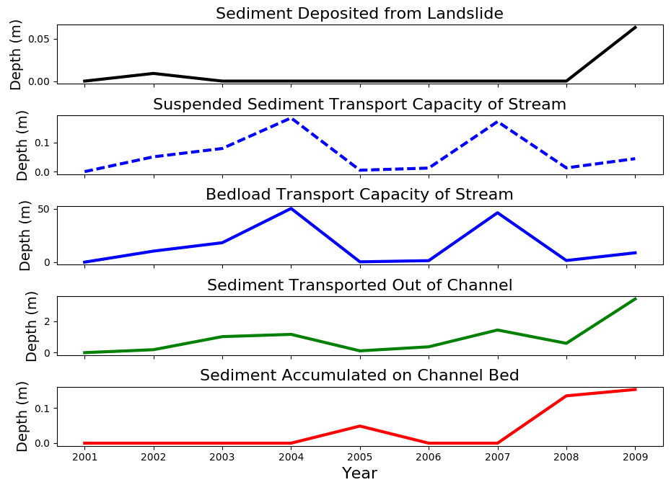
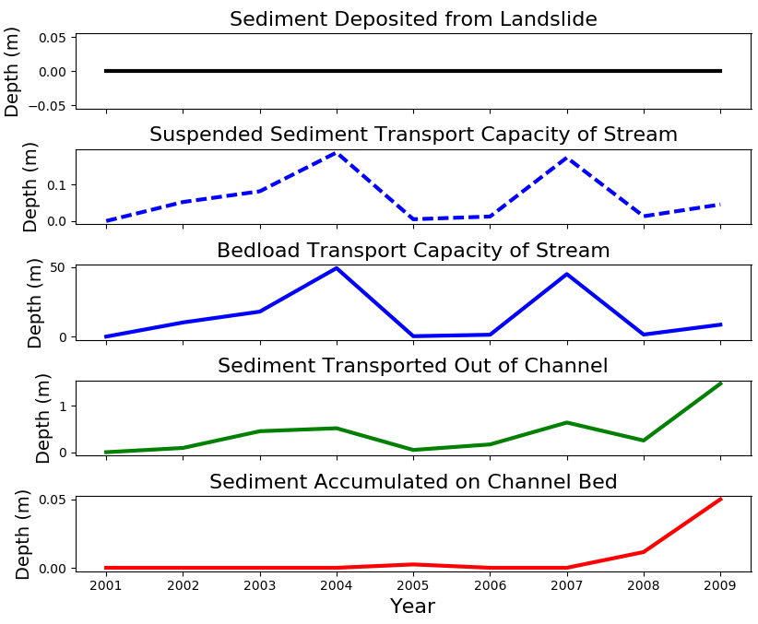
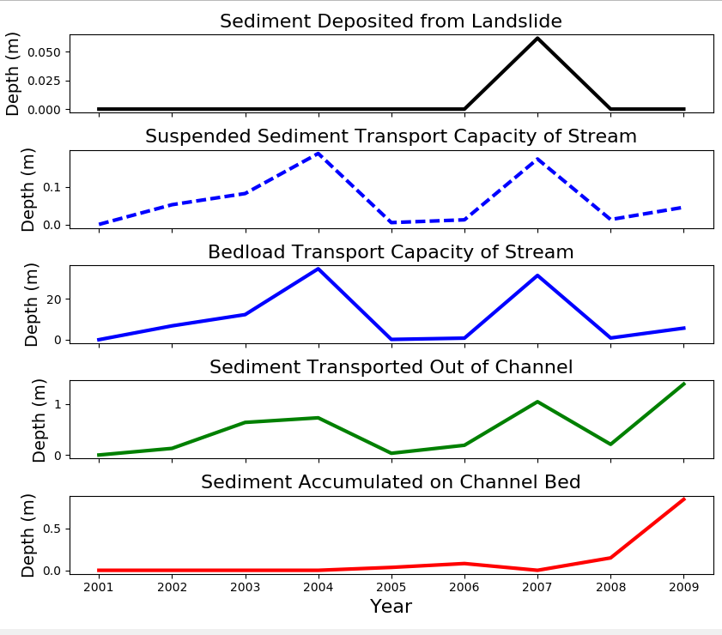
Mid Watershed Streams
Stream=207
Stream=205
Stream=196
Model Run: 2017-10-11_1132

Slide 10
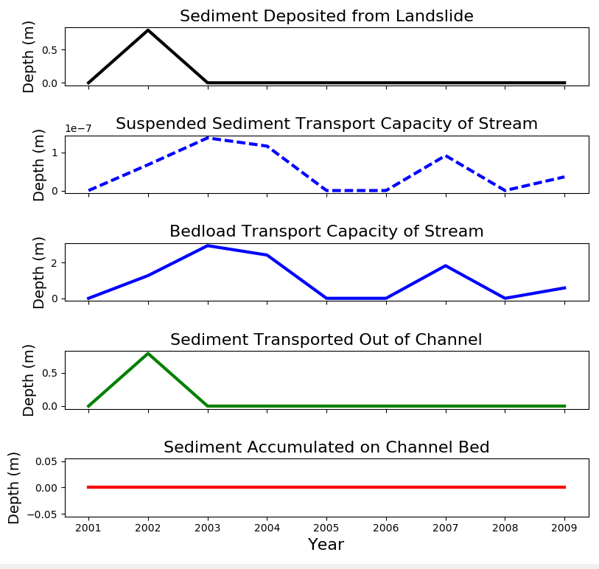
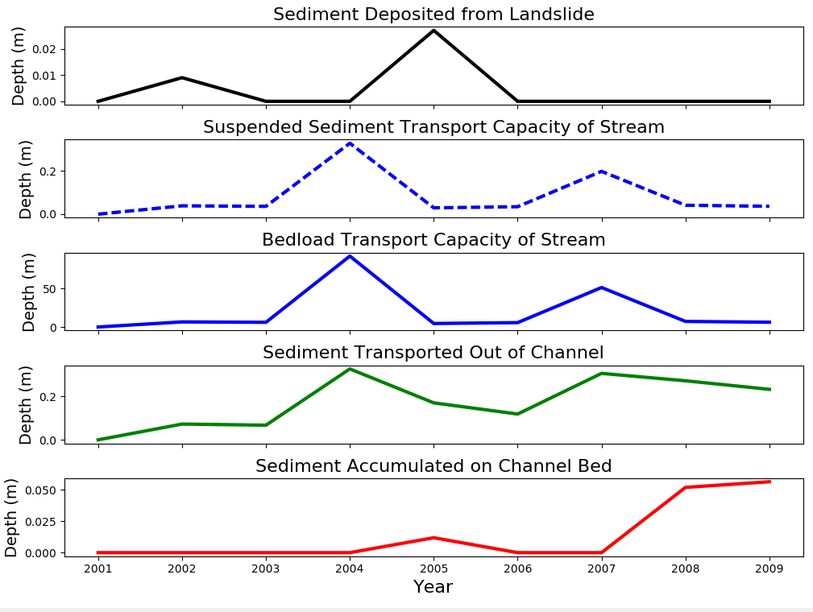
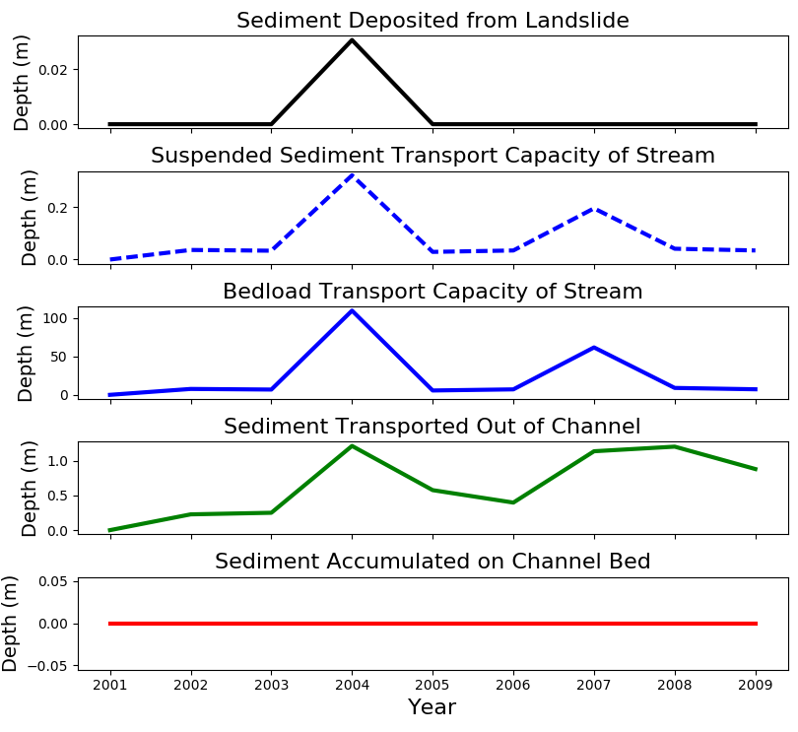
Lower Watershed Streams
Feeder Streams
Stream=65
Stream=37
Stream=40
Model Run: 2017-10-11_1132

Slide 11
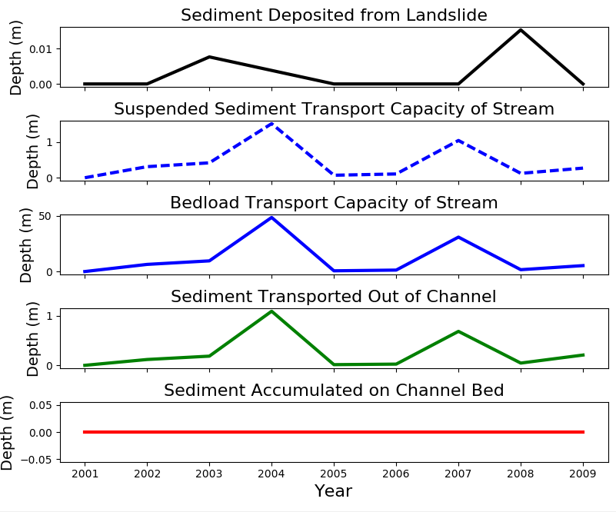
Outlet
Stream=1 (Outlet)
Model Run: 2017-10-11_1132

