Slide 1
Search Engine: Research Articles
Source: arXiv.org
2019-04-09
CS734/834
Puneeth Bikkasandra
Old Dominion University

Slide 2
Target:
A search engine for latest Research Documents.
Crawlable URLs : 3000 ; source: arXiv.org
User Experience:
Web Page where a user can input and submit an ‘Information Need’
Less Turnaround time
Returns latest research documents in the area of Computer Science.

Slide 3
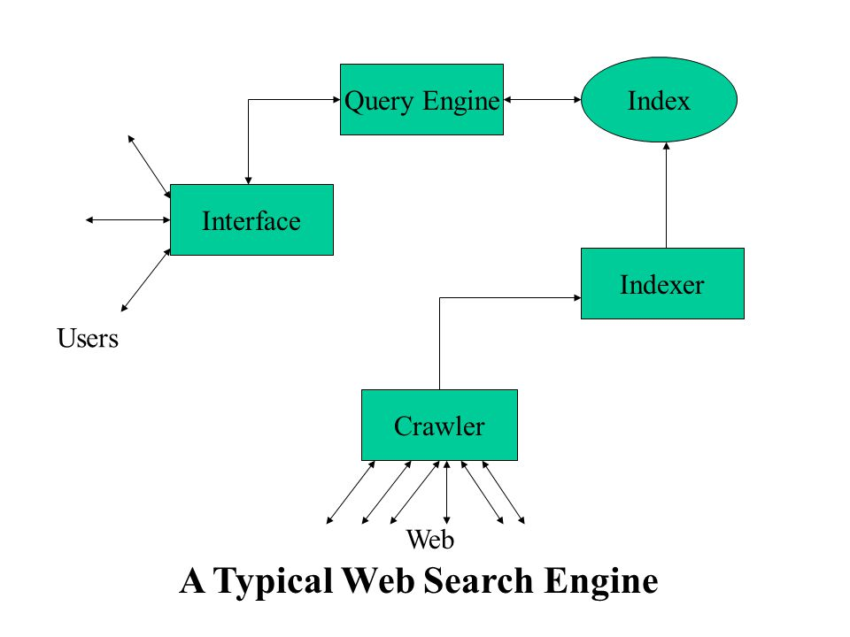
Design:
Infrastructure:
Software:
Scrapy - Crawler
ElasticSearch - Distributed DB
Data Source: arXiv.org
Seed Extraction: python libraries
(BeautifulSoup)
ScrapyElasticSearch – json Formatting
sHardware:
Virtual Machine:
Memory: 60 GB
2 cores, 6GB RAM
Laptop:
Memory: 128 GB
4GB RAM

Slide 4
Progress:
Extraction of 3000 unique URLs from the source (arXiv.org) - python (BeautifulSoup).
Scrape necessary fields for indexing - Scrapy (crawler).
JSON file to have the extracted content from seed list.
Perform Indexing - Index API (ElasticSearch).
Challenges Faced:
Extracting specific fields for Indexing through Scrapy.
Crawling arXiv.org – robots.txt exclusion.

Slide 5
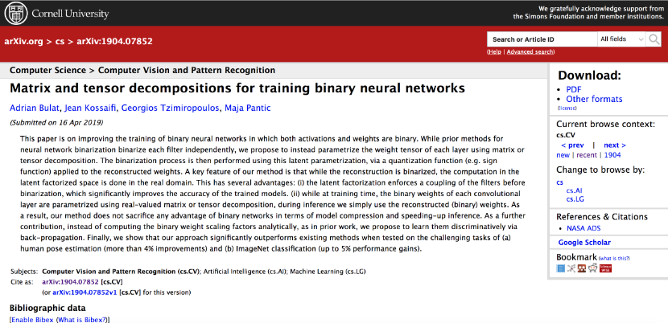
Page Structure and Continous Depth:

Slide 6
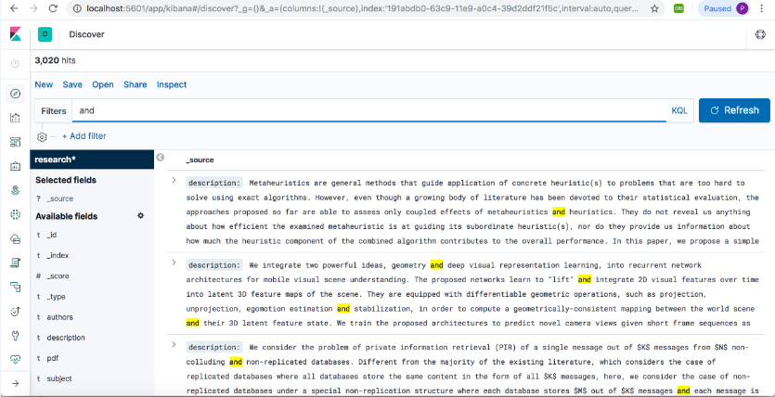
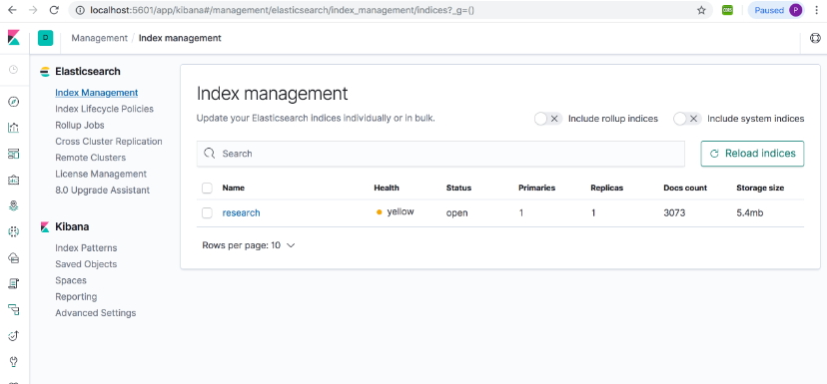
Kibana Dashboard

Slide 7
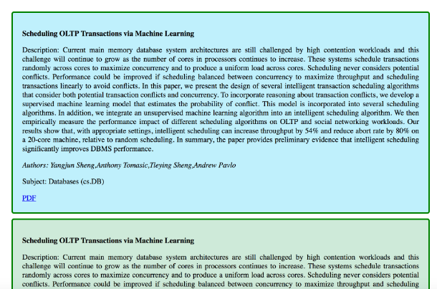

SERP:

Slide 8
Evaluation : Precision@K
Query | P@K
Machine Learning | 0.98
Computer Vision | 0.89
Pattern Recognition | 0.98
Java | 0.99
Google Custom Search Engine:
https://cse.google.com/cse/setup/basic?cx=001046393167602876589:ysksjhvo8ya

