Slide 1
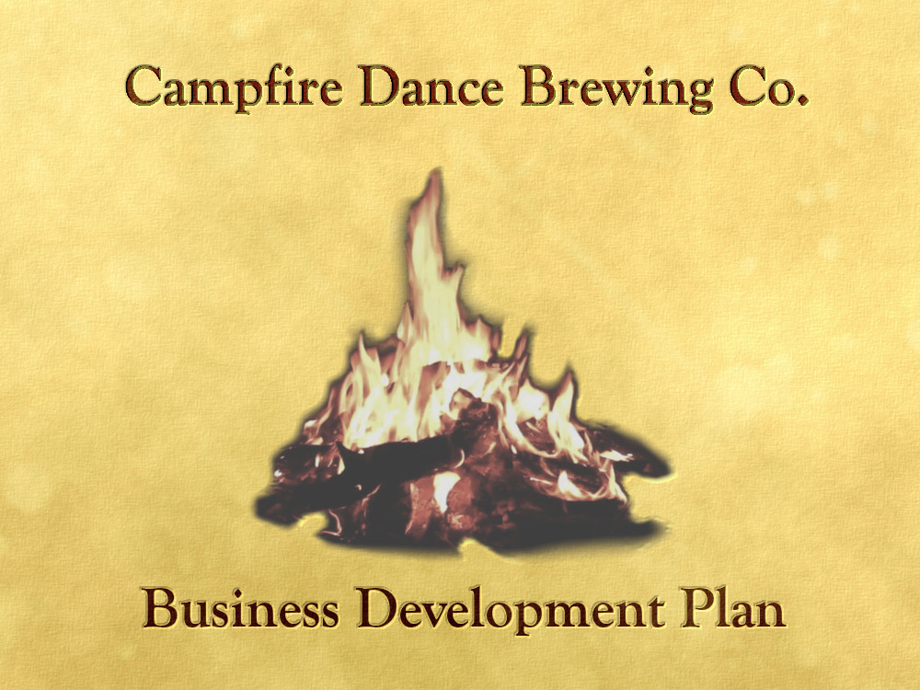
Paul Shoop
Booz|Allen|Hamilton
Data Visualization
Final Project

Slide 2
Main Questions:
Is now a good time to expand?
Where should the next brewery be built?
What style of beer should we be offering?
Data Sources Used:
Alcohol and Tobacco Tax and Trade Bureau Data for craft beer (2007-2018)
Brewer’s Association Data on Craft Breweries per Capita (data for all 50 states)
BeerAdvocate Review Data (1.58 million reviews, 104 beer styles, 5690 Breweries)
Openbeer Database (5914 Beers from 1423 Breweries)

Slide 3
Is now a good time to expand?

Slide 4
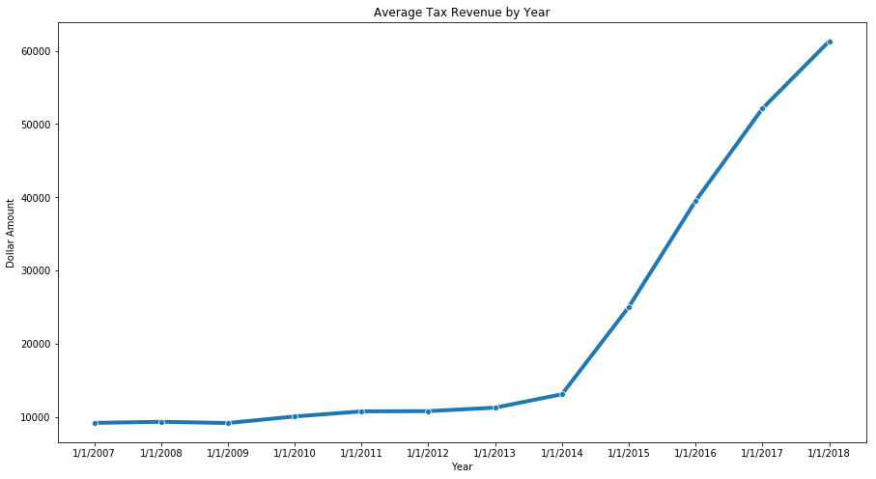
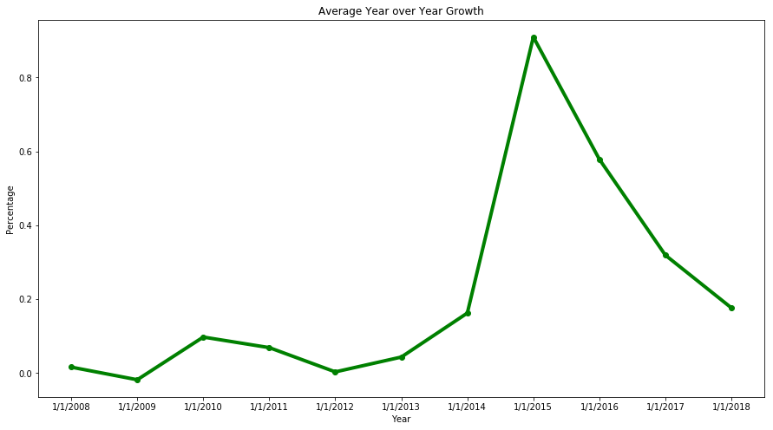
Though tax revenue is increasing, average tax revenue growth year over year shows a sharp decrease after 2015.
This may be an indication that the craft beer ‘bubble’ has burst and the market is correcting itself.
Based on 2007-2018 Alcohol and Tobacco Tax and Trade Bureau Data

Slide 5
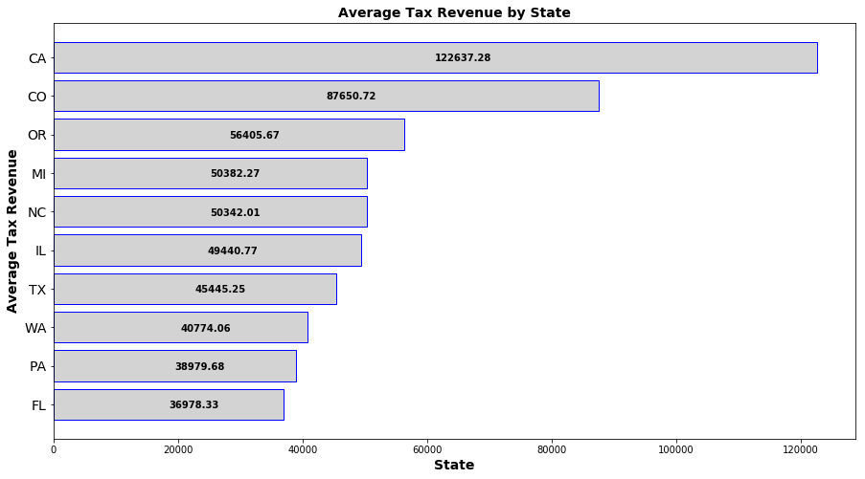
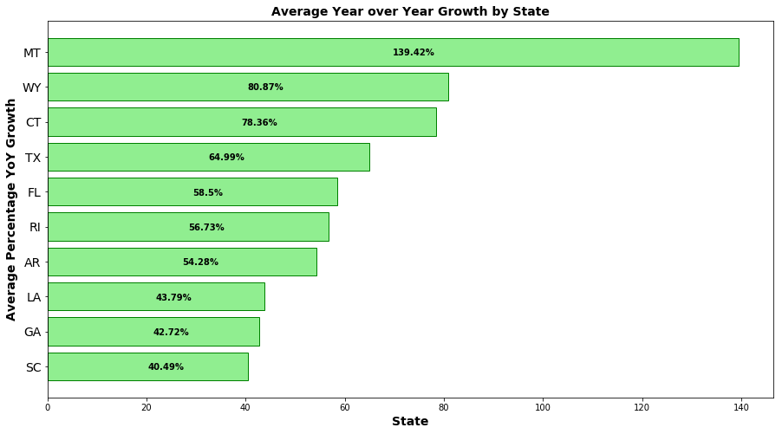
For tax years 2007-2015, California led in tax revenue.
For the same time period, Montana showed the most significant year over year tax revenue growth – well above 100%
Based on 2007-2018 Alcohol and Tobacco Tax and Trade Bureau Data

Slide 6
For tax years 2015-2018, some states still showed solid year over year growth despite market corrections.
Based on 2007-2018 Alcohol and Tobacco Tax and Trade Bureau Data

Slide 7
Where should the next brewery be built?

Slide 8
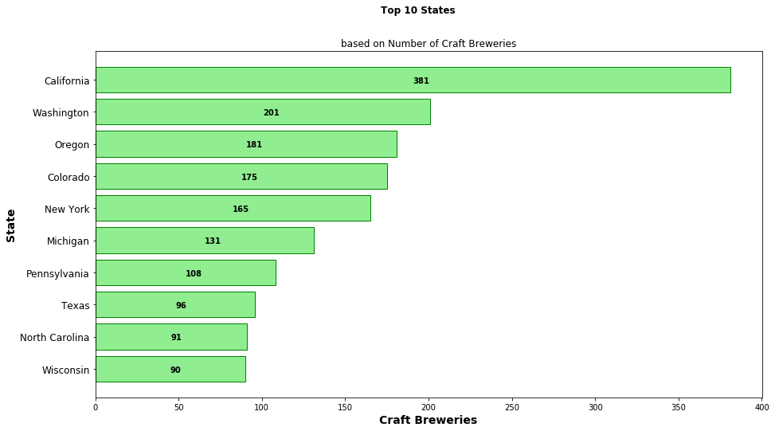
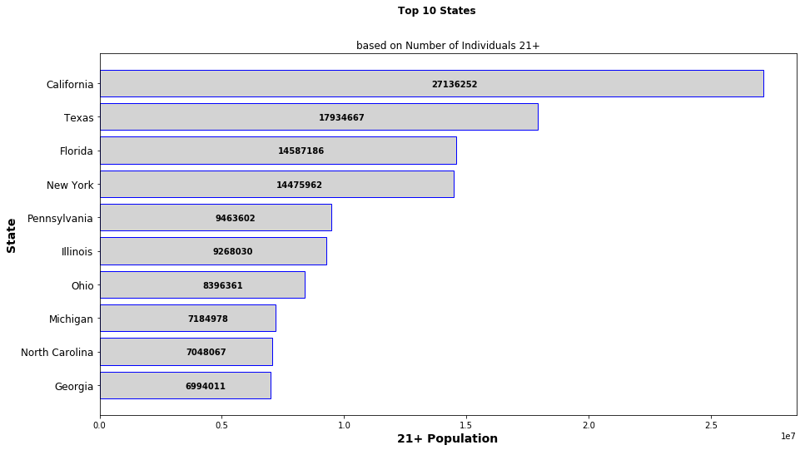
Having a large drinking-age population is a significant consideration in choosing a location.
Locating a market that is not oversaturated, yet with a healthy craft beer market is also key.
Notes:
LiveSlide file:///C:/Users/paul/Desktop/DS/DSV/Final_Project/plots/heatmap.html

Slide 9
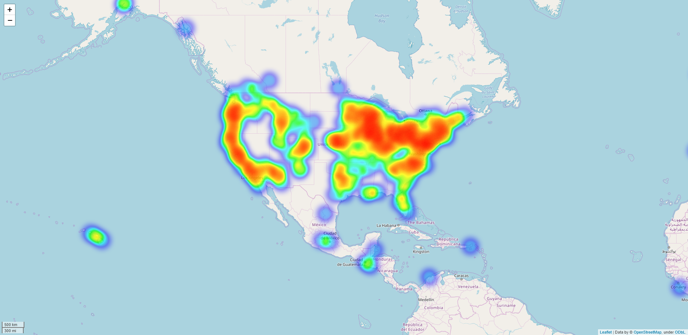
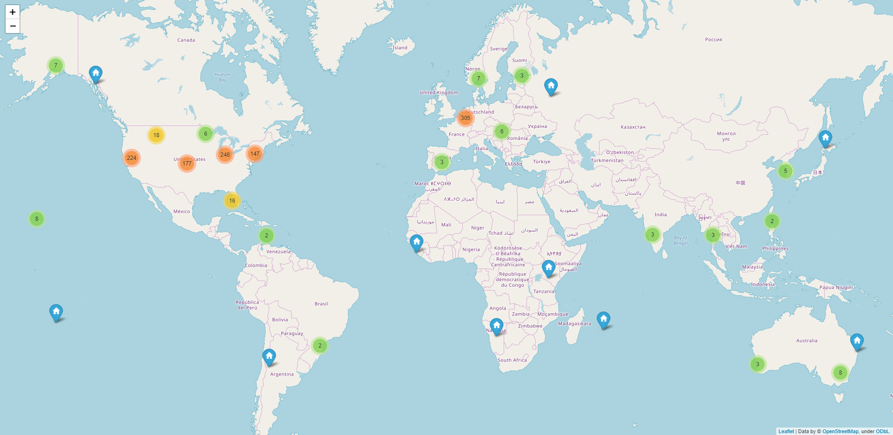
These maps help demonstrate the distribution density of craft breweries both in the U.S. and around the world.

Slide 10
What style of beer should we be offering?

Slide 11
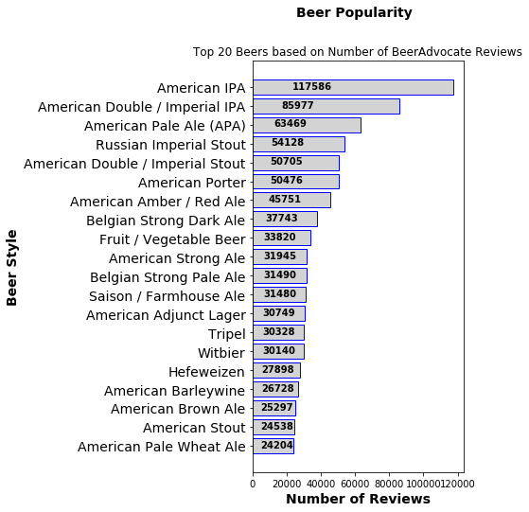
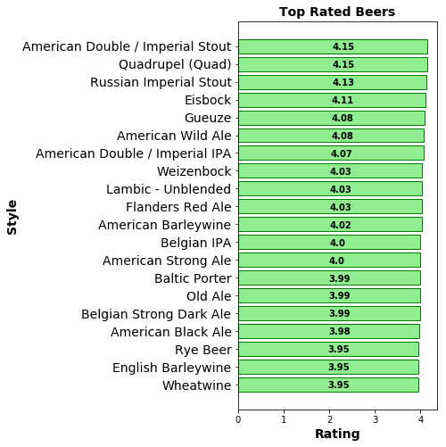
The number of reviews a beer style receives does not correlate to a top-rated beer.
American IPA, the most reviewed style, doesn’t make the top-20 best rated beers.
KPIs:
Average Rating: 3.77
Average Beer ABV: 7.04
Number of Styles: 104
Number of Reviews: 1.58 million

Slide 12
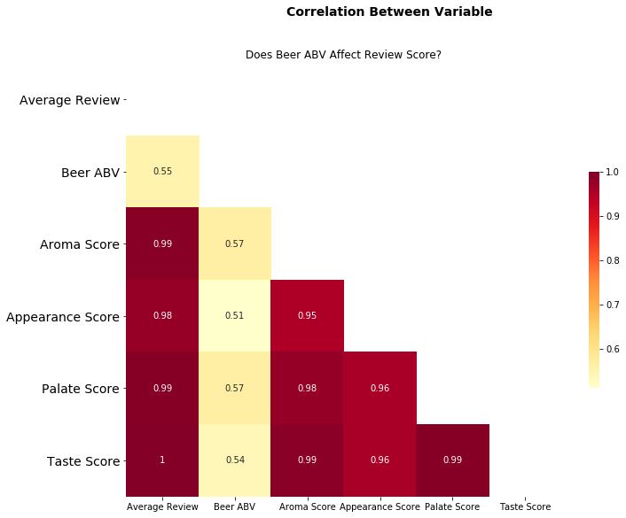

Slide 13
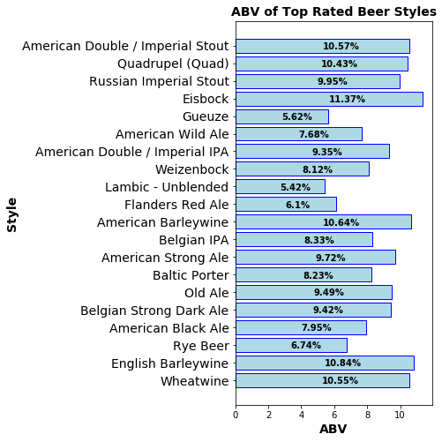
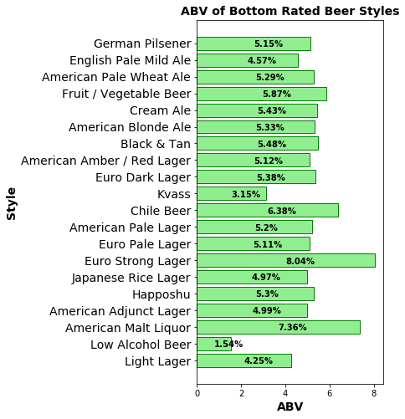
Despite not being able to show a strong correlation between ABV and beer review score, the top ten rated beer styles have higher than average ABV.
The bottom ten rated beer styles have lower than average ABV.

