Slide 1

Stock Price Prediction
Using Long-Short Term Memory
(LSTM) Networks
Team Members:
Shraddha Patil
Yash Manjare
Uttkarsh Morey
Kaivalya Pagrut
Krishna Narkhede
Department of Artificial Intelligence and Data Science
VISHWAKARMA INSTITUTE OF TECHNOLOGY, PUNE

Slide 2
Contents
01
05
02
06
03
07
04
08
Introduction
Methodology
Literature Review
Model Performance
Objectives
System Workflow
Workflow Diagram
Conclusion

Slide 3
Introduction
Complex Nature of Stock Market
Limitations of Traditional Models
Regression-based methods fail to capture sequential dependencies in data.
Stock market prediction is influenced by multiple unpredictable factors.
Power of Deep Learning (LSTM)
Focus of This Project
LSTMs can capture long-term temporal patterns and non-linear relationships.
Applying LSTM-based forecasting to Microsoft stock data (2020–2025).

Slide 4
Literature Review
Research Paper Title | Summary | Key Takeaways
Stock Price Prediction Using LSTM | Applies LSTM for stock prediction using historical data from the Indian NSE, with Tata Motors as a case study. | LSTM models handle sequential stock data well. Minimal error achieved in predictions. More data and sentiment analysis can enhance forecasts.
Stock Price Prediction Using LSTM on Indian Share Market | LSTM framework predicts future prices for Indian stocks, highlighting best intervals in various sectors. | LSTM works well for long-term stock forecasting. Longer historical data reduces error. Sector and time-span both influence accuracy.
Stock Price Prediction Using RNN and LSTM | Compares RNN and LSTM for predicting next-day stock prices in India. RNN slightly outperforms LSTM in this case. | Both models extract market patterns. RNN marginally better than LSTM here. Adaptable to new stocks or markets.
Stock Market Prediction Using LSTM Recurrent Neural Network | Tests LSTM for forecasting NYSE stocks; finds more training (epochs) improves prediction results. | LSTM learns complex financial data well. More epochs = better accuracy. Method generalizes to varied stocks.
Study on the prediction of stock price based on the associated LSTM | Proposes an LSTM-based network for predicting multiple stock prices (opening, low, high) simultaneously. | Multi-output LSTM improves accuracy. Strong results across different stocks. Over 95% prediction accuracy.

Slide 5
Objectives
Understand stock market patterns to enhance decision-making accuracy.
1
1
Improve forecasting precision using deep learning techniques.
2
Provide reliable insights to support informed investment decisions.
3
1
Explore LSTM capability for financial time series prediction.
4
Bridge research outcomes with practical real-world applications.
5
1

Slide 6
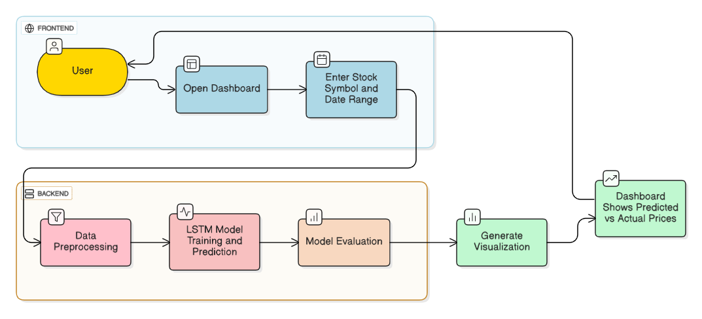
Workflow Diagram

Slide 7
Methodology
Data Collection & Preparation
Source: Collected Microsoft (MSFT) stock data (2020–2025) using Yahoo Finance API.
Cleaning: Removed missing values and ensured consistent date-time indexing.
Feature Engineering: Computed indicators like SMA, RSI, Bollinger Bands, and MACD.
Data Processing & Splitting
Feature Scaling: Applied MinMaxScaler to normalize features independently.
Sequence Preparation: Converted time-series data into lookback windows for LSTM input.
Train-Test Split: Divided data into training (80%) and testing (20%) sets.

Slide 8
Methodology
Model Development
Baseline Model: Trained Linear Regression as a benchmark for comparison.
Initial LSTM: Built and trained an LSTM model on prepared sequences.
Hyperparameter Tuning: Used Random Search (units, dropout, learning rate, lookback).
Evaluation & Visualization
Metrics: Evaluated using RMSE, MAE, and R² Score.
Visualization: Plotted actual vs predicted stock prices for interpretability.
Web Deployment
Deployed the trained LSTM model using Flask for real-time stock prediction.

Slide 9
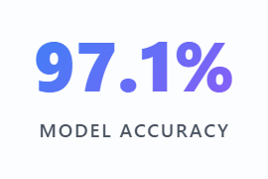
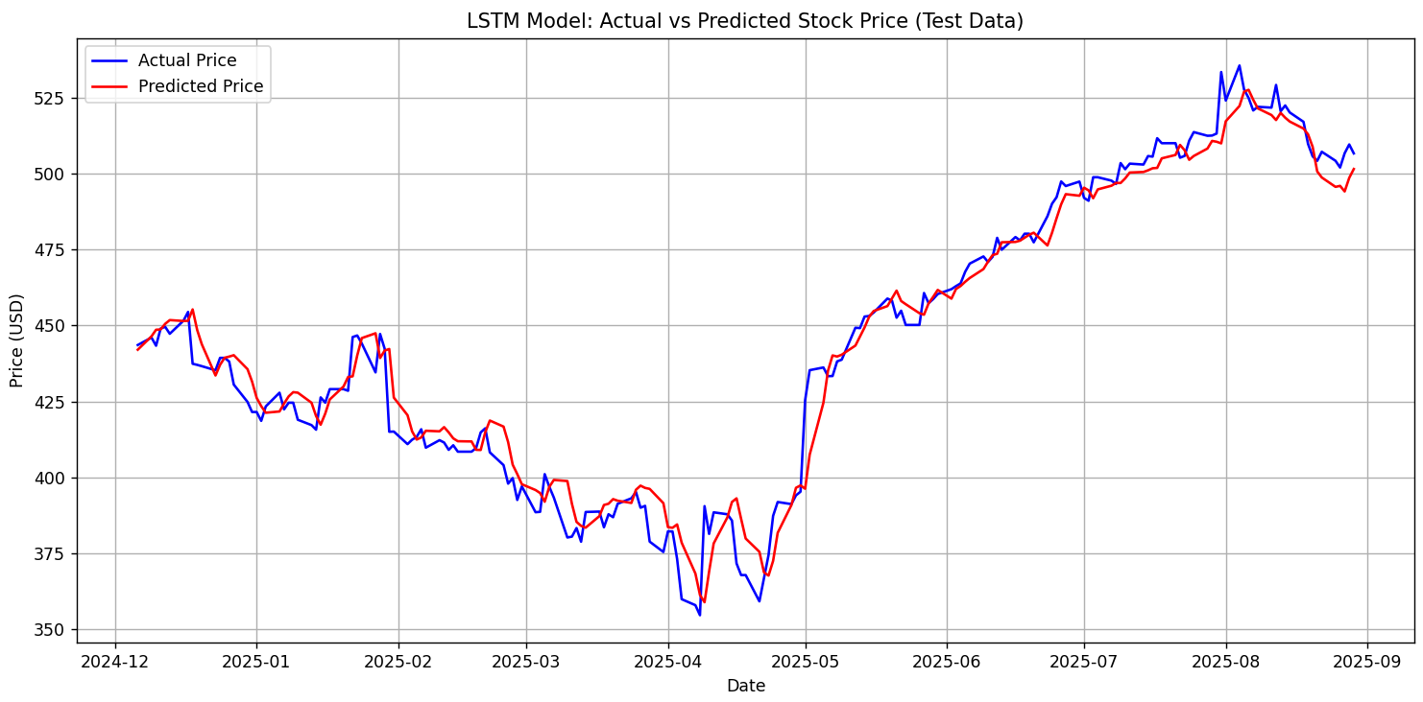
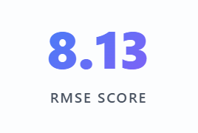
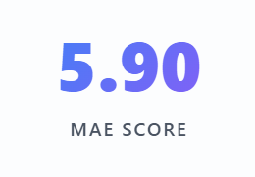
Model Performance Overview
Predicted vs. Actual MSFT Closing Prices

Slide 10
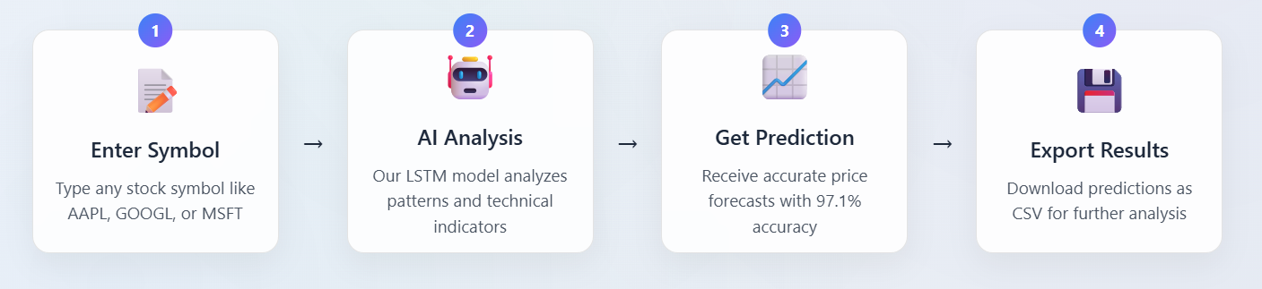
System Workflow
Real-time Data: Live stock market data updated continuously
Multiple Interfaces: Professional web dashboard and interactive analytics app
Advanced Analytics: Comprehensive technical indicator analysis
Historical Analysis: 60-day historical pattern recognition for better predictions
Instant Predictions: Pre-trained models ready for immediate forecasting
Key
Features

Slide 11
Conclusion
Accurate Forecasting
LSTM model successfully predicts stock price movements with high accuracy and stability.
Temporal Learning
Effectively learns long-term dependencies and market patterns from sequential data.
Market Consistency
Predicted trends aligned well with technical indicators, confirming realistic market behavior.
Model Reliability
Showed stable performance across different time periods and market conditions.

