Slide 1
Image Colorization
Prateek Shroff
Stuti Sakhi

Slide 2
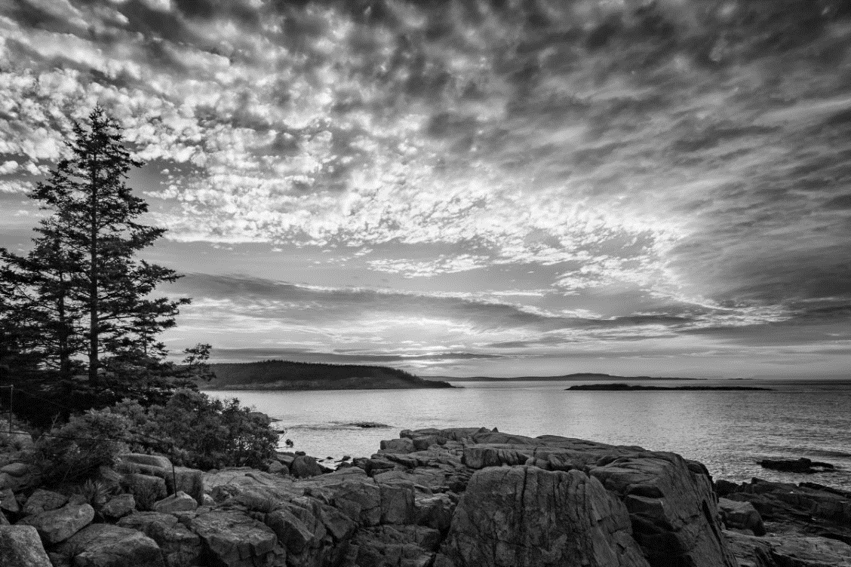

PROBLEM STATEMENT
Given a grayscale photograph as input, find the plausible color version of the image.

Slide 3
APPROACH
We implemented the method for colorization proposed in the paper ‘Colorful Image Colorization’ authored by Richard Zhang, Phillip Isola and Alexei A. Efros.
The method is fully automatic and generates bright and vibrant images unlike the previous approaches.
We made some changes to suit the computational and time constraints we had.

Slide 4
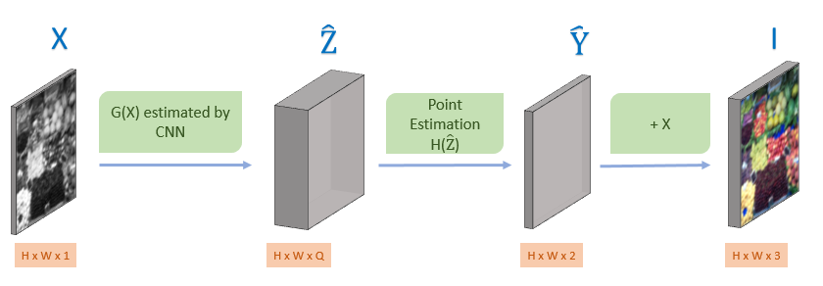


OVERVIEW
X: Grayscale
Image
$\hat{Z}$ : Probability
Distribution
$\hat{Y}$ : Estimated Color Channels
Output Colorized Image

Slide 5

Network Loss
We chose the same Q = 313 colors for the quantized color space.
To compare predicted probability distribution against ground truth, we use the one hot encoding of ground truth color by searching the nearest color in the quantized space.
We use the rebalanced cross entropy loss to train the network.
Class Rebalancing term

Slide 6
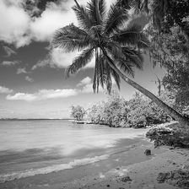
Network Architecture
1
64
128
256
256
313
512
28 x 28
56 x 56
56 x 56
56 x 56
112 x 112
224 x 224
Conv2D + Relu
Max Pool
Conv2D Transpose + Relu
Conv2D

Slide 7


Point Estimation
We used the annealed-mean of the predicted probability distribution to arrive at a point estimate in the ab space.
T was taken as 0.38

Slide 8
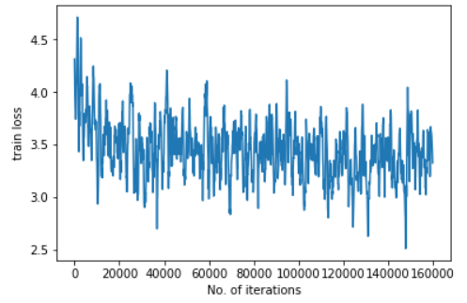
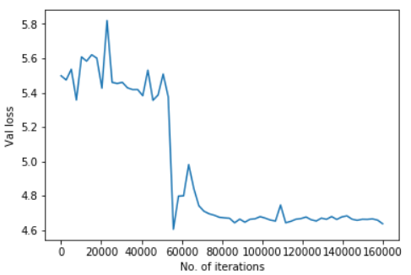
RESULTS: Loss
We used ILSRVC dataset. It has 1.3 million images.
We trained for 160K iterations with a batch size of 32.

Slide 9
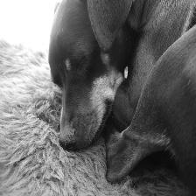
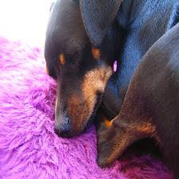
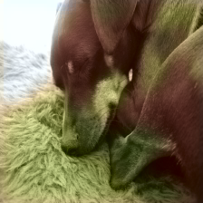
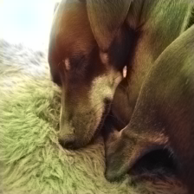
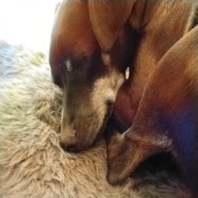
RESULTS: Good Performance
Grayscale
Ground Truth
40k iterations
80k iterations
120k iterations
Notes:
Bright colours not yet learnt.

Slide 10
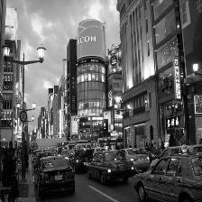
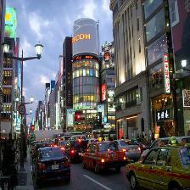
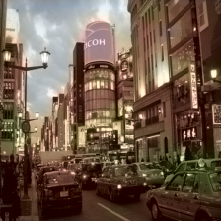
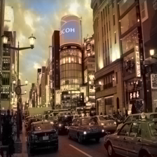
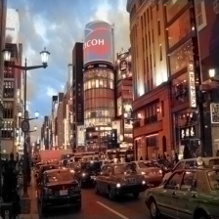
RESULTS: Good Performance
Grayscale
Ground Truth
40k iterations
80k iterations
120k iterations

Slide 11
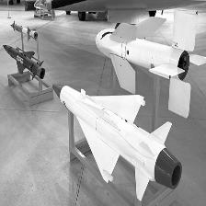
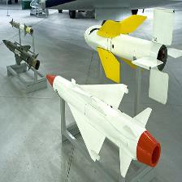
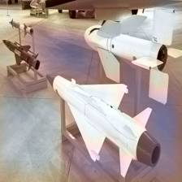
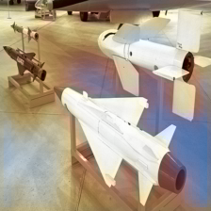
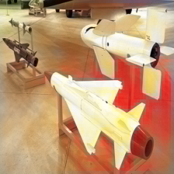
RESULTS: Failed Example
Grayscale
Ground Truth
40k iterations
80k iterations
120k iterations
Notes:
Artifacts, colored blue first assuming sky

Slide 12
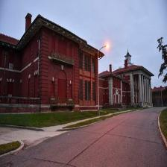
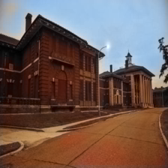
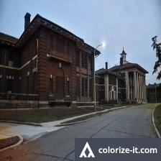
COMPARISON
Original Image
Our Implementation
Referenced Paper

Slide 13
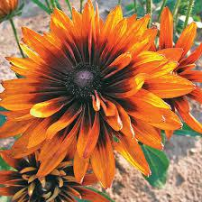
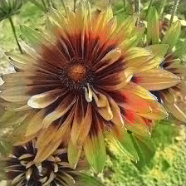
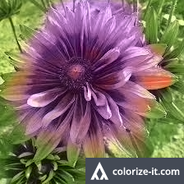
COMPARISON
Original Image
Our Implementation
Referenced Paper

Slide 14
COMPARISON
Network Architecture
Ground truth probability distribution - one-hot encoding vs soft encoding
Training iterations - 500k with batch size 40 vs 160k with batch size 32

Slide 15
THANK YOU
Questions?

