Slide 1
An Efficient Two-Layer Mechanism for Privacy-Preserving Correctness and expansion

Slide 2
GLAD_binary
Original data analysis
 | workers per task | tasks per worker
mean | 7.389937106918239 | 69.11764705882354
variance | 2.854238360824335 | 2180.927335640138

Slide 3
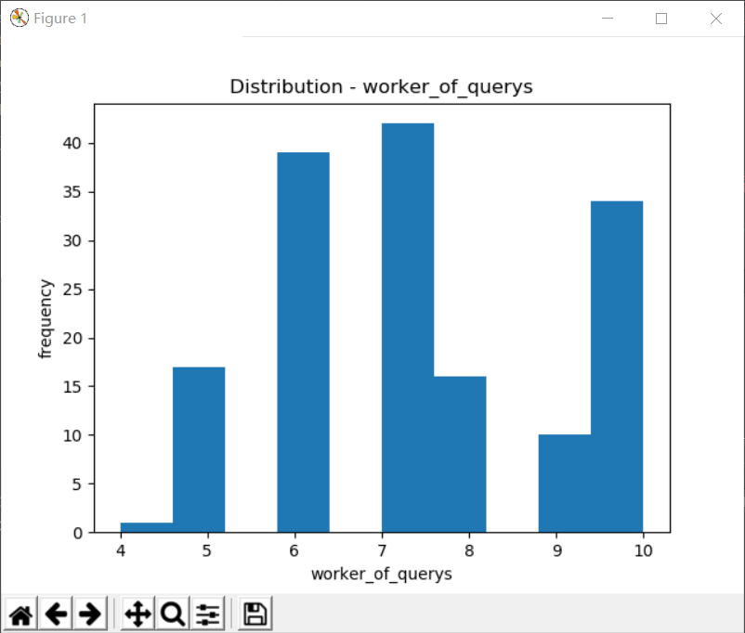
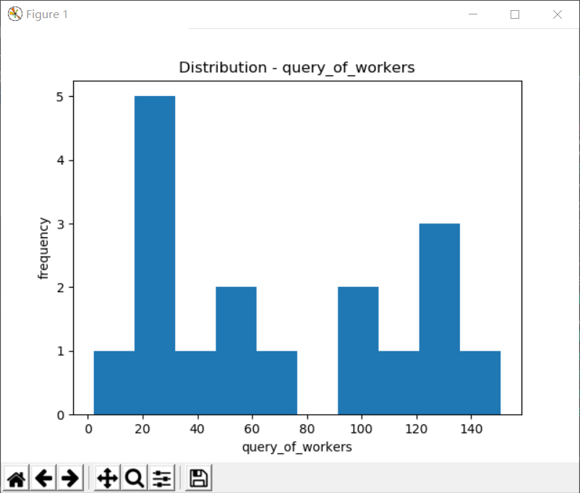
GLAD_binary

Slide 4
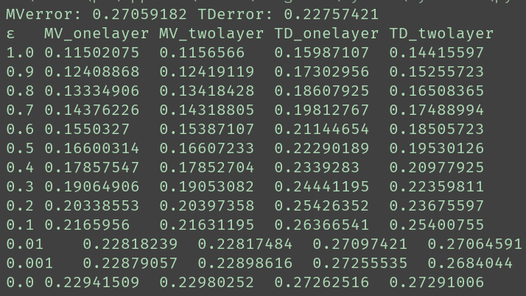
GLAD_binary
Results analysis
with 10000 cycles
w = log(p/(1-p))
Uniform a=0 b=2×pf

Slide 5
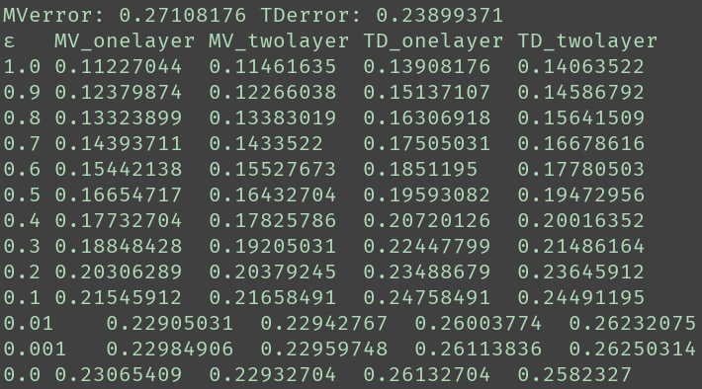
GLAD_binary
Results analysis
with 1000 cycles
w =p
Uniform a=0 b=2×pf

Slide 6
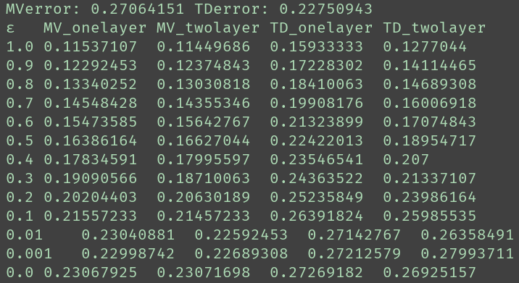
GLAD_binary
Results analysis
with 1000 cycles
w = log(p/(1-p))
Beta α=pf β=1-pf

Slide 7
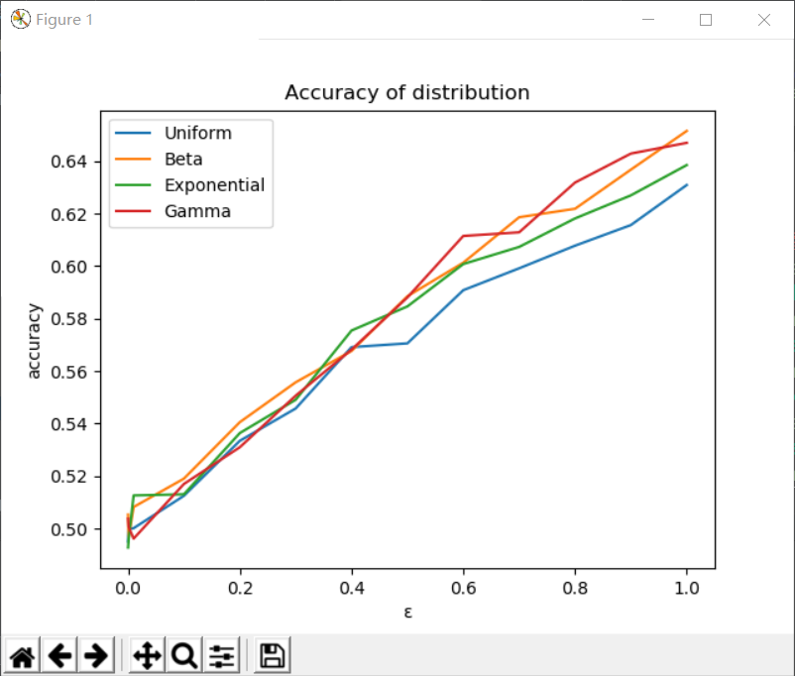
GLAD_binary
Results analysis
with 1000 cycles
w = log(p/(1-p))

Slide 8
barzanMozafari_binary
Original data analysis
 | workers per task | tasks per worker
mean | 5.0 | 60.24096385542169
variance | 0.0 | 16275.966032805925

Slide 9
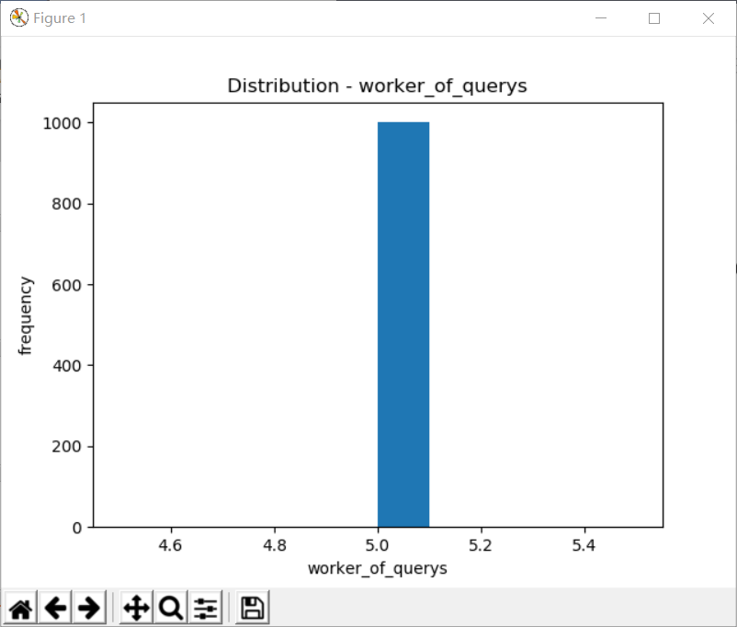
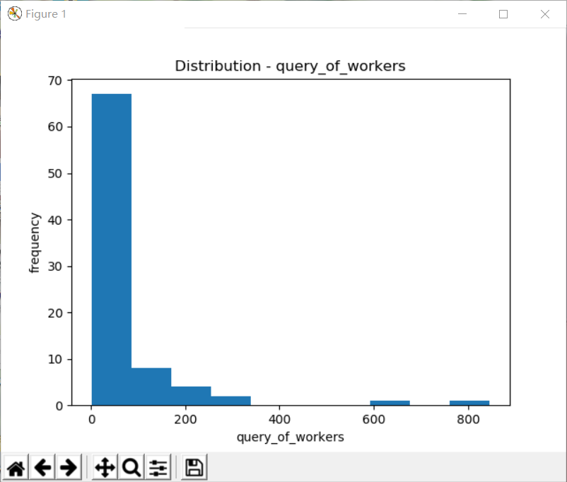
barzanMozafari_binary

Slide 10
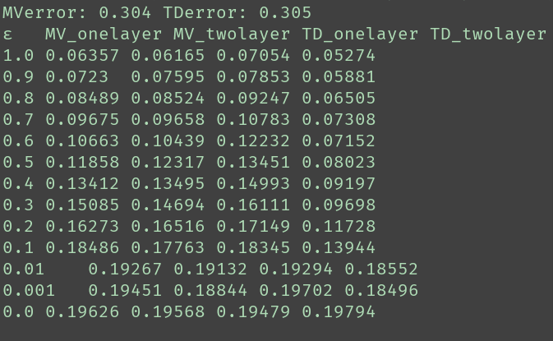
barzanMozafari_binary
Results analysis
with 100 cycles
w = log(p/(1-p))
Uniform a=0 b=2×pf

Slide 11
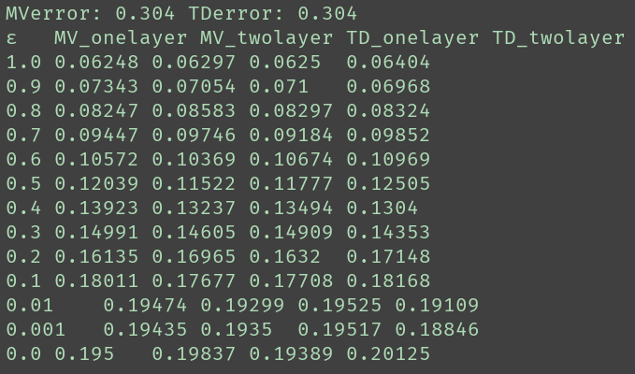
barzanMozafari_binary
Results analysis
with 100 cycles
w = p
Uniform a=0 b=2×pf

Slide 12
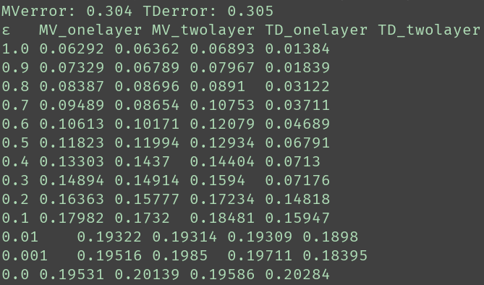
barzanMozafari_binary
Results analysis
with 100 cycles
w = log(p/(1-p))
Beta α=pf β=1-pf

Slide 13
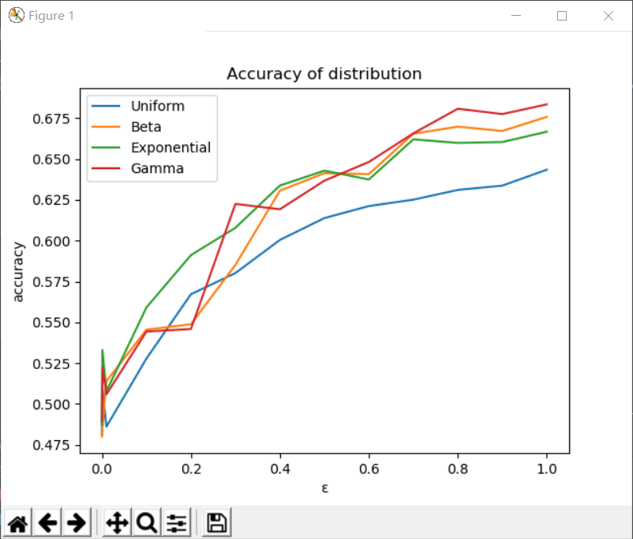
barzanMozafari_binary
Results analysis
with 100 cycles
w = log(p/(1-p))

Slide 14
d_Duck
Original data analysis
 | workers per task | tasks per worker
mean | 39.0 | 108.0
variance | 0.0 | 0.0

Slide 15
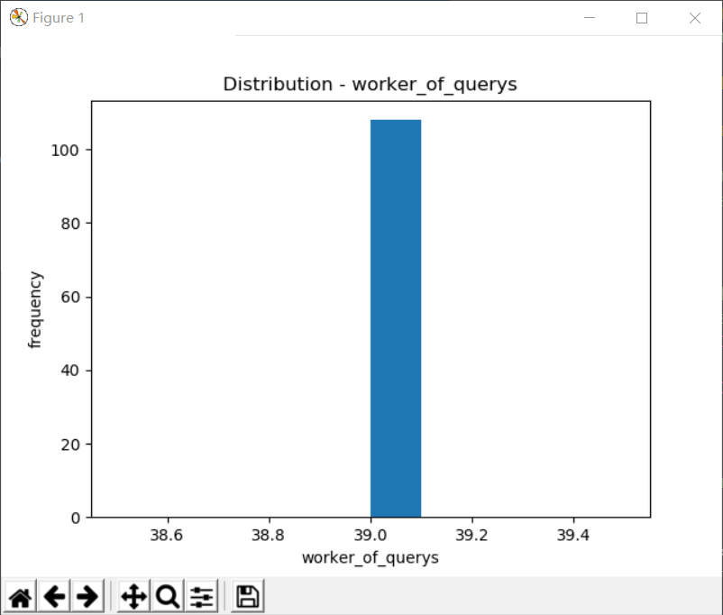
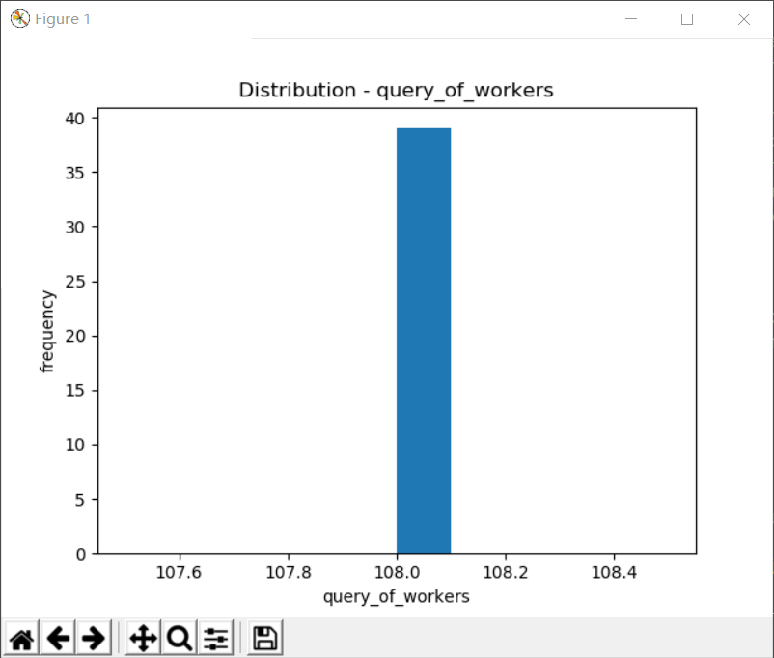
d_Duck

Slide 16
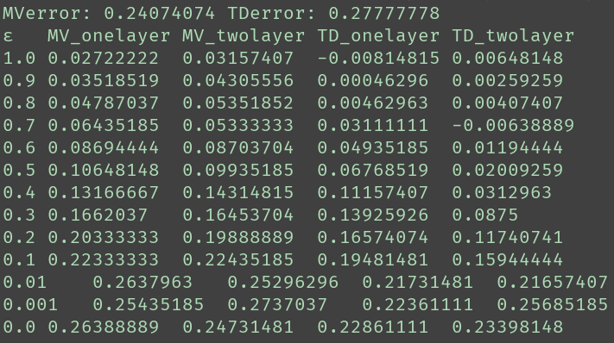
d_Duck
Results analysis
with 100 cycles
w = log(p/(1-p))
Uniform a=0 b=2×pf

Slide 17
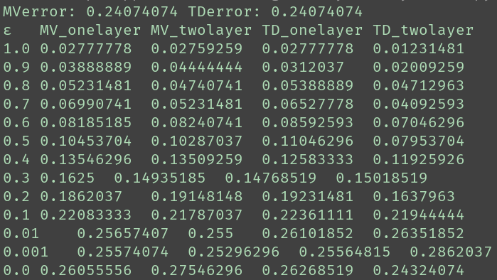
d_Duck
Results analysis
with 100 cycles
w = p
Uniform a=0 b=2×pf

Slide 18
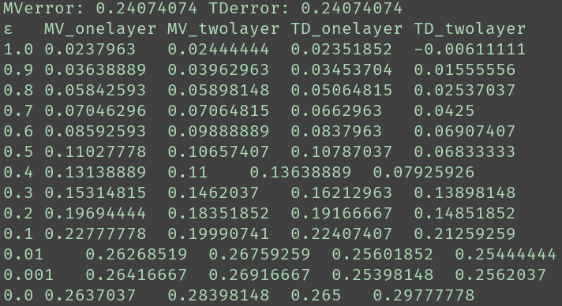
d_Duck
Results analysis
with 100 cycles
w = p
Beta α=pf β=1-pf

Slide 19
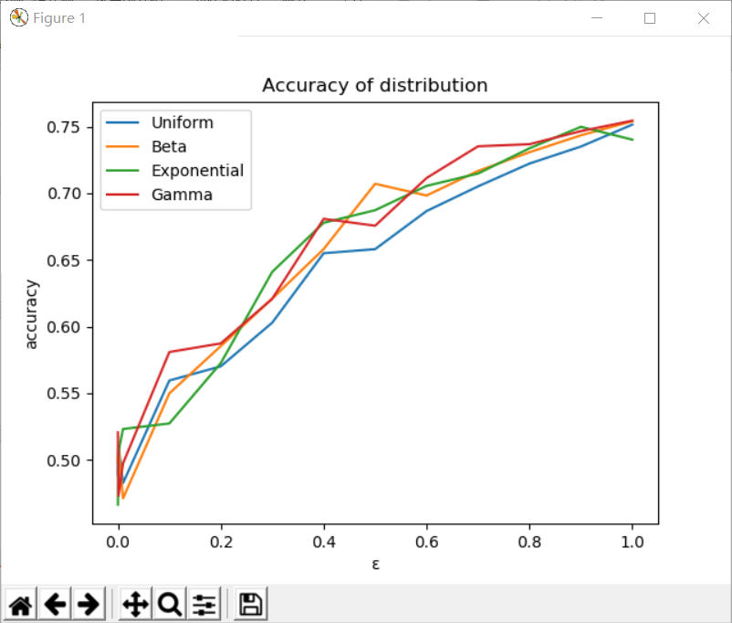
d_Duck
Results analysis
with 100 cycles
w = p

Slide 20
AdultContent2_multi
Original data analysis
 | workers per task | tasks per worker
mean | 9.96096096096096 | 12.33085501858736
variance | 10.950427905382861 | 558.0652561462667

Slide 21
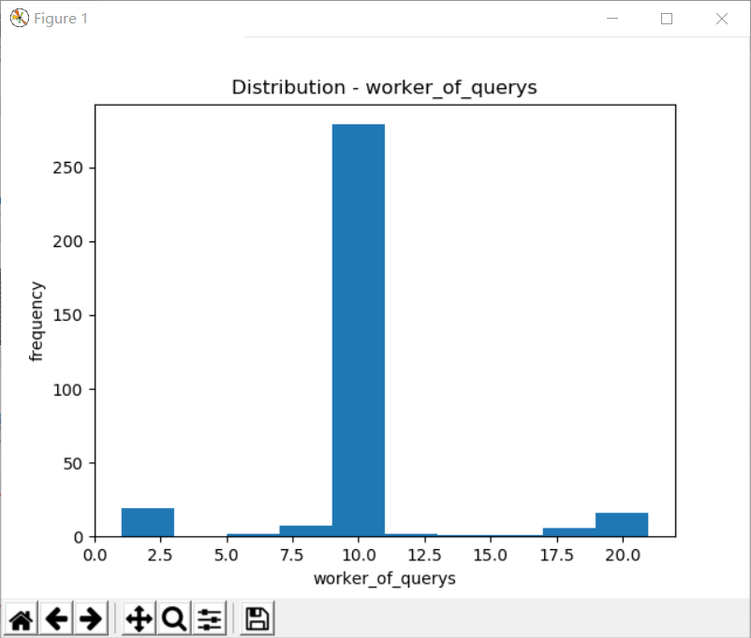
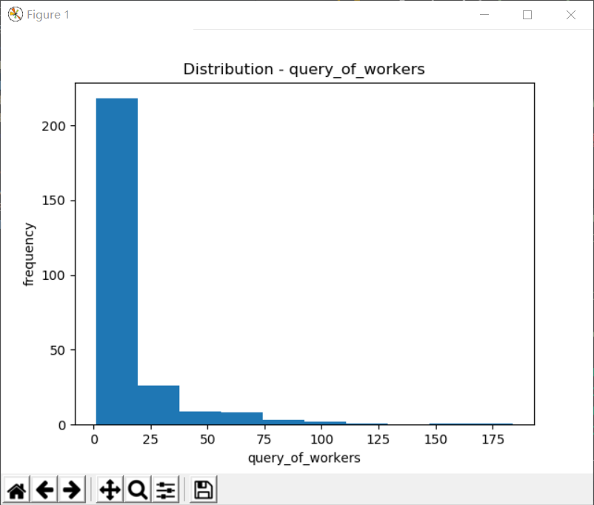
AdultContent2_multi

Slide 22
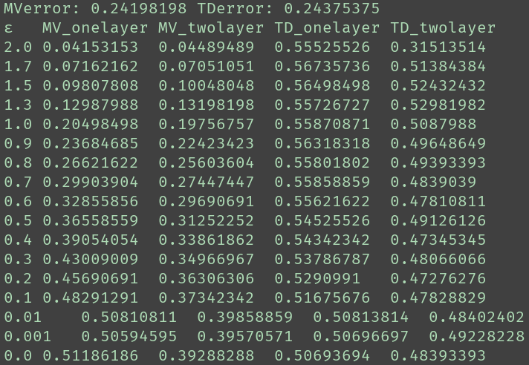
AdultContent2_multi
Results analysis
with 100 cycles
w = log(p/(1-p))
Uniform a=0 b=2×pf

Slide 23
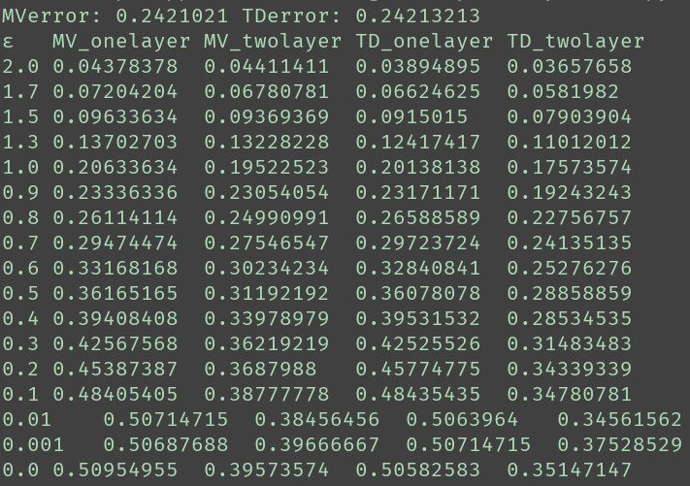
AdultContent2_multi
Results analysis
with 100 cycles
w = log(p/(1-p)) + 10
Uniform a=0 b=2×pf

Slide 24
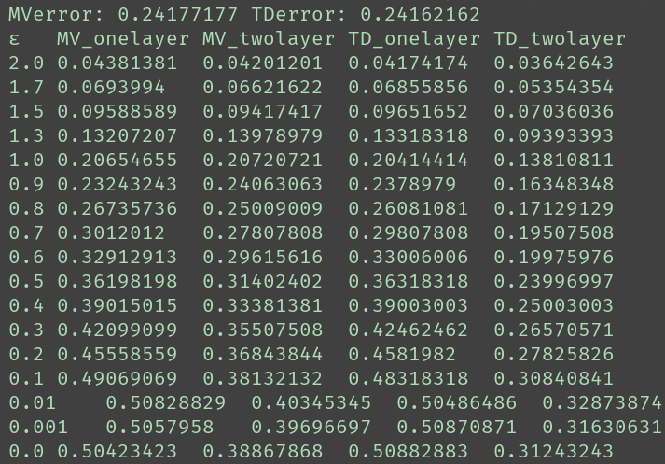
AdultContent2_multi
Results analysis
with 100 cycles
w = p
Uniform a=0 b=2×pf

Slide 25
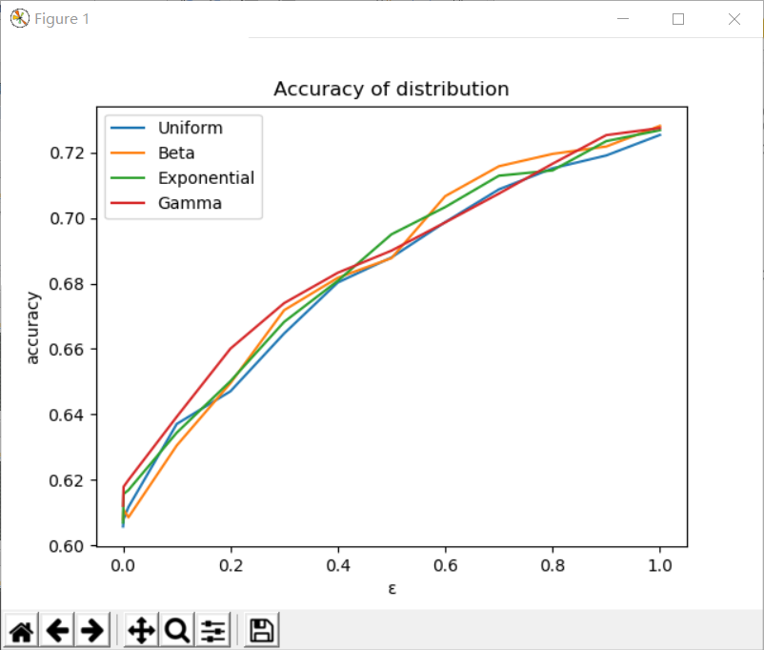
AdultContent2_multi
Results analysis
with 100 cycles
w = w = log(p/(1-p)) + 10

