Slide 1

HEURISTIC BACKPROPAGATION LEARNING TECHNIQUE FOR
FUNCTION APPROXIMATION
Team Members:
S. Allwyn Jones 021203008
P. Sibi 021203097
P. Siddarth 021203098
Guide:
Mr. S. Meganathan, Assistant Professor

Slide 2
ABSTRACT
The Goal of Approximation is to sufficiently yield an accurate solution while reducing the complexity of the problem. A function approximation problem asks us to select a function among a well-defined class that closely matches ("approximates") a target function in a task-specific way. Keeping function approximation as the base, data of any sort can be efficiently predicted.
An artificial neural network is a computational model that is inspired by the structure and functional aspects of biological neural networks. The approach applied here uses feed forward artificial neural networks (ANNs) with Back propagation for supervised learning in order to predict the data as against the expected data using Function Approximation in heuristic means. The main advantage of Back propagation Network(BPN) is that it can fairly approximate a large class of functions by training data over various layers of its network using factors like number of training samples, network size, activation function and learning rate.

Slide 3
EXISTING WORK
Supports individual BPN networks.
Benchmarks has to be written separately for each component according to the problem level.
Absence of simulator for analyzing BPN networks in the market.
Flexibility to adjust each node of the BPN network is limited.
Current system is limited to fixed BPN network.

Slide 4
PROPOSED WORK
Four BPN algorithms will be integrated into the simulator which can be used against various test datasets.
Easy Benchmarking.
Facility for configuring each node in the network according to
our will.
Evolving Network topology will be supported
Ability for the Persistence of previous Network configuration even on fresh startup of the simulator.

Slide 5
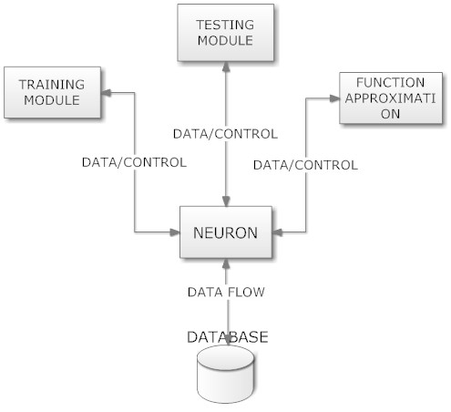
ARCHITECTURE DIAGRAM

Slide 6
MODULES USED
Neuron
Training Module
Testing Module
Function Approximation
Database

Slide 7
EXPLANATION ABOUT MODULES
NEURON
Neuron is the central module which controls all the modules. It provides a gateway to database for the other modules. The other modules access the database for getting the various configuration details related to BPN network. Using these details training, testing and function approximation can be done.

Slide 8
TRAINING MODULE
Accepts an input and accesses the various configuration related to BPN network from the database via the Neuron module and finally trains the BPN network according to the input provided. It also generates a file containing details about trained BPN network.

Slide 9
TESTING MODULE
Accepts the testing data as input. Before beginning testing, the BPN network is trained and then the input is propagated through the network and the output is generated which in turn is compared with the sample output and mean squared error is generated.

Slide 10
FUNCTION APPROXIMATION
Accepts the input for which is output is to be generated using function approximation. Initially the network is trained and then incase the stability of the network is to be known testing is done. Then with the help of the activation functions , the general function is approximated to generate the required output.

Slide 11
DATABASE
Stores various data related to configuration which is of immense importance while doing training, testing and function approximation.

Slide 12
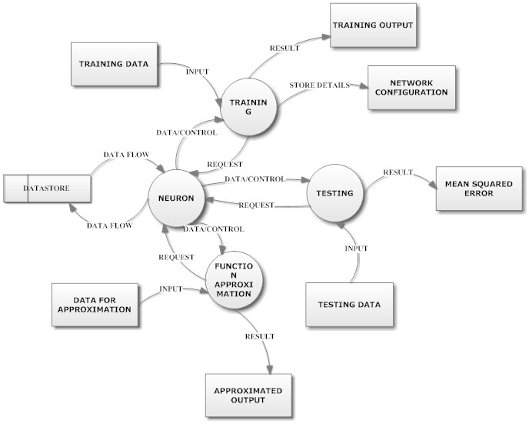
DATA FLOW DIAGRAM

Slide 13
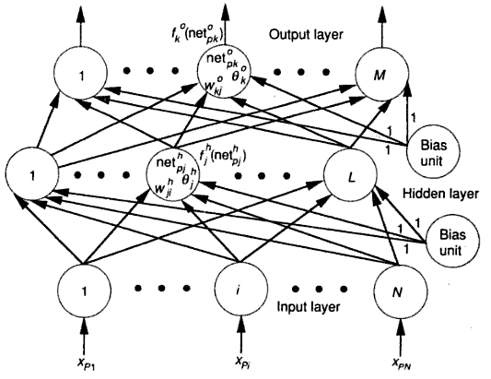
EQUATIONS AND EXPLANATION

Slide 14
Apply the input vector to the input units.
Input vector is
Calculate the net input values to the hidden layer units:
Calculate the outputs from the hidden layer:
Move to the output layer. Calculate the net-input values to each units:
Calculate the outputs:
Calculate the error terms for the output units

Slide 15
Calculate the error terms for hidden units:
Notice that the error terms on the hidden units are calculated before the connection weights to the output-layer units have been updated.
Update weights on the output layer:
Update weights on the hidden layer:
The order of the weight updates on an individual layer is not important. Be sure to calculate the error term
since this quantity is the measure of how well the network is learning. When
the error is acceptably small for each of the training-vector pairs, training can
be discontinued.

Slide 16
SOFTWARE AND HARDWARE REQUIREMENTS
SOFTWARE REQUIREMENTS
  Operating system: Linux
  Languages used: Python, C
  Database used: Berkeley DB
  IDE: Emacs
  GUI Toolkit: GTK+
  Version control system: Git
  Wiring component: SWIG
  API Documentation: Sphinx
HARDWARE REQUIREMENTS
  Configuration: Pentium 4, 40 GB Hard disk, 512 MB Ram

Slide 17
CONCLUSION
To build a high performance simulator which can perform benchmarking of the problem on the fly.
Easily test whether a network will get stabilized for a given problem.
Ability to control and change each node in the BPN network.
Perform function approximation of complex functions.

Slide 18
REFERENCES
Carroll, S.M. and B.W. Dickinson (1989). Construction of Neural Nets Using the Radon Transform. Proceedings of the 1989 International Joint Conference on Neural Networks 1 (June 1989):607-611.
Cybenko, G. (1989). Approximation by Superpositions of a Sigmoidal Function. Mathematics of Control, Signals, and Systems 2 (4):303-314.
Funahashi, K.I. (1989). On the Approximate Realization of Continuous Mappings By Neural Nets. Neural Networks 2 (3):183-192.
Gallant, A.R. and H. White (1988). There Exists a Neural Network That Does Not Make Avoidable Mistakes. Proceedings of the International Conference on Neural Networks 1 (July 1988):657-666.
Hecht-Nielsen, Robert (1989). Theory of the Backpropagation Neural Network. Proceedings of the IEEE INNS International Joint Conference on Neural Networks 1: 593-606.
Hornik, Kurt, Maxwell Stinchcombe, and Halbert White (1989). Multilayer Feedforward Networks are Universal Approximators. Neural Networks 2 (5):359-366.
Irie, B. and S. Miyake (1988). Capabilities of Three-Layer Perceptrons," Proceedings of the ZEEE Second International Conference on Neural Networks 1 (San Diego CA): 641648.

Slide 19
Mosteller, F. and J. Tukey (1977). Data Analysis and Regression. Addison- Wesley Publishing.
Specht, Donald (1991). A General Regression Neural Network. IEEE Transactions on Neural Networks 2 (6):568-576.
Weigend, A., Huberman, B. and D. Rumelhart (1990). Predicting the Future: A Connectionist Approach. International Journal of Neural System 1 (3):193-209.

