Slide 1
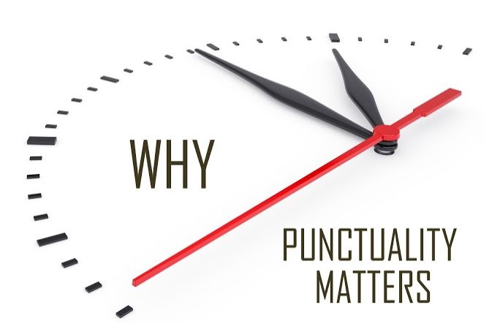
Airlines and Airports Punctuality Performance Analysis
By
Parag Siddamsettiwar
Abhishek Upadhayay

Slide 2
Why is this important?
In today’s busy world, time is a very precious commodity.
Flights are the most convenient and fastest way to travel.
More and more people are taking flights and according to IATA around 8.2 billion people will be travelling by flights in 2037. [1]
Flight delays and cancellations are a major cost escalator for passengers and Airlines.

Slide 3
Why is this important?
In today’s busy world, time is a very precious commodity.
Flights are the most convenient and fastest way to travel.
More and more people are taking flights and according to IATA around 8.2 billion people will be travelling by flights in 2037. [1]
Flight delays and cancellations are a major cost escalator for passengers and Airlines.

Slide 4

In 2010, passengers lost as much as $16.7 billion due to schedule buffer, delayed flights, flight cancellations and missed connections. [2]
According to a research an average Briton wastes 16 days of their holiday time waiting for their flight to take off. [3]

Slide 5
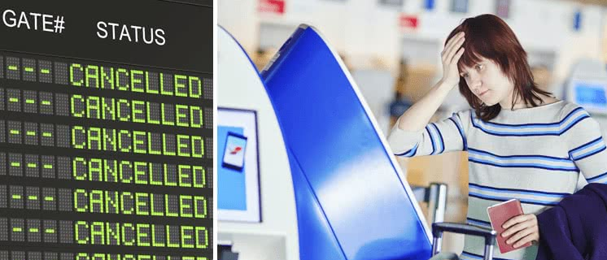

Remember the time when your flight was delayed or cancelled?
It will really help if we can visualize past flight data to get a better understanding of airlines and airports performance to make an informed choice before finalizing our travel plans.

Slide 6
Remember the time when your flight was delayed or cancelled?
It will really help if we can visualize past flight data to get a better understanding of airlines and airports performance to make an informed choice before finalizing our travel plans.

Slide 7






Existing analysis and visualizations
Most of the websites related to airlines and airports are travel booking websites, which only focus on seat availability and ticket prices.
There are handful of websites that provide an analysis on punctuality of airlines and airports.
Even the ones that are available are either on current data (real time or past few hours) and not an analysis on historical data for a proper analysis of trends or behavior.

Slide 8
Existing analysis and visualizations
Most of the websites related to airlines and airports are travel booking websites, which only focus on seat availability and ticket prices.
There are handful of websites that provide an analysis on punctuality of airlines and airports.
Even the ones that are available are either on current data (real time or past few hours) and not an analysis on historical data for a proper analysis of trends or behavior.

Slide 9
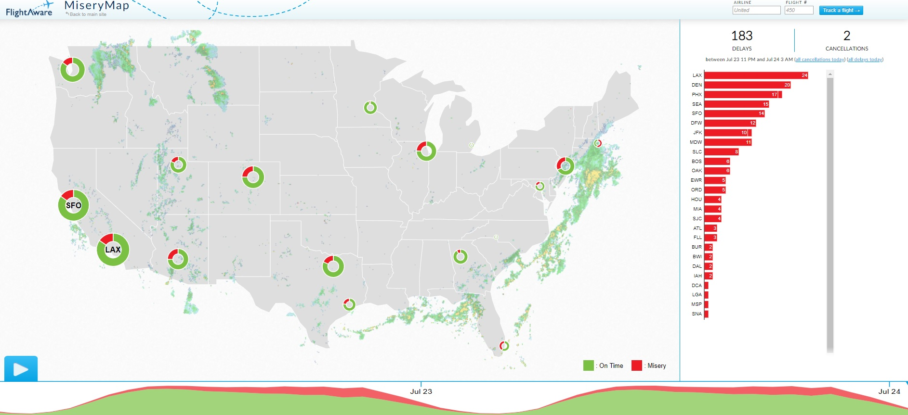
Flight aware flight delay visualization, MiseryMap 2019. [4] This visualization shows some big Airports only, no data available for Airlines and no option to choose other airports e.g. Indianapolis , Cincinnati etc. More importantly , this is based on current data (last few hours) and not an analysis on a historical dataset.

Slide 10
Flight aware flight delay visualization, MiseryMap 2019. [4] This visualization shows some big Airports only, no data available for Airlines and no option to choose other airports e.g. Indianapolis , Cincinnati etc. More importantly , this is based on current data (last few hours) and not an analysis on a historical dataset.

Slide 11
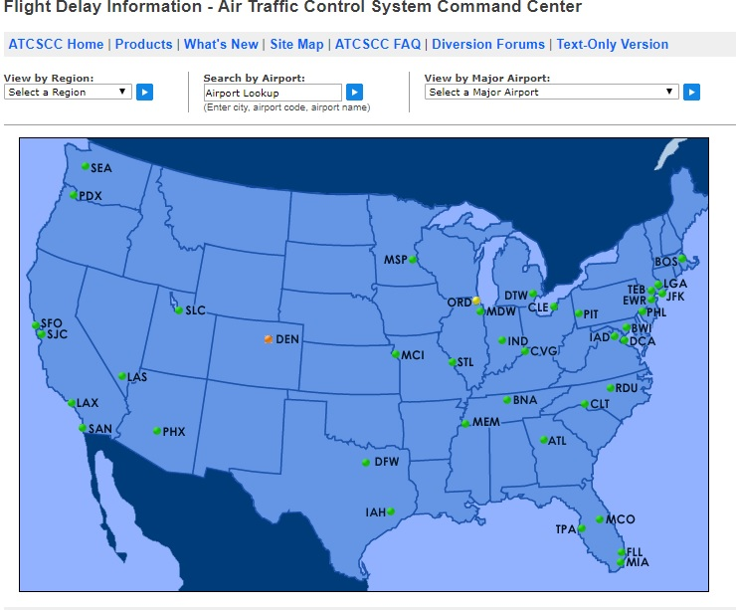
Flight Delay Information - Air Traffic Control System Command Center, 2019. [5] This visualization also shows airports and its also based on current data (last few hours) and not an analysis on a historical dataset. Its interactive and lets user select airport or flights and provides current situation for that.

Slide 12
Flight Delay Information - Air Traffic Control System Command Center, 2019. [5] This visualization also shows airports and its also based on current data (last few hours) and not an analysis on a historical dataset. Its interactive and lets user select airport or flights and provides current situation for that.

Slide 13
Are these visualizations enough?
There is not enough detail available that can help us in planning future travels from airports and airlines based on past trends and airlines behavior.
Even though a flight may show on time on these “current data” visualizations, its possible some of the airlines are regularly late when we analyze complete data.

Slide 14
Objectives
Analyze past years data to compare various airlines and airports based on punctuality.
Create a series of visualizations in order to help a traveler find best choices of carrier and airports in terms of punctuality and certainty.
Visualizations should be easy to understand and pleasing to eyes.

Slide 15
Objectives
Analyze past years data to compare various airlines and airports based on punctuality.
Create a series of visualizations in order to help a traveler find best choices of carrier and airports in terms of punctuality and certainty.
Visualizations should be easy to understand and pleasing to eyes.

Slide 16
Results

Slide 17
Insight
The visualizations presented clearly shows the airports that need to be avoided for travel during that time period. E.g. Chicago in January
These clearly shows the airlines that are lagging in terms of punctuality and their respective reasons for delays. E.g. American airlines in January.
These visualizations were a deep dive on a limited data to prove our concept, we can change the time period for any period analysis in a future work.

Slide 18
Insight
The visualizations presented clearly shows the airports that need to be avoided for travel during that time period. E.g. Chicago in January
These clearly shows the airlines that are lagging in terms of punctuality and their respective reasons for delays. E.g. American airlines in January.
These visualizations were a deep dive on a limited data to prove our concept, we can change the time period for any period analysis in a future work.

Slide 19
Future work
We want to make our visualizations more interactive, that will allow users to select airports or airlines and time periods to analyze.
A visualization where if you enter boarding and destination airports, it will provide best airlines based on punctuality analysis. (requires algorithms)

Slide 20
Future work
We want to make our visualizations more interactive, that will allow users to select airports or airlines and time periods to analyze.
A visualization where if you enter boarding and destination airports, it will provide best airlines based on punctuality analysis. (requires algorithms)

Slide 21
References
IATA Forecast Predicts 8.2 billion Air Travelers in 2037 https://www.iata.org/pressroom/pr/Pages/2018-10-24-02.aspx [1]
Annual U.S. Impact of Flight Delays (NEXTOR report) http://airlines.org/data/annual-u-s-impact-of-flight-delays-nextor-report/ [2]
Holidaymakers 'waste 16 days waiting in airports over lifetime https://www.telegraph.co.uk/travel/travelnews/7546209/Holidaymakers-waste-16-days-waiting-in-airports-over-lifetime.html [3]
FlightAware MiseryMap https://flightaware.com/miserymap/ [4]
Flight Delay Information - Air Traffic Control System Command Center https://www.fly.faa.gov/flyfaa/usmap.jsp [5]

