Slide 1
Airlines and Airports Punctuality Performance Analysis
By
Parag Siddamsettiwar
Abhishek Upadhayay

Slide 2
Why is this important?
In today’s busy world, time is a very precious commodity.
Flights are the most convenient and fastest way to travel.
More and more people are taking flights and according to IATA around 8.2 billion people will be travelling by flights in 2037. [1]
Flight delays and cancellations are a major cost escalator for passengers and Airlines.
In 2010, passengers lost as much as $16.7 billion due to schedule buffer, delayed flights, flight cancellations and missed connections. [2]
According to a research an average Briton wastes 16 days of their holiday time waiting for their flight to take off. [3]
Remember the time when your flight was delayed or cancelled?
It would have really helped if we can analyze and visualize the flight data to get a better understanding of Airlines and Airports to make an informed choice before finalizing our travel plans!

Slide 3
Existing analysis and visualizations
There are a handful websites that provide an analysis of punctuality of airlines and airports.
Even the ones that are available are either on current data (real time or past few hours) and not an analysis on historical data for a proper analysis of trends or behavior.
There is not enough detail available that can help us in making decision for future travels from airports and airlines based on past trends and airlines behavior.
Even though a flight may show on time on these current data visualizations, there is a possibility that the flights of an airline are regularly late due to unavailability of aircrafts or pilots. We may want to avoid taking that Airline

Slide 4
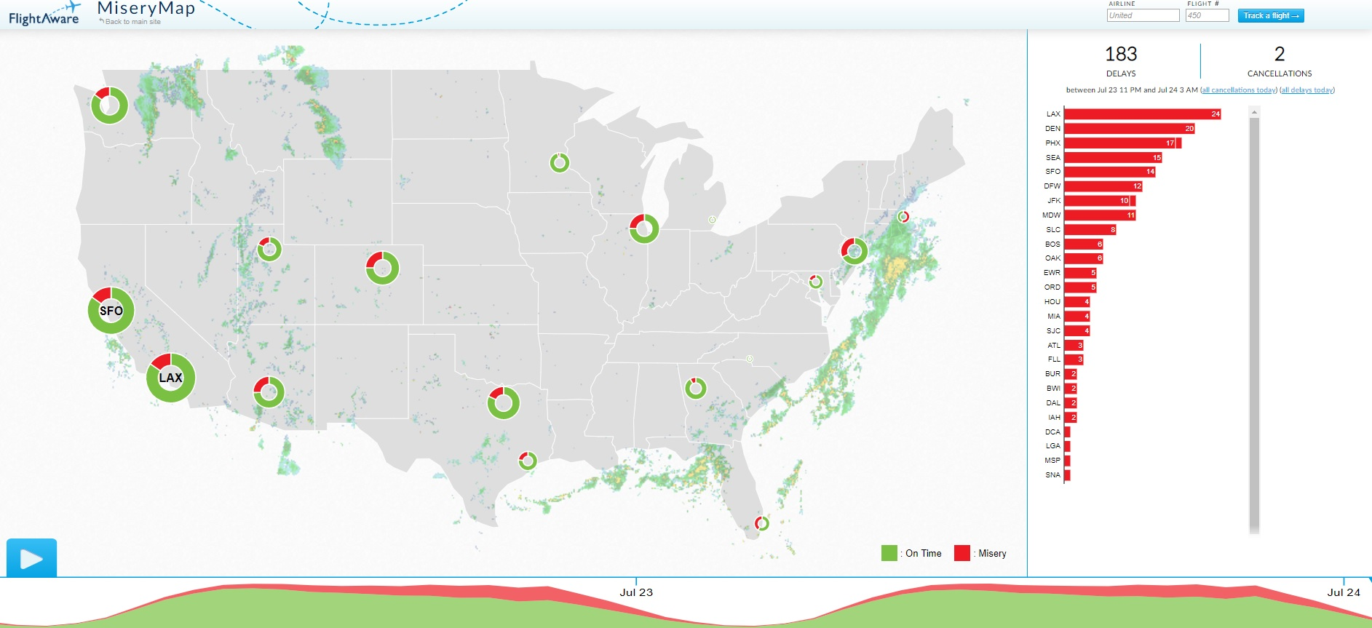
Flight aware flight delay visualization, MiseryMap 2019. [4] This visualization shows some big Airports only, no data available for Airlines and no option to choose other airports e.g. Indianapolis , Cincinnati etc. More importantly , this is based on current data (last few hours) and not an analysis on a historical dataset.

Slide 5
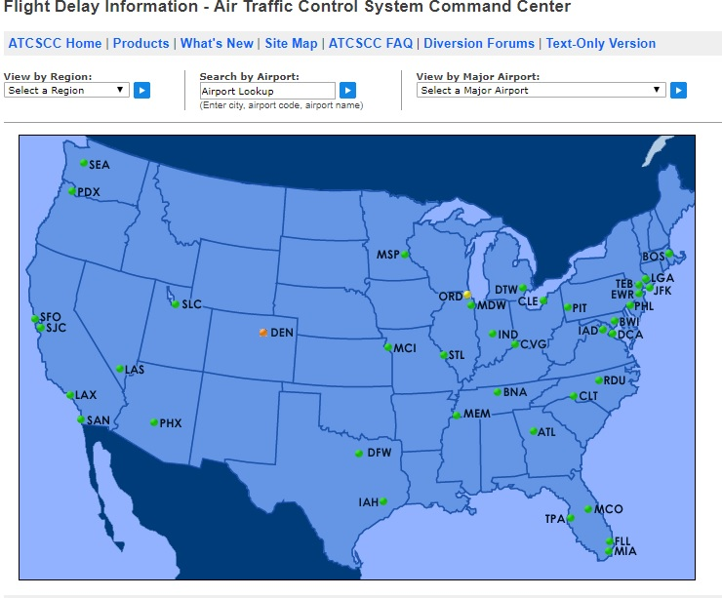
Flight Delay Information - Air Traffic Control System Command Center, 2019. [5] This visualization also shows airports and its also based on current data (last few hours) and not an analysis on a historical dataset. Its interactive and lets user select airport or flights and provides current situation for that.

Slide 6
Objective

Slide 7
Results

Slide 8
Insight

Slide 9
Future work
We want to add more interactive visualizations to allow users to select airports and airlines.

Slide 10
References
IATA Forecast Predicts 8.2 billion Air Travelers in 2037 https://www.iata.org/pressroom/pr/Pages/2018-10-24-02.aspx [1]
Annual U.S. Impact of Flight Delays (NEXTOR report) http://airlines.org/data/annual-u-s-impact-of-flight-delays-nextor-report/ [2]
Holidaymakers 'waste 16 days waiting in airports over lifetime https://www.telegraph.co.uk/travel/travelnews/7546209/Holidaymakers-waste-16-days-waiting-in-airports-over-lifetime.html [3]
Flightaware MiseryMap https://flightaware.com/miserymap/ [4]
Flight Delay Information - Air Traffic Control System Command Center https://www.fly.faa.gov/flyfaa/usmap.jsp [5]

