Slide 1
NASA Exoplanets
Zana Brown, Kris Mbah, Pritpal Sidhu, Jake Silvester

Slide 2
Overview and Purpose
Determine if a candidate planet is indeed an exoplanet or a false positive via machine learning.
Utilizing machine learning to analyze NASA Exoplanets dataset to determine which model and algorithm is the best.
Topic was chosen based on accessibility and vast amount of data organized within the file.
Data is also legitimately recognized within many scientific communities internationally.

Slide 3

What is an Exoplanet?
An exoplanet is any planet beyond our solar system. Most orbit other stars, but free-floating exoplanets, called rogue planets, orbit the galactic center and are untethered to any star.
Exoplanets come in a wide variety of sizes, from gas giants larger than Jupiter to small, rocky planets about as big around as Earth or Mars.
Notes:
Image Credit: https://exoplanets.nasa.gov/

Slide 4
Kepler
Spacecraft designed and launched in March 2009, designed to discover Earth-like planets orbiting other stars in the Milky Way.
Named after German astronomer Johannes Kepler (1571- 1630), that discovered three laws of planetary motion.
Intent was for the spacecraft to function for three years, but successfully completed a nine year mission discovering over 2,600 planets including those that could possibly sustain life forms.

Slide 5
Data
- Sourced from NASA Exoplanet Archive: Planetary Systems Composite Data
- Raw data extracted from “Planetary Systems Composite Data”. Then converted to a csv file with about 33,000 rows and 300 columns that was cleaned and converted (Mockup Model).
- “KOI Table (Cumulative list) was used as the raw data as “KEPLER_DATA.csv”. File contained about 9,600 rows and 150 columns. Cleaned data was then convert to “CLEAN_KEPLER_DATA.csv
- Kepler data chosen based on the confirmed, false negative, and candidate planets to assist in our training and testing.

Slide 6
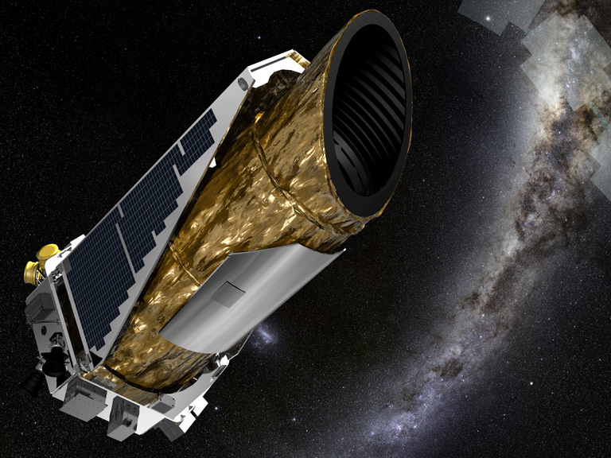
Question
- How can we use machine learning to automate the process of confirming a candidate planet as a real exoplanet or false positive?
- How accurate can we make the algorithm above?
Notes:
Image Credit: NASA/Ames/JPL-Caltech/T Pyle

Slide 7
Statistical Tools and Analysis
- Utilized supervised logistic regression which entails (binomial logistic regression), which which was concluded to be the best method of analysis due to data type. (ie conversion of booleens)
- The provided Kepler data was separated into two groups or tables, one with the “Confirmed” or “False Positive” planets (verified_df) and a another table for all the “Candidate” planets (unverified_df).
- The model was trained and tested using the “verified_df” to better predict potential candidate possibilities, with a test size of 33% providing the highest accuracy.

Slide 8
Technologies
- The Dashboard was created in Tableau to add interactivity that may not have been otherwise found in powerpoint or Google Slides based on the subject of our dataset.
- The Database was created utilizing Jupyter Notebook and Python to generate csv files of verified and unverified planets.
The schema for both csv files were scripted to PGAdmin through PostGreSQL. Thus creating the two localized tables.
The csv files were then added to the Amazon Web Services server and scripted into PGAdmin through PySpark adding both unverified and verified datasets into the localized tables.
Both tables were joined through a PostgreSQL script.
Resulting joined tables were connected to the model through Python in the Jupyter Notebook.
Notes:
Utilized Python, PostgreSQL, Tableau, Scikit, PySpark, AWS, Jupyter Notebook, and PGAdmin:

Slide 9
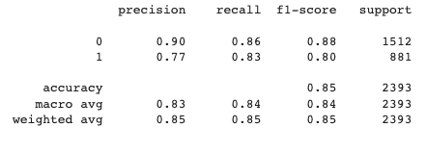
Analysis
- A Logistic Regression model was used due to the focus on predicting a binary outcome. Our model accuracy score was 84.3 percent
- Model prediction was based on nine key metrics: Number of planets in a system, planet’s radius, equilibrium temperature and orbit time, star’s radius, temperature, surface mass, gravity, and the ratio in size between the star and planet.
- Created two dataframes:
-Verified: False Positive (0) and True Positive(1)
-Unverified: Candidate (2).
- Advantages to logistic regression: Easy to interpret and higher training efficiency.
- Disadvantage to logistic regression: Assumption of linearity between independent and dependent variables. May lead to overfitting.

Slide 10
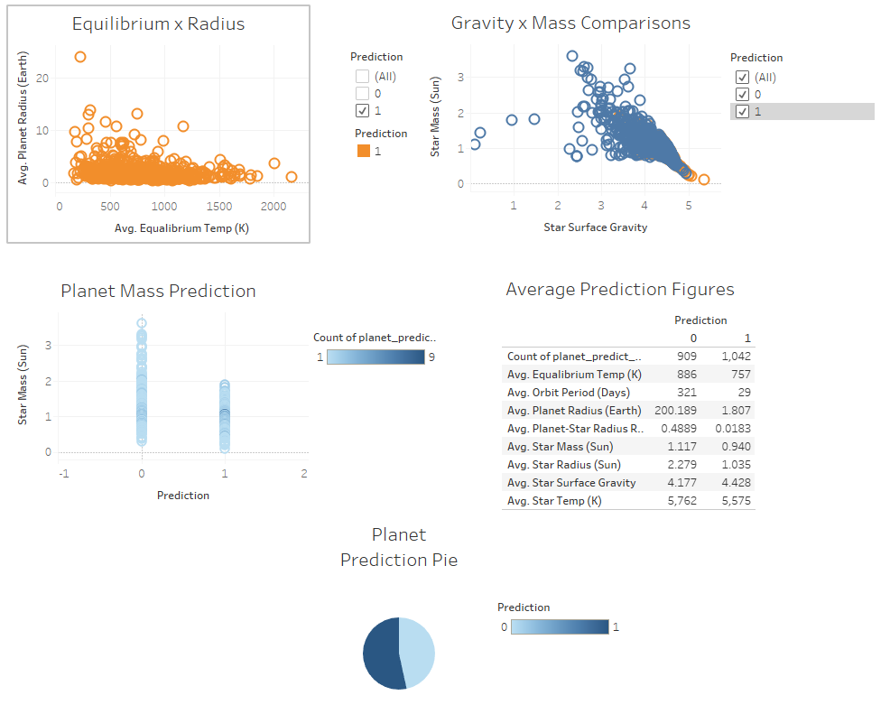

Slide 11
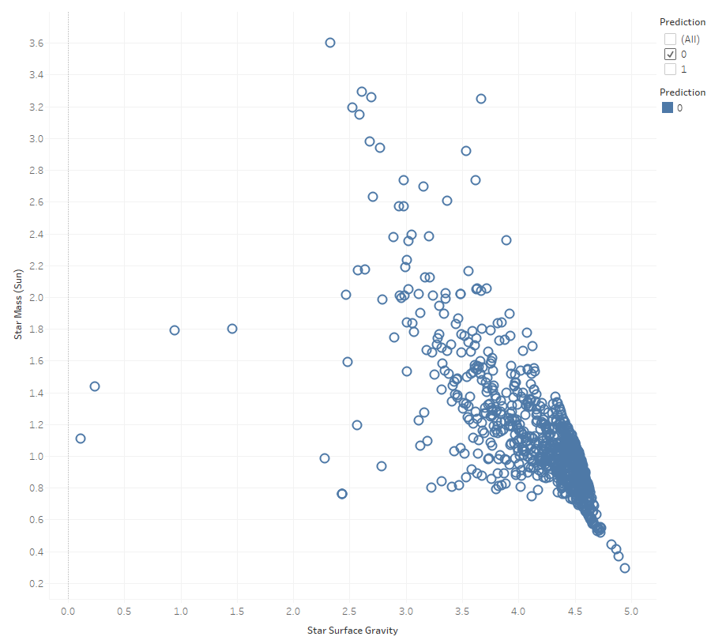
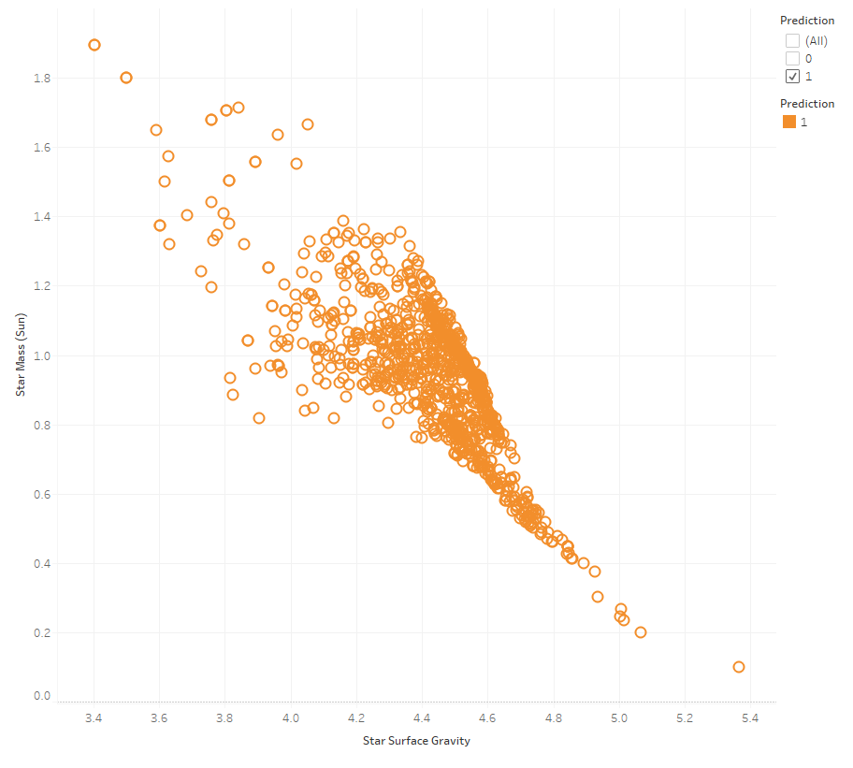
Predicted as Not a Planet
Predicted as Planet

Slide 12
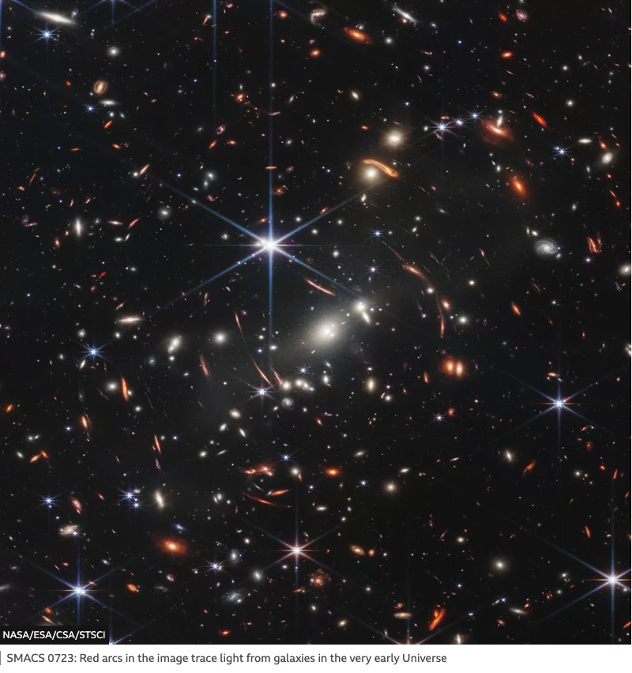
Future Analysis
- Where do we go from here?
- Future Technologies at NASA
- Further Candidates/Confirmed/False Negatives Observed
- Compare Future Datasets Against Our Model
- Improving Accuracy
- Advancements in Academia

Slide 13
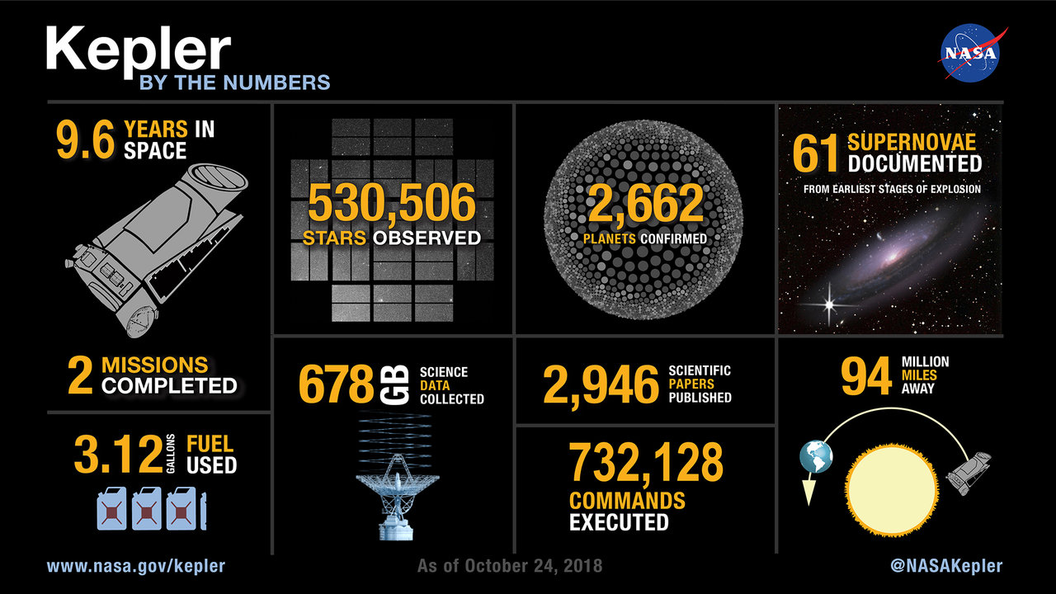
Questions?
Notes:
Image Credit: https://exoplanets.nasa.gov/keplerscience/

