Slide 1






Kryptonics

Slide 2

Hello!
This is team Pandas
We are here to showcase our project - “Kryptonics” is a ML based assist app which helps you to get the best crypto’s to invest.
Theme: Blockchain + ML

Slide 3



1.
Problem Statement
Why did we choose this project?

Slide 4
There are numerous ways to invest in a stock market... But! Don't you think it's differs from region to region and the market is quite saturated and common?
So we came up with Kryptonic a unique WebApp that lets you compare different cryptocurrencies and suggests a personalised cryptocurrency for a given amount of time, based upon a Machine learning model... and all of it happens real-time!

Slide 5
1,200,000,000$
42,290,501 users
328,300 transaction
That’s a lot of money invested in cryptos - 1.2bn $
And a lot of users
Daily (of bitcoin alone)

Slide 6








Then
Why?
Why is not everyone investing and buying cryptocurrency?

Slide 7
Because most of the people think its too complicated to understand & much more unpredictable in accordance with stock market !
Reference : https://www.finder.com/uk/why-people-arent-buying-cryptocurrency

Slide 8

Which brings us to
Kryptonics : A simple web app which will assist you in deciding in which cryptocurrency to invest by making future predictions !

Slide 9
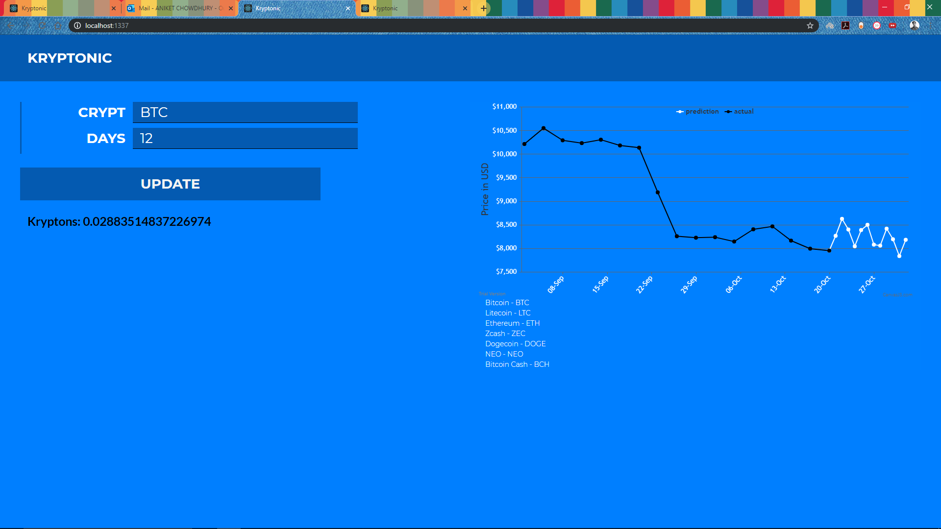
Kryptonic
WebApp hosted on azure developed NodeJS and React
Place your screenshot here

Slide 10

Features
Fully Developed and Hosted on Microsoft Azure.
Using Web App module to host our app, machine learning model is deployed on a virtual machine and code was created on the notebook.

Slide 11

Features
The app works on live data and generates a personalized ML model for each coin based on its history, the live api we are using “CryptoCompare” has a 98% Up rate.

Slide 12


Novelty
We used Facebook’s prophet algorithm for time series data as it takes in account for season, weekday, holidays which are variables in predicting in such a problem.

Slide 13
Team
Swapnil Panwala
Sachin Khandelwal
Naman Bansal
Aniket Chowdhury

Slide 14
Extra resources
Repo: github.com/psifrous/Kryptonic
Website: mlh-jaipur.azurewebsites.net

Slide 15

Thanks!
Any questions?

