Slide 1

Storytelling with Data
The crash course you were looking for
Ashwin Malshe

Slide 2
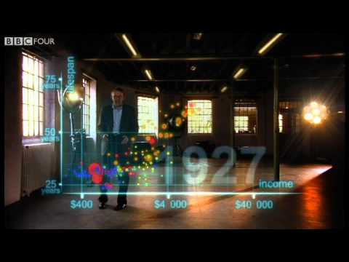

Slide 3
Data Storytelling
Data
Narrative
Visualizations
The three key components of data storytelling:

Slide 4
Storytelling
Paul Smith in “Lead with a Story” explains why stories are so powerful.
Stories are simple
Stories are timeless
Stories are contagious
Stories are easy to remember
Stories inspire
Stories are demographics-proof
Stories put the listener in a mental learning mode
Stories fit better where most of the learning happens in the workplace

Slide 5
Key Components
Characters
This doesn’t need to be part of your presentation, but you should define the key players for yourself beforehand.
Setting
Conflict
Resolution

Slide 6
