Slide 1
Segmentation/Clustering
Marketing Analytics

Slide 2
Topics
Overview of segmentation
Choice-based segmentation
Application: Titanic Survival.
Application: Route Choice
Targeting
Case-study for you: Bank Marketing
Need-based segmentation
Clustering

Slide 3
Managerial Decision-Making
Segmenting Customers:
How to understand the diversity of your customer’s needs and customer’s characteristics?
How to identify and divider various markets?
Targeting Customers:
How to identify and target
best customers?
most pertinent markets/segments/niches

Slide 4
Why segmentation?
A company deals with hundreds, thousands, and at times, millions of current and prospective customers every day.
Cannot be treated uniformly!
No more “one size fits all” marketing.
Customers have different needs, wants, profiles, profit potential.
Customization in marketing.

Slide 5
Segmentation
Segmentation is the process of categorizing customers into groups (i.e. classifying).
…so that customers within a segment/cluster are similar enough to be treated similarly (economies of scale, coherence), yet different enough from customers in other segments (worth the effort to differentiate).

Slide 6
A good segment is…
Distinct
If two segments have similar customers, why treat them separately?
Homogenous
Otherwise, customers within that segment cannot be treated the same way, which defeats the purpose of segmentation.
Identifiable
A segment is not conceptual only, it is also operational.
If you cannot identify/target members of a segment, its value is low.
Substantial
Not necessarily in terms of number of customers, but in terms of objective value (e.g. profit).
Worth being treated as a separate segment.
Useful/operational
Too many segments are impractical (costly).
What’s in it? What can I learn from it? How can it help my marketing strategy?

Slide 7

How could you group these cards?

Slide 8
How should you optimally group these cards?
No optimal segmentation without considering the specific purpose (objective).

Slide 9
Uses of segmentation (short term)
Salesforce allocation, call planning, and direct marketing campaigns
Channel assignment
Communication program
Pricing
Identify a firm’s competitors and its current relative advantage to the customer
Others?
Employees?

Slide 10
Uses of segmentation (long term)
Firm’s strategy & positioning
Product development
Identify new markets/niches
How to satisfy customer needs in different ways
Emerging needs
Identify a small group of today’s customers who might be representative of future broad-base needs/future potential.
Others?

Slide 11
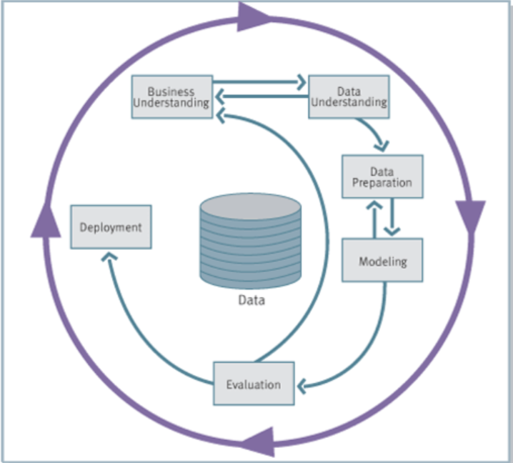
Managing segmentation
Define segmentation problem
Identify data needs
Conduct market research
Build segmentation database
Define market segments
Describe market segments
Implement results

Slide 12
Define segmentation problem
Internal assessment and planning
Objective(s) of segmentation!
Resources?
Constraints?
...
Database review
Primary data availability
Secondary data availability
…

Slide 13
Identify data needs
What kind of data is most suited to answer your business problem?
Sociodemographic? Firmographic? Psychographic?
Past behavior? Purchase data? Scanner data?
Deep needs? Benefits sought? Perceptions?

Slide 14
Readily available data?
No – Do market research!
Collect data, do segmentation analysis on a small (random) sample of customers, but leverage the insights across the entire market/customer base.
Understand how my brand is perceived by different segments in the market.
Yes – Database marketing.
Use the available data, typically behavioral.
Identify shopping habits among my existing customers (e.g. big spenders, promotion-driven customers, etc.)

Slide 15
For market research (if needed)
Qualitative study
Interviews, sources, materials
“Deep needs” identification
Decision-making process assessment
Which criteria to use, what questions to include?
Quantitative study
Sample design
Questionnaire development
Data collection

Slide 16
Build segmentation database
Assemble different data sources, with two types of variables:
Segmentation variables (bases)
Attributes that tell us why segments differ
(e.g. needs, wants, benefits, solutions to problems, usage situation, usage rate, decision processes, past behavior, etc.)
Discriminant variables (descriptors)
Attributes that tell us how to find, reach, identify segments
(e.g. age, income, education, profession, lifestyles, media habits, industry, size, location, organizational structure, etc.)

Slide 17
Define/describe market segments
Two core approaches to segmentation
Choice-based segmentation
Need-based segmentation (next)
How many segments?
How are they defined?
Segmentation variables
How can the segments be described/reached?
Discriminant variables

Slide 18
Choice-based segmentation
Choice-based segmentation is the process of categorizing customers into groups (a.k.a. clusters) based on their response likelihood (to but/not to buy, to chose brand A/B/C).
…Similarities (of needs, wants, past behavior) only matter to the extent that they are predictive of customer choices.

Slide 19
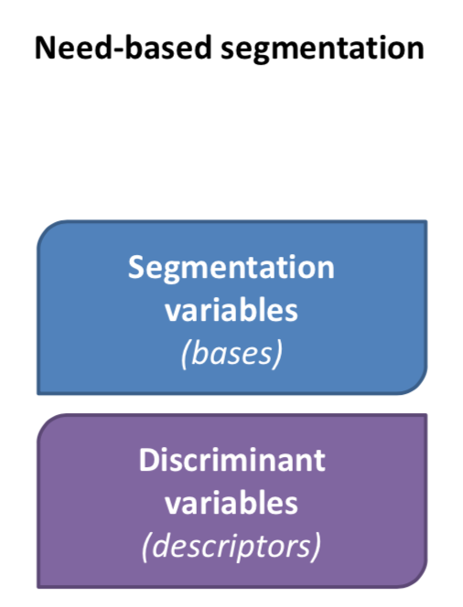
Data needs
In need-based segmentation, we divide the data between segmentation and discriminant variables. Then, we build segments based on the segmentation variables (needs).
Strategy based solely on discriminant variables (firmographic, demographic, etc.) does not identify customer needs.

Slide 20
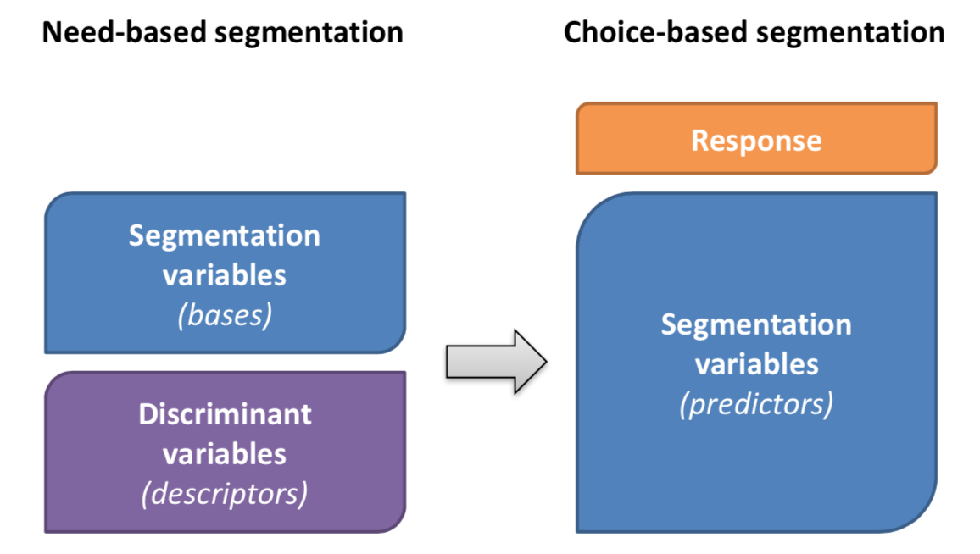
Data needs
In choice-based segmentation, the model decides what is relevant, and all data is considered as segmentation variables.

Slide 21
Choice models, scoring, and score classes
A choice model is a mathematical model that predicts the likelihood of an observed choice/response based on related attributes data (predictors).
Components:
Observed choice
Buy/Not Buy (e.g. direct marketers)
Brand bought (e.g. packaged goods)
Predictors
Demographics
Attitudes, perceptions
Market conditions (price, promotion, etc.)
Past behavior, pattern of previous choices.
Modeling: Predicts customer’s likelihood of buying. Reveals the importance of each predictor on the likelihood.

Slide 22
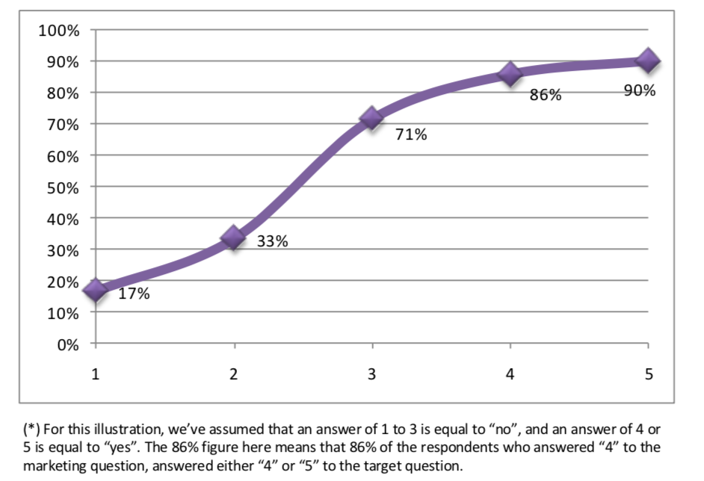
Example: Interest in Marketing
Predictor: “Student’s interest in marketing as a major”
Survey: Scale 1 (no interest) - 5 (high interest)
Response “Takes a marketing elective course”
Survey: 0 (would take) and 1 (would not take).

Slide 23

The Logit Model
$Probability of response = \frac{1}{1+e^{−\sum{weights × Predictors}}}$
Observed (0/1)
Inferred to provide best fit
Observed
(including intercept)

Slide 24
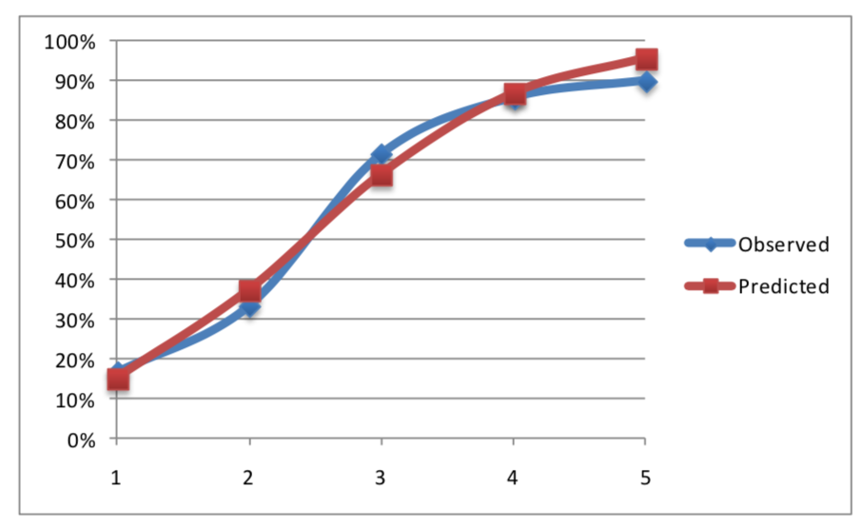

The Logit Model
$P\left(course\right)= \frac{1}{1+e^{−(−2.9+\left(1.19×Marketing\right))}}$
This term is positive and significant.
The higher the student’s interest in marketing…
…the more likely he/she is going to take the elective course.

Slide 25
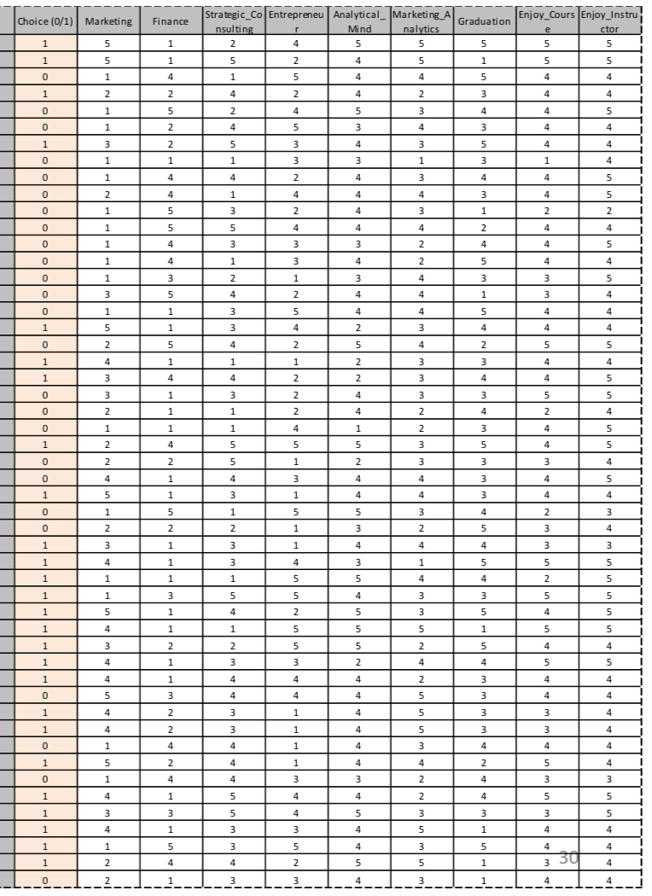
Full Data
306 respondents
1 Choice
9 Predictors

Slide 26
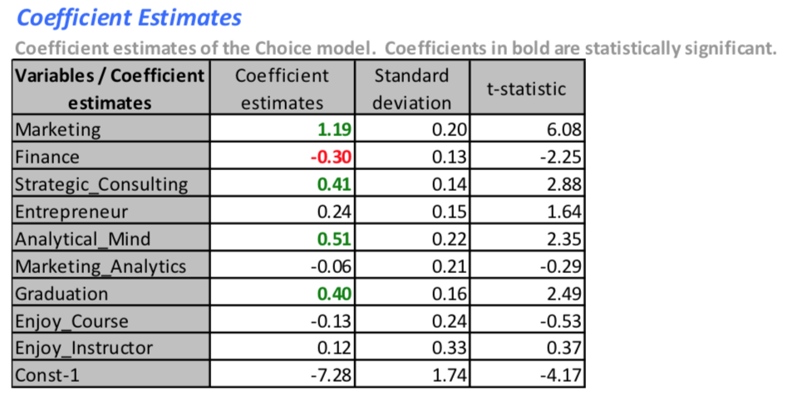
Results
Most important predictors/drivers of choice:
Interest in marketing
Analytical mind
Strategic consulting
Close to graduation
Interest in Finance (-)

Slide 27
Good fit?
Confusion matrix on Sample
Comparison of observed vs. predicted. High values across the diagonal shows good classification.
80.4% of respondents are well classified.
114 correct “yes” and 132 correct “no” out of 306 samples
Observed | Predicted
 | Yes | No
Yes | 114 | 18
No | 42 | 132

Slide 28
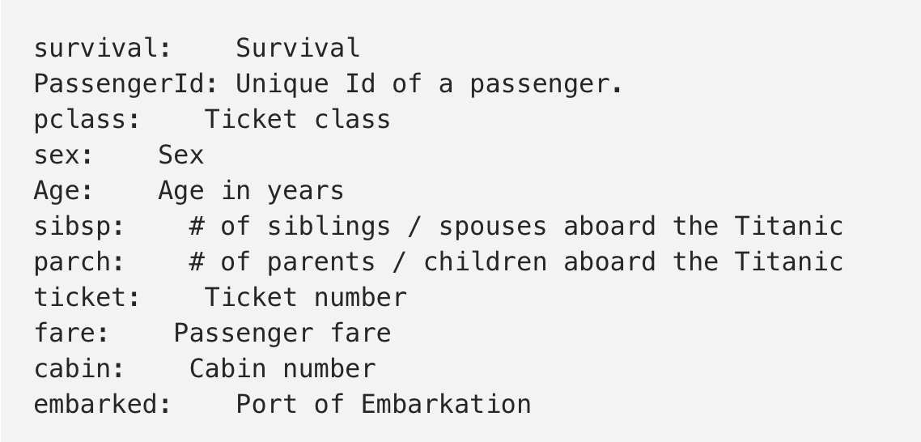
Application: Titanic
Task: Predicting the survival (0,1) of a passenger
Attributes:
To load data:
Install the package by install.packages("titanic"),
Load the data by library(titanic)

Slide 29
Application: Titanic
REST OF THE APPLICATION IN R-STUDIO
Download: LogisticRegression_Titanic_student.R

Slide 30
Case for you – Route Choice
Please work on the following case-study.
You are given 453 samples of a travel survey collected in the State College of Pennsylvania (Download: Travel Route Classify Excel). All of the households in the sample are making the morning commute to work. They are all departing from the same origin (a large residential complex in the suburbs) and going to work in the CBD. They have the choice of three alternative routes:
A 4 lane (2+2) arterial (speed Limit = 35mph)
A 2 lane (1+1) rural road (speed limit = 35mph)
A limited access 4 lane (2+2) freeway (speed limit = 55mph)
Task: Estimate a model of Route Choice for the 4 lane arterial (i.e. likelihood of an individual traveler taking the 4 lane arterial).
Write up (practice) should include:
Results of your best model, preprocessing, and exploration.
Discussion of model parameters (sign and importance of predictors).
R code with ample comments for each line of code.

Slide 31
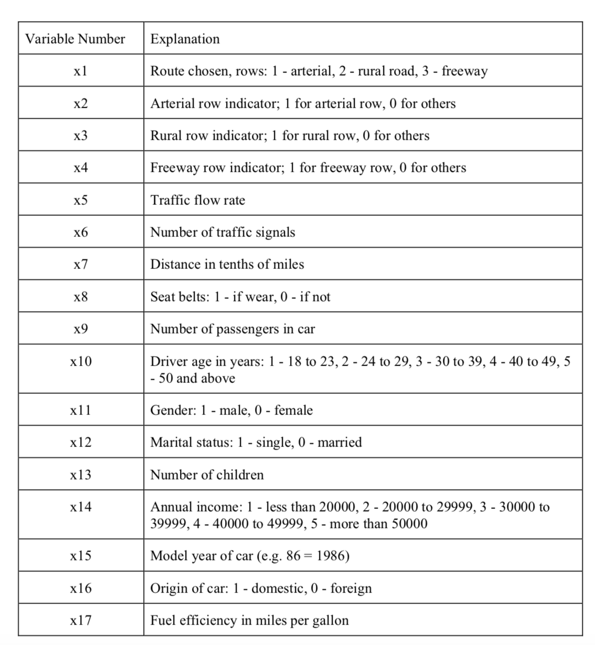
Variables

