Slide 1
Segmentation/Clustering
Marketing Analytics

Slide 2
Topics
Overview of segmentation
Choice-based segmentation
Application: Titanic Survival.
Application: Route Choice
Targeting
Case-study for you: Bank Marketing
Need-based segmentation
Clustering

Slide 3
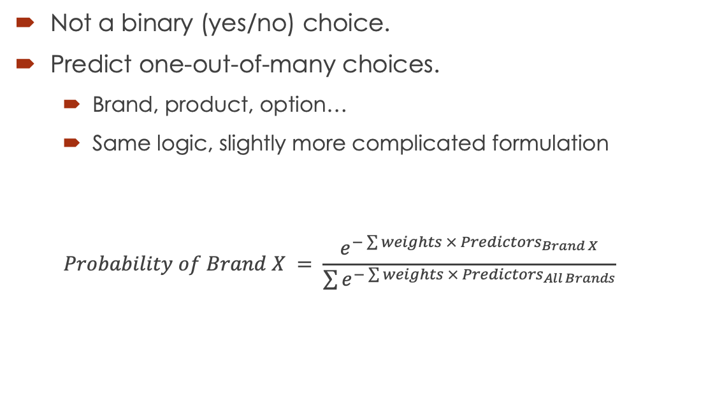
Multinomial Logit
Not a binary (yes/no) choice.
Predict one-out-of-many choices.
Brand, product, option…
Same logic, slightly more complicated formulation
$$Probability of Brand X = \frac{e^{−\sum{weights × {Predictors}_{Brand X}}}}{\sum{e^{−\sum{weights × {Predictors}_{All Brands}}}}}$$

Slide 4
Applications of Choice Models
TARGETING
Calibrate model coefficients on a sample of customers
Different customers (test)
Same customers, different periods in time
Apply choice model to a larger list of customers
Predict likelihood of choice
Rank order, from least likely to most likely
Target customers based on predictions

Slide 5
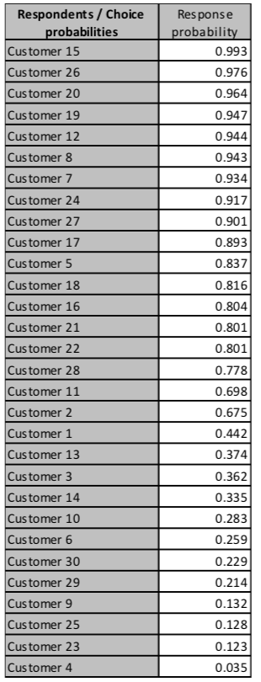
Who to target?
A list of 30 customers with their respective likelihood of response.
Which ones to target?
Depends on the purpose of the action.

Slide 6
Goal: Elicit a Purchase
Goal:
Send a catalog to ask for order.
Place a call to elicit a sale
Send a direct mail to ask for donation
Target customers who are most likely to answer (most loyal)!
MAXIMIZE PROFITABILITY!

Slide 7
Goal: Influence Behavior
Goal:
Send a coupon to ease trial/purchase.
Change, modify perceptions.
Target customers who are potential switchers!
MAXIMIZE MARKETING IMPACT!

Slide 8
Why?
These customers will be loyal anyway.
No need for coupons
No need to “convince” them
They are convinced.
These customers will never buy from you
Don’t waste time & resources.

Slide 9
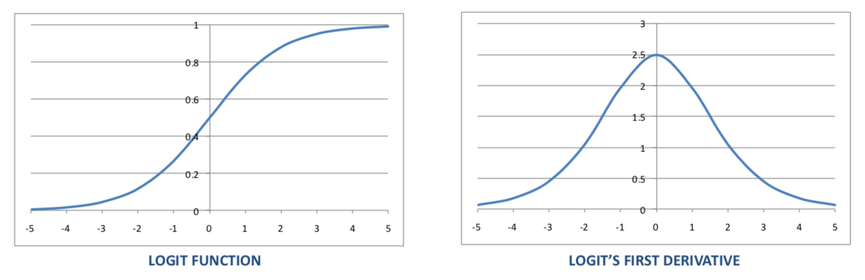
Implication of the Logit Model
The first derivative (gradient) of the Logit function is the marginal impact of a change in a variable (e.g. marketing actions).
When probability of choices is near 50% impact of marketing actions is maximized.

Slide 10
Score
A score is a characterization of a customer’s most likely behavior/potential.
In the simplest case, a score is a simply the result of a choice model (e.g. likelihood of purchase).
In more complex cases, a score can be the result of a combination of choice and predictive models.

Slide 11
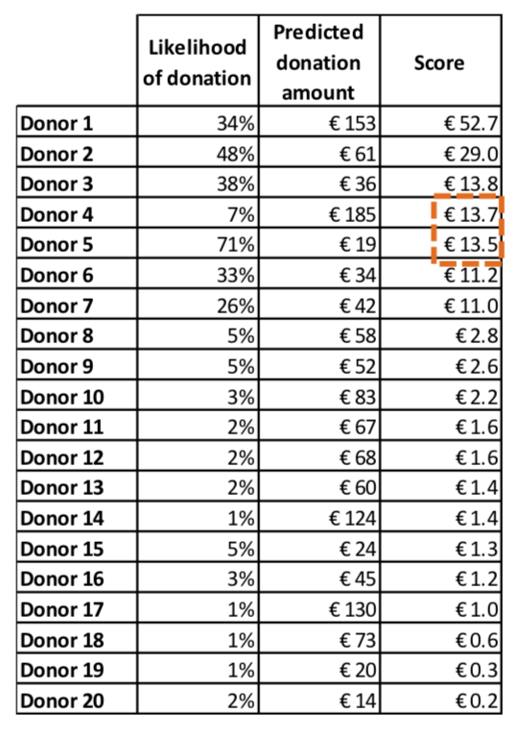
Example of Score
Fundraising campaign
Likelihood of donation (choice model)
Predicted donation amount, if donating (e.g. regression analysis)
Score = combination of both (expected donation amount).
Two donors can have similar scores with different underlying behavior

Slide 12
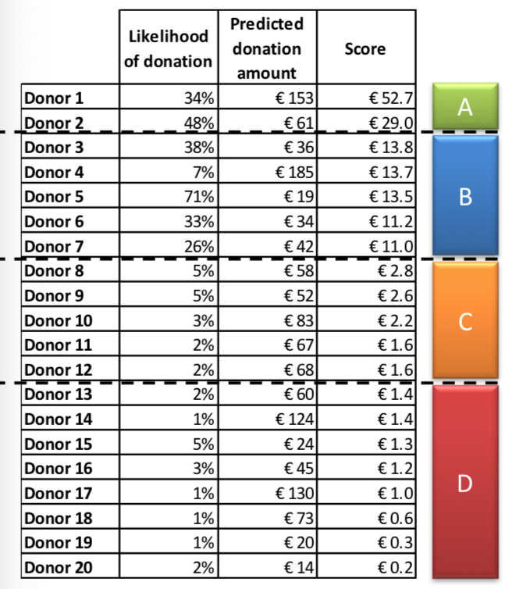
Score Class
A score class is a grouping of customers whose scores fall within a given range.
Example:
Donors are grouped into 4 classes: A, B, C, D.

Slide 13
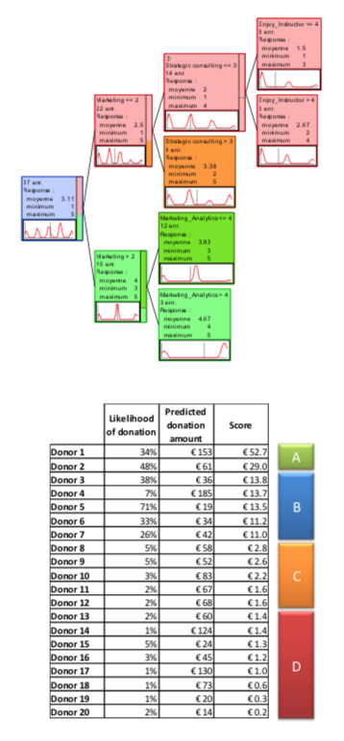
Score Classes vs. Choice-based Segmentation
Similarities
They group customers based on likelihood of choices
They are simple to use (e.g. a few segments/classes)
Differences
Score classes are more complex
They need regular updates of response models
They are more complete and accurate; use all available data
They are harder to “get” intuitively (who’s in class A & why?)
Trade-off: Accuracy/Performance vs. Simplicity/Usability.

Slide 14
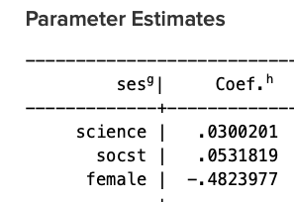
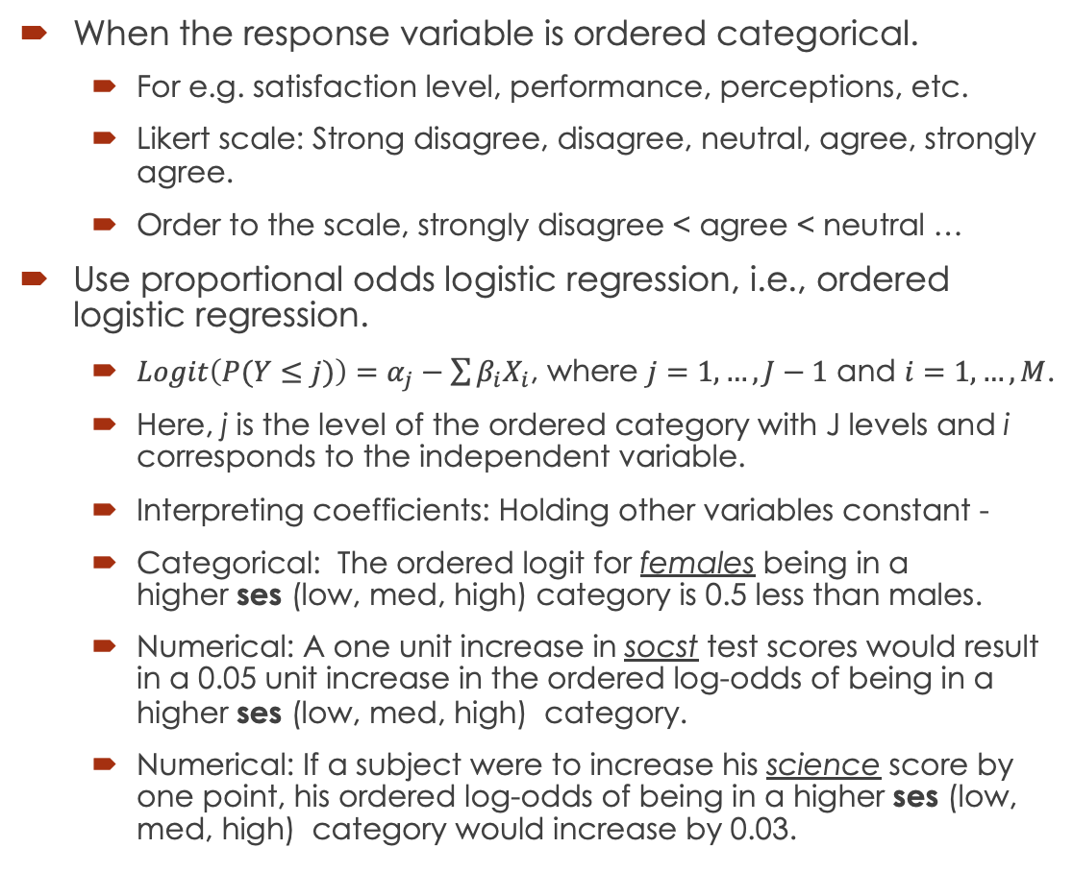
Ordinal Logistic Regression
When the response variable is ordered categorical.
For e.g. satisfaction level, performance, perceptions, etc.
Likert scale: Strong disagree, disagree, neutral, agree, strongly agree.
Order to the scale, strongly disagree < agree < neutral …
Use proportional odds logistic regression, i.e., ordered logistic regression.
$Logit\left(P(Y≤j)\right)=α_{j}−\sum{β_{i}X_{i}}$, where $j=1,…,J−1$ and $i=1,…,M$.
Here, j is the level of the ordered category with J levels and i corresponds to the independent variable.
Interpreting coefficients: Holding other variables constant -
Categorical: The ordered logit for females being in a higher ses (low, med, high) category is 0.5 less than males.
Numerical: A one unit increase in socst test scores would result in a 0.05 unit increase in the ordered log-odds of being in a higher ses (low, med, high) category.
Numerical: If a subject were to increase his science score by one point, his ordered log-odds of being in a higher ses (low, med, high) category would increase by 0.03.

Slide 15
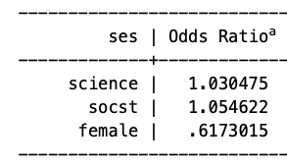
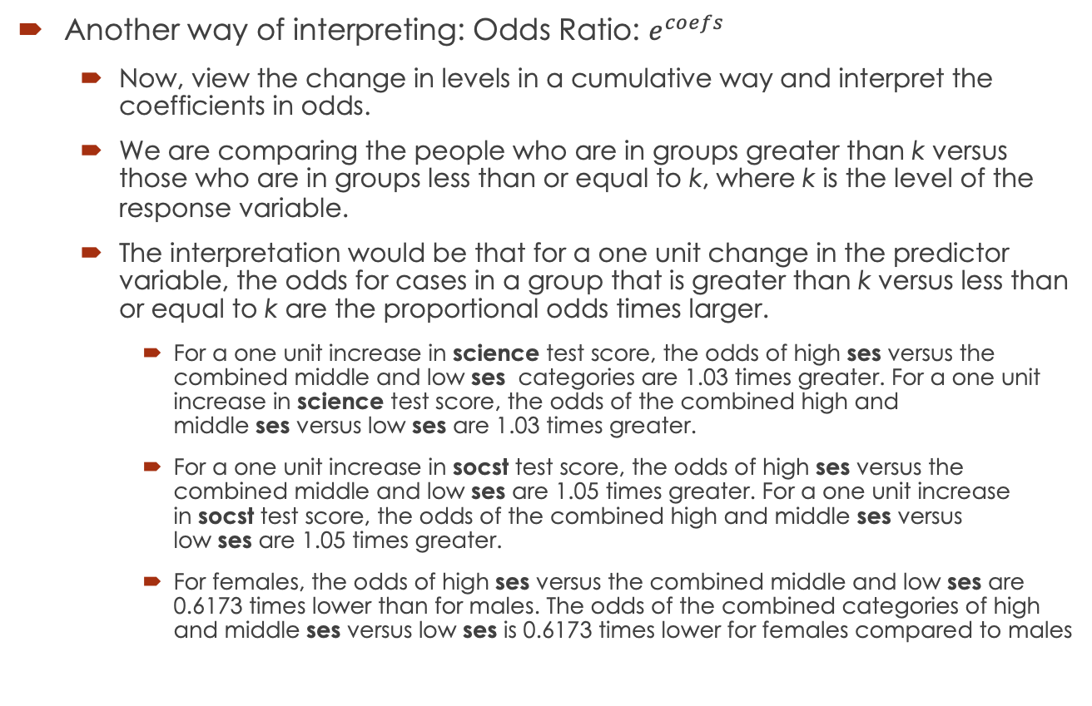
Odds Ratio
Another way of interpreting: Odds Ratio: $e^{coefs}$
Now, view the change in levels in a cumulative way and interpret the coefficients in odds.
We are comparing the people who are in groups greater than k versus those who are in groups less than or equal to k, where k is the level of the response variable.
The interpretation would be that for a one unit change in the predictor variable, the odds for cases in a group that is greater than k versus less than or equal to k are the proportional odds times larger.
For a one unit increase in science test score, the odds of high ses versus the combined middle and low ses categories are 1.03 times greater. For a one unit increase in science test score, the odds of the combined high and middle ses versus low ses are 1.03 times greater.
For a one unit increase in socst test score, the odds of high ses versus the combined middle and low ses are 1.05 times greater. For a one unit increase in socst test score, the odds of the combined high and middle ses versus low ses are 1.05 times greater.
For females, the odds of high ses versus the combined middle and low ses are 0.6173 times lower than for males. The odds of the combined categories of high and middle ses versus low ses is 0.6173 times lower for females compared to males

Slide 16
Ordinal Logistic Regression
Demo in R-Studio
Data: Wine Rating

Slide 17
Case for you – Bank Marketing
See the dataset at: http://archive.ics.uci.edu/ml/datasets/Bank+Marketing – Use file bank-additional.csv
The data is related with direct marketing campaigns of a Portuguese banking institution. The marketing campaigns were based on phone calls. Often, more than one contact to the same client was required, in order to access if the product (bank term deposit) would be ('yes') or not ('no') subscribed.
The classification goal is to predict if the client will subscribe (yes/no) a term deposit (variable y).
Input variables:
age (numeric)
job : type of job (categorical: 'admin.','blue-collar','entrepreneur','housemaid','management','retired','self-employed','services','student','technician','unemployed','unknown’)
marital : marital status (categorical: 'divorced','married','single','unknown'; note: 'divorced' means divorced or widowed)
education (categorical: 'basic.4y','basic.6y','basic.9y','high.school','illiterate','professional.course','university.degree','unknown’)
default: has credit in default? (categorical: 'no','yes','unknown’)
housing: has housing loan? (categorical: 'no','yes','unknown’)
loan: has personal loan? (categorical: 'no','yes','unknown') # related with the last contact of the current campaign:
contact: contact communication type (categorical: 'cellular','telephone’)
month: last contact month of year (categorical: 'jan', 'feb', 'mar', ..., 'nov', 'dec’)
day_of_week: last contact day of the week (categorical: 'mon','tue','wed','thu','fri’)
duration: last contact duration, in seconds (numeric). Important note: this attribute highly affects the output target (e.g., if duration=0 then y='no'). Yet, the duration is not known before a call is performed. Also, after the end of the call y is obviously known. Thus, this input should only be included for benchmark purposes and should be discarded if the intention is to have a realistic predictive model.
# other attributes:
campaign: number of contacts performed during this campaign and for this client (numeric, includes last contact)
pdays: number of days that passed by after the client was last contacted from a previous campaign (numeric; 999 means client was not previously contacted)
previous: number of contacts performed before this campaign and for this client (numeric)
poutcome: outcome of the previous marketing campaign (categorical: 'failure','nonexistent','success’)
social and economic context attributes - You may want to research some of these variables for more context.
emp.var.rate: employment variation rate - quarterly indicator (numeric)
cons.price.idx: consumer price index - monthly indicator (numeric)
cons.conf.idx: consumer confidence index - monthly indicator (numeric)
euribor3m: euribor 3 month rate - daily indicator (numeric)
nr.employed: number of employees - quarterly indicator (numeric)
Output variable (desired target):
y - has the client subscribed a term deposit? (binary: 'yes','no’)
Individual Submission: Write a report, including any data exploration, data cleaning, data analysis, discussion of results, interpretation and conclusion.
See Case Study Guidelines for details. Please put all codes in appendix.
Source: [Moro et al., 2014] S. Moro, P. Cortez and P. Rita. A Data-Driven Approach to Predict the Success of Bank Telemarketing. Decision Support Systems, Elsevier, 62:22-31, June 2014

