Slide 1
Ensemble Methods

Slide 2
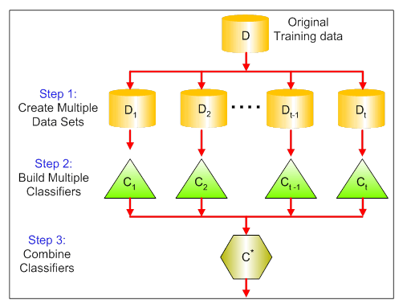
The visual below shows the 3 different steps in bagging:
Step 1: Here you replace the original data with new data. The new data usually have a fraction of the original data's columns and rows, which then can be used as hyper-parameters in the bagging model.
Step 2: You build classifiers on each dataset. Generally, you can use the same classifier for making models and predictions.
Step 3: Lastly, you use an average value to combine the predictions of all the classifiers, depending on the problem. Generally, these combined values are more robust than a single model.

Slide 3
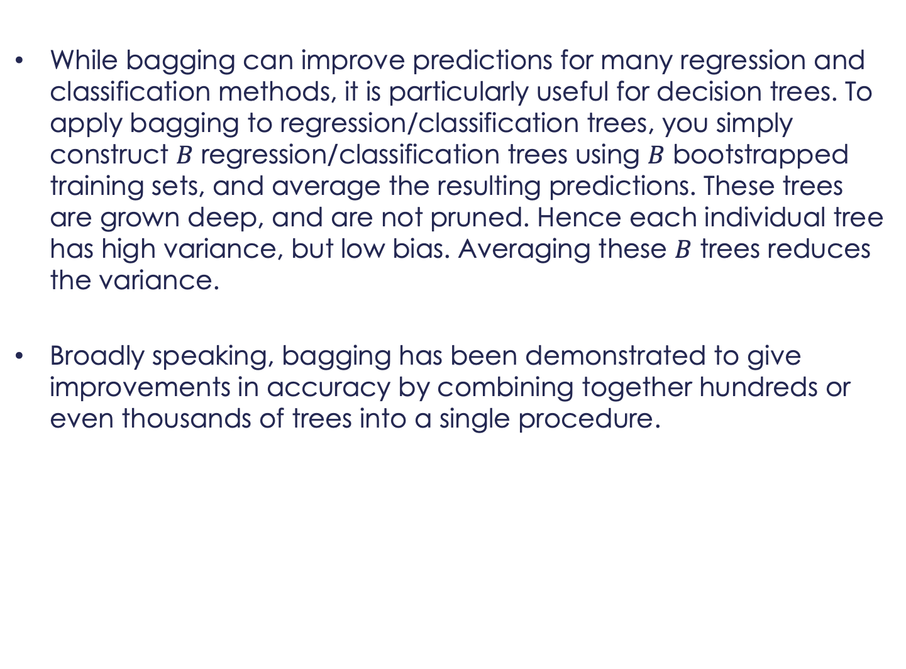
While bagging can improve predictions for many regression and classification methods, it is particularly useful for decision trees. To apply bagging to regression/classification trees, you simply construct $B$ regression/classification trees using $B$ bootstrapped training sets, and average the resulting predictions. These trees are grown deep, and are not pruned. Hence each individual tree has high variance, but low bias. Averaging these $B$ trees reduces the variance.
Broadly speaking, bagging has been demonstrated to give improvements in accuracy by combining together hundreds or even thousands of trees into a single procedure.

Slide 4
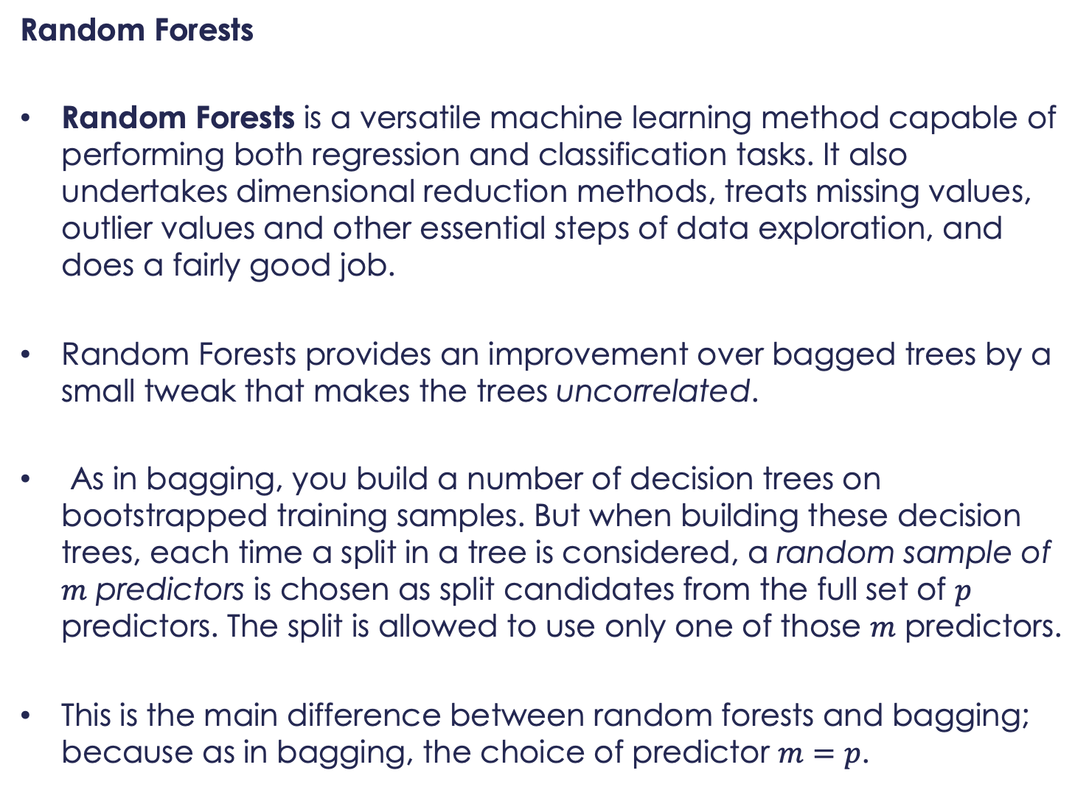
Random Forests
Random Forests is a versatile machine learning method capable of performing both regression and classification tasks. It also undertakes dimensional reduction methods, treats missing values, outlier values and other essential steps of data exploration, and does a fairly good job.
Random Forests provides an improvement over bagged trees by a small tweak that makes the trees uncorrelated.
As in bagging, you build a number of decision trees on bootstrapped training samples. But when building these decision trees, each time a split in a tree is considered, a random sample of $m$ predictors is chosen as split candidates from the full set of $p$ predictors. The split is allowed to use only one of those $m$ predictors.
This is the main difference between random forests and bagging; because as in bagging, the choice of predictor $m=p$.

Slide 5
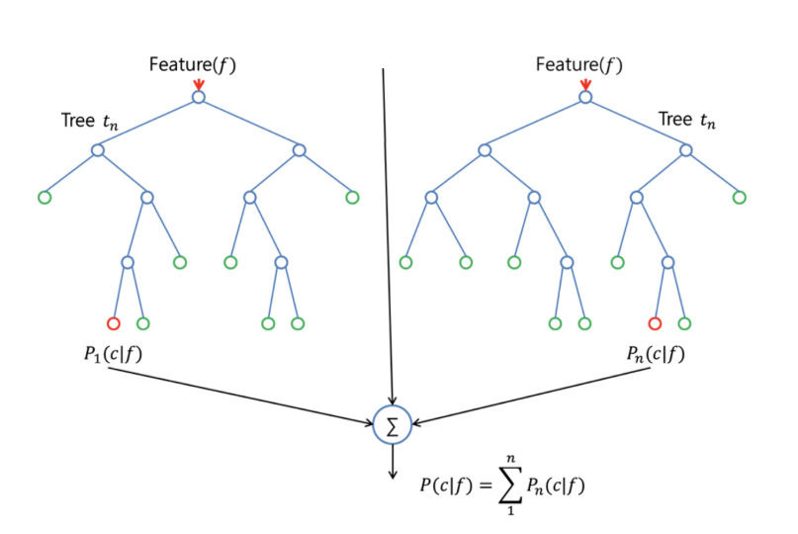
In order to grow a random forest, you should:
First assume that the number of cases in the training set is K. Then, take a random sample of these K cases, and then use this sample as the training set for growing the tree.

Slide 6
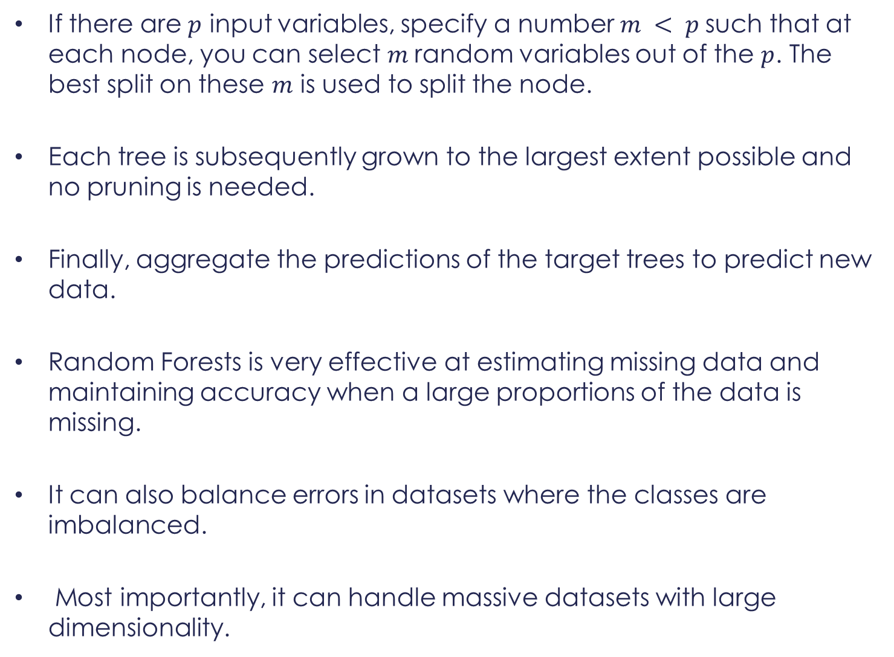
If there are $p$ input variables, specify a number $m < p$such that at each node, you can select $m$random variables out of the $p$. The best split on these $m$ is used to split the node.
Each tree is subsequently grown to the largest extent possible and no pruning is needed.
Finally, aggregate the predictions of the target trees to predict new data.
Random Forests is very effective at estimating missing data and maintaining accuracy when a large proportions of the data is missing.
It can also balance errors in datasets where the classes are imbalanced.
Most importantly, it can handle massive datasets with large dimensionality.

Slide 7
However, one disadvantage of using Random Forests is that you might easily overfit noisy datasets, especially in the case of doing regression.
Boosting
Boosting is another approach to improve the predictions resulting from a decision tree. Like bagging and random forests, it is a general approach that can be applied to many statistical learning methods for regression or classification.
Boosting works in a similar way, except that the trees are grown sequentially: each tree is grown using information from previously grown trees.
Boosting does not involve bootstrap sampling; instead, each tree is fitted on a modified version of the original dataset.

Slide 8
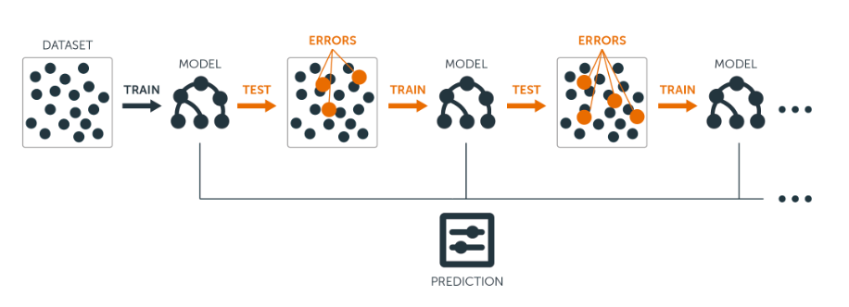
For both regression and classification trees, boosting works as follows:
Unlike fitting a single large decision tree to the data, which amounts to fitting the data hard and potentially overfitting, the boosting approach instead learns slowly.
Given the current model, you fit a decision tree to the residuals from the model. That is, you fit a tree using the current residuals, rather than the outcome $Y$, as the response.

Slide 9
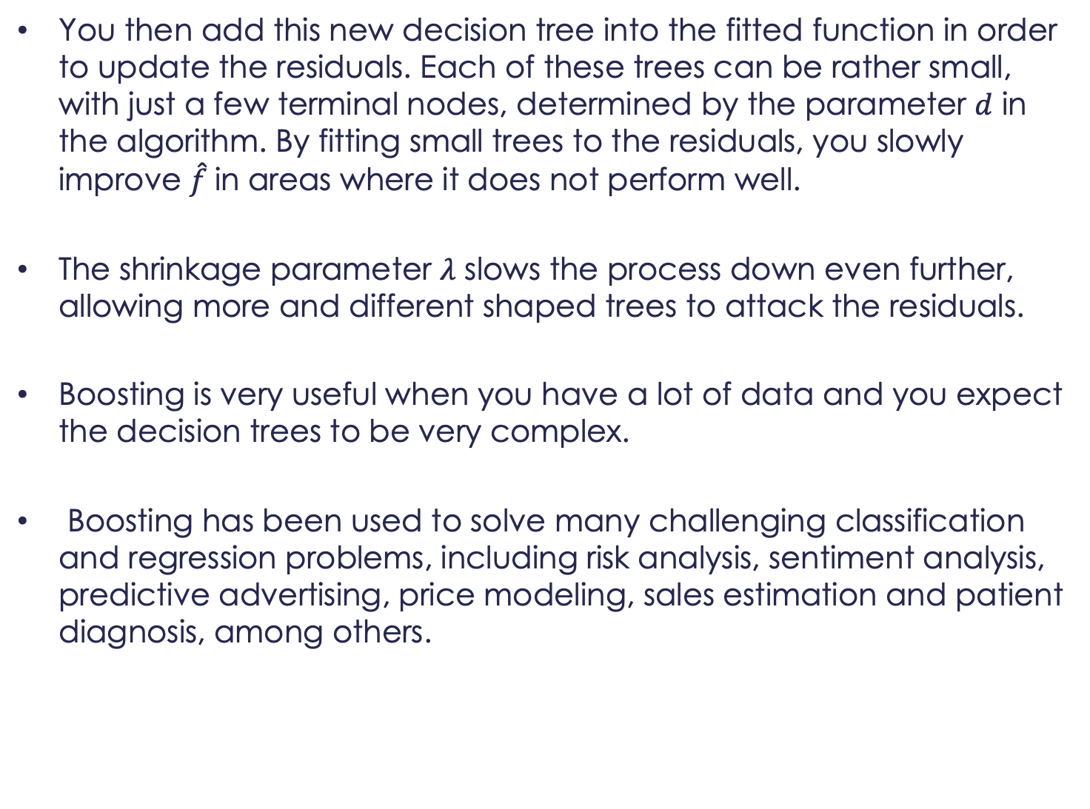
You then add this new decision tree into the fitted function in order to update the residuals. Each of these trees can be rather small, with just a few terminal nodes, determined by the parameter $d$ in the algorithm. By fitting small trees to the residuals, you slowly improve $\hat{f}$in areas where it does not perform well.
The shrinkage parameter $λ$ slows the process down even further, allowing more and different shaped trees to attack the residuals.
Boosting is very useful when you have a lot of data and you expect the decision trees to be very complex.
Boosting has been used to solve many challenging classification and regression problems, including risk analysis, sentiment analysis, predictive advertising, price modeling, sales estimation and patient diagnosis, among others.
Demo in R-Studio

Slide 10
Case Study – Customer Acquisition & Retention
Use acquisitionRetention data set to predict which customers will be acquired and for how long (duration) based on a feature set using a random forest.
Compute variable importance to detect interactions and optimize hyper-parameters for acquired customers.
Compare the accuracy of model with a decision trees and logistic regression model for acquiring customers.
Compare the accuracy improvements if any for portfolios of CLV
Extra credit: generate PDP plots for all variables
To access data type: data(acquisitionRetention), after installing the “SMCRM” package.

