Slide 1
Segmentation/Clustering
Marketing Analytics

Slide 2
Topics
Overview of segmentation
Choice-based segmentation
Application: Titanic Survival.
Application: Route Choice
Targeting
Case-study for you: Bank Marketing
Need-based segmentation
Clustering

Slide 3
Need-based Segmentation
Customers are grouped together based on their similarities of
Needs,
Wants,
Lifestyles,
Behavior, …
E.g. Customers in segment “X” highly value prestige, peace of mind, and are not price-sensitive (bases). This segment is mostly composed of men with high income who have been loyal customers for more than 3 years (descriptors).

Slide 4
Example
A simple survey to understand customer’s needs
Context B2B, IT industry, assembly parts, direct marketing (catalog)
Question 1: On a scale of 1-7, how many items/references would you like to find in our catalog?
- 1: Very few (key references only, but easy to find)
- 7: Many (very large choice with many references)
Question 2: How much technical assistance and support would you expect from us in your decision-making process?
- 1: none (I know exactly what I want and don’t need help)
- 7: a lot (I will require a lot of support and expertise from you)

Slide 5
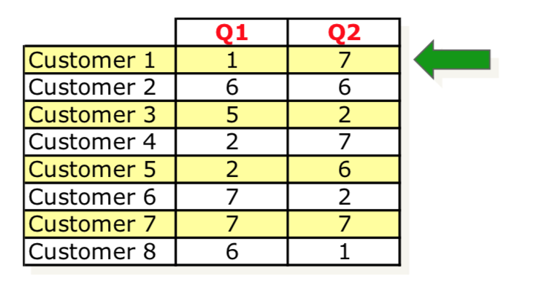
Example
Each respondent can be represented by a line in a table.
There are 8 respondents.
For e.g. 1st respondent answered “1” to the first question, and “7” to the second question.

Slide 6
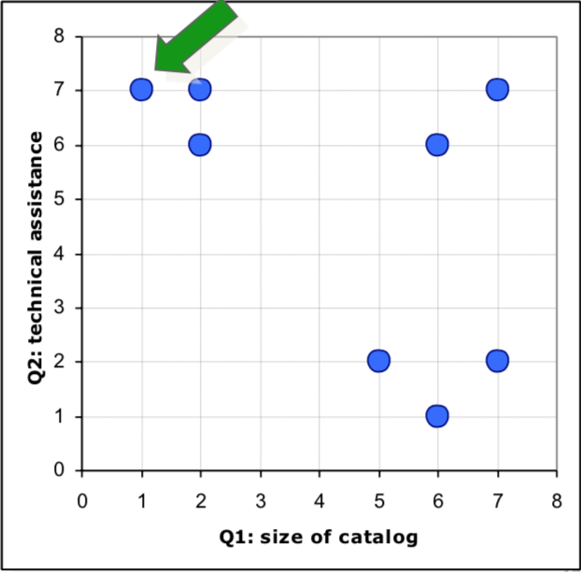
Example
Each respondent can also be plotted on a chart.

Slide 7
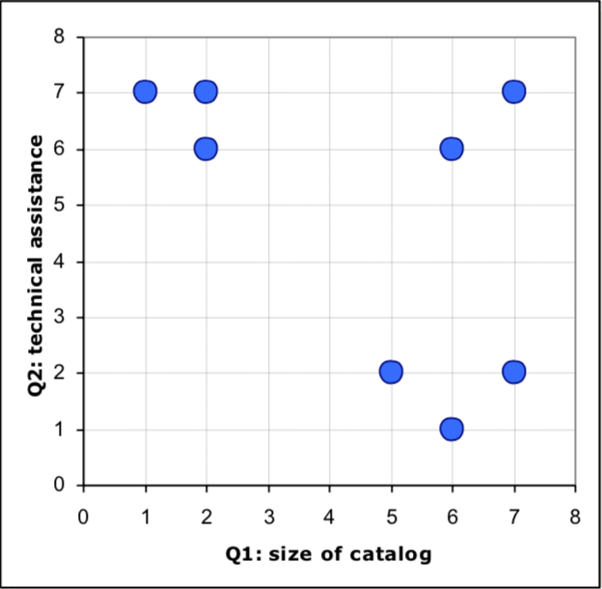
Example
How may segments of customers do you see?

Slide 8
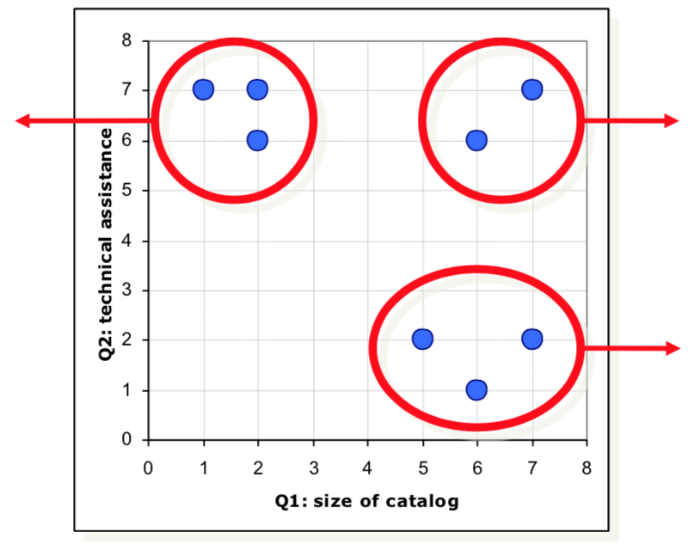
Example
Intuitively, customers can be segmented into 3 segments with homogenous needs.
Segment 1:
Small catalog,
lots of support
Segment 2:
Large catalog,
lots of support
Segment 3:
Large catalog,
Not much
support

Slide 9
Step-by-step Process
How to reach that result more formally?
Consider each customer as a separate segment.
Find the two segments/customers that, if grouped together, would lead to the lowest loss of information.
Continue merging segments/customers until such merging would lead to an unacceptable loss of information.

Slide 10
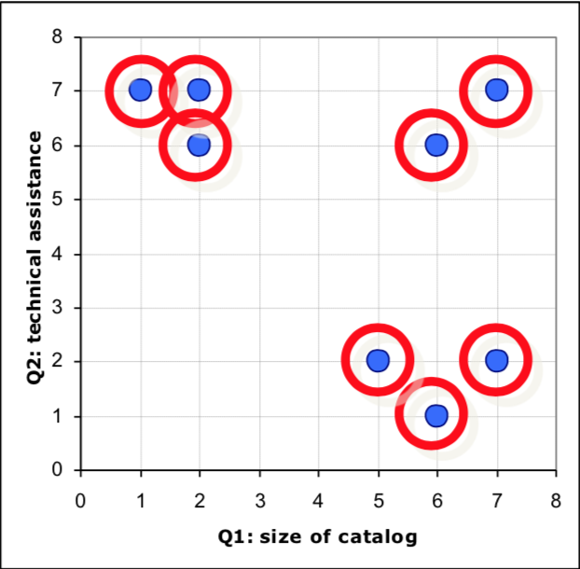
Example
We start with 8 segments. Which should be grouped first?

Slide 11
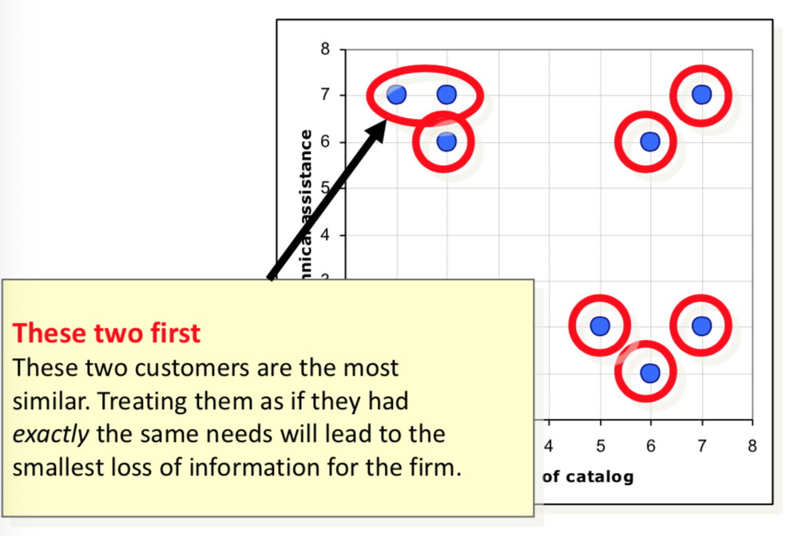
Example
Which should be grouped next?

Slide 12
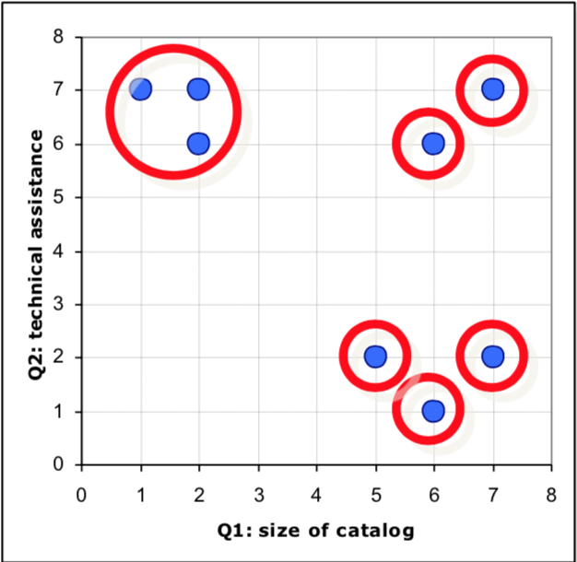
Example
Which should be grouped next?

Slide 13
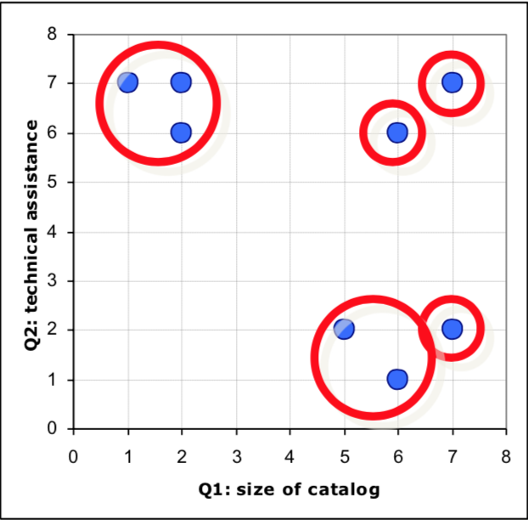
Example
Which should be grouped next?

Slide 14
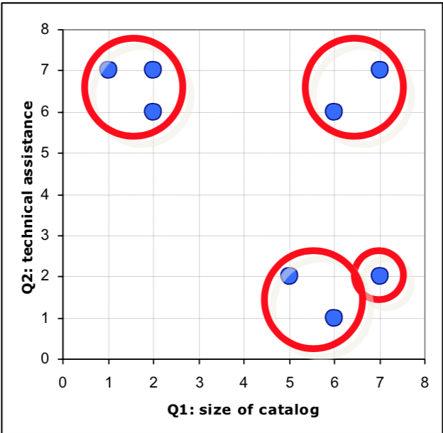
Example
Which should be grouped next?

Slide 15
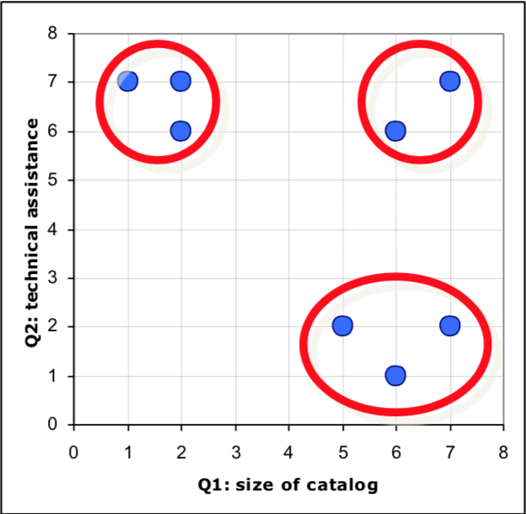
Example
Which should be grouped next?

Slide 16
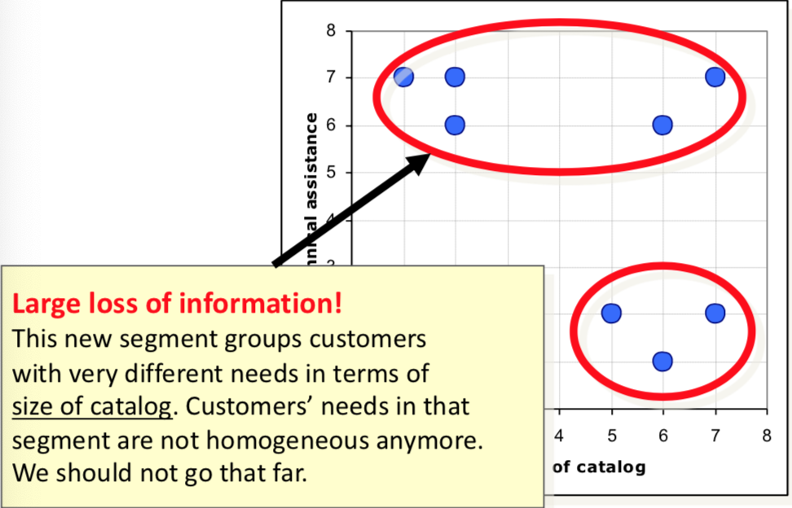
Example
Which should be grouped next?

Slide 17
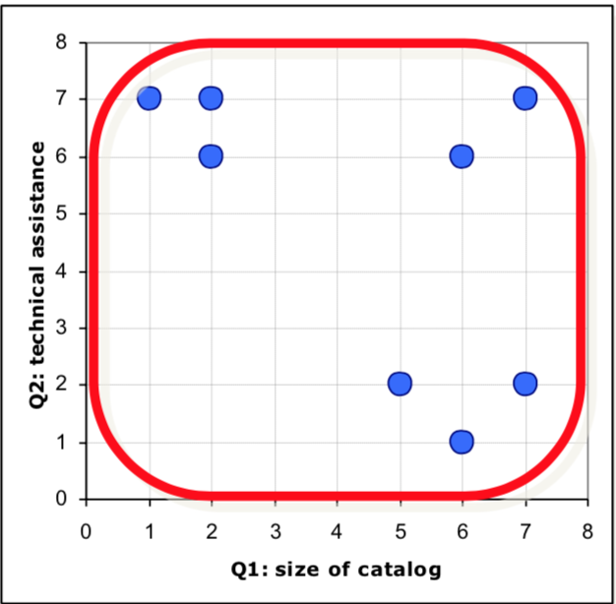
Example
You can even segment your customers into one segment. Not very useful, though!

Slide 18
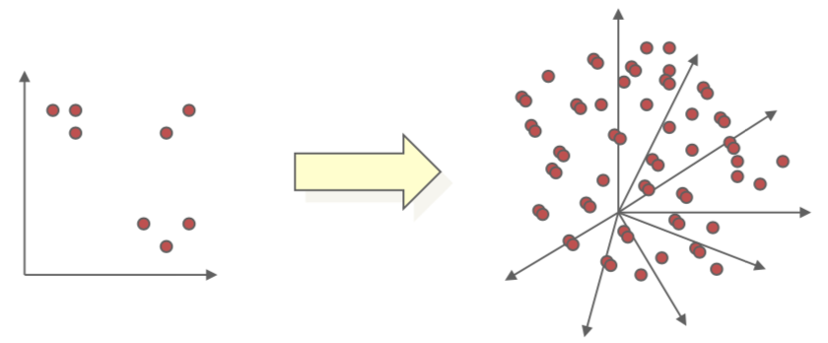
More systematic approach
Real-life applications will be much more complex
Many more questions (dimensions)
Many more respondents (observations)
Need a more systematic approach to treat large datasets
More formal definition of “similarity”
More formal definition of “loss of information”

Slide 19
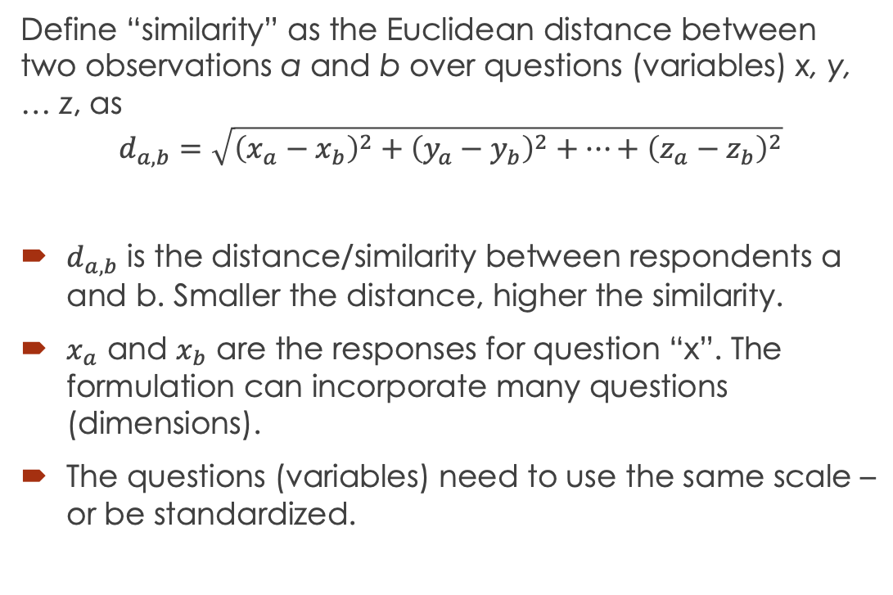
Formal definition of “similarity”
Define “similarity” as the Euclidean distance between two observations a and b over questions (variables) x, y, … z, as
$$d_{a,b}=\sqrt{{\left(x_{a}−x_{b}\right)}^{2}+{\left(y_{a}−y_{b}\right)}^{2}+…+{\left(z_{a}−z_{b}\right)}^{2}}$$
$d_{a,b}$ is the distance/similarity between respondents a and b. Smaller the distance, higher the similarity.
$x_{a}$ and $x_{b}$ are the responses for question “x”. The formulation can incorporate many questions (dimensions).
The questions (variables) need to use the same scale – or be standardized.

Slide 20
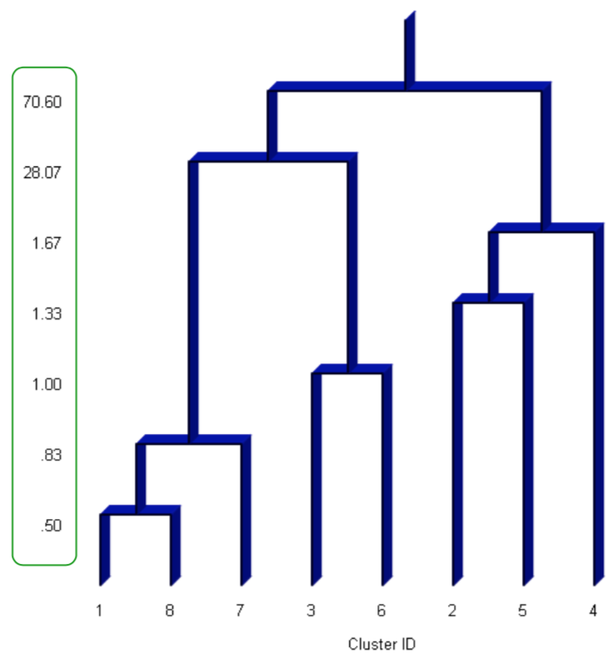
Formal definition of “loss of information”
A dendrogram shows how much distance separates the next two closest segments.
The value on the y-axis indicates how much distance we need to travel to join two segments.
i.e., how much information is lost when the two segments are grouped together.

Slide 21
Formal definition of “loss of information”
The dendrogram shows how much distance separates the next two closest segments.
If there is a sudden jump, stop!
In this case, 3 segments!
This is Agglomerative Hierarchical Clustering. Bottom up!

Slide 22
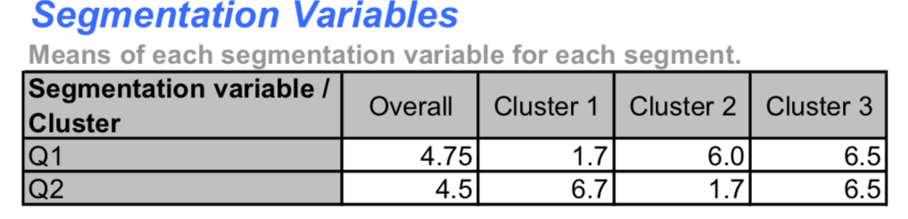
Summarize the segments
Once the segments are formed, describe them by their means.
Much easier to deal with than with each customer individually!

Slide 23
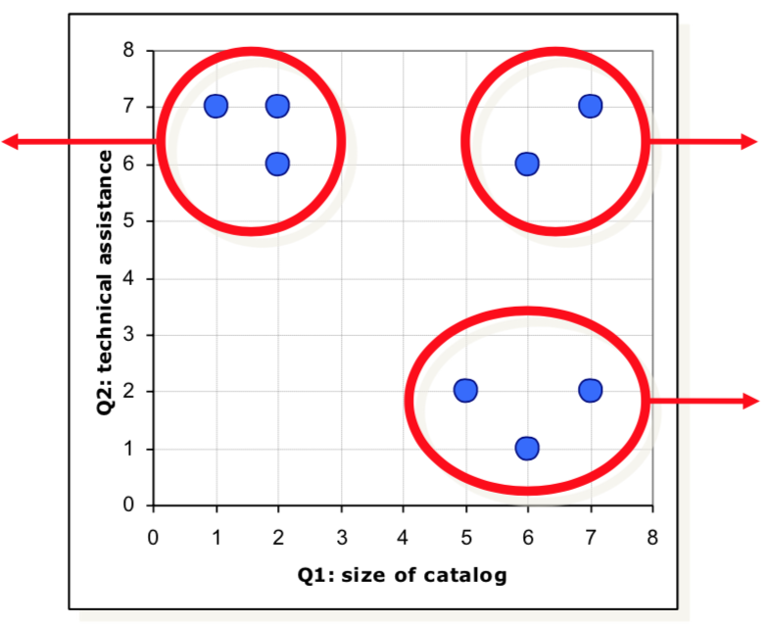
Name Segments
Caution: Names stick! Name carefully!
Clueless?
Small catalog,
Lots of support
Demanding?
Large catalog,
Lots of support
Independent?
Large catalog,
Not much support

Slide 24
Describe the segments
Often surveys include additional information about respondents, not related to their needs, but informative, called discriminant variables (descriptors).
They do not describe what they want or why they buy. They describe who they are and how they can be reached:
B2C: Age, Gender, Profession, Income, Number of children, Magazines subscriptions, TV shows watched…
B2B: Industry, Revenues, Sales, Number of employees…

Slide 25
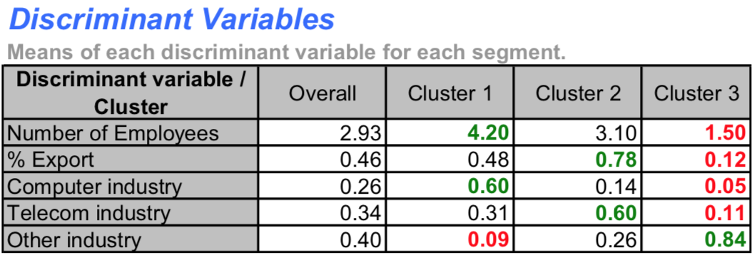
Discriminant Variables
Describe the segments using their descriptors:
Customers in segment 2 export a lot, and can be found mostly in the Telecom industry.
Informs us about who they are, but not what they want.

Slide 26
Finding customers/prospects
How can we assign all customers/prospects to the right segment?
If they replied to the survey, that’s easy.
But most do not…

Slide 27
Discriminant Analysis
Can I predict to which segment a customer will belong to based on his/her descriptors?
Remember:
Segmentation variables (based) define the segments. This information is only available from the surveys.
Discriminant variables (descriptors) describe the segments. This information is in the survey but also often readily available as secondary data. Easier to gather!

Slide 28
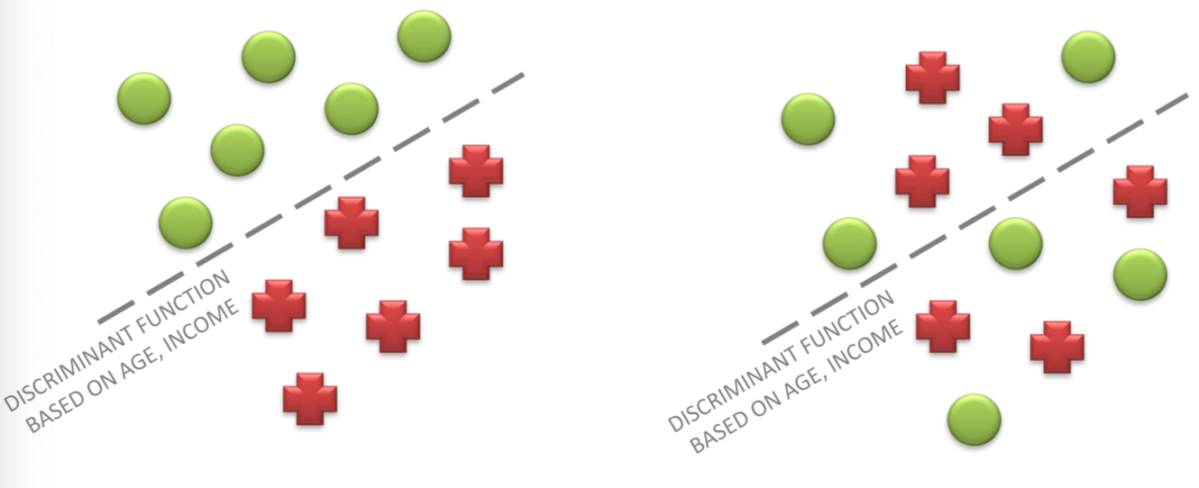
Good vs. bad discrimination
How to assess whether discriminant variables predict cluster memberships well?
Confusion matrix
Hit rate

Slide 29
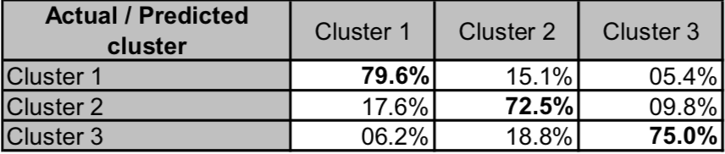
Confusion Matrix
Compares cluster membership predictions based on discriminant variables and actual cluster memberships.
High values in the diagonal of the confusion matrix (in bold) indicates that discriminant data was good at predicting cluster memberships.
Hit rate (% of total cases correctly classified): 76.88%.

Slide 30
Clustering in R
To perform a cluster analysis in R, generally, the data should be prepared as follows:
Rows are observations (individuals) and columns are variables
Any missing value in the data must be removed or estimated.
The data must be standardized (i.e., scaled) to make variables comparable. Recall that, standardization consists of transforming the variables such that they have mean zero and standard deviation one.

Slide 31
Application for you - USArrests
Built-in R dataset: USArrests
Statistics in arrests per 100,000 residents for assault, murder, and rape in each of the 50 US states in 1973.
Also includes the percent of the population living in urban areas
Task: Cluster states into 4 segments!
REST OF THE DEMO IN R-STUDIO
Download: Clustering_Arrests_Students.R

Slide 32
LDA Analysis
Compare the performance of LDA and logistic regression on the Titanic data.
Create a training and testing dataset using 80% / 20% split on the Titanic_Train data.
I.e. name ttrain and ttest from the Titanic_Train data.
Compare accuracy on the ttest data using confusion matrix.
Rest of the Demo on R-studio

