Slide 1
Classification with SVM
Applications in Medicine & Marketing

Slide 2
Basic Idea
Develop a hyperplane for linearly separable points.
Extend to points that are nonlinearly separable by using a Kernel Trick: transformation of original data to map into new dimension.

Slide 3
Why is is called support vectors?
Only a few critical points (yellow) that support the hyperplane (orange). These are known as support vectors.
The objective function is only dependent on the support vectors (usually only a few), that are a subset of the training data.
Margin

Slide 4
Assuming Linear Separation
For now, assume linear separability (later relaxed).
Assume in 2D, the data can be separated by a line. In higher dimensions, we use a hyperplane.

Slide 5
Which hyperplane?
There can be many hyperplanes (red, blue, grey) that separate the data. Which one is the best (optimal)?
Concept: Maximize the margin, while correctly classifying all the points.

Slide 6
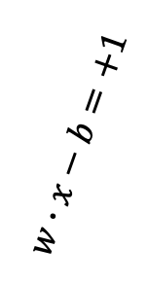
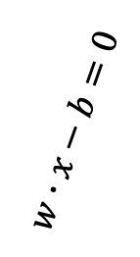

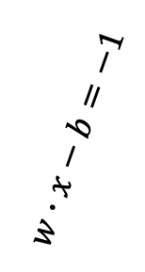
Setup
With a standardized dataset, everything classified on either side is +1 or =1.
$$w∙x−b=−1$$
Geometrically, the distance between the dashed lines is $\frac{2}{|\left|w\right||}$.
In order to maximize margin, we minimize $\left|\left|w\right|\right|$.
$$w∙x−b=+1$$
$$w∙x−b=0$$
d₋
d₊
d₋ is the shortest distance to closest negative points
d₊ is the shortest distance to closest positive points
H₂
H₀
H₁
Max Margin

Slide 7
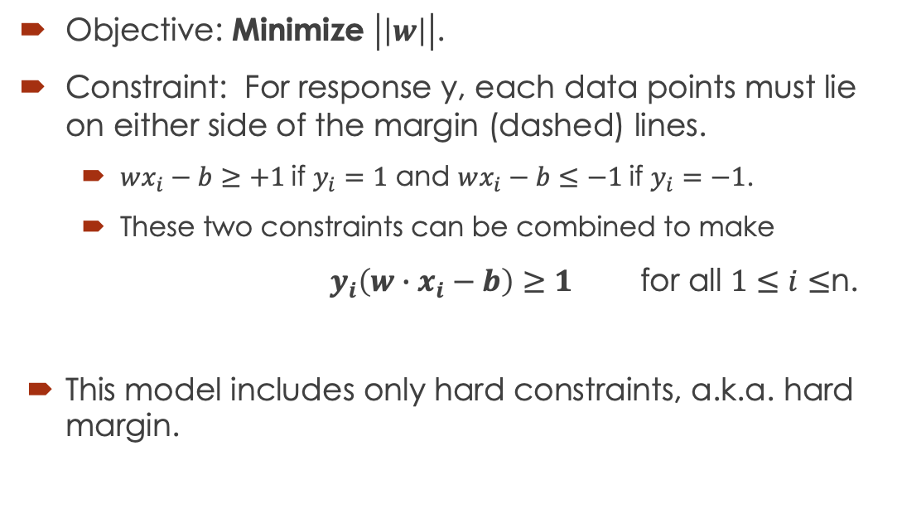
Optimization
Objective: Minimize $\left|\left|w\right|\right|$.
Constraint: For response y, each data points must lie on either side of the margin (dashed) lines.
$wx_{i}−b≥+1$if $y_{i}=1$ and $wx_{i}−b≤−1$if $y_{i}=−1$.
These two constraints can be combined to make
$y_{i}\left(w∙x_{i}−b\right)≥1$ for all $1≤i≤$n.
This model includes only hard constraints, a.k.a. hard margin.

Slide 8
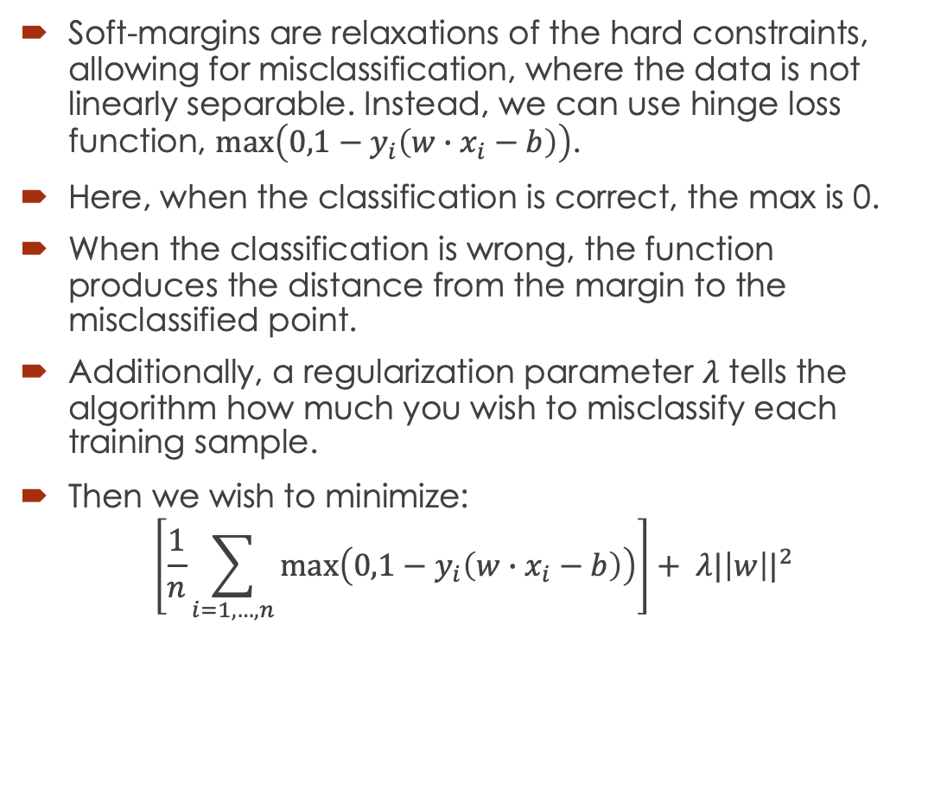
Optimization
Soft-margins are relaxations of the hard constraints, allowing for misclassification, where the data is not linearly separable. Instead, we can use hinge loss function, $\max\left(0,1−y_{i}\left(w∙x_{i}−b\right)\right)$.
Here, when the classification is correct, the max is 0.
When the classification is wrong, the function produces the distance from the margin to the misclassified point.
Additionally, a regularization parameter $λ$ tells the algorithm how much you wish to misclassify each training sample.
Then we wish to minimize:
$$\left[\frac{1}{n}\sum_{i=1,…,n}{\max\left(0,1−y_{i}\left(w∙x_{i}−b\right)\right)}\right]+ λ{|\left|w\right||}^{2}$$

Slide 9
Regularization
You can control this regularization parameter. In python referenced as “C”, and in R referenced as “cost” in svm function.
Low regularization
value
High regularization
value

Slide 10

Kernels
What if the data is not so easily separable?
No straight line can separate the stars from the squares (left).
Let’s apply a transformation and add a dimension (middle/right).
$$x^{2}+y^{2}=z$$
y
z
y
x
y
x
Transform + dimension
equivalent

Slide 11
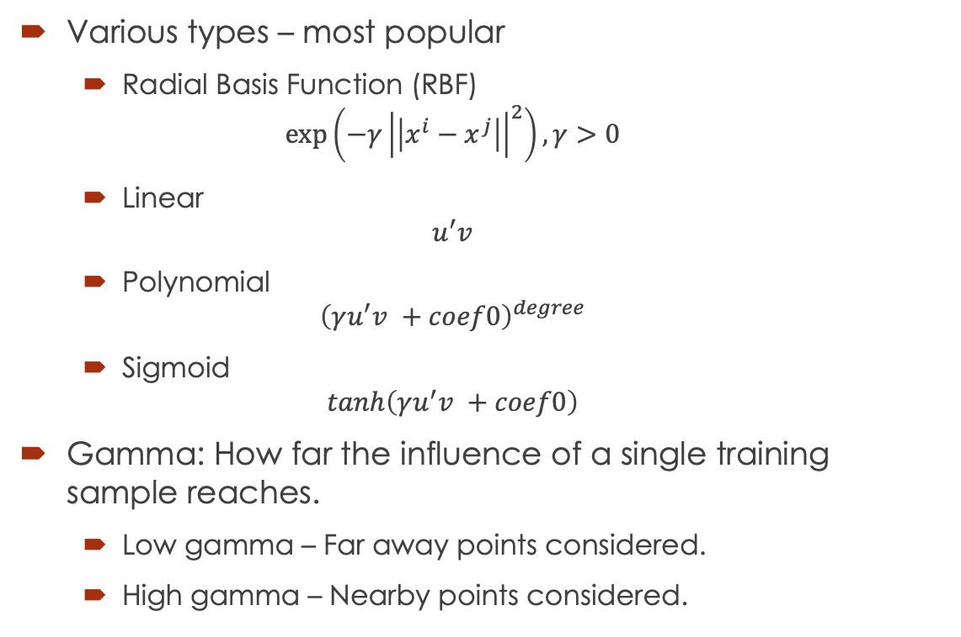
Kernels in R
Various types – most popular
Radial Basis Function (RBF)
$$\exp\left(−γ{\left|\left|x^{i}−x^{j}\right|\right|}^{2}\right), γ>0$$
Linear
$$u^{′}v$$
Polynomial
$${\left(γu^{′}v +coef0\right)}^{degree}$$
Sigmoid
$$tanh\left(γu^{′}v +coef0\right)$$
Gamma: How far the influence of a single training sample reaches.
Low gamma – Far away points considered.
High gamma – Nearby points considered.
Gamma values:
High (top) and low (bottom)
Start with simplest (linear) and increase complexity – reduces overfitting!

Slide 12
Advantages/Disadvantages
Advantages:
Works well in high dimensional spaces, e.g. classification.
Memory efficient, only relies on subset of training points, i.e. support vectors.
Versatile, since nonlinear kernels allow for high flexibility for the decision boundary.
Disadvantages:
Sensitive to choice of parameters.
No probabilistic interpretation.

Slide 13
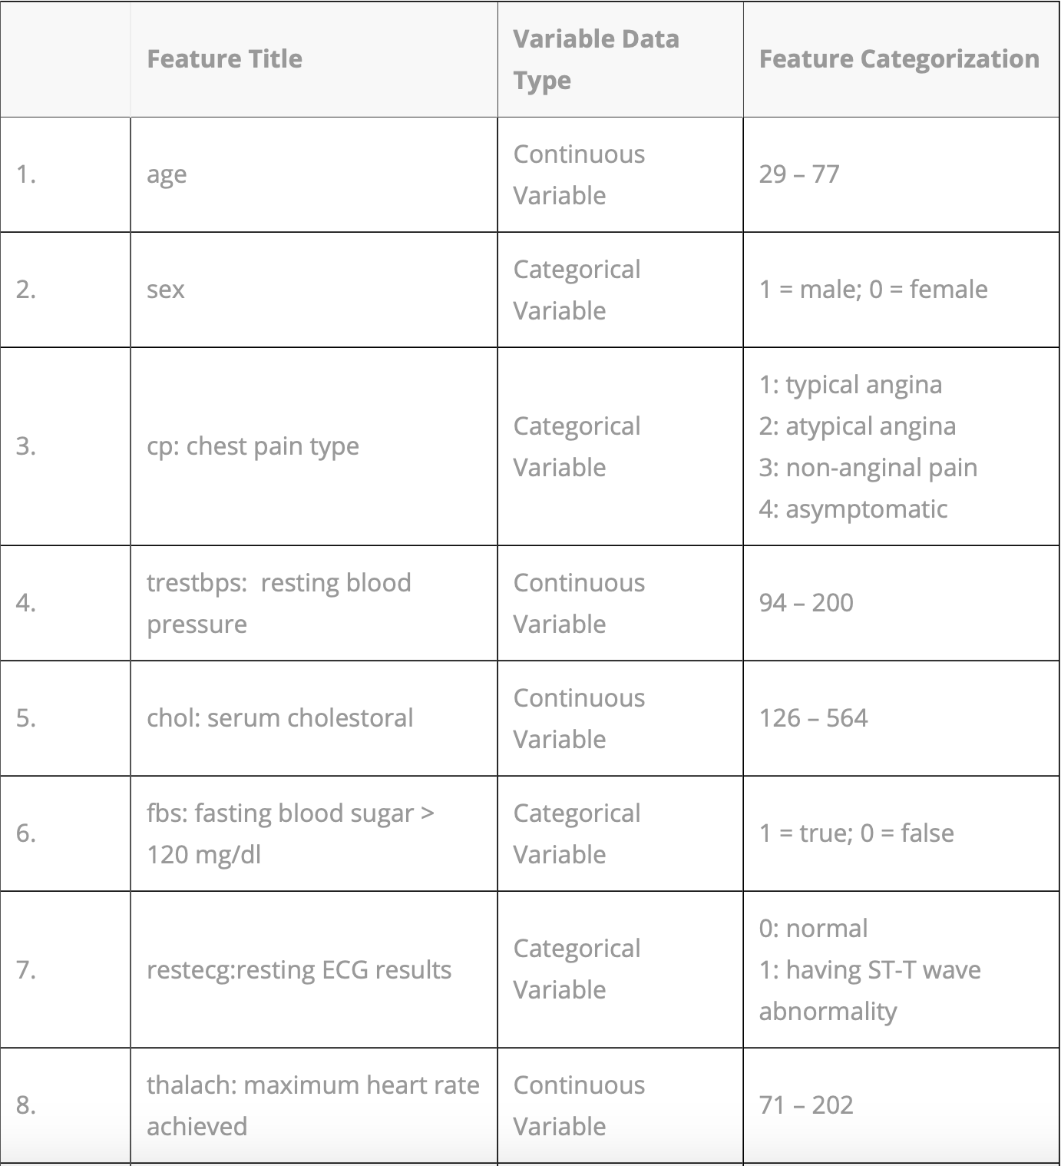
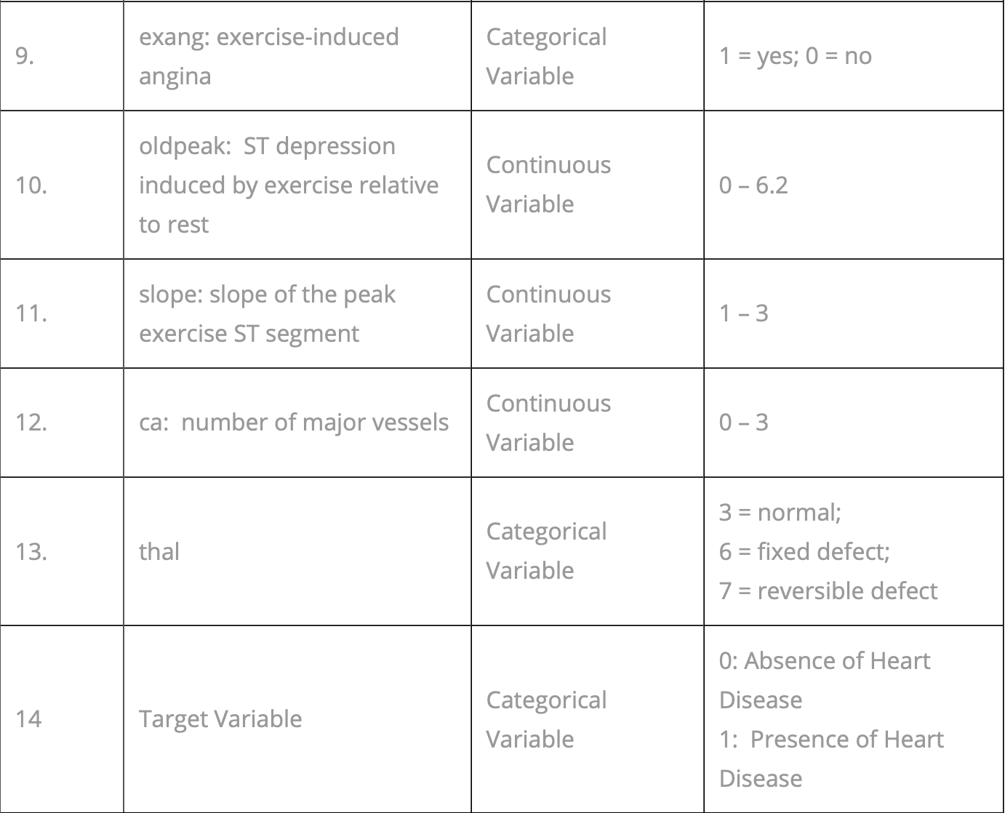
Application for you -
Heart disease data consists of 14 attributes:
First 13 are explanatory variables.
14th variable is the target for predicting heart disease.
Task: Predict whether a patient is suffering from heart disease or not.
Demo in R-Studio!

Slide 14


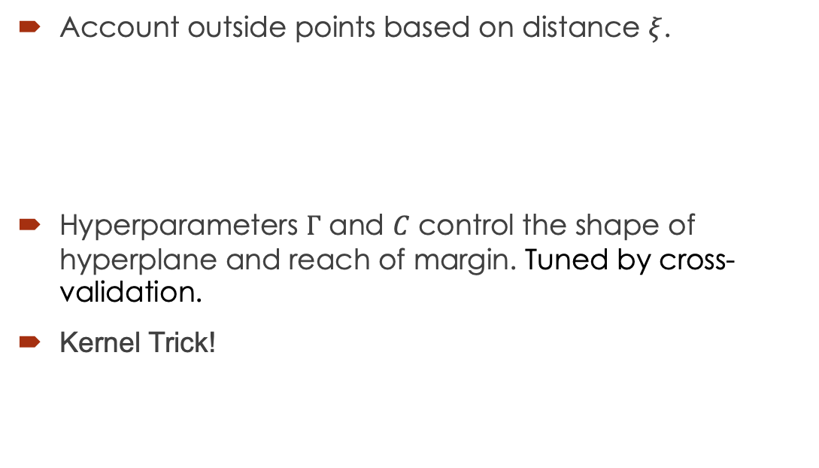

Support Vector Regression
Account outside points based on distance $ξ$.
Hyperparameters $Γ$ and $C$ control the shape of hyperplane and reach of margin. Tuned by cross-validation.
Kernel Trick!
$$ξ$$
$$−ε$$
$$+ε$$
y
y
z² = x² + y²
Transform dimension
Equivalent
x
x
y

Slide 15
Case for you – Bookbinders
About 50,000 new titles, including new editions are published in the US each year, giving rise to a $20 billion book publishing industry (in 1994). About 10% of the books are sold through mail order.
Book retailing in the 1970s was characterized by growth of chain bookstore operations in concert with the development of shopping malls. Traffic in bookstores in the 1980s was enhanced by the spread of discounting. In 1990s, the superstore concept of book retailing was responsible for the double-digit growth of the book industry. Generally situated near large shopping centers, superstores maintain large inventories of anywhere from 30,000 to 80,000 titles. Superstores are putting intense competitive pressure on book clubs, mail-order firms and retail outlets. Recently, online superstores such as Amazon have emerged, carrying 1-2.5million titles and further intensifying the pressure on book clubs and mail order firms. In response to these pressures, book clubs are starting to look at alternative business models that will make them more responsive to their customer’s preferences.

Slide 16
Bookbinders
Historically, book clubs offered their readers continuity and negative option programs that were based on an extended contractual relationship between the club and its subscribers. In a continuity program, popular in such genres as children’s book, a reader signs up for an offer of several books for a few dollars each (plus shipping and handling on each book) and agrees to receive a shipment of one or two books each month thereafter. In a negative option program, subscribers get to choose which and how many additional books they will receive, but the default option is that the club’s selection will delivered to them each month. The club informs them of the monthly selection and they must mark “no” on their order forms if they do not want to receive it. Some firms are now beginning to offer books on a positive-option basis, but only to selected segments of their customer lists that they deem receptive to specific offers.
Book clubs are also beginning to use database marketing techniques to work smarter rather than expand the coverage of their mailings. According to Doubleday present Marcus Wllhelm, “The database is the key to what we’re doing… We have to understand what our customers want and be more flexible. I doubt book clubs can survive if they offer the same 16 offers, the same fulfillment to everybody”¹. Doubleday uses modeling techniques to look at more than 80 variables, including geography and the type of books customer’s purchase, and selects three to five variables that are most influential predictors.
1: DM News, May 23, 1994.

Slide 17
Bookbinders
The BBB Club, Bookbinders Book Club, was established in 1986 for the purpose of selling specialty books through direct marketing. BBBC is strictly a distributor and does not publish any of the books it sells. In anticipation of using database marketing, BBBC made a strategic decision right from the start to build and maintain a detailed database about its members containing all relevant information about them. Readers fill out an insert and return it to BBBC which then enters the data into the database. The company currently has a database of 500,000 readers and sends out a mailing about once a month. ‘
BBBC is exploring whether to use predictive modeling approaches to improve the efficacy of its direct mail program. For a recent mailing, the company selected 20,000 customers in Pennsylvania, New York, and Ohio from its database and included with their regular mailing a specially produced brochure for the book The Art History of Florence. This resulted in a 9.03% response rate (1806 orders) for the purchase of the book. BBBC then developed a database to calibrate a response model to identify the factors that influences these purchases.
This case and data were developed by Professors Nissan Levin and Jacob Zahavi at Tel Aviv University. The materials have been adapted and further discussed in the book Marketing Engineering.

Slide 18
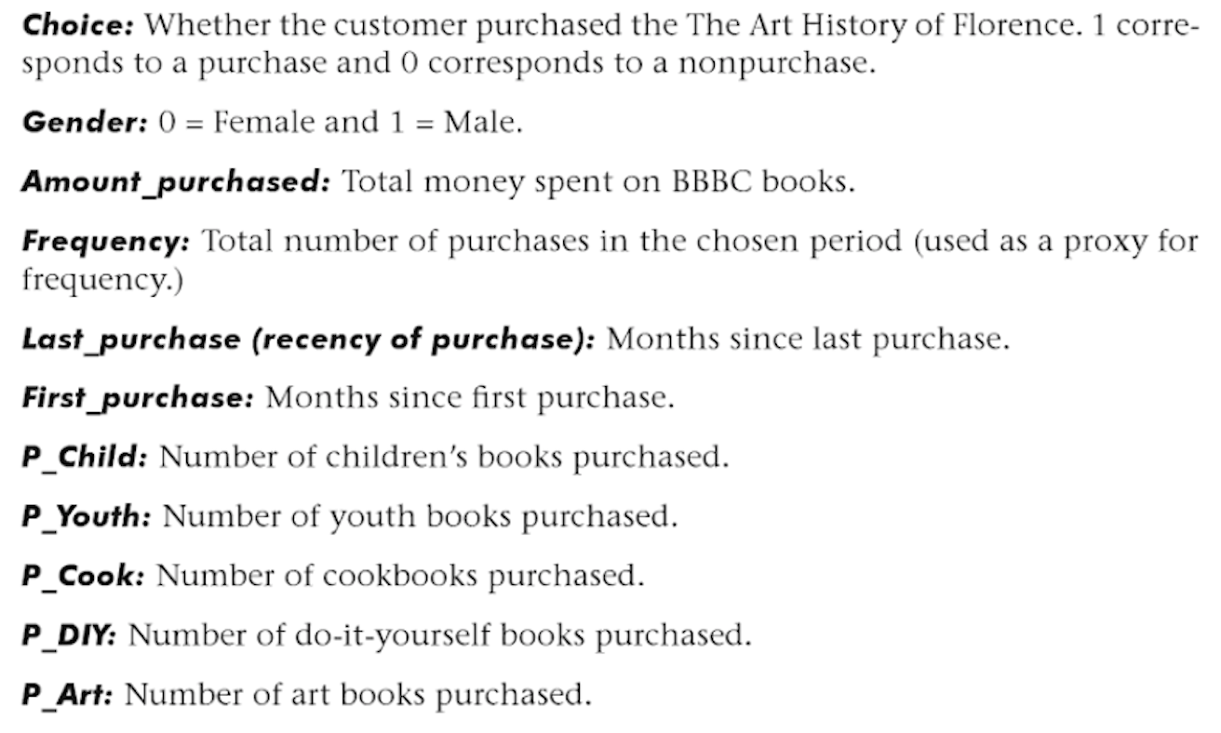
Bookbinders
For this case analysis, we will use a subset of the database available to BBBC. It consists of data for 400 customers who purchased the book and 1200 customers who did not, thereby over-representing the response group. The dependent variable for the analysis is Choice – purchase or no purchase of the book. BBBC also selected several independent variables that it thought might explain the observed choice behavior. The descriptions of the variables are:

Slide 19
Bookbinders
BBBC is evaluating three different modeling methods: ordinary linear regression, a logit model, and support vector machines. While they want to isolate the factors that most influenced customers to by the book, they also want to develop a highly accurate model.
Summarize the results of your analysis for the three models. The training, testing, and prediction data can be found on Blackboard.
Interpret the results of the models. In particular, for models the influential covariates and their coefficients, provide insights.
BBBC is considering a similar mail campaign in the Midwest where it has data for 50,000 customers. Such mailings typically promote several books. The allocated cost of the mailing is $0.65/addressee (including postage) for the art book, and the book costs $15 to purchase and mail. The company allocates overhead to each book at 45% of cost. The selling price of the book is $31.95. Based on the model, which customers should Bookbinders target? How much more profit would you expect the company to generate using these models as compare to sending the mail offer to the entire list.
Please also summarize the advantages and disadvantages of the three models, as you experienced in the modeling exercise. Should the company develop expertise in either (or all) of these methods to develop in-house capability to evaluate its direct mail campaigns.
How would you simplify and automate your recommended method(s) for future modeling efforts at the company.

