Slide 1
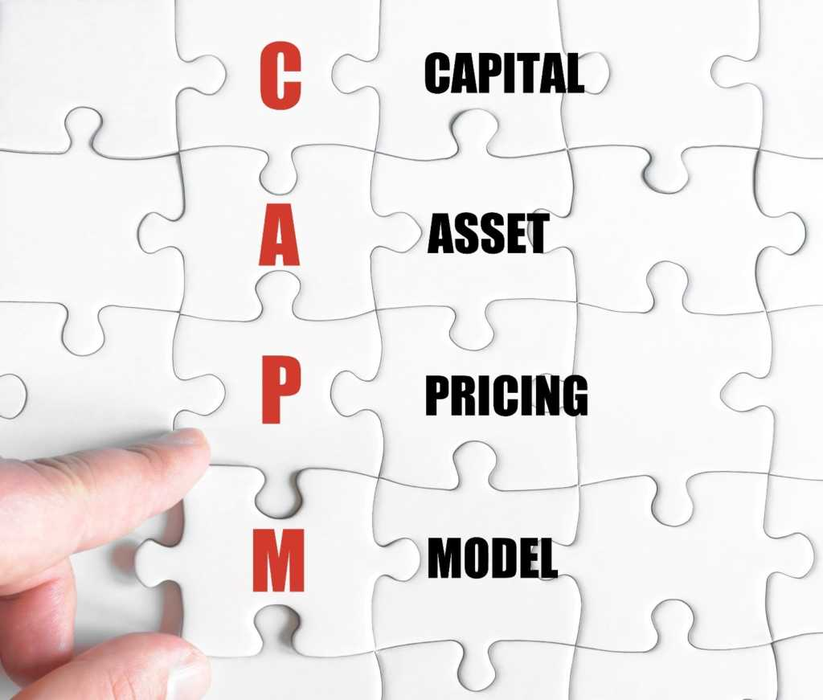

Slide 2
Topics
Introduction
What is the Capital Asset Pricing Model – CAPM
Assumptions of the Capital Asset Pricing Model
Understanding the CAPM equation
Problems with the CAPM
Capital Asset Pricing Model (CAPM) Summary

Slide 3
Introduction
The capital asset pricing model was the work of financial economist (and later, Nobel laureate in economics) William Sharpe, set out in his 1970 book "Portfolio Theory and Capital Markets." His model starts with the idea that individual investment contains two types of risk:
Systematic Risk– These are market risks that cannot be diversified away. Interest rates, recessions, and wars are examples of systematic risks.
Unsystematic Risk – Also known as "specific risk," this risk is specific to individual stocks and can be diversified away as the investor increases the number of stocks in his or her portfolio. In more technical terms, it represents the component of a stock's return that is not correlated with general market moves.

Slide 4
Modern portfolio theory shows that specific risk can be removed through diversification.
The trouble is that diversification still does not solve the problem of systematic risk; even a portfolio of all the shares in the stock market can't eliminate that risk.
Therefore, when calculating a deserved return, systematic risk is what most plagues investors. CAPM, therefore, evolved as a way to measure this systematic risk.

Slide 5
What is the Capital Asset Pricing Model – CAPM
The Capital Asset Pricing Model (CAPM) describes the relationship between systematic risk and expected return for assets, particularly stocks.
The CAPM is based on the idea that not all risks should affect asset prices. In particular, a risk that can be diversified away when held along with other investments in a portfolio is, in a very real way, not a risk at all. The CAPM gives us insights about what kind of risk is related to return.
CAPM is widely used throughout finance for pricing risky securities and generating expected returns for assets given the risk of those assets and cost of capital.

Slide 6
Assumptions of the Capital Asset Pricing Model
Diversification is an excellent way to shield against risk. However, diversification may include costs such as transaction and investment monitoring. This leads to an issue of cost-benefit analysis. Instead, the CAPM model assumes that:
There are no transactions costs.
Investments are infinitely divisible.
Investors can access all information and are equally informed.
CAPM ignores any associated costs of diversification, and so investors will diversify until their portfolio contains all assets on the market. Therefore, all investors will diversify until they each hold the market portfolio. Every investor holds the same portfolio.

Slide 7
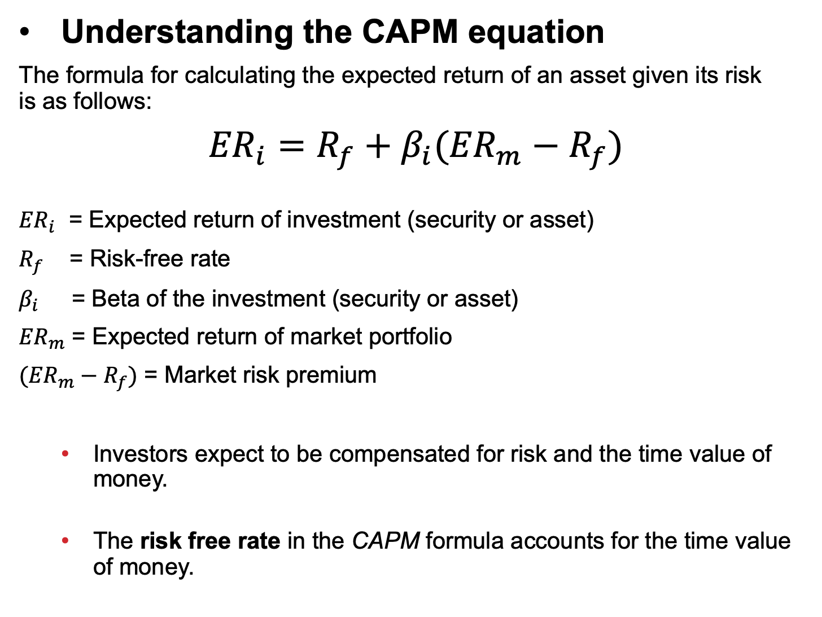
Understanding the CAPM equation
The formula for calculating the expected return of an asset given its risk is as follows:
$${ER}_{i}=R_{f}+β_{i}({ER}_{m}−R_{f})$$
${ER}_{i}$ = Expected return of investment (security or asset)
$R_{f}$ = Risk-free rate
$β_{i}$ = Beta of the investment (security or asset)
${ER}_{m}$ = Expected return of market portfolio
$({ER}_{m}−R_{f})$ = Market risk premium
Investors expect to be compensated for risk and the time value of money.
The risk free rate in the CAPM formula accounts for the time value of money.

Slide 8

The other components of the CAPM formula account for the investor taking on additional risk.
The beta of a potential investment is a measure of how much risk the investment will add to a portfolio that looks like the market.
Beta is a statistical measure which captures the relationship between the returns of a security and the returns of the market.
If a stock is riskier than the market, it will have a beta greater than 1.
If a stock has a beta of less than 1, the formula assumes it will reduce the risk of a portfolio.
Beta is calculated as the covariance between the security’s excess returns and the excess returns of the market portfolio divided by the market portfolio variance.

Slide 9
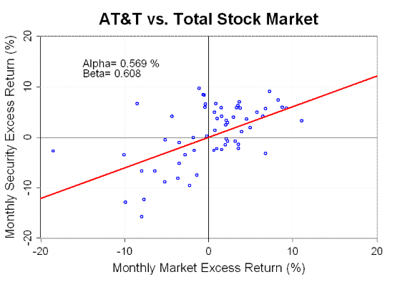
This can be more simply illustrated in the graph below. The scatter plot shows the last 5-years of monthly excess returns on AT&T stock and the monthly excess market returns.

Slide 10
The red line is the best fit line showing the relationship between the market’s excess returns and AT&T’s excess returns.
The slope of this line is the beta of AT&T. In this case, the beta is equal to 0.608, which means that when the market rises or falls by 1% the stock of AT&T tends to rise or fall by about 0.608%.
Obviously, the regression relationship between the AT&T return and the market return is far from perfect.
Many of the scatter plot points showing the actual returns for AT&T and the market portfolio fall far from the best fit line.
However, according to the CAPM these “errors” should average out in a diversified portfolio.

Slide 11
so what is alpha? : y-intercept
In the CAPM, alpha is a risk-adjusted measure of return. It measures the extent to which a security’s return exceeds or falls short of the return predicted by the CAPM.
A positive alpha indicates that, after adjusting for exposure to market risk, a security has outperformed the market portfolio.
If the CAPM is a good model, we would expect that broadly diversified portfolios should have alphas that are close to zero.
If we are able to sort stocks into portfolios which consistently generate a significantly positive or negative alpha then this would indicate a problem with the model.

Slide 12
A stock’s beta is then multiplied by the market risk premium, which is the return expected from the market above the risk-free rate.
The risk-free rate is then added to the product of the stock’s beta and the market risk premium.
The result should give an investor the required return or discount rate they can use to find the value of an asset.
The goal of the CAPM formula is to evaluate whether a stock is fairly valued when its risk and the time value of money are compared to its expected return.

Slide 13
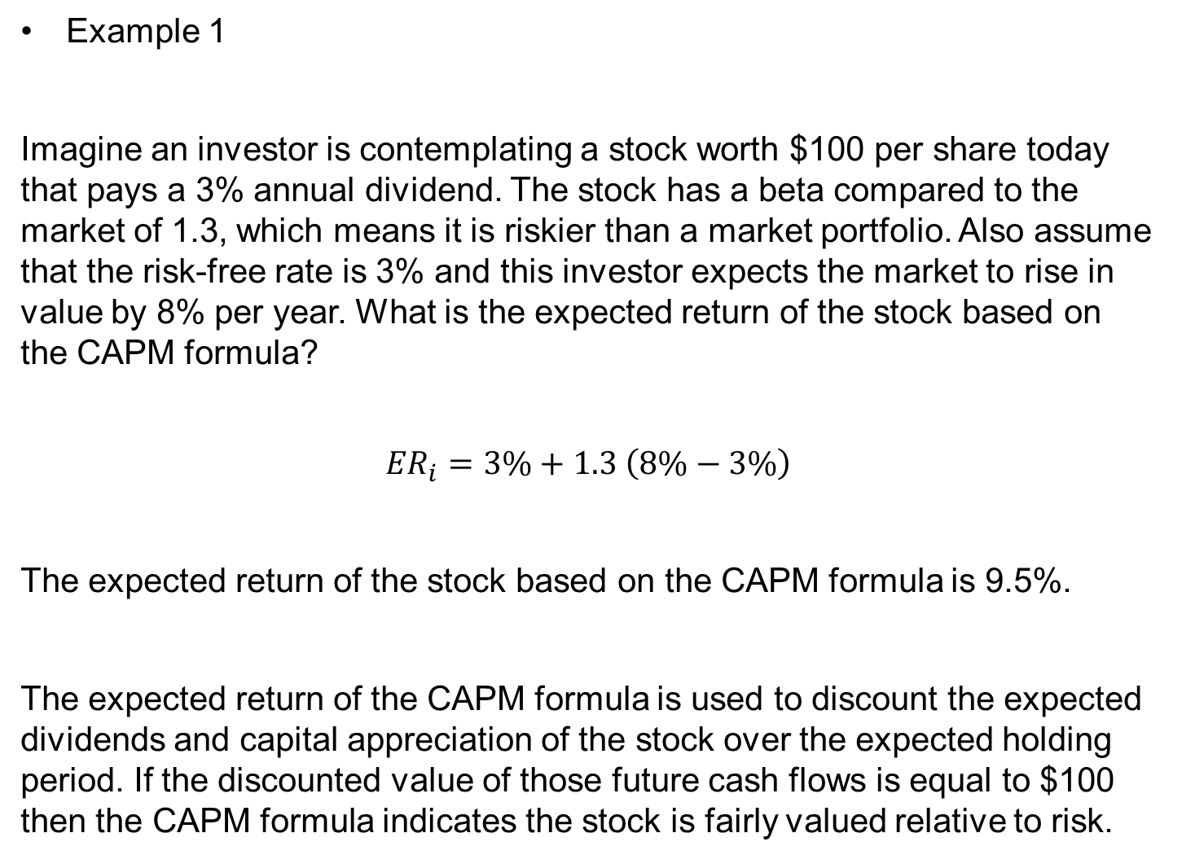
Example 1
Imagine an investor is contemplating a stock worth $100 per share today that pays a 3% annual dividend. The stock has a beta compared to the market of 1.3, which means it is riskier than a market portfolio. Also assume that the risk-free rate is 3% and this investor expects the market to rise in value by 8% per year. What is the expected return of the stock based on the CAPM formula?
$${ER}_{i}=3\%+1.3 \left(8\%−3\%\right)$$
The expected return of the stock based on the CAPM formula is 9.5%.
The expected return of the CAPM formula is used to discount the expected dividends and capital appreciation of the stock over the expected holding period. If the discounted value of those future cash flows is equal to $100 then the CAPM formula indicates the stock is fairly valued relative to risk.

Slide 14

Example 2
If the risk-free rate equals 4% and a stock with a beta of 0.8 has an expected return of 10%, what is the expected return of market?
$$10\%=4\%+0.75 ({ER}_{m}−4\%)$$
The expected return of the market on the CAPM formula is 12%.

Slide 15
Problems with the CAPM
There are several assumptions behind the CAPM formula that have been shown not to hold in reality. Despite these issues, the CAPM formula is still widely used because it is simple and allows for easy comparisons of investment alternatives.
Including beta in the formula assumes that risk can be measured by a stock’s price volatility. However, price movements in both directions are not equally risky. The look-back period to determine a stock’s volatility is not standard because stock returns (and risk) are not normally distributed.

Slide 16
The CAPM also assumes that the risk-free rate will remain constant over the discounting period.
The market portfolio that is used to find the market risk premium is only a theoretical value and is not an asset that can be purchased or invested in as an alternative to the stock. Most of the time, investors will use a major stock index, like the S&P 500, to substitute for the market, which is an imperfect comparison.
The most serious critique of the CAPM is the assumption that future cash flows can be estimated for the discounting process. If an investor could estimate the future return of a stock with a high level of accuracy, the CAPM would not be necessary.

Slide 17
Practical value of CAPM
Considering the critiques of the CAPM and the assumptions behind its use in portfolio construction, it might be difficult to see how it could be useful. However, using the CAPM as a tool to evaluate the reasonableness of future expectations or to conduct comparisons can still have some value.
Imagine an advisor who has proposed adding a stock to a portfolio with a $100 share price. The advisor uses the CAPM to justify the price with a discount rate of 13%. The advisor’s investment manager can take this information and compare it to the company’s past performance and its peers to see if a 13% return is a reasonable expectation.

Slide 18
Assume in this example that the peer group’s performance over the last few years was a little better than 10% while this stock had consistently underperformed with 9% returns. The investment manager shouldn’t take the advisor’s recommendation without some justification for the increased expected return.
An investor can also use the concepts from the CAPM and efficient frontier to evaluate their portfolio or individual stock performance compared to the rest of the market. For example, assume that an investor’s portfolio has returned 10% per year for the last 3 years with a standard deviation of returns (risk) of 10%. However, the market averages have returned 10% for the last 3 years with a risk of 8%.
The investor could use this observation to reevaluate how their portfolio is constructed and which holdings may not be on the SML. This could explain why the investor’s portfolio is to the right of the CML. If the holdings that are either dragging on returns or have increased the portfolio’s risk disproportionately can be identified, the investor can make changes to improve returns.

Slide 19
Capital Asset Pricing Model (CAPM) Summary
The CAPM uses the principles of Modern Portfolio Theory to determine if a security is fairly valued.
It relies on assumptions about investor behaviors, risk and return distributions, and market fundamentals that don’t match reality.
The underlying concepts of CAPM and the associated efficient frontier can help investors understand the relationship between expected risk and reward as they make better decisions about adding securities to a portfolio.

Slide 20
Finding Beta
Go to Yahoo Finance, and download the stock prices for
1. Google
2. Facebook
3. S&P 500 (market).
Use the stock prices to compute the excess returns, and using the S&P 500 as the market, compute betas for Google and Facebook.
Now demo R-Studio!

