Slide 1
Decision Trees

Slide 2
What is a Decision Tree ? How does it work ?
Decision tree is a type of supervised learning algorithm that can be used in both regression and classification problems.
It works for both categorical and continuous input and output variables.
In this technique, we split the population or sample into two or more homogeneous sets (or sub-populations) based on most significant splitter / differentiator in input variables.

Slide 3
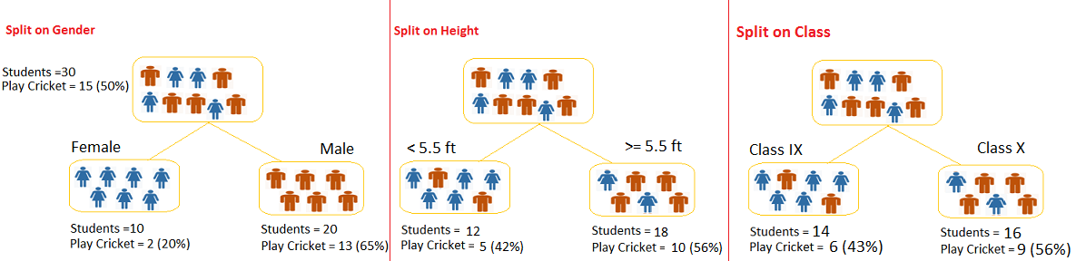
Example:-
Let’s say we have a sample of 30 students with three variables Gender (Boy/ Girl), Class( IX/ X) and Height (5 to 6 ft). 15 out of these 30 play cricket in leisure time. Now, I want to create a model to predict who will play cricket during leisure period? In this problem, we need to segregate students who play cricket in their leisure time based on highly significant input variable among all three.
This is where decision tree helps, it will segregate the students based on all values of three variable and identify the variable, which creates the best homogeneous sets of students (which are heterogeneous to each other). In the snapshot below, you can see that variable Gender is able to identify best homogeneous sets compared to the other two variables.
Now the question: How do we do this? Various algorithms!

Slide 4
Important Terminology related to Decision Trees
Let’s look at the basic terminology used with Decision trees:
Root Node: It represents entire population or sample and this further gets divided into two or more homogeneous sets.
Splitting: It is a process of dividing a node into two or more sub-nodes.
Decision Node: When a sub-node splits into further sub-nodes, then it is called decision node.
Leaf/ Terminal Node: Nodes do not split is called Leaf or Terminal node.
Pruning: When we remove sub-nodes of a decision node, this process is called pruning. You can say opposite process of splitting.

Slide 5
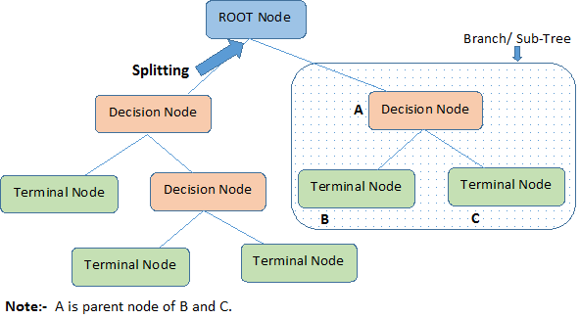
Branch / Sub-Tree: A sub section of entire tree is called branch or sub-tree.
Parent and Child Node: A node, which is divided into sub-nodes is called parent node of sub-nodes where as sub-nodes are the child of parent node.
These are the terms commonly used for decision trees.

Slide 6
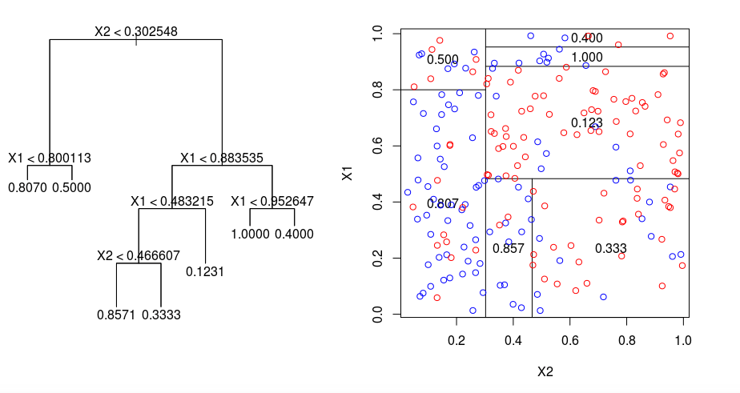
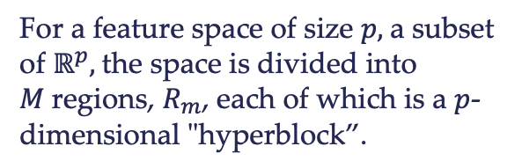
Types of Decision Trees
Regression Trees
Let's take a look at the image below, which helps visualize the nature of partitioning carried out by a Regression Tree.
This shows a regression tree fit to a random dataset.
The left visualizations show a series of splitting rules, starting at the top of the tree.
Splitting Left is yes and right is no! The leaf nodes show the predicted response.
The right visualization shows the final feature space fully split.
Notice that every split of the domain is aligned with one of the feature axes.
The concept of axis parallel
splitting generalizes straightforwardly
to dimensions greater than two.
For a feature space of size $p,$a subset of $ℝ^{p},$the space is divided into $M$regions, $R_{m}$, each of which is a $p$-dimensional "hyperblock”.

Slide 7

In order to build a regression tree, you first use recursive binary splitting to grow a large tree on the training data, stopping only when each terminal node has fewer than some minimum number of observations.
Recursive Binary Splitting is a greedy and top-down algorithm used to minimize the Residual Sum of Squares (RSS), an error measure also used in linear regression settings.
The RSS = SSE, in the case of a partitioned feature space with M partitions is given by:
Beginning at the top of the tree, you split it into 2 branches, creating a partition of 2 spaces. You then carry out this particular split at the top of the tree multiple times and choose the split of the features that minimizes the (current) RSS.

Slide 8
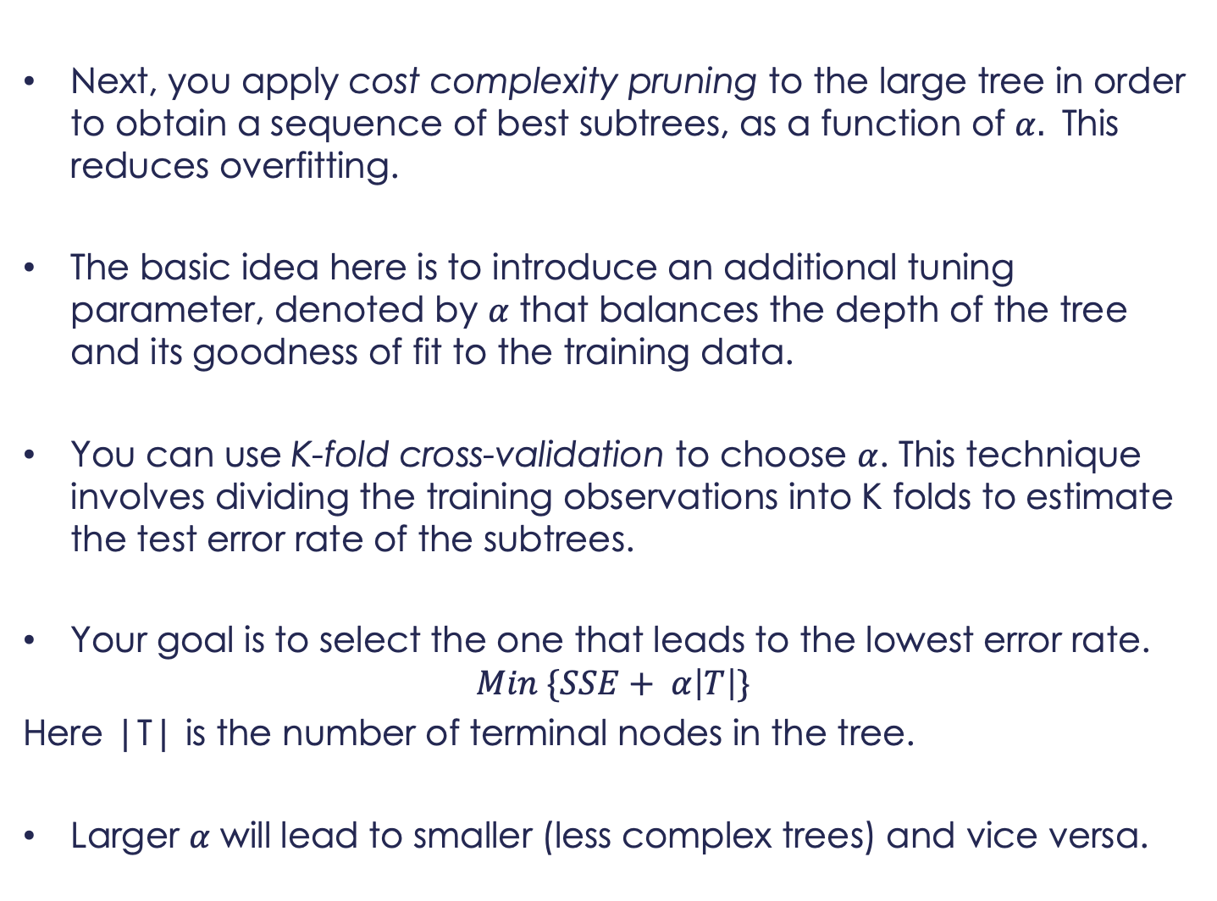
Next, you apply cost complexity pruning to the large tree in order to obtain a sequence of best subtrees, as a function of $α.$ This reduces overfitting.
The basic idea here is to introduce an additional tuning parameter, denoted by $α$ that balances the depth of the tree and its goodness of fit to the training data.
You can use K-fold cross-validation to choose $α$. This technique involves dividing the training observations into K folds to estimate the test error rate of the subtrees.
Your goal is to select the one that leads to the lowest error rate.
$$Min \{SSE+ α\left|T\right|\}$$
Here |T| is the number of terminal nodes in the tree.
Larger $α$ will lead to smaller (less complex trees) and vice versa.

Slide 9
Classification Trees
A classification tree is very similar to a regression tree, except that it is used to predict a qualitative response rather than a quantitative one.
Recall that for a regression tree, the predicted response for an observation is given by the mean response of the training observations that belong to the same terminal node. In contrast, for a classification tree, you predict that each observation belongs to the most commonly occurring class of training observations in the region to which it belongs.
In interpreting the results of a classification tree, you are often interested not only in the class prediction corresponding to a particular terminal node region, but also in the class proportions among the training observations that fall into that region.

Slide 10
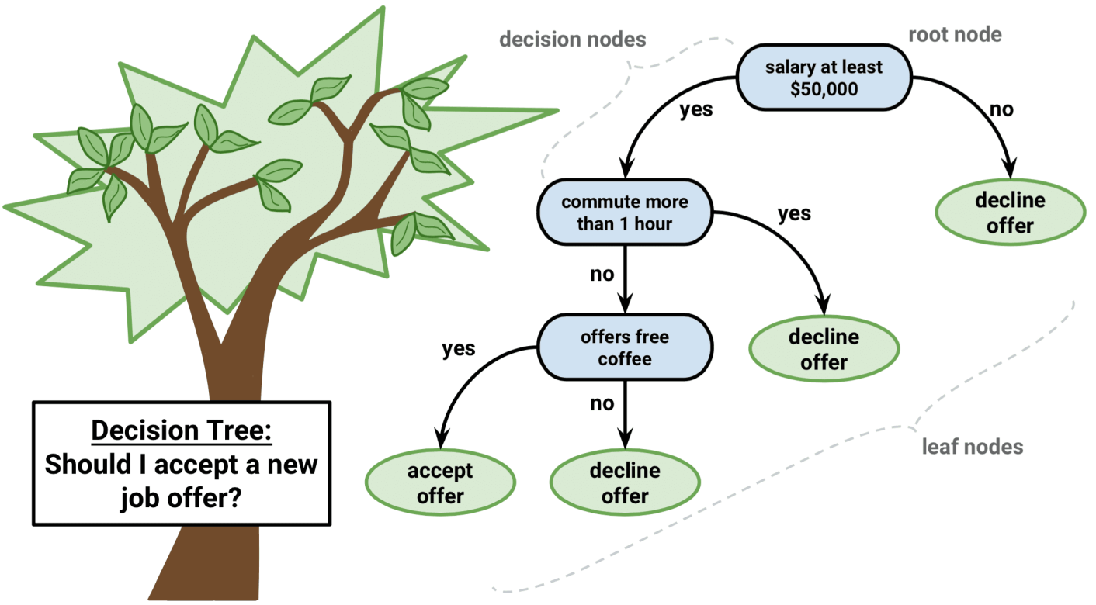
The task of growing a classification tree is quite similar to the task of growing a regression tree.
Just as in the regression setting, you use recursive binary splitting to grow a classification tree.
However, in the classification setting, Residual Sum of Squares cannot be used as a criterion for making the binary splits. Instead, you can use either of these 3 methods:

Slide 11
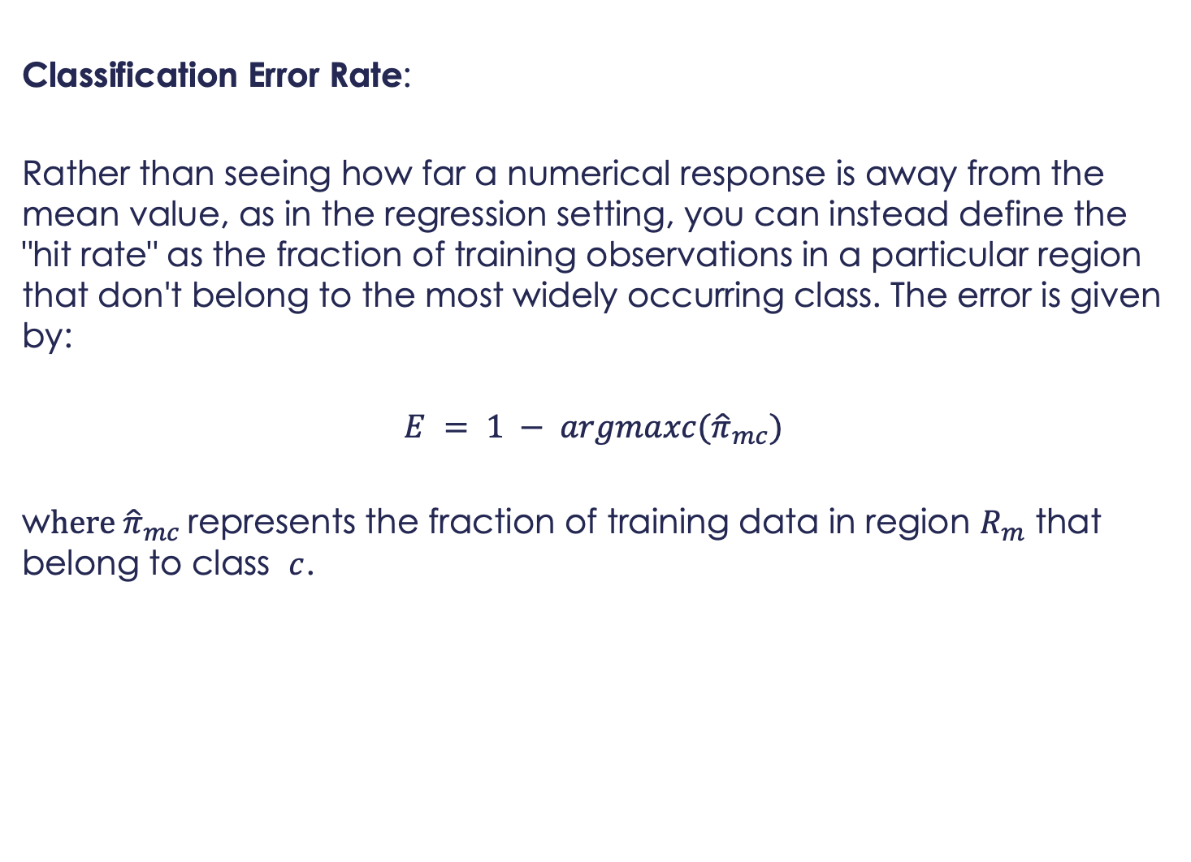
Classification Error Rate:
Rather than seeing how far a numerical response is away from the mean value, as in the regression setting, you can instead define the "hit rate" as the fraction of training observations in a particular region that don't belong to the most widely occurring class. The error is given by:
$$E = 1 − argmaxc({\hat{π}}_{mc})$$
w$here {\hat{π}}_{mc}$represents the fraction of training data in region $R_{m}$ that belong to class $c$.

Slide 12
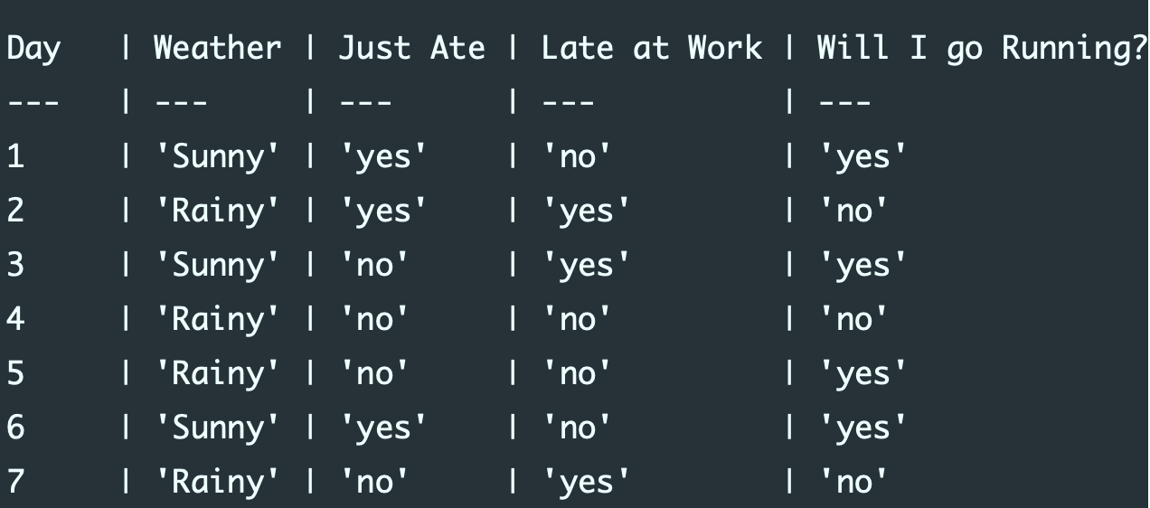
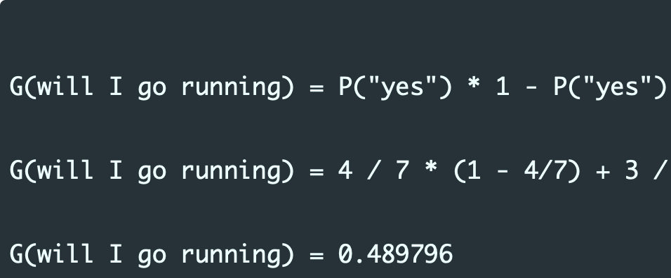
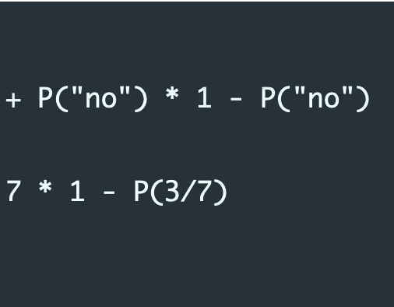
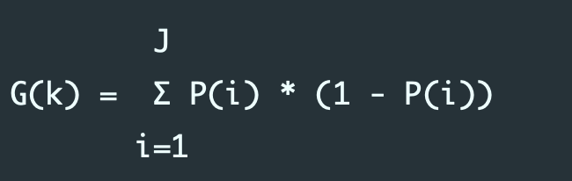
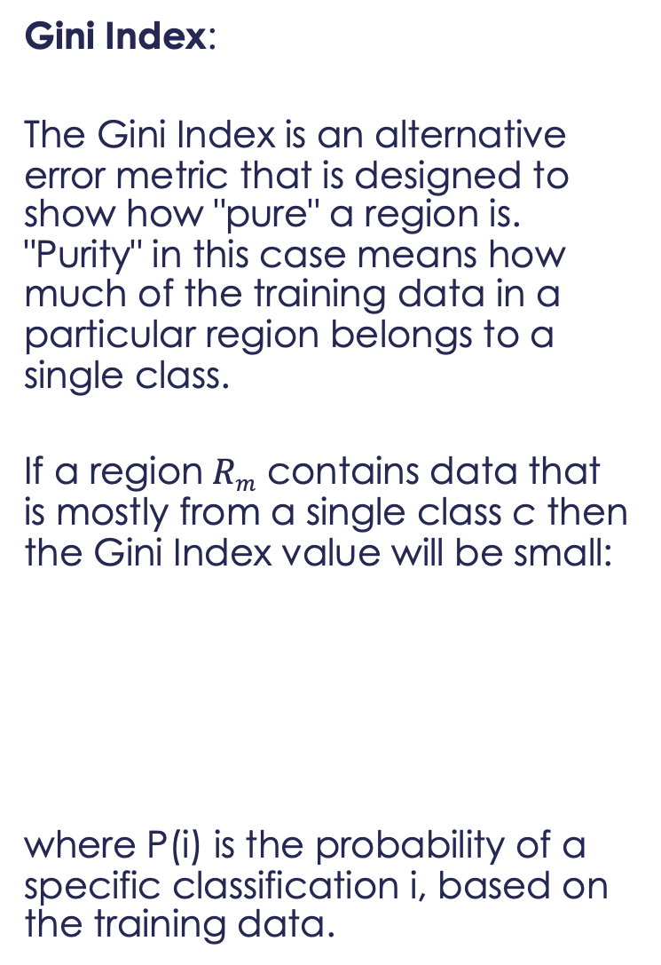
Gini Index:
The Gini Index is an alternative error metric that is designed to show how "pure" a region is. "Purity" in this case means how much of the training data in a particular region belongs to a single class.
If a region$Rm$ contains data that is mostly from a single class c then the Gini Index value will be small:
where P(i) is the probability of a specific classification i, based on the training data.
This means there is a 48.97% chance of a new data point being incorrectly classified, based on the observed training data we have at our disposal.

Slide 13
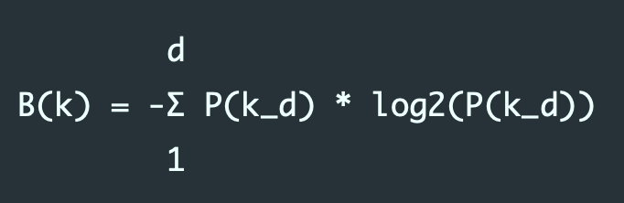
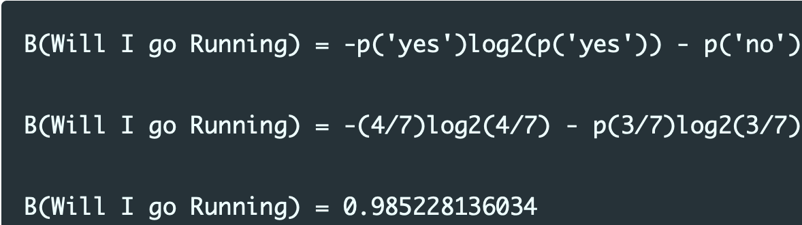
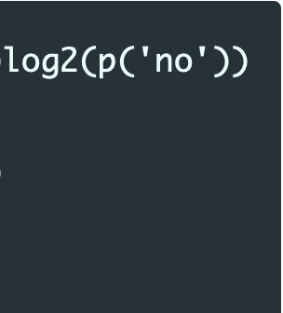
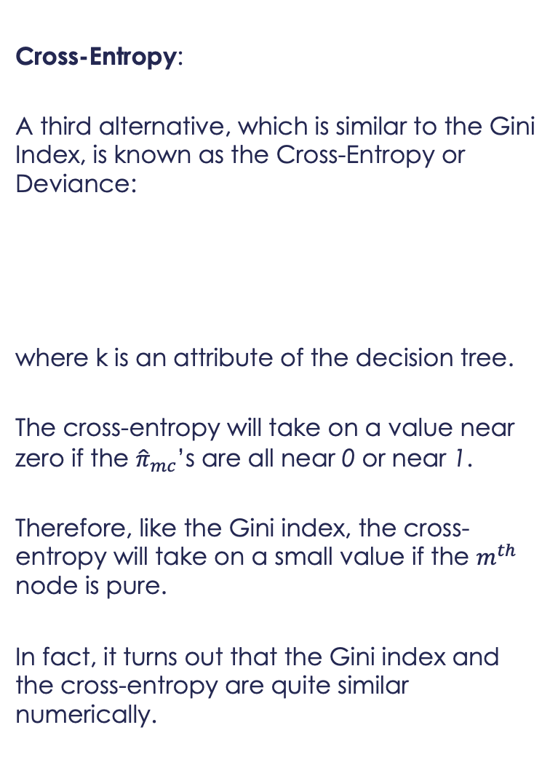
Cross-Entropy:
A third alternative, which is similar to the Gini Index, is known as the Cross-Entropy or Deviance:
where k is an attribute of the decision tree.
The cross-entropy will take on a value near zero if the ${\hat{π}}_{mc}$’s are all near 0 or near 1.
Therefore, like the Gini index, the cross-entropy will take on a small value if the $m^{th}$ node is pure.
In fact, it turns out that the Gini index and the cross-entropy are quite similar numerically.
So the total entropy for the variable Will I go running is a small amount less than 1, indicating that there is slightly less than a 50% chance that the decision to go running will be yes/no.

Slide 14
When building a classification tree, either the Gini index or the cross-entropy are typically used to evaluate the quality of a particular split, since they are more sensitive to node purity than is the classification error rate.
The Gini index is often preferred as it does not include an expensive log computation.
Any of these 3 approaches might be used when pruning the tree, but the classification error rate is preferable if measuring the prediction accuracy of the final pruned tree is the goal.

Slide 15
Advantages and Disadvantages of Decision Trees
Advantages
Easy to Understand: Decision tree output is very easy to understand even for people from non-analytical background. It does not require any statistical knowledge to read and interpret them. Its graphical representation is very intuitive and users can easily relate their hypothesis.
Useful in Data exploration: Decision tree is one of the fastest way to identify most significant variables and relation between two or more variables. With the help of decision trees, we can create new variables / features that has better power to predict target variable. For example, we are working on a problem where we have information available in hundreds of variables, there decision tree will help to identify most significant variable.

Slide 16
Less data cleaning required: It requires less data cleaning compared to some other modeling techniques. It is not influenced by outliers and missing values to a fair degree.
Data type is not a constraint: It can handle both numerical and categorical variables.
Non Parametric Method: Decision tree is considered to be a non-parametric method. This means that decision trees have no assumptions about the space distribution and the classifier structure.

Slide 17
Disadvantages
Overfitting: One of the most practical difficulty for decision tree models. In other words, while the tree may perform well with the training data, they fail with the testing data. This problem gets solved by setting constraints on model parameters and pruning.
Not robust: Uncertainties (small changes) in the data can have a significant impact on the decisions.
By aggregating many decision trees, using methods like bagging, random forests, and boosting, the predictive performance of decision trees can be substantially improved.

Slide 18
Regression & Classification
Decision Trees demos in R-Studio

Slide 19
Dow Jones Index Case Study
Data Set Information:
In predicting stock prices you collect data over some period of time - day, week, month, etc. But you cannot take advantage of data from a time period until the next increment of the time period. For example, assume you collect data daily. When Monday is over you have all of the data for that day. However you can invest on Monday, because you don't get the data until the end of the day. You can use the data from Monday to invest on Tuesday. In our research each record (row) is data for a week. Each record also has the percentage of return that stock has in the following week (percent_change_next_weeks_price). Ideally, you want to determine which stock will produce the greatest rate of return in the following week. This can help you train and test your algorithm. Some of these attributes might not be use used in your research. They were originally added to our database to perform calculations. (Brown, Pelosi & Dirska, 2013) used percent_change_price, percent_change_volume_over_last_wk, days_to_next_dividend, and percent_return_next_dividend. We left the other attributes in the dataset in case you wanted to use any of them. Of course what you want to maximize is percent_change_next_weeks_price. Training data vs Test data: In (Brown, Pelosi & Dirska, 2013) we used quarter 1 (Jan-Mar) data for training and quarter 2 (Apr-Jun) data for testing. Interesting data points: If you use quarter 2 data for testing, you will notice something interesting in the week ending 5/27/2011 every Dow Jones Index stock lost money.
More info at:
Brown, M. S., Pelosi, M. & Dirska, H. (2013). Dynamic-radius Species-conserving Genetic Algorithm for the Financial Forecasting of Dow Jones Index Stocks. Machine Learning and Data Mining in Pattern Recognition, 7988, 27-41.

Slide 20
Dow Jones Index Case Study
Attribute Information:
quarter: the yearly quarter (1 = Jan-Mar; 2 = Apr=Jun).
stock: the stock symbol.
date: the last business day of the work (this is typically a Friday)
open: the price of the stock at the beginning of the week
high: the highest price of the stock during the week
low: the lowest price of the stock during the week
close: the price of the stock at the end of the week
volume: the number of shares of stock that traded hands in the week
percent_change_price: the percentage change in price throughout the week
percent_chagne_volume_over_last_wek: the percentage change in the number of shares of
stock that traded hands for this week compared to the previous week
previous_weeks_volume: the number of shares of stock that traded hands in the previous week
next_weeks_open: the opening price of the stock in the following week
next_weeks_close: the closing price of the stock in the following week
percent_change_next_weeks_price: the percentage change in price of the stock in the
following week days_to_next_dividend: the number of days until the next dividend
percent_return_next_dividend: the percentage of return on the next dividend
Data on BB: dow_jones_index

Slide 21
Dow Jones Index Case Study
Training data vs Test data: Use quarter 1 (Jan-Mar) data for training and quarter 2 (Apr-Jun) data for testing.
Task: Build models to predict stock prices and evaluate risks of stocks.
Try different models (LM, Decision Trees/SVR) to test for accuracy. Discuss appropriateness of model and insights from findings. Discuss prediction accuracy. Discuss risks of different stocks using CAPM.
Hint: Try lagged variables?

