Slide 1
Market Segmentation: Adidas
DA6823.902 – Practicum I
Collin Real
yhi267

Slide 2
Introduction
- Create a demographic profile of our target customer
Engaging the audience
Visual aids
Final tips & takeaways

Slide 3

The power of communication

Slide 4

Overcoming nervousness
Confidence-building strategies

Slide 5
Engaging the audience
Make eye contact with your audience to create a sense of intimacy and involvement
Weave relatable stories into your presentation using narratives that make your message memorable and impactful
Encourage questions and provide thoughtful responses to enhance audience participation
Use live polls or surveys to gather audience opinions, promoting engagement and making sure the audience feel involved

Slide 6
Selecting visual aids
Enhancing your presentation

Slide 7
Variables of Interest
Target Variable
Adidas – Shoes/Footwear Brand
Single Driver Variables
“I make my clothes last a long time”
”Often buy clothes I don’t really need”
“Important to look attractive to others”
”Clothes are discount department are just as good as department
”Dress to please myself”

Slide 8
ABSTRACT CONSTRUCTS
Does our customer purchase products online?
“It’s safe to make purchases online”
“I am more likely to buy online than in store”
“I use my electronic devices when shopping to look for a better deal”
“I like to hear about new products/services through email”
“The internet has changed how I shop for products”
What is our customer’s social media habits?
“Buy product recommended by friend on social media”
“I follow favorite brand/company on social media”
“I use social media to tell people about products I like”
“More likely to buy product on social media”
“Trust product information on social media over other sources”

Slide 9
Principal Components Analysis
Your ability to communicate effectively will leave a lasting impact on your audience
Effectively communicating involves not only delivering a message but also resonating with the experiences, values, and emotions of those listening

Slide 10
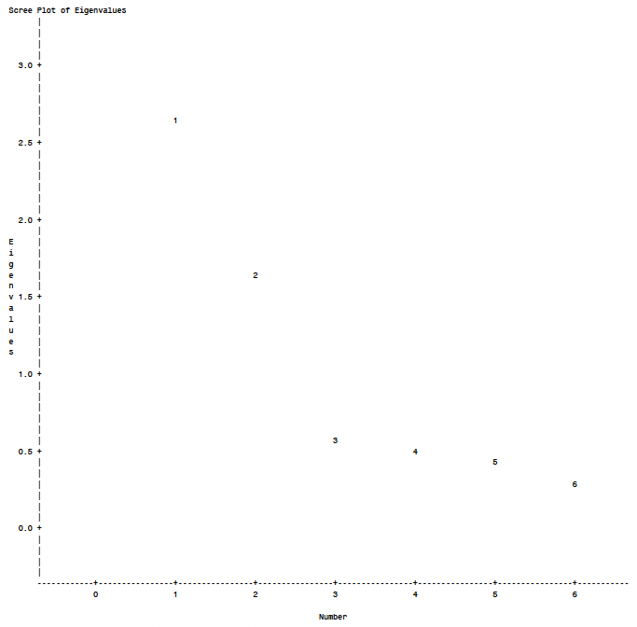
Scree Plot

Slide 11
Rotated Factor Pattern
Target Variable
Adidas – Shoes/Footwear Brand
Single Driver Variables
“I make my clothes last a long time”
”Often buy clothes I don’t really need”
“Important to look attractive to others”
”Clothes are discount department are just as good as department
”Dress to please myself”

Slide 12
Navigating Q&A sessions
Know your material in advance
Anticipate common questions
Rehearse your responses
Maintaining composure during the Q&A session is essential for projecting confidence and authority. Consider the following tips for staying composed:
Stay calm
Actively listen
Pause and reflect
Maintain eye contact

Slide 13
Dynamic delivery
Learn to infuse energy into your delivery to leave a lasting impression
One of the goals of effective communication is to motivate your audience
Metric | Measurement | Target | Actual
Audience attendance | # of attendees | 150 | 120
Engagement duration | Minutes | 60 | 75
Q&A interaction | # of questions | 10 | 15
Positive feedback | Percentage (%) | 90 | 95
Rate of information retention | Percentage (%) | 80 | 85

Slide 14
Speaking engagement metrics
Impact factor | Measurement | Target | Achieved
Audience interaction | Percentage (%) | 85 | 88
Knowledge retention | Percentage (%) | 75 | 80
Post-presentation surveys | Average rating | 4.2 | 4.5
Referral rate | Percentage (%) | 10 | 12
Collaboration opportunities | # of opportunities | 8 | 10

Slide 15
Thank you
Brita Tamm
502-555-0152
brita@firstupconsultants.com
www.firstupconsultants.com

