Slide 1

It can happen to you: Sources and proximity of lack of reproducibility
Ross Hardison
Penn State University
June 6, 2016

Slide 2
Sources of lack of reproducibility
A. Fabrication
B. Inadequate measures for data quality and reproducibility
C. Biased reporting of results
D. Inappropriate analysis
E. Incomplete description of methods

Slide 3
A. Fabrication: Infamous examples
William Summerlin (1974) Memorial Sloan-Kettering Research Institute
Transplant research: expected change in coat color; drew patches on mice with a black marker pen
Eric Poehlman (1992-2002), University of Vermont
Fabricated data in 10 research papers on hormone replacement therapy and ageing
Andrew Wakefield (1998): Lancet paper linking autism with MMR vaccine
“highly selective reporting of data”
Hwang Woo-Suk (2004-2005) : papers in Science on production of human embryonic stem cells by somatic cell nuclear transfer
Data fabrication
Later today: Cancer treatment predictions from transcriptomes – was Anil Potti guilty of fabrication, or was it all data mix-ups and poor analysis?
Selected examples from presentation by Chris Willmott (University of Leicester)
http://www.slideshare.net/cjrw2/infamous-cases-of-research-misconduct

Slide 4
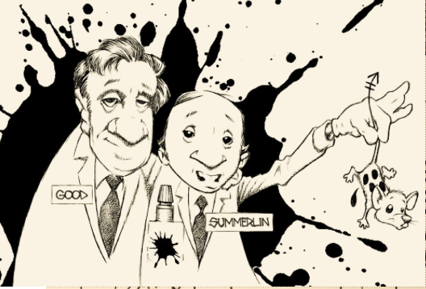
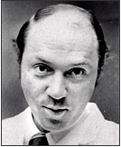
Is it just someone else’s problem?
When I was training, I thought you’d have to be crazy to think you’d get away with fabrication
Seriously – using your marker pen to paint mice???

Slide 5
Is fabrication rare or common?
I’ve reviewed cases of fabrication at this University, under the direction of the Office for Research Protections
If you suspect data fabrication or other research misconduct, contact Candice A. "Candy" Yekel, Associate Vice President for Research, Director, Office for Research Protections
Last year, a Ph.D. thesis and degree were withdrawn because of plagiarism
It does happen!

Slide 6
B. Inadequate measures for data quality and reproducibility
Errors arising from not knowing what is reproducible
More later from Dr. Qunhua Li
Back when we had 3 determinations in an assay for each condition, reproducibility or not was pretty obvious
Data space now is enormous
When you have hundreds of millions of observations (e.g. mapped sequencing reads), how do you assess reproducibility in an objective manner?

Slide 7
C. Biased reporting of results
Examples
Reporting only some of the results – the ones that support the major conclusion
Showing only portions of a Western blot
Not using fully validated reagents
More from Dr. Broach on this topic (Begley papers)
One remedy: Have a different investigator replicate the result

Slide 8
D. Inappropriate analysis
Analysis is misleading
Usually inadvertant
Have plenty of high quality data in a well-designed experiment
But are the results of your analyses robust and biologically meaningful?

Slide 9
General example: Choice of negative controls
Genomes of most eukaryotes are large, complex, and highly heterogeneous
The sequences are not random
What do we mean by the “null expectation” when we calculate enrichment?
This question does not have one common answer for all applications
Random sequences of the same base composition as the targets of interest
Randomly chosen DNA segments in the vicinity of the targets of interest (Genome structure correction)
Others

Slide 10
Specific example: Motif enrichment
Paper in Nature with high resolution ChIP-exo data on binding sites for TFIIB and POL2 in a mammalian cell line
Venters and Pugh (2013) Nature 502:53-58
Valuable data; new, comprehensive insights into promoters genome-wide, defined by the key proteins that act at promoters
Found that these biochemically defined promoters have matches to Core Promoter Elements
Also found less enrichment in negative controls

Slide 11
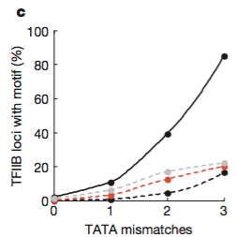
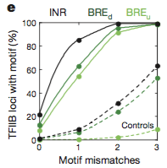
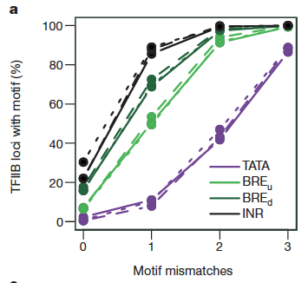
But are the motifs enriched in the promoters?
Brief Communication Arising paper says that the motifs are not enriched
Siebert and Söding (2014) Nature 511: E11-E12
Used a different method for calculating frequency in negative controls
Venters and Pugh retracted the paper, despite the fact that the basic data are sound.
Venters and Pugh
Siebert and Söding

Slide 12
D. Inappropriate analysis: summary
This may be one of the most pervasive problems in scientific research
It is certainly a huge issue in Big Data
In genomics, the negative dataset is not always obvious
Use more than one!
Even with appropriate negative datasets, care is needed in applying the analysis
Vetting by independent analysts

Slide 13
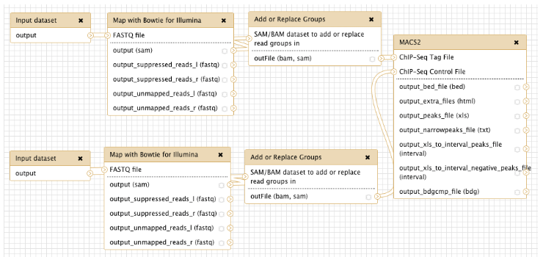
E. Incomplete description of methods
If you don’t tell people what you did, how can they reproduce it?
This is a common problem, but it is not acceptable
Supplementary material rarely has a limit, you can explain it there
Have another researcher read the methods and ask them – Can you do this procedure following these methods?
Use workflows that you make public, e.g. via Galaxy
More later in the Boot Camp
University of Queensland, Research Computing Centre

Slide 14
Sources of lack of reproducibility
A. Fabrication
B. Inadequate measures for data quality and reproducibility
C. Biased reporting of results
D. Inappropriate analysis
E. Incomplete description of methods

