Slide 1
Modern Methods in Data Analysis Lecture 4: Correlation, Prediction, and NN
Class in basic concepts and methods, so that students who have passed are able to produce
analogous new methods
for new data types and/or issues
Versus, say, learning systems like scikit-learn that can be used with no knowledge of methods

Slide 2
Lecture contents: Neural Network
Correlation problem; regression and classification
Artificial neuron; activation function
Feed forward one hidden layer architecture; edge/connection weights
Quadratic error
Steepest (gradient) descent algorithm for minimization
Error-back propagation algorithm for finding edge weights
Example

Slide 3
Correlation: Features X (input) and features Y (target) in Data table
Problem:
Given a set of mappings F, find decision rule F∈F so that
F(X)≈Y (up to an error, of course)
That is, Ŷ=F(X) so that Ŷ ≈Y.
F must be not that big, nor that small: the number of parameters specifying F must be considerably smaller than the data size.

Slide 4
Correlation: Features X (input) and features Y (target) in Data table
F(X)≈Y (up to an error, of course)
That is, Ŷ=F(X) so that Ŷ ≈Y.
Usually, Y is just one feature.
Then F is classifier if Y is categorical, F is regression if Y is quantitative.
Quiz: What feature is quantitative?

Slide 5
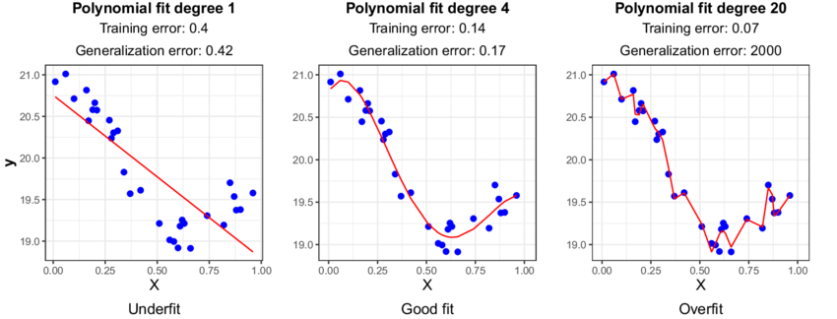
Correlation: Features X (input) and feature Y (target) in Data table
Regression
Underfitting – Overfitting: No good theory so far, 1

Slide 6
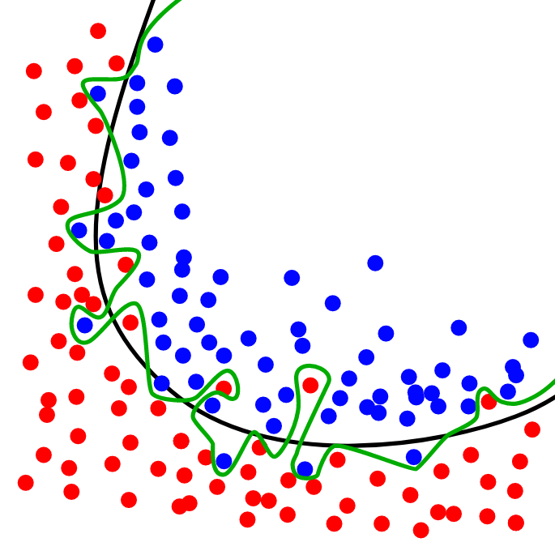
Correlation: Features X (input) and feature Y (target) in Data table
Good – Overfitting: No good theory so far, 2
Classifier

Slide 7
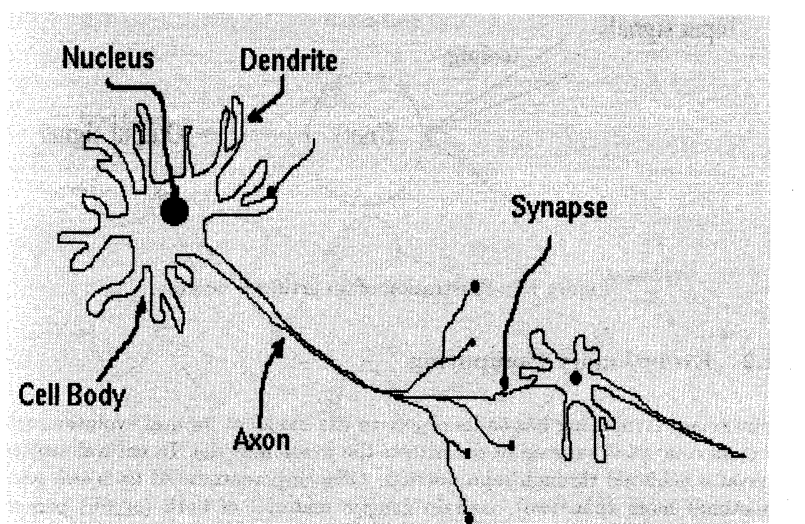
Neural Network Decision Rule
Neuron: Synapse is a point at which signal goes to other neuron.
Upon receiving enough signals, neuron fires.

Slide 8
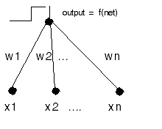
Artificial neuron
U=f(w₁*x₁+w₂*x₂+…+w_{n}*x_{n}), fires if w₁*x₁+w₂*x₂+…+w_{n}*x_{n} > a,
that is, w₁*x₁+w₂*x₂+…+w_{n}*x_{n} +a*(-1) > 0,
that is, w₁*x₁+w₂*x₂+…+w_{n}*x_{n} + w_{n+1}*x_{n+1} > 0.
a is “bias”

Slide 9
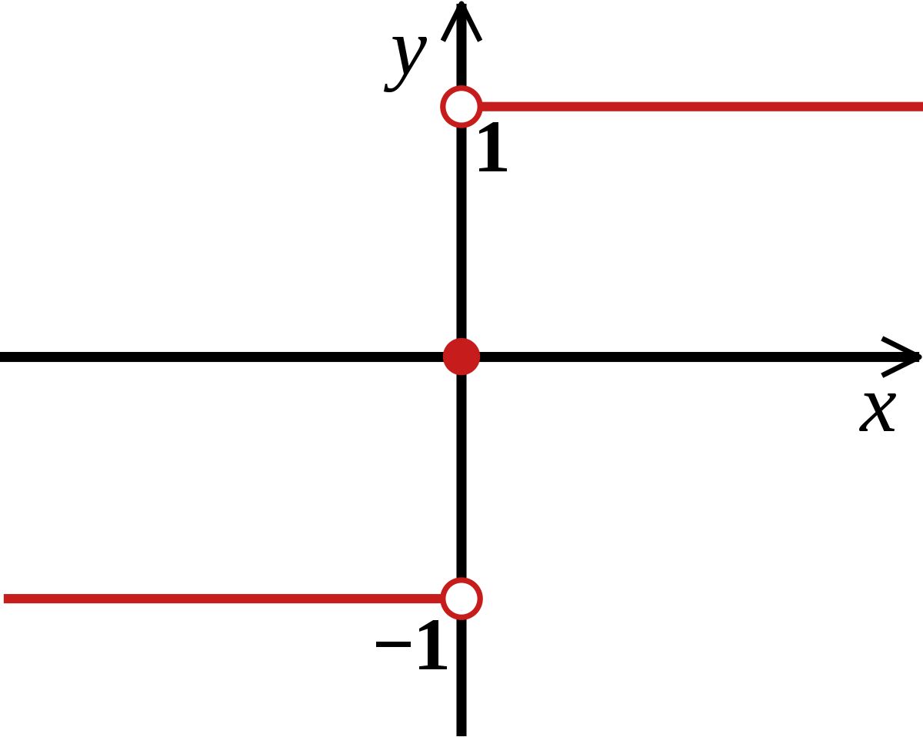
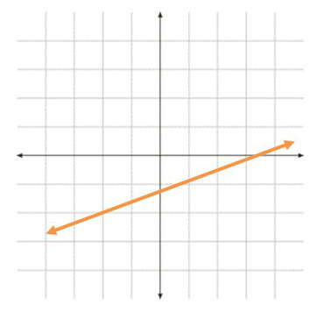
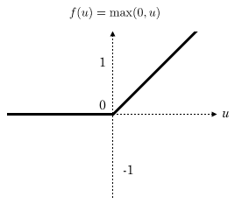
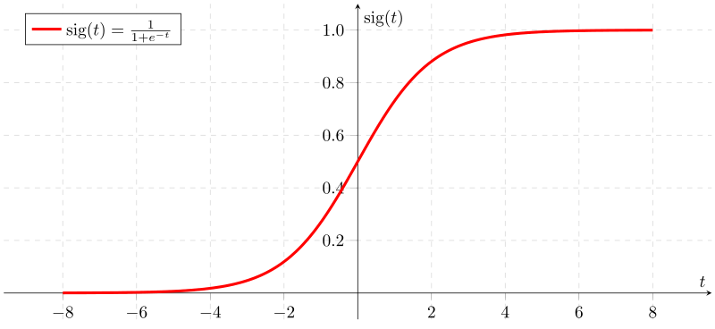
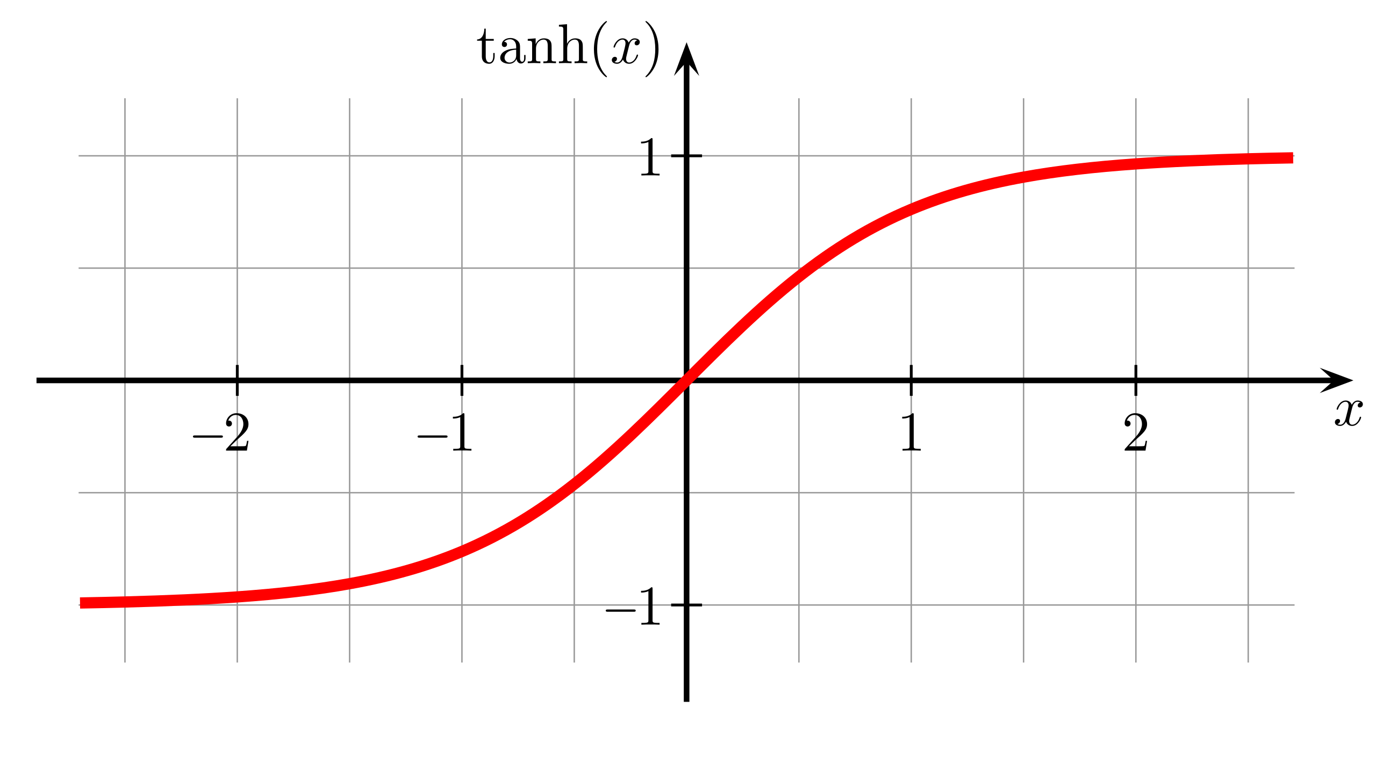
activation function u=f(w₁*x₁+w₂*x₂+…+w_{n}*x_{n})
1
2
3
4
5
Popular:
sign function û =sign(u),
linear function, û = au+b,
ReLU (Rectified linear unit), û = max(0, au+b),
sigmoid (logistic) activation function û =s(u),
s(u) = 1/(1 + exp(-u)),
5. tanh activation function û =tanh(u)=2s(2u) - 1,
A smoothed version of sign(u), a symmetric
version of s(u): tanh(-x)=- tanh(x)

Slide 10
Issue: Build a feed-forward NN to relate Iris sepal sizes with petal sizes; weights w_{ij} and v_{jk} unknown [V=(v_{jk}), W=(w_{ij})}
ŷ ₁ ŷ ₂
k
v11 v12 v21 v22 v31 v32
III1
III2
Output layer (identical)
Hidden layer (th)
II1
II2
II3
j
w21 w22 w23
w11 w12 w13 w31 w32 w33
i
I1
I2
I3
x₁ x₂ x₀ = 1 Input (linear)
Quiz: What sizes are of W and V matrices?

Slide 11
Mapping ŷ = F(x)? Hidden layer: unit j input : zj=w_{1j}∗x₁ + w_{2j}∗x₂+w_{3j}∗x₃ , vector: z=x∗W unit j output: th(zj), vector: u=th(x∗W) Output layer: unit k input=output: ∑ _{j} v_{jk}∗th(zj), vector: ŷ = th(z)*V=th(x∗W)*V
ŷ ₁ ŷ ₂
k
v11 v12 v21 v22 v31 v32
III1
III2
Output layer (identical)
Hidden layer (th)
II1
II2
II3
j
w21 w22 w23
w11 w12 w13 w31 w32 w33
i
I1
I2
I3
x₁ x₂ x₀ = 1 Input (linear)

Slide 12
Mapping ŷ = th(x∗W)*V Matrices W, V are unknown. Use data to estimate W and W. How? Minimize quadratic error! Observed: y=(y₁, y₂), Computed: ŷ=(ŷ₁, ŷ₂), Error: e = y − ŷ =(y₁− ŷ₁, y₂ − ŷ₂) Squared error E=<y− ŷ, y− ŷ > = <y − th(x*W)*V, y − th(x*W)*V >
ŷ ₁ ŷ ₂
k
v11 v12 v21 v22 v31 v32
III1
III2
Output layer (identical)
Hidden layer (th)
II1
II2
II3
j
w21 w22 w23
w11 w12 w13 w31 w32 w33
i
I1
I2
I3
x₁ x₂ x₀ = 1 Input (linear)

Slide 13
Minimize quadratic error over unknown W, V: E=<y− ŷ, y− ŷ >/2 = <y − th(x∗W)∗V, y − th(x∗W)∗V>/2 th(u) = 2(1+ e^{-2u})⁻¹ - 1
A journey into general optimization of functions H(x)
Gradient descent: sequence x0, x1,…, xn, …
x(t+1)=x(t) −μ∗grad(H(x(t)), grad(H(x))=(∂H/∂x_{i})
- step size (learning rate), should tend to 0 at t tending to infinity, but not too fast
may be constant at quadratic H

Slide 14
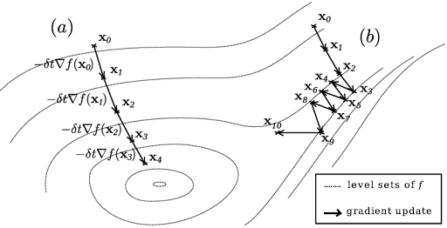
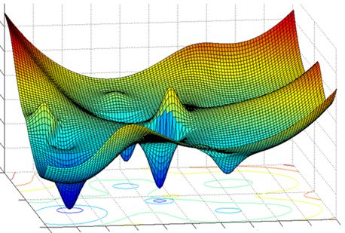
Gradient descent (Steepest descent)
Effective (converges) Local minimum
Two runs, (a) and (b) (not necessarily a global minimum)
Easy to extend to minimization with constraints

Slide 15
Steepest descent for E = [y₁ − ∑_{j}v_{j1}∗th(w_{1j}∗x₁ + w_{2j}∗x₂+w_{3j}∗x₃)]²/2+ [y₂ − ∑_{j}v_{j2}∗th(w_{1j}∗x₁ + w_{2j}∗x₂+w_{3j}∗x₃)]²/2
v_{jk}(t+1)=v_{jk} (t) - μ∗∂ E/∂v_{jk} ,
w_{ij}(t+1)=w_{ij}(t) - μ∗∂ E/∂w_{ij} (i∈I, j∈II, k∈III)
Derivatives:
∂E/∂v_{jk} = –(y_{k} – ŷ_{k})∗∂ ŷ_{k} /∂ v_{jk} = –(y_{k} – ŷ_{k})∗th(w_{1j}∗x₁ + w_{2j}∗x₂+w_{3j}∗x₃)
∂E/∂w_{ij} = ∑_{k}[–(y_{k} – ŷ_{k})∗∂ ŷ_{k} /∂w_{ij}]=
∂ ŷ_{k} /∂w_{ij} = v_{jk}∗th′(∑_{i} x_{i}∗w_{ij})∗x_{i} = v_{jk}∗(1+th(∑_{i} x_{i}∗w_{ij}))∗(1–th(∑_{i} x_{i}∗w_{ij}))∗x_{i} , since
th′(u)=4∗s(2u)∗[1-s(2(u)]=(1+th(u))∗(1–th(u))

Slide 16
Steepest descent for squared error E
v_{jk}(t+1)=v_{jk} (t) - μ∗∂ E/∂v_{jk} ,
w_{ij}(t+1)=w_{ij}(t) - μ∗∂ E/∂w_{ij} (i∈I, j∈II, k∈III) (*)
Derivatives:
∂E/∂v_{jk} = –(y_{k} – ŷ_{k})∗∂ ŷ_{k} /∂ v_{jk} = –(y_{k} – ŷ_{k})∗th(w_{1j}∗x₁ + w_{2j}∗x₂+w_{3j}∗x₃)
∂E/∂w_{ij} = ∑_{k}[–(y_{k} – ŷ_{k})∗v_{jk}∗(1+th(∑_{i} x_{i}∗w_{ij}))∗(1–th(∑_{i} x_{i}∗w_{ij}))∗x_{i}
How this can be applied to learning NN? No space, just data table. Where to start? How to move forward?
Rumelhart, David E.; Hinton, Geoffrey E.; Williams, Ronald J. proposed a way to go in 1985

Slide 17
Error back-propagation mimicking Steepest descent for squared error E
v_{jk}(t+1)=v_{jk} (t) - μ∗∂ E/∂v_{jk} ,
w_{ij}(t+1)=w_{ij}(t) - μ∗∂ E/∂w_{ij} (i∈I, j∈II, k∈III) where (*)
∂E/∂v_{jk} = –(y_{k} – ŷ_{k})∗th(∑_{i} x_{i}∗w_{ij})
∂E/∂w_{ij} = ∑_{k}[–(y_{k} – ŷ_{k})∗v_{jk}∗(1+th(∑_{i} x_{i}∗w_{ij}))∗(1–th(∑_{i} x_{i}∗w_{ij}))∗x_{i} (**)
Algorithm
0. Specify NE, number of epochs. Standardize features to [-1,1] interval. Generate W, V N(0,1) randomly.
Epoch. In a loop over objects (x,y)
1.1. Forward computation: Find ŷ=F(x) and error e=y – ŷ
1.2. Error back-propagation: Use formulas (**) to estimate derivatives of E
1.3. Weights update: Use formulas (*) to update V and W
Halting test: If the number of epochs reached NE, output e, E, V, W and halt; else: randomize the order of objects and go to 1.

Slide 18
Error back-propagation mimicking Steepest descent for squared error E
Algorithm
0. Specify NE, number of epochs. Standardize features to [-1,1] interval. Generate W, V N(0,1) randomly.
Epoch. In a loop over objects (x,y)
1.1. Forward computation: Find ŷ=F(x) and error e=y – ŷ
1.2. Error back-propagation: Use formulas (**) to estimate derivatives of E
1.3. Weights update: Use formulas (*) to update V and W
Halting test: If the number of epochs reached NE, output e, E, V, W and halt; else: randomize the order of objects and go to 1.
Quiz 1: What is halt?
Quiz 2: Any other halting test?

Slide 19
Prediction of petal sizes from sepal sizes, at 10000 epochs, features normalized to [-10,10]; 3 runs (Matlab pseudocode in Mirkin’s Text, p. 513)
At 3 hidden units
e = 1.1488 1.7518 || 1.0630 1.7677 || 1.1394 1.7505
At 13 hidden units
e = 0.9520 1.5995 || 0.9763 1.5879 || 0.9390 1.5349
At 20 hidden units
e = 0.8657 1.4729 || 0.8413 1.4236 || 0.9256 1.5186
At 40 hidden units
e = 0.8297 1.4135 || 0.7970 1.4173|| 0.8292 1.3763

Slide 20
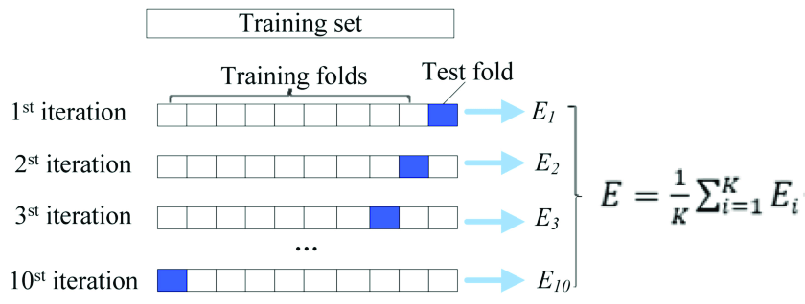
To mimic learning, dataset should be randomly divided in training part /testing part
Cross-validation
Leave-one-out

Slide 21
Concepts learnt
Regression, classifier
Overfitting, underfitting
Artificial neuron
Activation function
Sigmoid, Tangent hyperbolic
Neural network
Hidden layer
Weight matrices
Steepest (gradient) descent; learning rate
Error back-propagation
Epoch
Cross-validation

