Slide 1
Blog Application

Slide 2
Building real time Rest APIS for Blogging Application using Spring Boot, String Security , JWT , Spring Data JPA(Hibernate) and MySQL.
Creating Rest Endpoints
Complex Db structure (JPA Entities)
Role based Authentication
Handling Exceptions
Using DTO for Data Transfer
Swagger

Slide 3
Technologies used
Core java (oops , package , exception , lambda , stream api etc)
Basics of Spring Framework( Spring Core(DI) , JPA and MVC)
Spring Boot Basics
Basics of MySQL Database
STS IDE
React JS
Java Script
Postman
MySql

Slide 4
Client – Server Architecture
SERVER
CLIENT
Request
Android
Database
Desktop App
Data Exchange
JSON , XML
REST APIS
PostMan
Response
Web App
Web Server

Slide 5
What is REST ?
It is a software architectural style created by Roy Fielding in 2000 to guide the design of architecture for the web.
Format
json,xml
REST means :
Representational
State
Transfer
Data
Transfer data between two parties

Slide 6
REST Architecture
Client Server Architecture
Stateless
Cacheable
Layered System
Unform Interface

Slide 7
REST Concepts
Resource
Sub-resource
URI
Http Methods
Http Response Code

Slide 8
Http Request Methods
HTTP defines a set of request methods to indicate the desired action to be performed for a given resource
GET | http://localhost:8282/students/ | Return the list of students
GET | http://localhost:8282/students/12 | Return the student of id 12
POST | http://localhost:8282/students/ | Create a new student
PUT | http://localhost:8282/students/20 | Update a student of id 20
DELETE | http://localhost:8282/students/2 | Delete a student of id 2
Http Methods

Slide 9
Http Response Codes
HTTP response status codes indicate whether a specific HTTP request has been successfully completed.
200 OK | Request is successful
201 Created | Request is successful and new resource is created
401 Unauthorized | Authentication is required for resource
404 Not Found | Resource Not Found
500 Internal Server Error | Error occurred on server and request can not fulfilled.
Http Response codes

Slide 10
Blogging application where user can write blogs and articles .
user can comment on the blogs/article .
We have to build simple Blogging Application:-
User should create, update, delete and list posts.
User should add, update, comments on posts.
Categories the posts according to categories.
New user should able to Register on our application
User should able to login to our application.
Post include one picture too.

Slide 11
What we are going to build: Some technical terms.
Proper Login and Register API.
Posts API includes Pagination and Sorting.
Proper user input validation handling
Proper exception handling
Role based authentication-role based security with apis
JSW based authentication
Document all rest apis so that consumer can easy understand.
Deploy the backend application on any cloud platform.

Slide 12
Technologies and tools used for this application
Framework: Spring Boot Java Framework.
Java 8+
Maven
STS
Apache Tomcat
Spring core, Spring security(jwt) , Spring data JPA(Hibernate) et.c
MySQL Database.
Postman Rest Client
Swagger
AWS- EC2

Slide 13
Resources for Blogging Application
USER
CATEGORY
POST
COMMENTS

Slide 14
Architecture for using Spring Boot for backend.
API Layers
Business Logic
Dao Layer
Controllers
Services
Repositories
Database
Postman
(Client)
Spring Boot APP

Slide 15
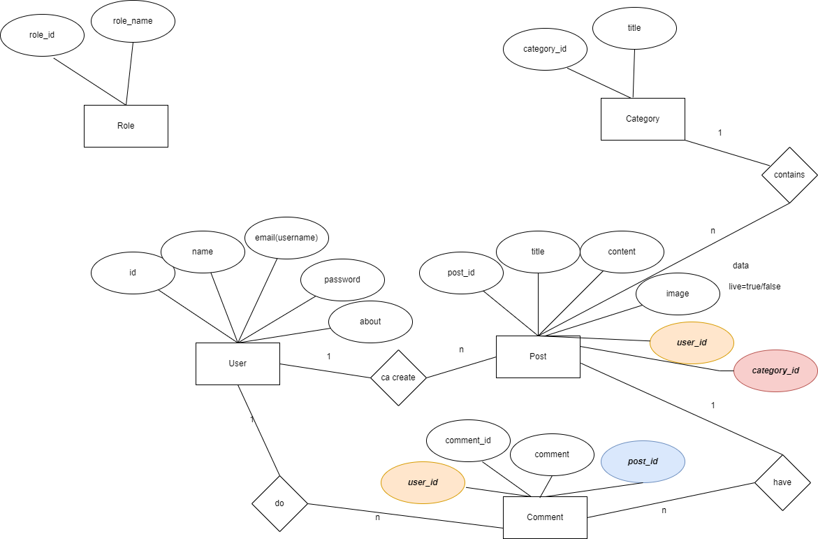

Slide 16

Basics of Validation
Java bean is validated with JSR 380 known as Bean Validation 2.0
JSR 380 is specification for the Java API for bean validation . Properties of bean meet the specific criteria .
For validation different annotations is used like @NotNull, @Min, @Size etc.
Hibernate Validator is a implementation of validation api.

Slide 17
Important Annotations for validations
@NotNull
@Email
@Size
@Min
@Max
@NotEmpty
Etc……………

Slide 18
How to use :
Spring boot provides support for Hibernate Validator.
<dependency>
<groupId>org.springframework.boot</groupId>
<artifactId>spring-boot-starter-validation</artifactId>
<version>2.6.6</version>
</dependency>

Slide 19
Securing Rest APIS

Slide 20
Steps to Implement JWT
Add dependency(io.jsonwebtoken)
Create JWT authenticationEntryPoint implements AuthenticationEntryPoint
Create JWTTokenHelper
JwtAuthenticationFilter extends OnceRequestFilter
Get jwt token from request
Validate token
Get user from token
Load user associated with token
Set spring security
Create JwtAuthResponse
Configure JWT in spring security config
Create login api to return token
Test the application.

