Slide 1

Multidimensional deprivation index using small area estimation methods:
An application for the adult population in Colombia
Andrés Gutiérrez¹, Alejandra Arias-Salazar², Stalyn Guerrero-Gómez ¹,
Natalia Rojas-Perilla³ , Xavier Mancero¹, Hanwen Zhang⁴
Economic Commission for Latin America and the Caribbean¹
Freie Universität Berlin²
United Arab Emirates University³
Universidad Autónoma de Chile⁴
MDI using SAE methods

Slide 2
Table of Contents
Motivation
Case study: Multidimensional deprivation index in Colombia
Methodology
Application
Data sources
Results
Conclusion
MDI using SAE methods

Slide 3


Motivation
Poverty and multidimensional poverty leading topics in national and international agendas: “End poverty in all its forms everywhere” (UN General Assembly, 2015).
Necessity of quality data on poverty in its different expressions.
Disaggregated information: geographically and based on relevant characteristics (e.g. sex, age, ethnicity)
MDI using SAE methods

Slide 4
The ECLAC multidimensional deprivation index (MDI)
ECLAC is developing a regionally comparable MDI for 18 Latin American countries.
The index considers the person (and not the household) as unit of analysis.
The MDI is based on the Alkire & Foster (2007) methodology.
Complements the Global Multidimensional Poverty Index using regionally specific indicators and thresholds.
4/19
MDI using SAE methods

Slide 5
The ECLAC multidimensional deprivation index (MDI)
ECLAC is developing a regionally comparable MDI for 18 Latin American countries. The index considers the person (and not the household) as unit of analysis.
The MDI is based on the Alkire & Foster (2007) methodology.
Complements the Global Multidimensional Poverty Index using regionally specific indicators and thresholds.
It considers 5 dimensions and 8 indicators:
Dimension | Indicator | Weight | Available in census | Target population
Housing | Poor housing materials | 1/10 | Yes | Adults and seniors
 | Overcrowding | 1/10 | Yes | Adults and seniors
Water and sanitation | Lack of drinking water | 1/10 | Yes | Adults and seniors
 | Lack of sanitation | 1/10 | Yes | Adults and seniors
Energy and connectivity | Lack of internet service | 1/10 | Yes | Adults and seniors
 | Lack of electricity | 1/10 | Yes | Adults and seniors
Education | Unfinished education | 2/10 | No* | Adults and Seniors
Employment and social | No or insufficient pension | 2/10 | No | Seniors
protection | Unemployment or insufficient employment-related income | 2/10 | No | Adults
4/19
MDI using SAE methods

Slide 6
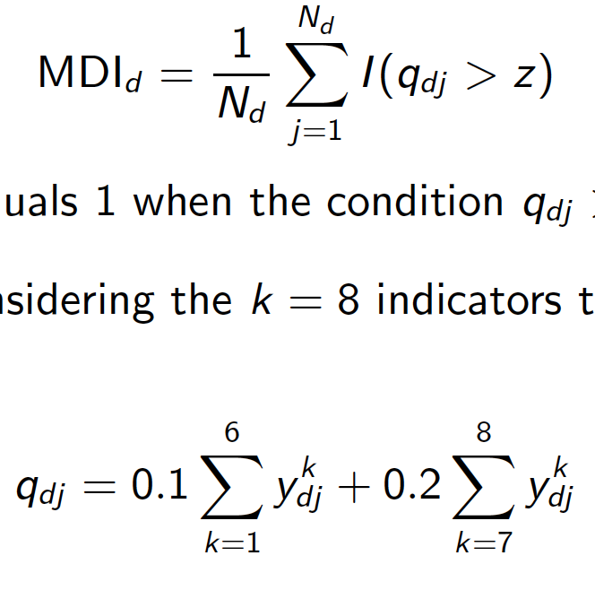

The ECLAC multidimensional deprivation index (MDI)
The MDI is computed as:
The indicator function I (·) equals 1 when the condition qdj > z is met,
i.e. qdj > 0.4.
qdj is a weighted quantity considering the k = 8 indicators that comprise
the index.
$y_{dj}^{k}$indicates if the person j in domain d has a deprivation or not in each
of the k = 8
MDI using SAE methods

Slide 7
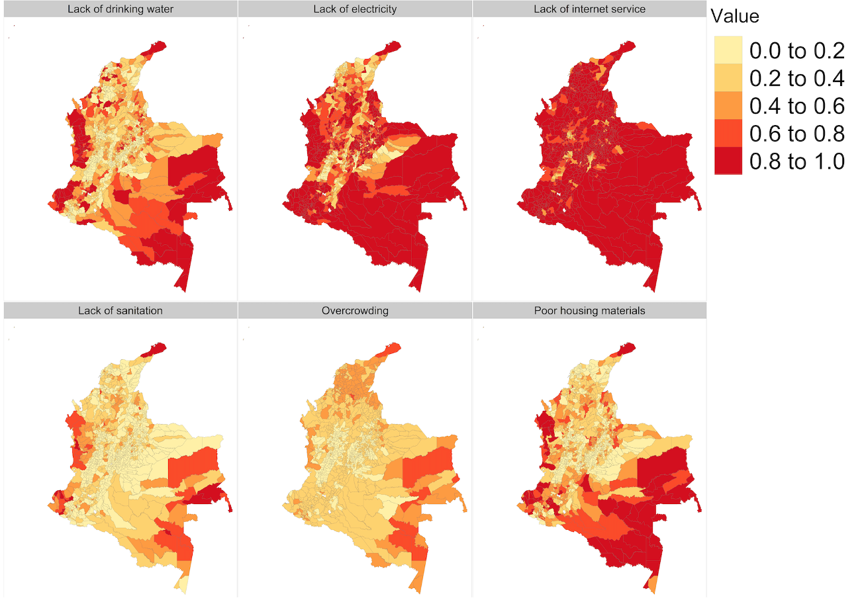
Case study: Multidimensional deprivation index in Colombia
Figure 1: Direct estimates of MDI components for 6 available indicators at municipality level.
MDI using SAE methods

Slide 8
Case study: Multidimensional deprivation index in Colombia
Objective: Producing reliable estimates of the multidimensional deprivation index and its components (indicators and dimensions) for the adult population of Colombia at department and municipality level.
7/19
MDI using SAE methods

Slide 9
Case study: Multidimensional deprivation index in Colombia
Objective: Producing reliable estimates of the multidimensional deprivation index and its components (indicators and dimensions) for the adult population of Colombia at department and municipality level.
Challenge: 2/8 indicators are missing so the final MDI cannot be computed.
7/19
MDI using SAE methods

Slide 10
Case study: Multidimensional deprivation index in Colombia
Objective: Producing reliable estimates of the multidimensional deprivation index and its components (indicators and dimensions) for the adult population of Colombia at department and municipality level.
Challenge: 2/8 indicators are missing so the final MDI cannot be computed.
Identified scenarios:
- Only 1 missing indicator: Using a unit-level Bernoulli logit mixed model.
7/19
MDI using SAE methods

Slide 11
Case study: Multidimensional deprivation index in Colombia
Objective: Producing reliable estimates of the multidimensional deprivation index and its components (indicators and dimensions) for the adult population of Colombia at department and municipality level.
Challenge: 2/8 indicators are missing so the final MDI cannot be computed.
Identified scenarios:
- Only 1 missing indicator: Using a unit-level Bernoulli logit mixed model.
- Two missing indicators: Finding the the expected value of the linear combination of the them.
7/19
MDI using SAE methods

Slide 12
Case study: Multidimensional deprivation index in Colombia
Objective: Producing reliable estimates of the multidimensional deprivation index and its components (indicators and dimensions) for the adult population of Colombia at department and municipality level.
Challenge: 2/8 indicators are missing so the final MDI cannot be computed.
Identified scenarios:
- Only 1 missing indicator: Using a unit-level Bernoulli logit mixed model.
- Two missing indicators: Finding the the expected value of the linear combination of the them.
- More than two missing indicators: Using a Monte Carlo simulation approach
to obtain “hard” estimates (0,1) for each individual in each missing indicator.
7/19
MDI using SAE methods

Slide 13
Case study: Multidimensional deprivation index in Colombia
Objective: Producing reliable estimates of the multidimensional deprivation index and its components (indicators and dimensions) for the adult population of Colombia at department and municipality level.
Challenge: 2/8 indicators are missing so the final MDI cannot be computed.
Identified scenarios:
- Only 1 missing indicator: Using a unit-level Bernoulli logit mixed model.
- Two missing indicators: Finding the the expected value of the linear combination of the them.
- More than two missing indicators: Using a Monte Carlo simulation approach
to obtain “hard” estimates (0,1) for each individual in each missing indicator.
Assumptions: There is no dependence when there are two or more missing indicators, and there are no causal relationships between the dependent and independent variables.
7/19
MDI using SAE methods

Slide 14
Table of Contents
Motivation
Case study: Multidimensional deprivation index in Colombia
Methodology
Application
Data sources
Results
Conclusion
MDI using SAE methods

Slide 15

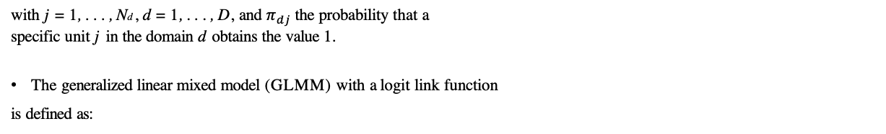
Unit-level Bernoulli logit mixed model
The variable of interest is binary (ydj = 0 or 1),
The target estimation can be, the proportion per domain:
with j = 1, . . . , Nd , d = 1, . . . , D, and $π_{dj}$ the probability that a
specific unit j in the domain d obtains the value 1.
The generalized linear mixed model (GLMM) with a logit link function
is defined as:
8/19
MDI using SAE methods

Slide 16
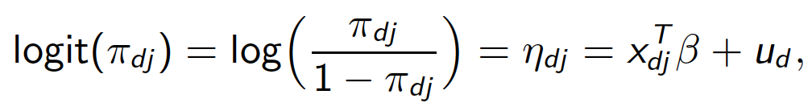
Unit-level Bernoulli logit mixed model
The variable of interest is binary (ydj = 0 or 1),
The target estimation can be, the proportion per domain:
with j = 1, . . . , Nd , d = 1, . . . , D, and $π_{dj}$ the probability that a
specific unit j in the domain d obtains the value 1.
The generalized linear mixed model (GLMM) with a logit link function
is defined as:
with β the vector of fixed-effects parameters, ud the random area-specific
effect for d and ud ~ $N\left(0,σ_{u}^{2}\right).$
ud are assumed independent with ydj |ud ∼ Bernoulli($π_{dj}$ ) with
E (ydj |ud ) = $π_{dj}$ and Var (ydj |ud ) = $σ_{dj}$ = $π_{dj}$ (1 − $π_{dj}$ ).
8/19
MDI using SAE methods

Slide 17
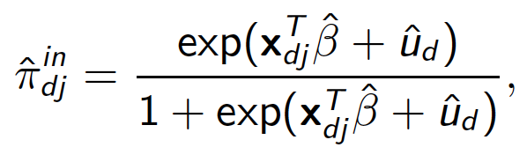
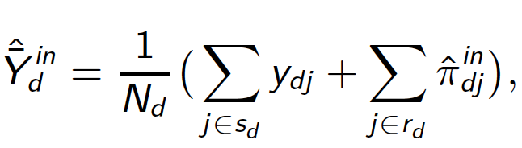

Point estimation - one missing indicator
The plug-in predictor of $π_{dj}$ is:
(2)
which would allow obtaining the plug-in predictor of Y
(3)
where s and r represent the in- and out-of-sample observations respectively.
9/19
MDI using SAE methods

Slide 18
Point estimation - one missing indicator
The plug-in predictor of $π_{dj}$ is:
(2)
which would allow obtaining the plug-in predictor of Y
(3)
where s and r represent the in- and out-of-sample observations respectively.
* In this case study, the two missing indicators Y1 = education and
Y2 = employment could be obtained with this procedure. However, it does not
allows to compute the final MDI.
9/19
MDI using SAE methods

Slide 19
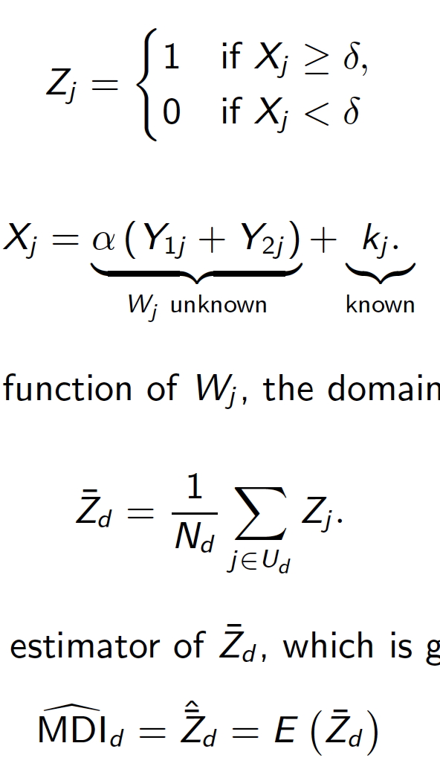

Point estimation - two missing indicators
Let’s define the poverty status for each individual j, i.e. multidimensional poor (1) or not (0) based on a threshold $δ$:
MDI using SAE methods

Slide 20
Point estimation - two missing indicators
Let’s define the poverty status for each individual j, i.e. multidimensional poor (1) or not (0) based on a threshold $δ$:
where
MDI using SAE methods

Slide 21

Point estimation - two missing indicators
Let’s define the poverty status for each individual j, i.e. multidimensional poor (1) or not (0) based on a threshold $δ$:
where
By finding the mass probability function of Wj , the domain proportion is:
The target predictor is then the estimator of ${\overline{Z}}_{d},$which is given by the expectation of ${\overline{Z}}_{d}:$
MDI using SAE methods

Slide 22
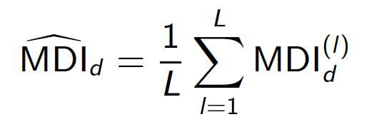


Point estimation - more than two missing indicators
A Monte Carlo simulation approach can be implemented when more than three indicators are missing:
1. Use the sample data to fit a unit-level Bernoulli logit mixed model for each indicator and estimate ${\hat{β}}^{k}$, ${\hat{u}}_{d}^{k}$, and finally ${\hat{π}}_{dj}^{in,k}$.
2. For $l=1, …, L Monte Carlo simulations:$
for each individual in the census, predict the probability of obtaining the value 1. i.e. ${\hat{π}}_{dj}^{in,k, (l)} ∀ j ∈U_{d}.$
obtain Monte Carlo “hard” estimates ${\tilde{y}}_{dj}^{k, (l)}$ with $y_{dj}^{k, (l)}\sim Bernoulli ({\hat{π}}_{dj}^{in,k}$)
compute the MDI^{(l)}, with 6/8 indicators available in the census and ${\tilde{y}}_{dj}^{k, (l)}$.
3. The final point estimate in each small area d is computed by taking the mean over each L simulation:
MDI using SAE methods

Slide 23
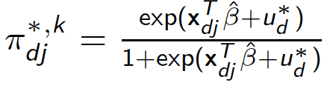
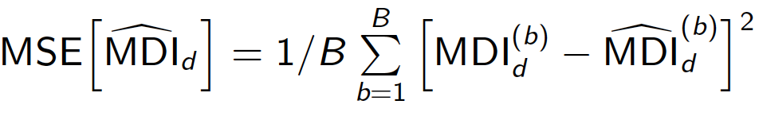
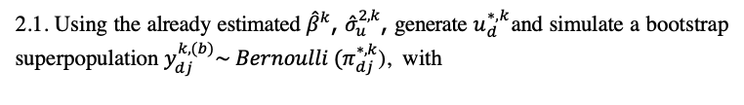

Uncertainty estimation: Following González-Manteiga et al (2007)
Suitable when using a logistic mixed model for estimating any characteristic of the population.
Small area robust wild bootstrap (SAWB) is a re-sampling procedure for the MSE estimation of an empirical predictor.
For k = 1, 2
For b = 1, ..., B
2.1. Using the already estimated ${\hat{β}}^{k}$, ${\hat{σ}}_{u}^{2,k}$, generate $u_{d}^{∗,k}$and simulate a bootstrap superpopulation $y_{dj}^{k, (b)}\sim Bernoulli (π_{dj}^{∗,k}$), with
2.2. Compute the ${\text{MDI}}_{d}^{(b)}$
2.3. Extract the bootstrap sample and obtain the estimated MDI following the point estimate – Monte Carlo approach ${\hat{\text{MDI}}}_{d}^{(b)}$
3.
12/19
MDI using SAE methods

Slide 24
Table of Contents
Motivation
Case study: Multidimensional deprivation index in Colombia
Methodology
Application
Data sources
Results
Conclusion
MDI using SAE methods

Slide 25
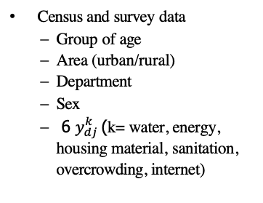
Data sources and covariates
Data sources:
National population and housing census, Colombia 2018.
Employment and living conditions survey (Large Integrated Household Survey), Colombia 2018.
Satellite imagery, Colombia 2016 from Earth Engine Data Catalog.
Covariates:
Census and survey data
Group of age
Area (urban/rural)
Department
Sex
6 $y_{dj}^{k}$(k= water, energy, housing material, sanitation, overcrowding, internet)
Satellite imagery
Intensity of nighttime lights
Distance to cultivated areas (crops)
Urbanization (human settlements)
Area level
Unemployment rate
13/19
MDI using SAE methods

Slide 26
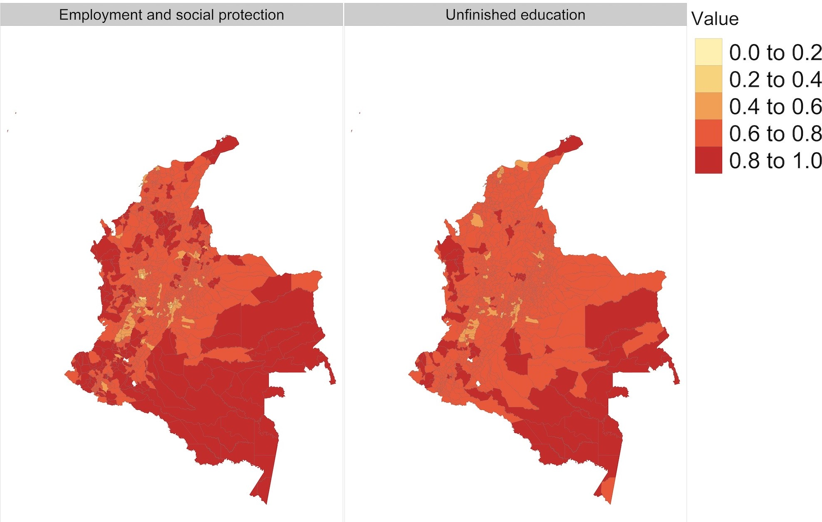
Results: Estimated MDI indicators
Figure 2: Model-based estimates for the indicators employment and social protection and unfinished education at municipality level.
MDI using SAE methods

Slide 27
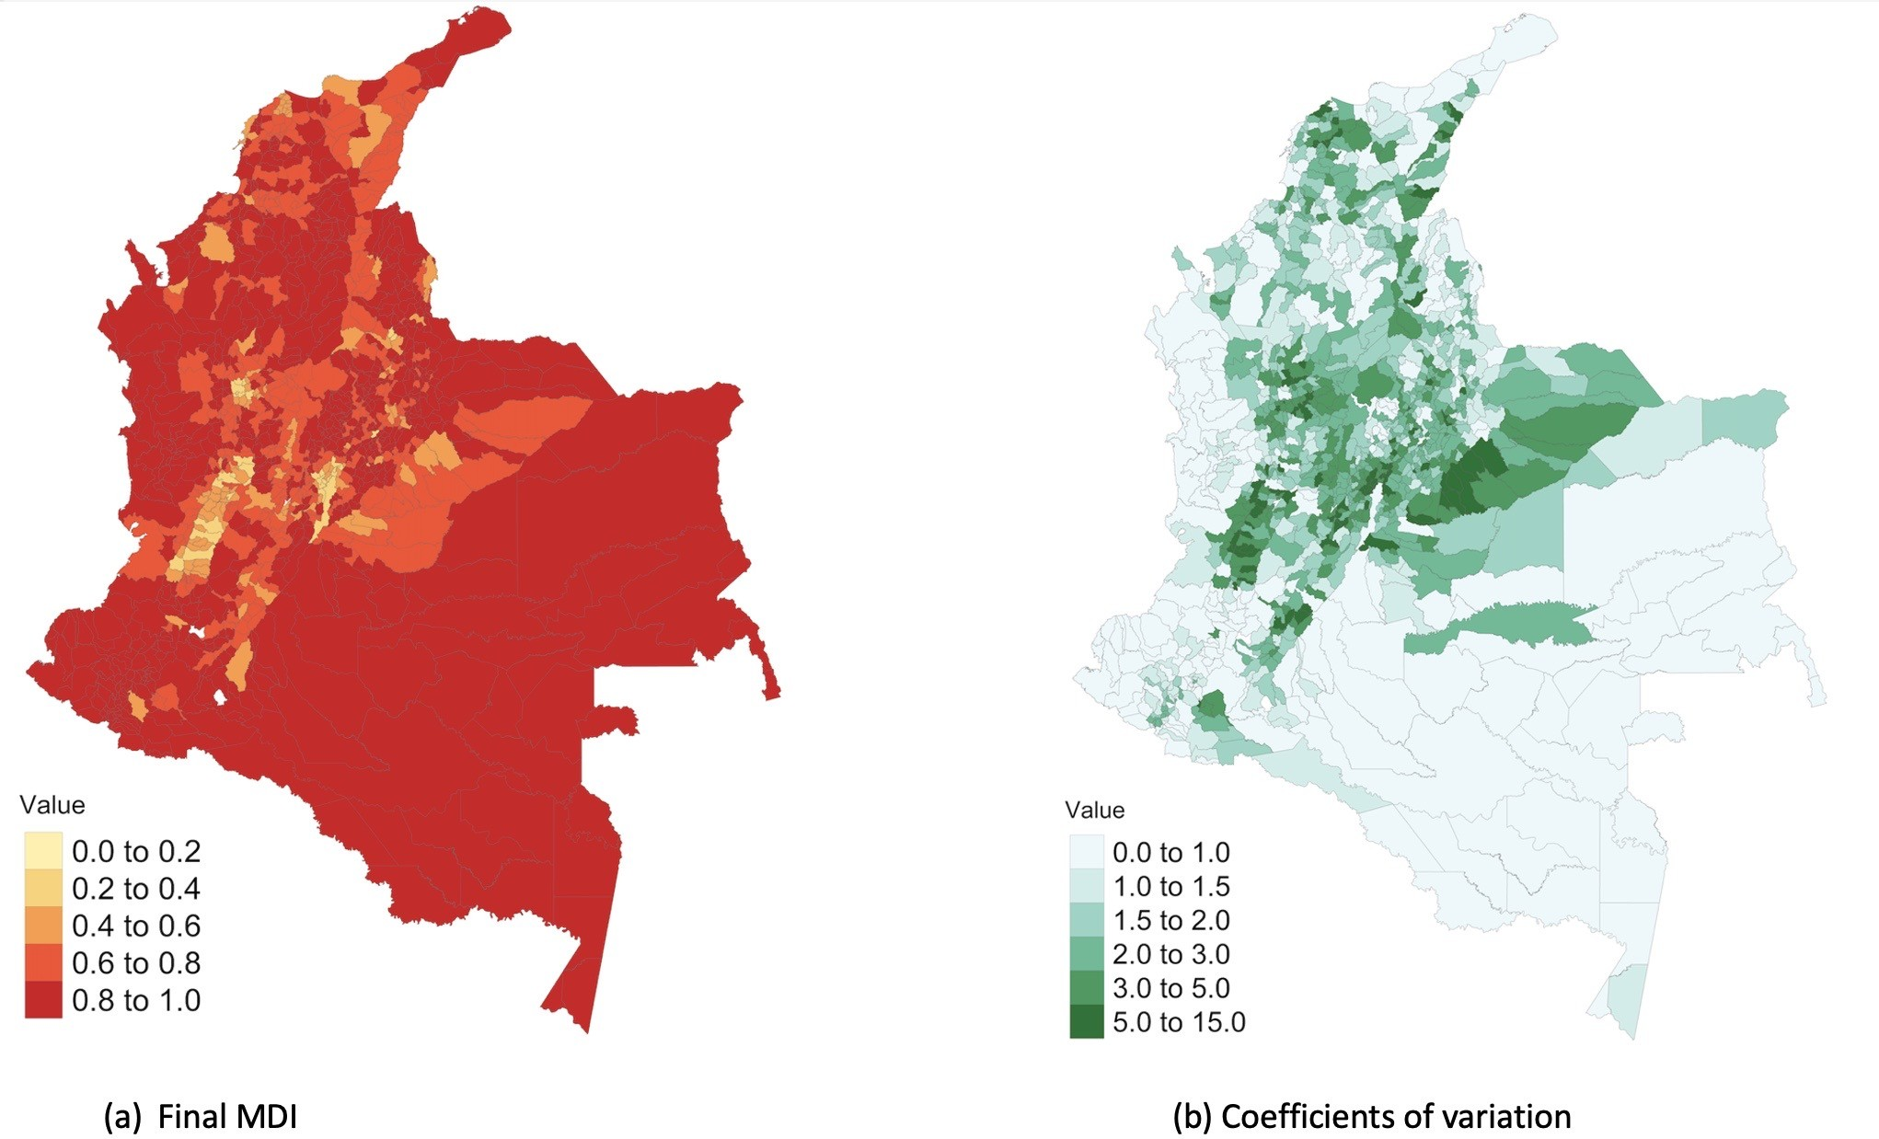
Results: Estimated MDI
Figure 3: Model-based estimates for final MDI (a) and coefficients of variation (b) for municipalities in
Colombia.
15/19
MDI using SAE methods

Slide 28
Table of Contents
Motivation
Case study: Multidimensional deprivation index in Colombia
Methodology
Application
Data sources
Results
Conclusion
MDI using SAE methods

Slide 29
Conclusion and further research
Unit-level Bernoulli logit mixed models can be used when one, two or more indicators of the MDI are not available in the census data.
Further research:
Modeling (co-)relations: How to take into account dependencies and covariances between indicators? and dimensions?
Time-gap between census and survey: Modeling all indicators to “update” them yearly.
MSE estimation: Evaluate the performance of the point and variance estimators.
Benchmark: Possible alternatives and Bayesian approximations.
Generalization: Compute all the indicators and dimensions of the MDI with SAE methods.
16/19
MDI using SAE methods

Slide 30
Main references
Chandra H, Kumar S, Aditya K. (2018). Small area estimation of proportions with different levels of auxiliary data. Biometrical Journal. 60(2): 395-415.
González-Manteiga, W., Lombardía, M. J., Molina, I., Morales, D., and Santamaría, L. (2007). Estimation of the mean squared error of predictors of small area linear parameters under a logistic mixed model. Computational statistics data analysis, 51(5): 2720–2733.
Hobza, T., Morales, D. (2016). Empirical best prediction under unit-level logit mixed models. Journal of Official Statistics, 32(3), 661.
Jiang, J., Lahiri, P. (2001). Empirical best prediction for small area inference with binary data. Annals of the Institute of Statistical Mathematics, 53(2), 217-243.
Morales, D., Esteban, M. D., Pérez, A., Hobza, T. (2021). A course on small area estimation and mixed models. Methods, theory and applications in R.
MDI using SAE methods

Slide 31
Thank you for your attention
Alejandra Arias-Salazar
(alejandra.arias@fu-berlin.de)
The authors gratefully acknowledge support by UAEU Start-up Research Grant from the United Arab Emirates University
MDI using SAE methods

