Slide 1
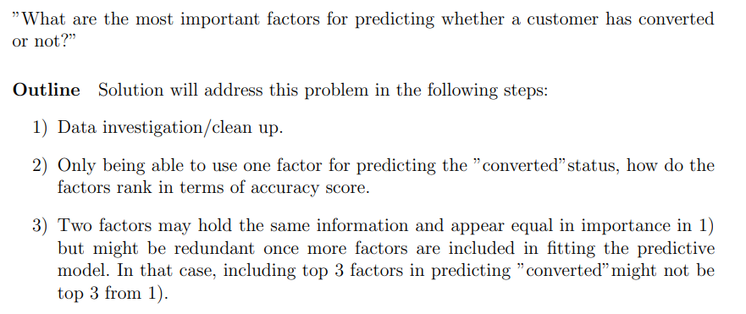
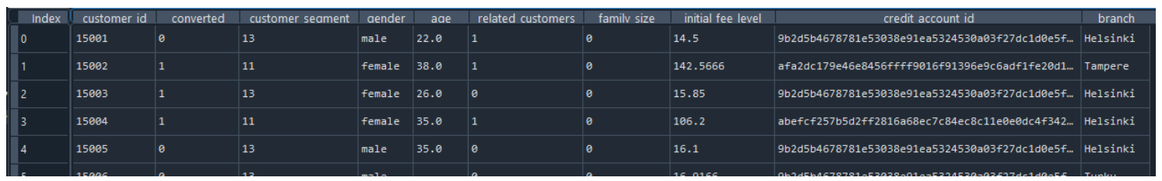
Lenus eHealth

Slide 2
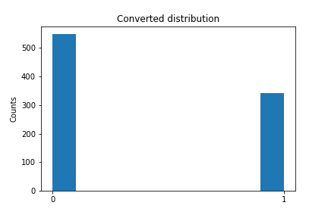
Data investigation/clean up
“Converted” column: No nulls. Model only predicting zeros has 61.6% accuracy.

Slide 3
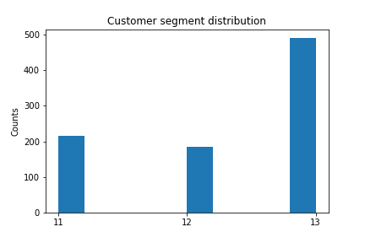
Data investigation/clean up
“Customer segment” column: No nulls. Categories, not numbers.

Slide 4
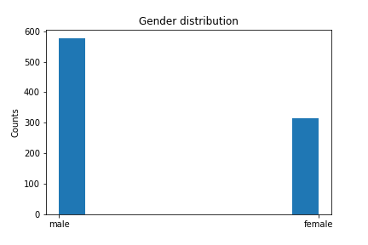
Data investigation/clean up
“Gender” column: No nulls.

Slide 5
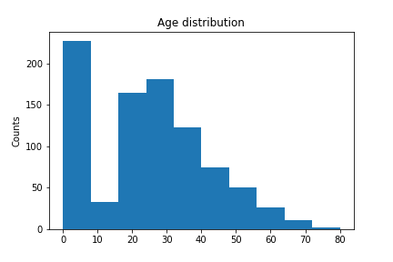
Data investigation/clean up
“Age” column: 177 nulls (here shown as 0). High age could possibly be classified as outliers.

Slide 6
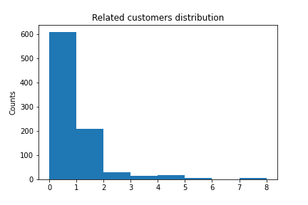
Data investigation/clean up
“Related customers” column: No nulls. Possible outliers.

Slide 7
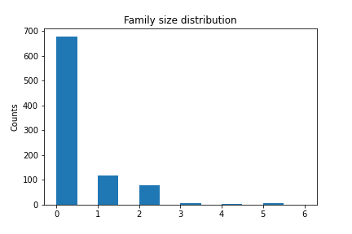
Data investigation/clean up
“Family size” column: No nulls. Little variation – many zeros.

Slide 8
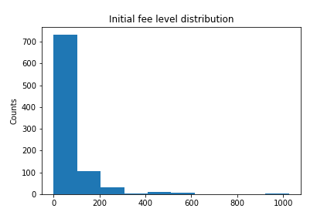
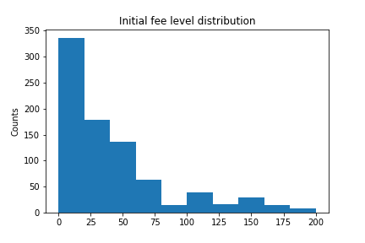
Data investigation/clean up
“Initial fee” column: No nulls. Possible outliers.

Slide 9
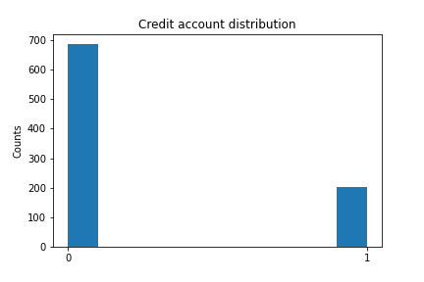
Data investigation/clean up
“Credit account ID” column: No nulls. Changed to “has credit ID” yes/no.
“9b2d5b...” = no. Other = “yes”.

Slide 10
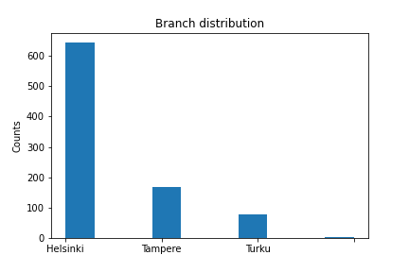
Data investigation/clean up
“Branch” column: 1 null. 3 categories.

Slide 11
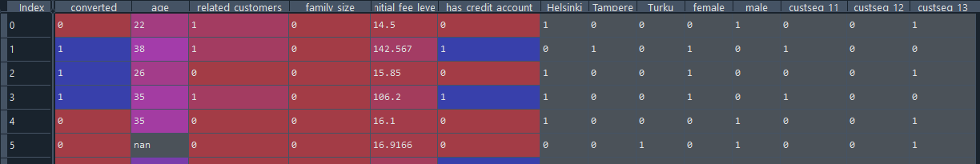
Data investigation/clean up
Resulting dataset:

Slide 12
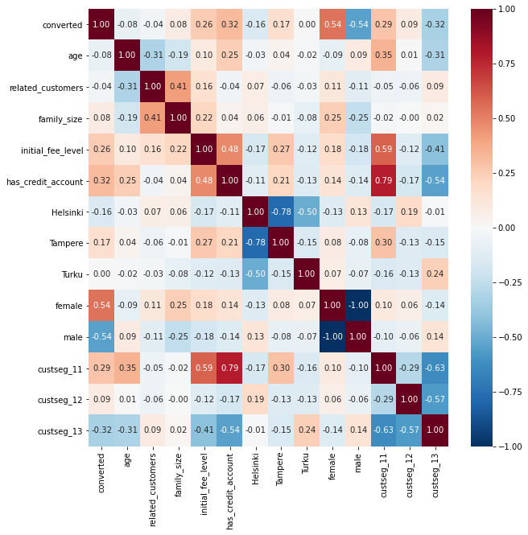


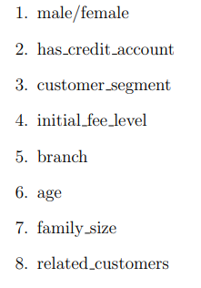
Predicting “converted” - individual

Slide 13
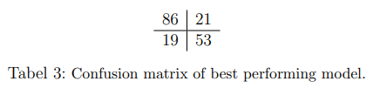
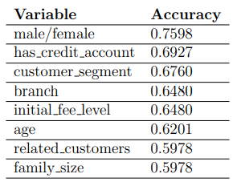
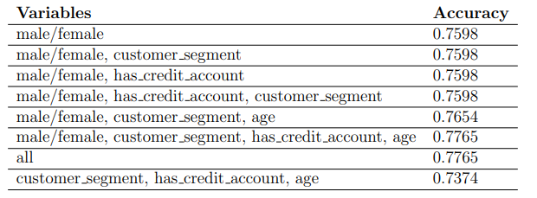
Predicting “converted” - Model
Logistic regression:
Null age rows removed.
Data split into training/test (75/25).
Dataset scaled to zero mean, unit variance.
Next:
Detailed look at false negative/false positive rows.
Deal with null values in age column.
Effect of outliers.

