Slide 1
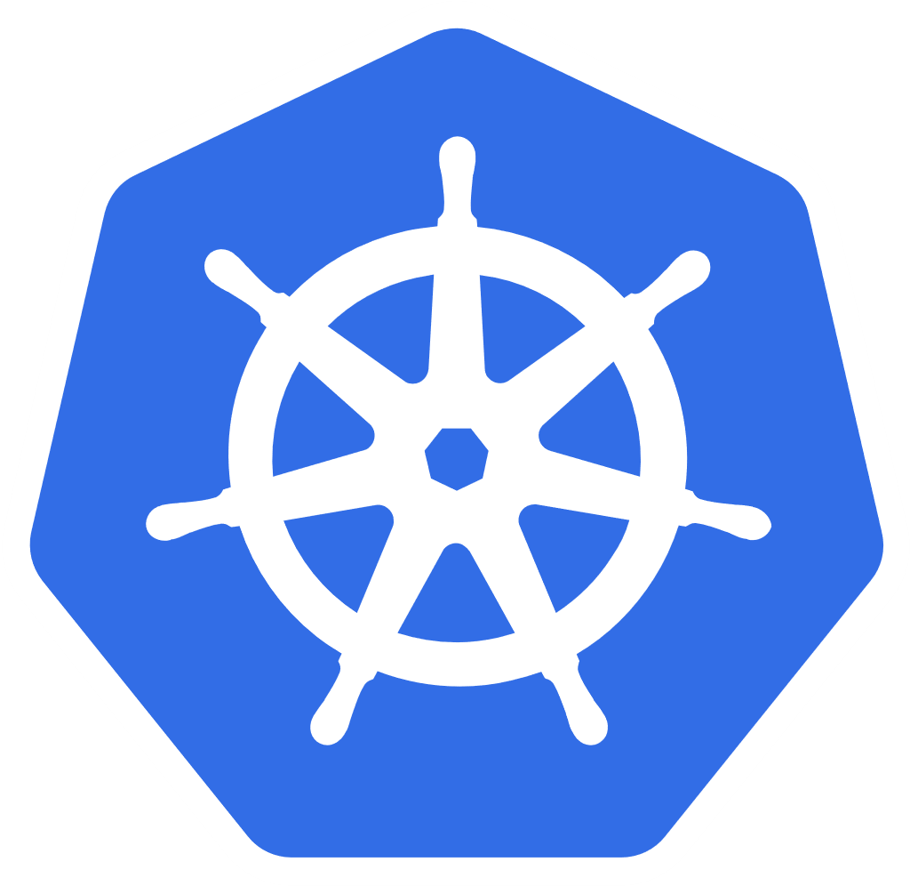
Kubernetes
Why Kubernetes?
Core Concepts
Architecture
Demo: Creating a Cluster
Demo: Deploying a Web App
Peter Sivák (peter.sivak@2ring.com)

Slide 2
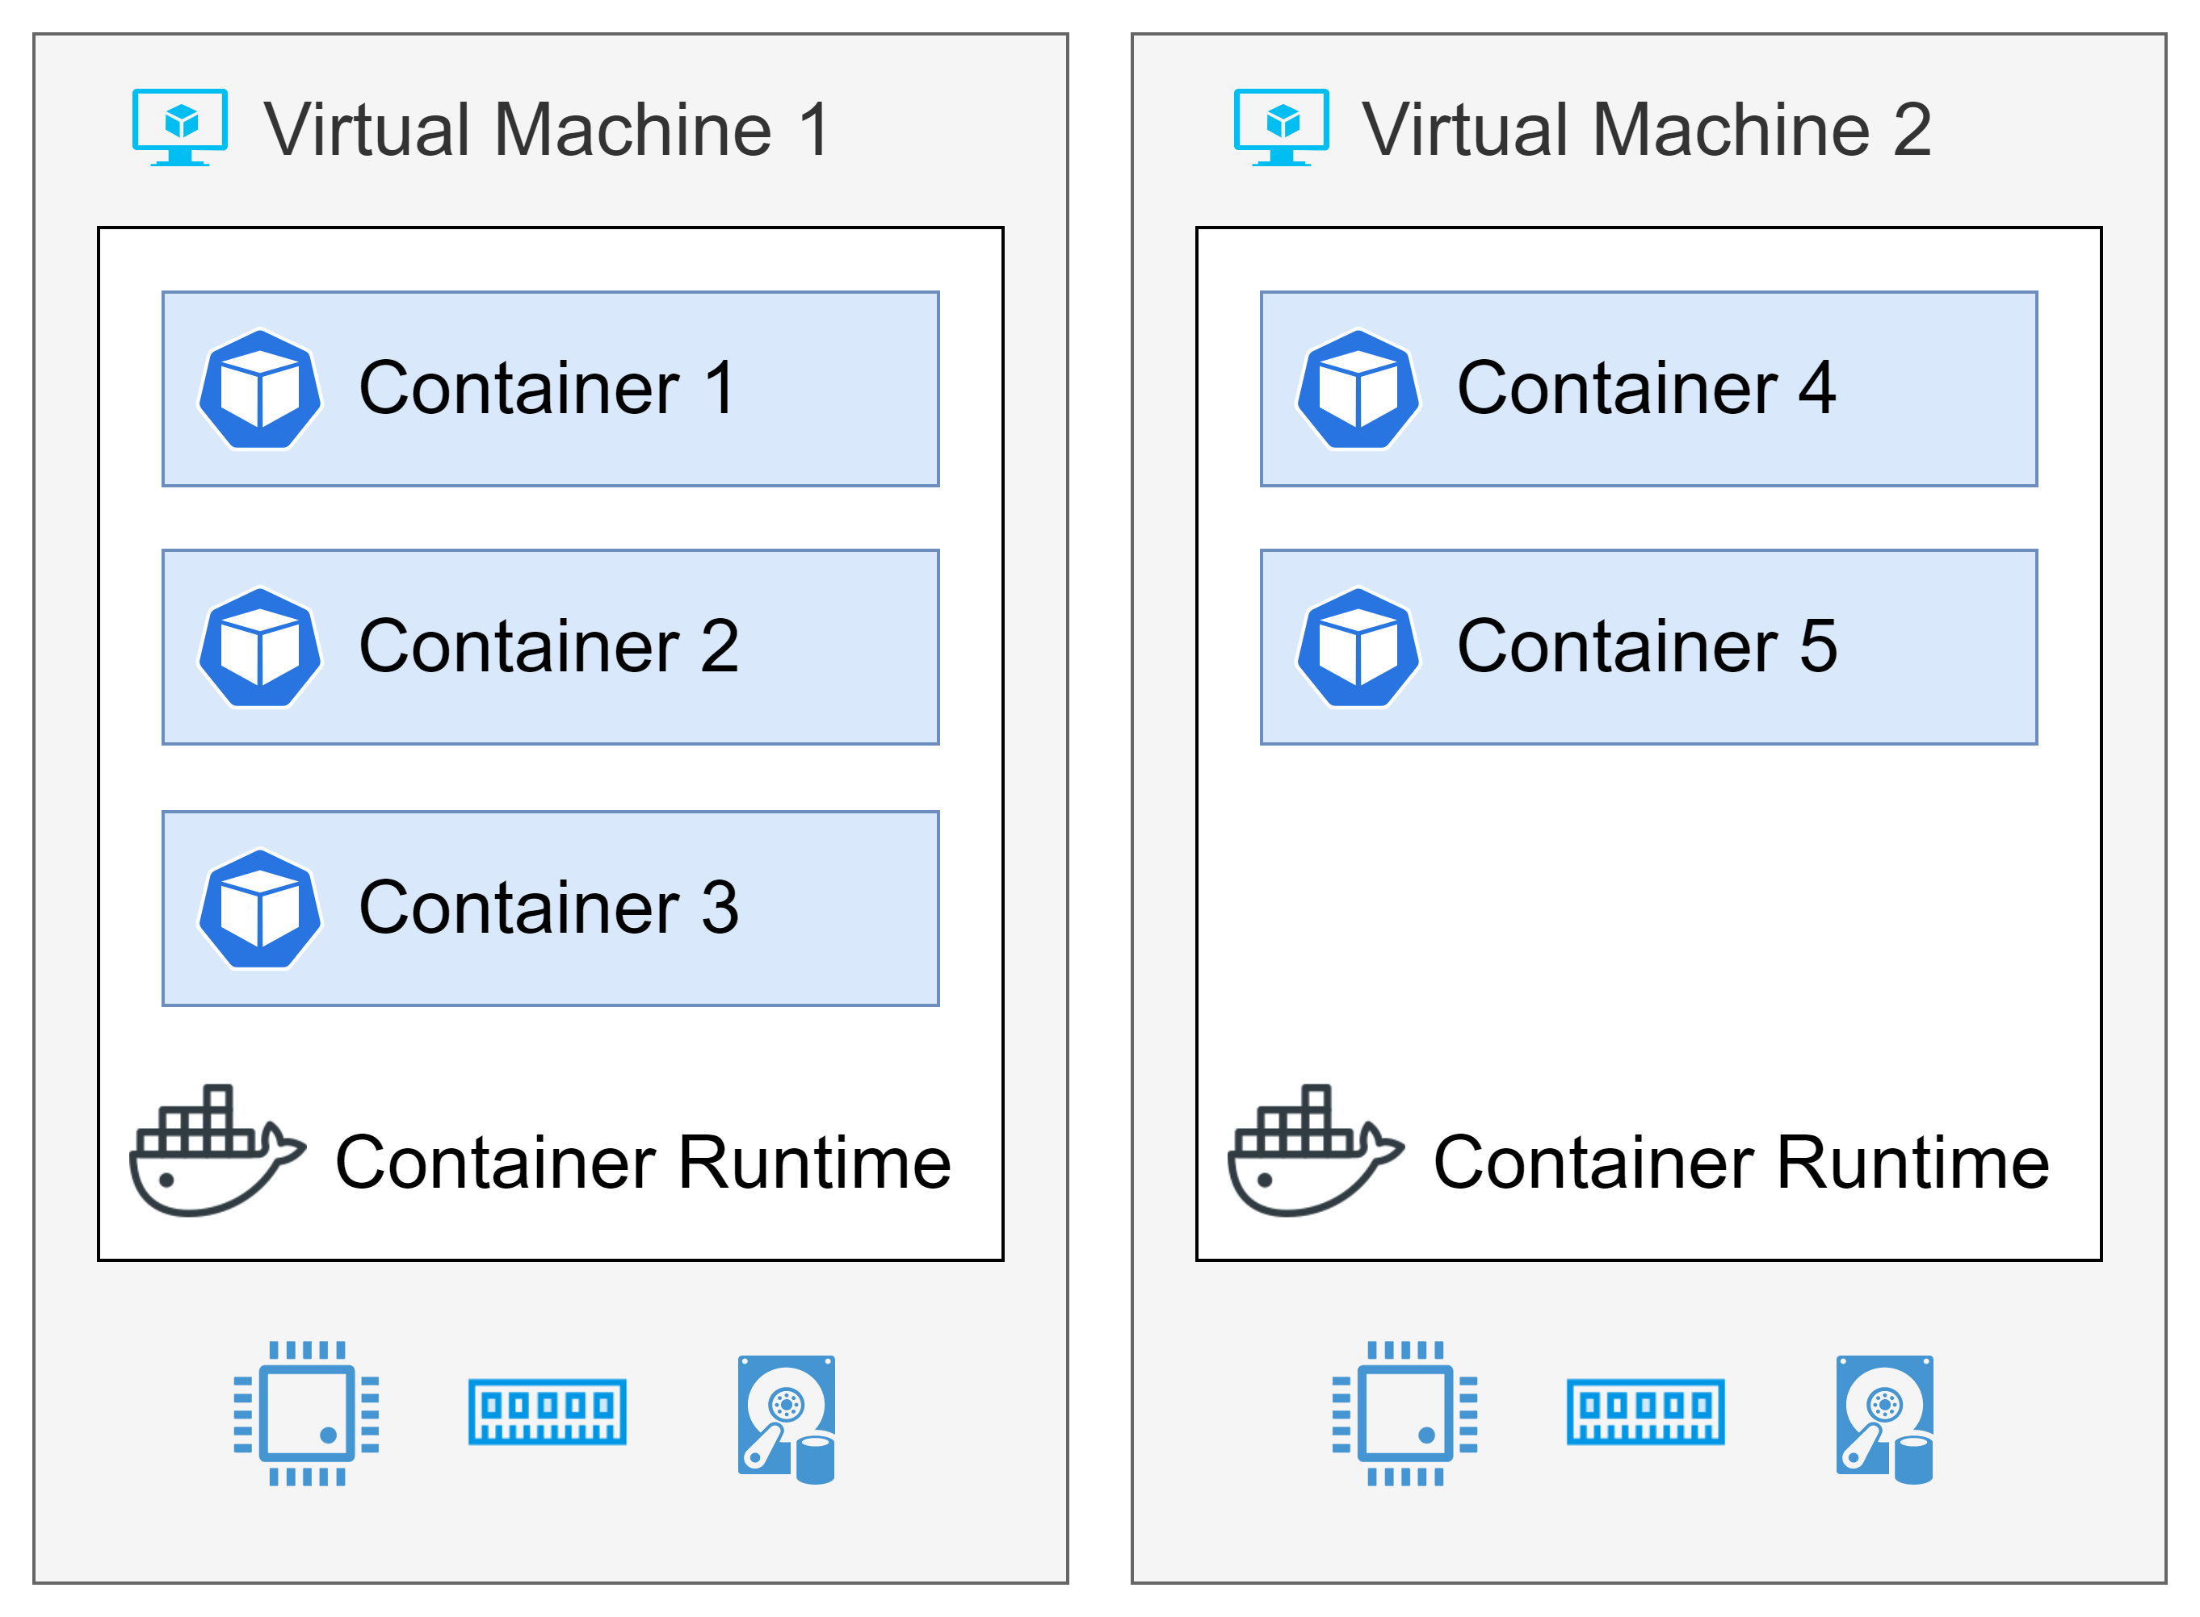
Why Kubernetes?

Slide 3
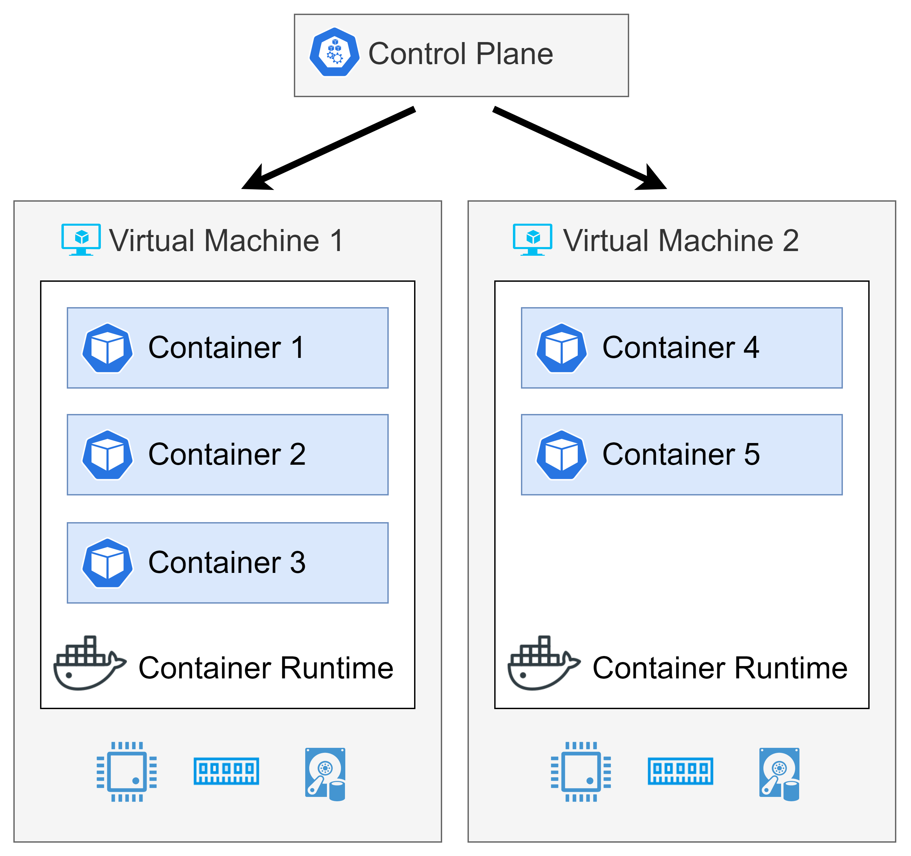
Kubernetes
Kubernetes, also known as K8s, is an open-source system for automating deployment, scaling, and management of containerized applications.
Developed by Google
Cloud Native Computing Foundation
Alternatives:
Docker Swarm
Apache Mesos
Container Runtime
Containerd
CRI-O
Docker
(kubernetes.io)

Slide 4
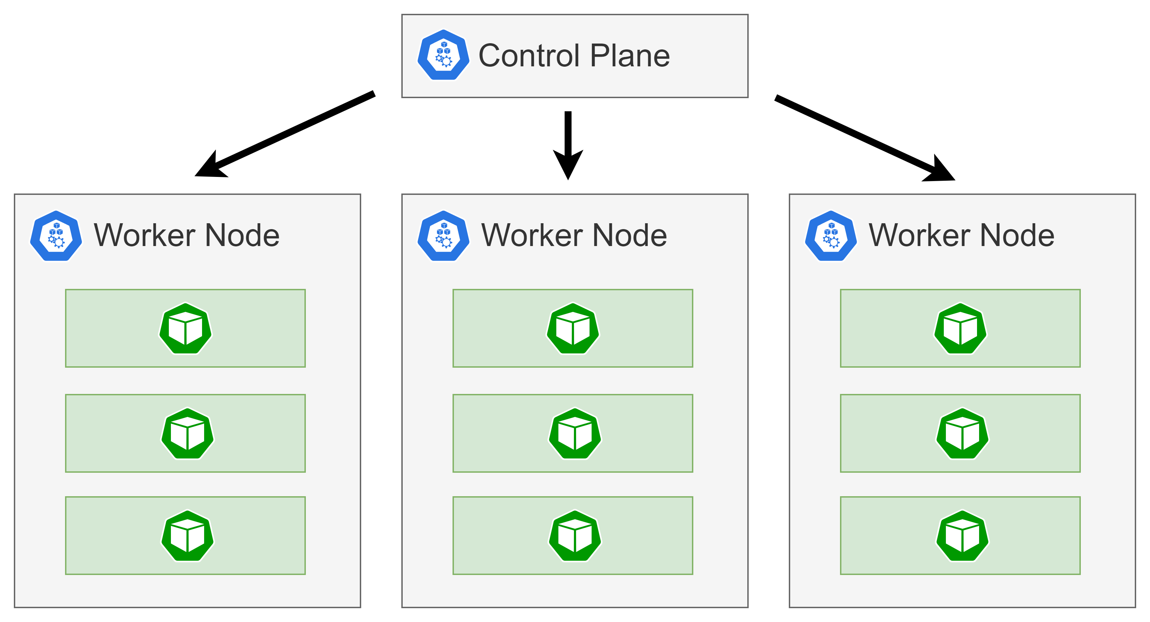
Core Concepts – Node
A Kubernetes cluster consists of a set of worker machines, called nodes, that run containerized applications.
Virtual or physical machine
Managed by the control plane

Slide 5
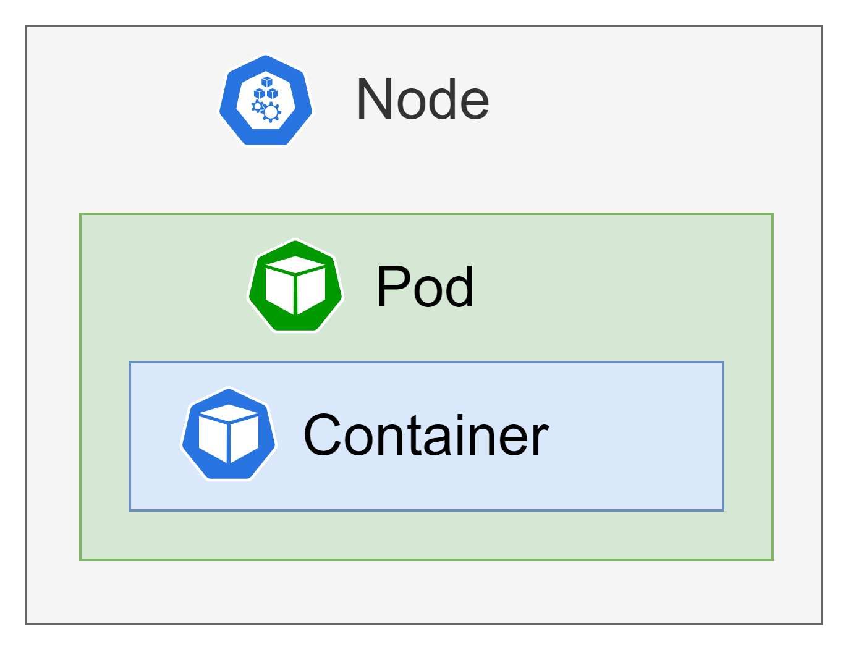
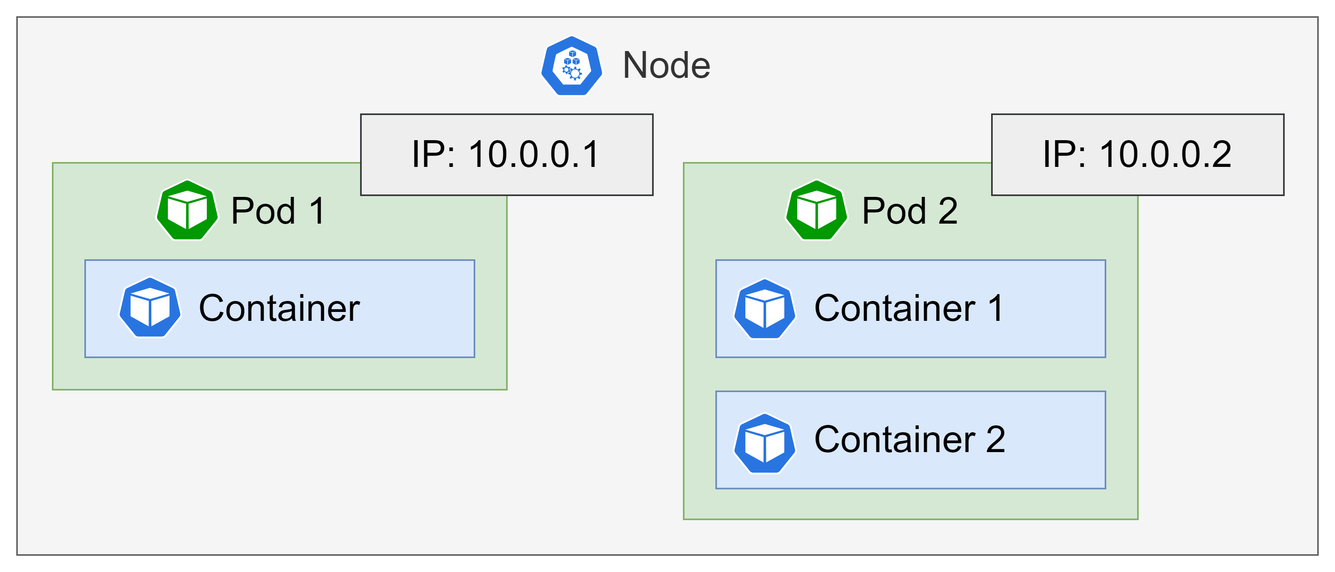
Core Concepts – Pod
Smallest deployable units of computing
Group of one or more containers, with shared storage and network resources, and a specification for how to run the containers
Co-located containers
You can inject containers for debugging
Init containers: specialized containers that run before app containers in a Pod

Slide 6
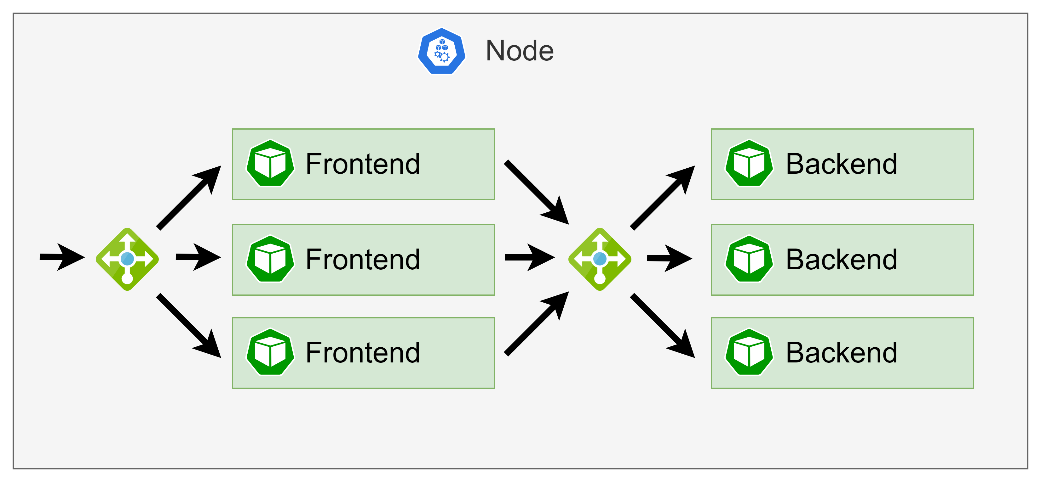
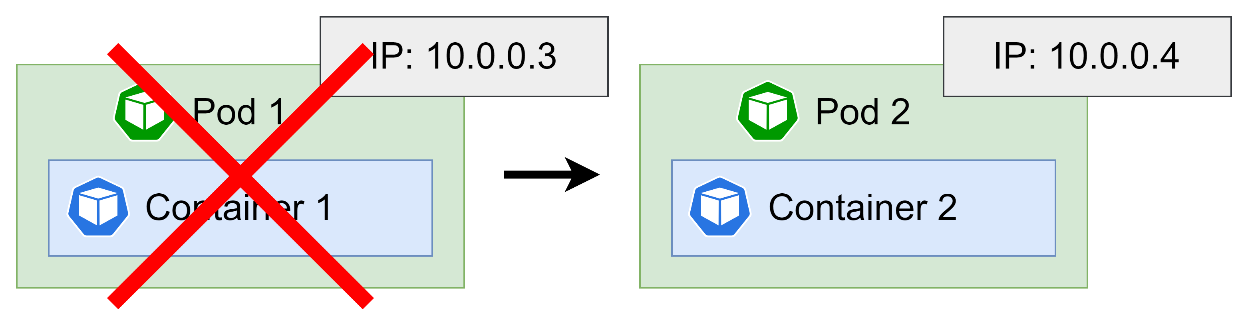
Core Concepts – Deployment
Maintains a stable set of replica Pods running at any given time
It can create and destroy Pods dynamically
Scaling
Self Healing
Zero Downtime Update - Deployment's rollout is triggered if and only if the Deployment's Pod template is changed
Rollback - Deployment's rollout history is kept in the system so that you can rollback anytime you want

Slide 7
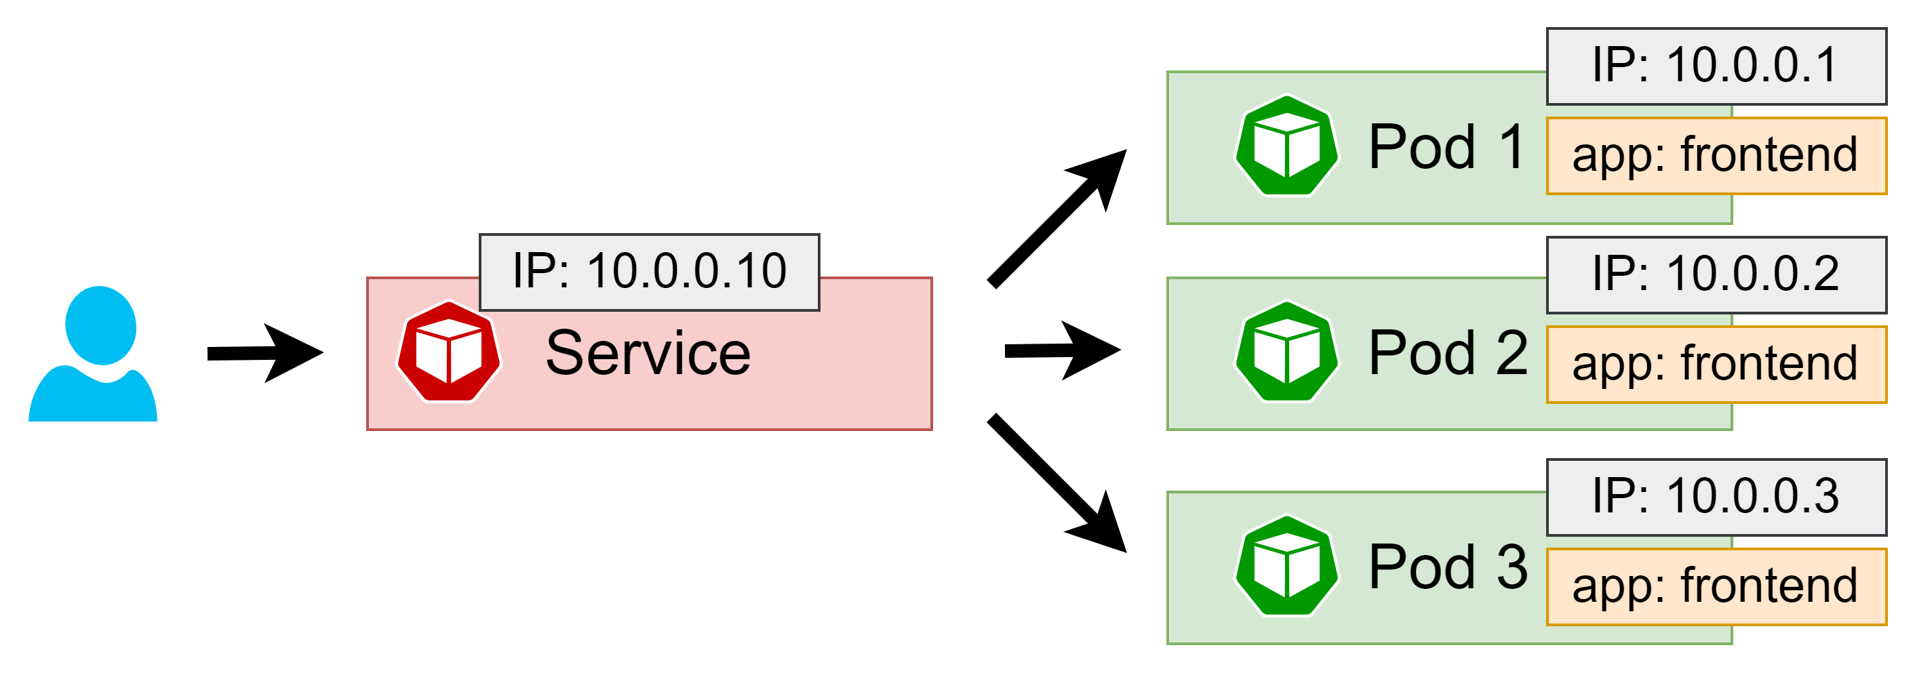
Core Concepts – Service
How do the frontends find out and keep track of which IP address to connect to, so that the frontend can use the backend part of the workload?
Logical set of Pods and a policy by which to access them
The set of Pods targeted by a Service is usually determined by a selector.

Slide 8
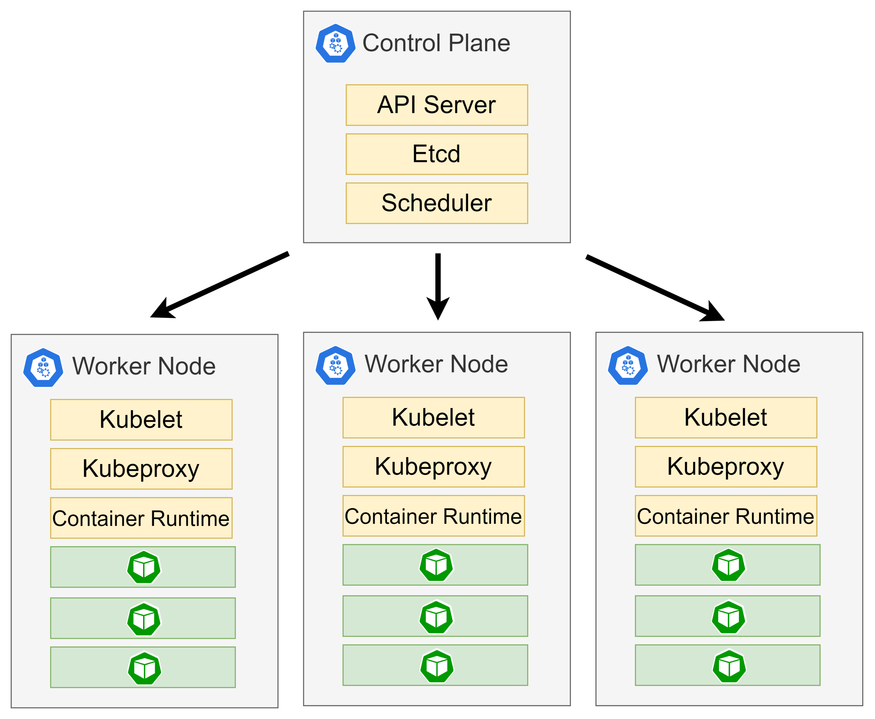
Architecture
Control Plane Components
API Server - exposes the Kubernetes API
Etcd - key value store for all cluster data
Scheduler - watches for newly created Pods with no assigned node, and selects a node for them to run on
Worker Node Components
Kubelet - makes sure that containers are running in a Pod
Kube-proxy - network proxy
Container-runtime – Containerd, CRI-O, Docker

Slide 9
Links
GitHub: https://github.com/psivak/kubernetes
Kubernetes Documentation: https://kubernetes.io/docs/concepts/
Azure Kubernetes Service (AKS): https://docs.microsoft.com/en-us/azure/aks/
AZ-400: Create and manage containers using Docker and Kubernetes: https://docs.microsoft.com/en-us/learn/paths/az-400-create-manage-containers-using-docker-kubernetes/
Peter Sivák (peter.sivak@2ring.com)

