Slide 1
CT-based Patient Triage of COVID-19:
Predicting ICU Admission and Death
Problem Statement 12 - adapted to a public lab-data cohort
UE24CS352A Machine Learning - Mini-Project - Group 23
Prajwal S Jyanopanthar (PES1UG24CS594) | Prakash N Heroor (PES1UG24CS595)

Slide 2
Problem and source paper
Zhan & Li, CS229 Spring 2020, Stanford
• Goal: at admission, flag COVID-19 patients likely to need ICU, ventilation, or to die - so limited resources go to those at highest risk
• Paper: CT radiomics + clinical + lab data; 1662 patients to develop models, 700 unseen patients to validate
• Paper's method: SMOTEENN for rare outcomes; LASSO / PCA / FPR feature selection; LR, RF, SVM, MLP, LightGBM; bootstrap comparison of data types
• Paper's best: AUROC 0.91 (ICU), 0.92 (ventilation), 0.83 (death) using radiomics + clinical + lab

Slide 3
Our adaptation: what we could and could not reproduce
• The paper's data (Jinling Hospital) is private; the authors' GitHub repository returns 404 - original data cannot be obtained
• We kept the methodology and moved to a public dataset: Routine Blood Values (Huyut, Mendeley Data v1)
• Kept: ICU admission and death prediction, imbalance handling, feature selection, 5 classifiers, held-out test + bootstrap, data-type comparison
• Dropped: CT radiomics, clinical symptoms, ventilation outcome - not present in any public dataset we could find
• So our results are a lab-only study and are not directly comparable to the paper's numbers

Slide 4
Dataset
Huyut, Routine Blood Values Datasets - Mendeley Data v1 (non-commercial / educational)
Task | Patients | Positives | Features | Blocks
ICU admission | 2000 | 279 (14.0%) | 54 | biochemical 25, hematological 17, immunological 10, age, sex
In-hospital death | 2597 | 233 (9.0%) | 37 | biochemical 12, hematological 15, immunological 10
• No patient ID: the three files per task are joined by row position (label order identical across files)
• ICU hematology/immunology files miss 1035 labels - labels taken from the biochemical file (they agree wherever both exist)

Slide 5
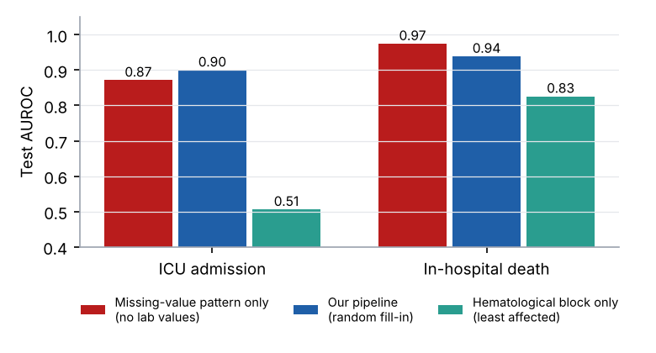
Data-quality problem we found (and handled)
The most important finding for interpreting any result
• Missing values were filled with constants. In the death files the constant differs by class: Ferritin = 395 for 92% of deaths; D-dimer = 1277 for 80% - the label leaks. A model on the raw data scores AUROC 1.00
• Fix: blank values covering >25% of a class in a column (or whose most common value differs by class); impossible zeros become missing
• Even afterwards, a model that sees ONLY which values are missing reaches AUROC 0.87 (ICU) / 0.97 (death)
• So we impute with random draws from observed values (no constant for trees to detect) and treat results as likely optimistic

Slide 6
Approach: pipeline and experiment design
Clean &
align
Random-draw
impute, clip
1-99%, scale
SMOTEENN
or none
LASSO / PCA /
FPR / none
LR, RF, SVM,
MLP, LightGBM
Test once
+ bootstrap
• Stratified 70/30 split; all 40 combinations per task scored by 5-fold CV on the 70% (resampling and selection refit inside every fold - no leakage)
• Best CV AUROC configuration refit on 70% and evaluated once on the 30% held-out test set
• Winner re-trained on each data block (biochemical / hematological / immunological / all) and compared with a plain LR baseline: paired bootstrap, 200 resamples, 95% CIs
• Threshold from out-of-fold scores (Youden); permutation importance for interpretation

Slide 7
Results on the held-out test set
Data used | ICU AUROC (95% CI) | ICU AUPRC | Death AUROC (95% CI) | Death AUPRC
All lab features | 0.90 (0.87-0.93) | 0.64 | 0.94 (0.91-0.96) | 0.71
Biochemical only | 0.88 (0.84-0.92) | 0.63 | 0.83 (0.79-0.89) | 0.46
Hematological only | 0.51 (0.45-0.57) | 0.14 | 0.83 (0.78-0.87) | 0.36
Immunological only | 0.55 (0.50-0.61) | 0.16 | 0.73 (0.66-0.79) | 0.37
Baseline LR | 0.82 (0.76-0.87) | 0.50 | 0.86 (0.79-0.90) | 0.57
• Best: ICU LightGBM + FPR selection (CV AUROC 0.91); death LightGBM (CV AUROC 0.96); no resampling in either
• ICU: sensitivity 0.79, specificity 0.83, precision 0.43 | Death: 0.80 / 0.90 / 0.44
• All blocks together beat every single block; for ICU, biochemistry carries nearly all the signal (hematology, immunology near chance)

Slide 8
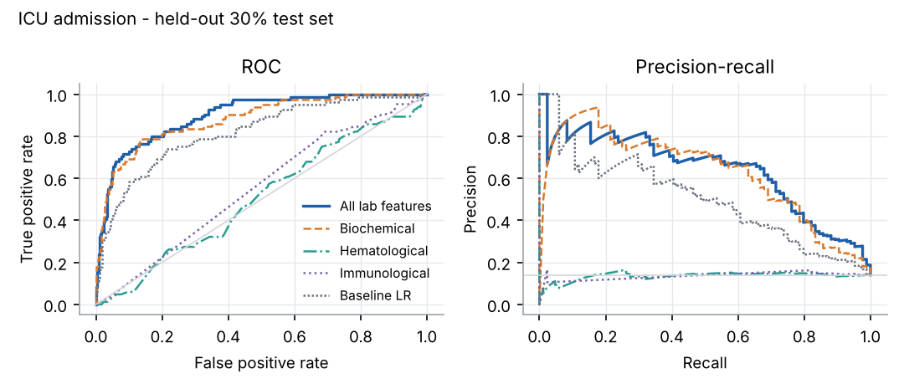
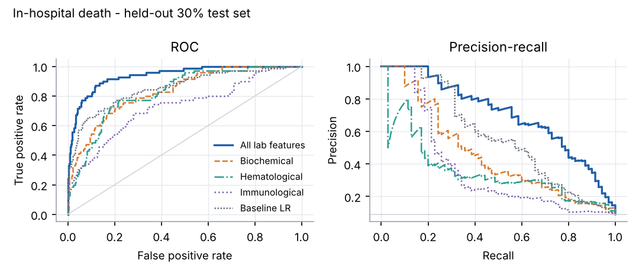
ROC and precision-recall curves
Left: ICU admission. Right: in-hospital death. Dotted gray = baseline logistic regression.
• Precision-recall matters more than ROC here: positives are only 14% (ICU) and 9% (death)

Slide 9
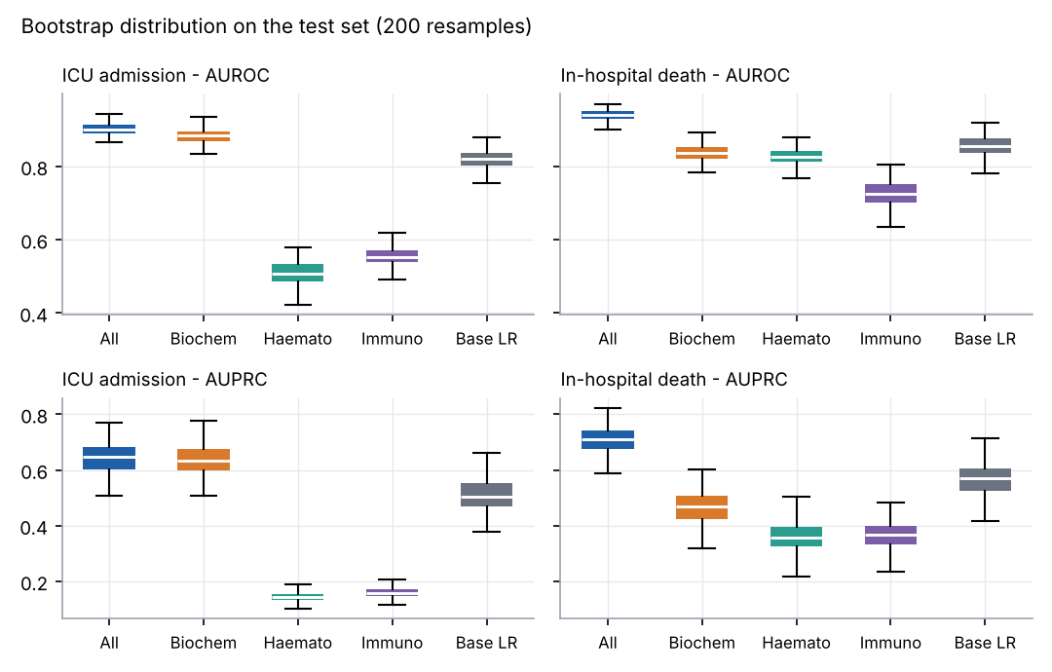
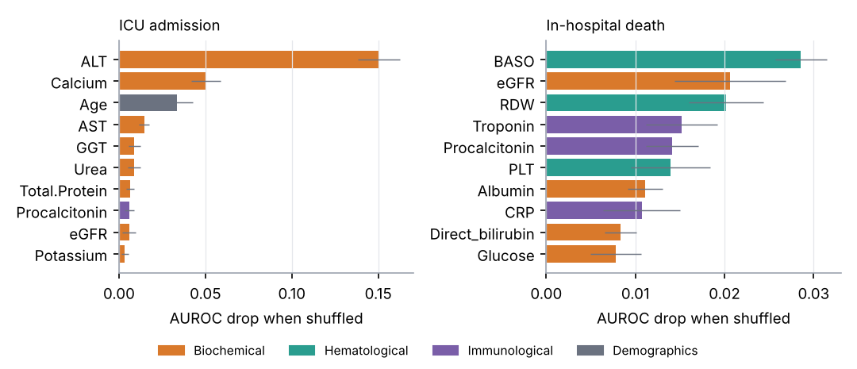
Robustness and interpretation
• Bootstrap: all-lab model above each single block and the baseline in nearly all resamples on death; ICU margin over biochemistry alone is smaller
• ICU top features: ALT, calcium, age, AST, GGT; death: BASO, eGFR, RDW, troponin, procalcitonin

Slide 10
Differences from the paper
• SMOTEENN did not help: best CV AUROC / AUPRC with it is lower than without it on both tasks (the paper used it in nearly all best models)
• FPR selection helped ICU (CV AUROC 0.91 vs 0.88 without); LASSO/PCA gave no gain on death
• Boosted trees won, as in the paper's ventilation task; the paper's gain from radiomics cannot be tested here
• Our 70/30 stratified split replaces the paper's date-based cohorts - no external validation cohort

Slide 11
Can we do better? Tested honestly
Choices made with CV on the training split only; test set used once per model
Variant | ICU CV AUROC | Death CV AUROC | Death CV AUPRC
A baseline | 0.909 | 0.958 | 0.793
B + 6 clinical ratio features | 0.908 | 0.958 | 0.803
C B + tuned LightGBM | 0.895 | 0.962 | 0.825
D C averaged over 5 imputations | 0.902 | 0.963 | 0.854
E D + RF + ExtraTrees + LR | 0.881 | 0.950 | 0.810
• ICU: nothing beats the baseline - kept
• Death: variant D wins; test AUPRC 0.71 to 0.78 (better in 100% of bootstraps), AUROC unchanged at 0.94
• Accuracy is misleading: always saying 'no' is 86% / 91% accurate
• We did not exploit the missing-value pattern (would give ~0.95-0.99 AUROC but reflects dataset artifacts)

Slide 12
Live demo and repository
• Private GitHub repository, shared with faculty and TAs; README with setup and run steps
• python src/demo.py --task icu --n 6 scores random held-out patients: risk score, flag, true outcome
• python src/demo.py --task death --n 6
• python src/run.py reproduces everything in about two minutes (fixed seed 42); --quick is a smoke test
src/data.py (load, align, clean) | src/pipeline.py (models) | src/run.py (experiments) | src/plots.py, demo.py, build_report.py

Slide 13
Conclusions and limitations
• Lab-only models separate ICU-bound and fatal cases well on held-out data: AUROC 0.90 (ICU), 0.94 (death); fusing all blocks beat any single block
• Absolute numbers are probably optimistic: imputation artifacts, row-position join, no external cohort. Least-affected estimate: hematological-only death model AUROC 0.83
• Not clinically deployable as is - the dataset's artifacts would have to be fixed at collection time
• Future work: radiomics features, nested CV with hyperparameter search, calibration, external validation

