Slide 1
Report about classification generalization
Reporter : Shaojun Pan
2019.7.29

Slide 2
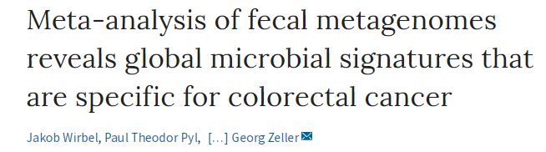
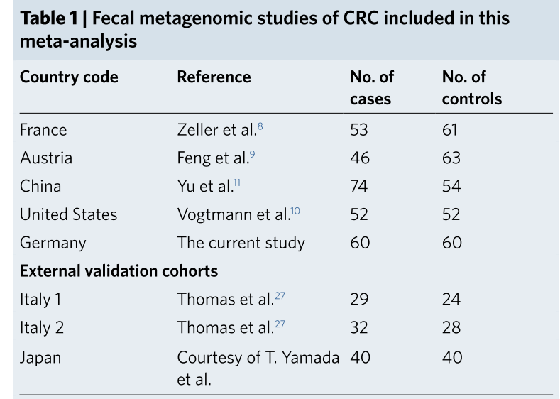
Background
A meta-analysis of colorectal cancer(CRC , n=768)
eight geographically and technically diverse fecal shotgun metagenomics studies
fecal metagenomic data from 386 cancer cases and 392 tumor-free controls

Slide 3
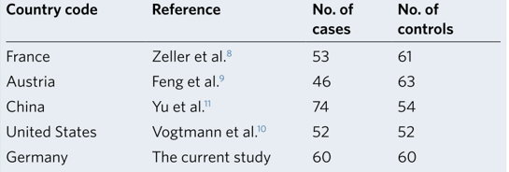
Classification
Metagenomic CRC classification models
(LASSO) logistic regression
Using five studies including the 849 most abundant microbial species
Experiment
Study to Study Transfer
Leave one Study Out

Slide 4
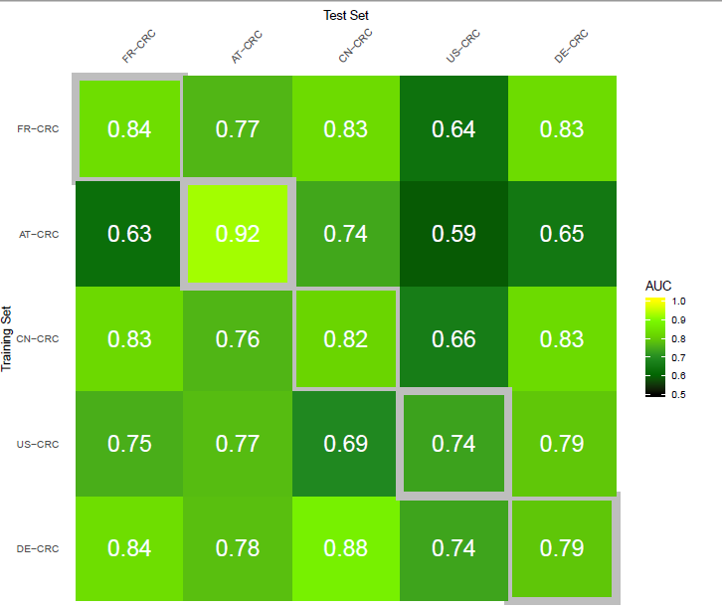
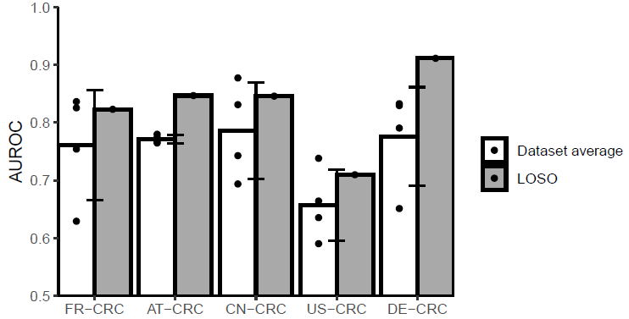
Classification
Study to Study Transfer(AUC)
Leave one Study Out(AUC)

Slide 5
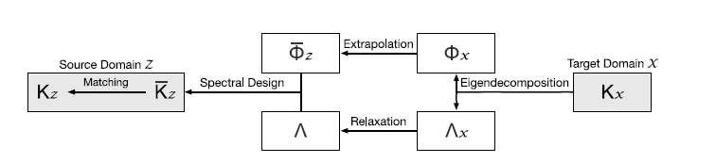
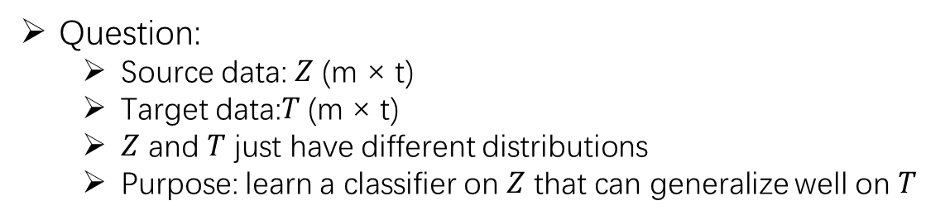
Classification generalization
Question:
Source data: $Z$ (m × t)
Target data:$T$(m × t)
$Z$ and $T$ just have different distributions
Purpose: learn a classifier on $Z$ that can generalize well on $T$
Method: Transfer Kernel Learning
Learn a domain-invariant kernel by directly matching source and target distributions in RKHS.

Slide 6



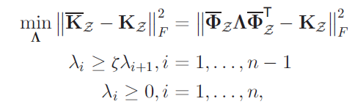
Transfer Kernel Learning
Transfer Kernel Learning Algorithm:
Choose a kernel method
Standard eigendecomposition
Extrapolation
Learning object function
The kernel matrix learned can be used in any
kernel machine learning methods.

Slide 7
Experiments
Experiment Setting
Dataset
Log-transforms features(log + z-score)
10 cross validation with 10 times
Methods
LASSO Logistic Regression
Linear SVM
Linear Transfer Kernel Learning SVM

Slide 8
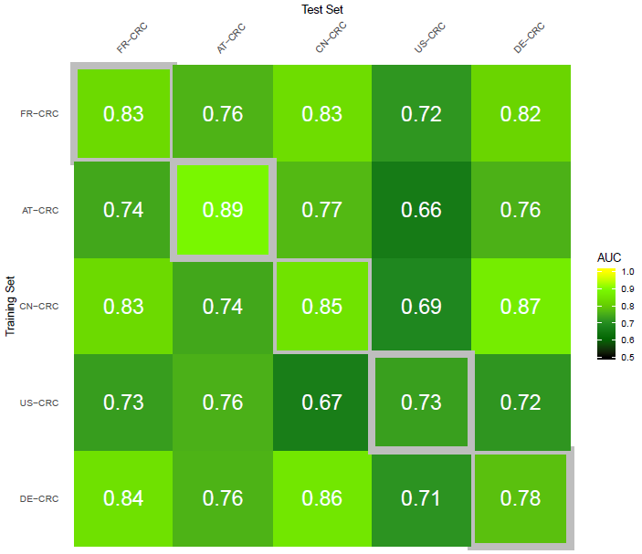
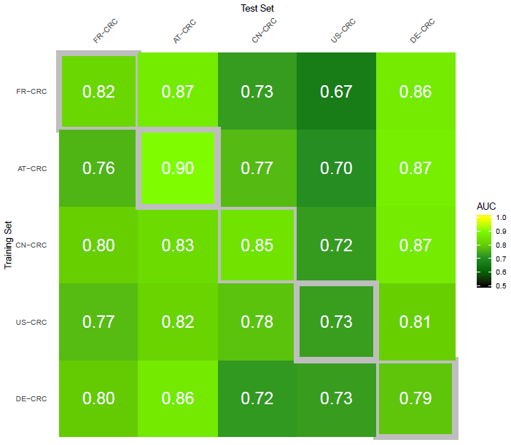
Results(SVM and TKL SVM)
Study to Study Transfer(AUC)
Linear SVM
Linear Transfer Kernel Learning

Slide 9
Results(SVM and TKL SVM)
Study to Study Transfer(AUC)
Leave One Study Out(AUC)

Slide 10
Results(LR and TKL SVM)
Study to Study Transfer(AUC)

Slide 11
Results(LR and TKL SVM)
Study to Study Transfer(AUC)
Leave One Study Out(AUC)

Slide 12
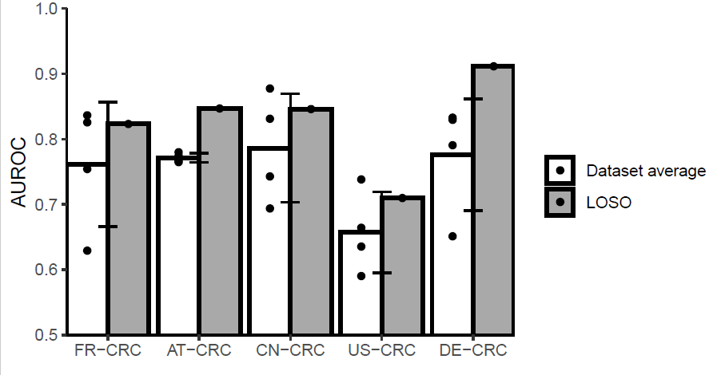
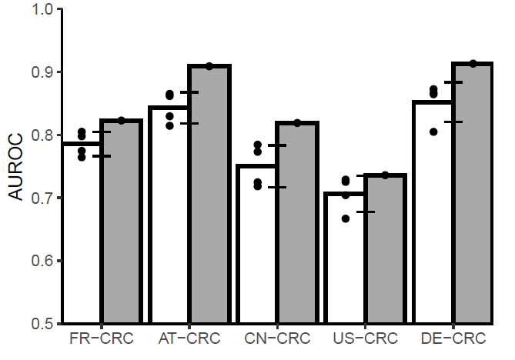
Leave One Study Out(AUC)
Logistic Regression
TKL SVM

Slide 13
Problems
Study to Study Transfer(AUC)

