Slide 1
Hybrid Based Movie Recommendation System
Pushpendra Singh - 190040082
Prerak Gandhi - 17B030004

Slide 2
Problem Statement
Create a hybrid recommendation system which can recommend movies to a user based on the user id or related to a movie selected by the user.

Slide 3
Motivation
Recommender systems are widely employed in industry and are ubiquitous in our daily lives.
Online shopping, music/streaming services, mobile applications and online advertising are the most common recommender systems today.
The major goal is to help users discover relevant items so as to create a delightful user experience.
They are used to reduce the effort and time involved in search engines and can often provide users with unknown offers and deals.
Many companies depend on effective recommender systems to position themselves ahead of competition

Slide 4
Introduction
There are many steps that are involved in developing a recommendation plan. They often follow a particular order:
Collecting/Compiling data
Analysing the data
Delivering the content
Studying the results
Taking measures to improve
The common architecture of a recommendation system includes:
Candidate Generation - Given a query, the system generates a set of relevant candidates.
Scoring - Given a user or an item, the model provides scores to the relevant candidates based on features like similarity, popularity, user history, etc.
Ranking - Candidates are arranged in a descending order of their scores to allot their rank. A threshold is used to limit the candidates as recommendations to the user.

Slide 5
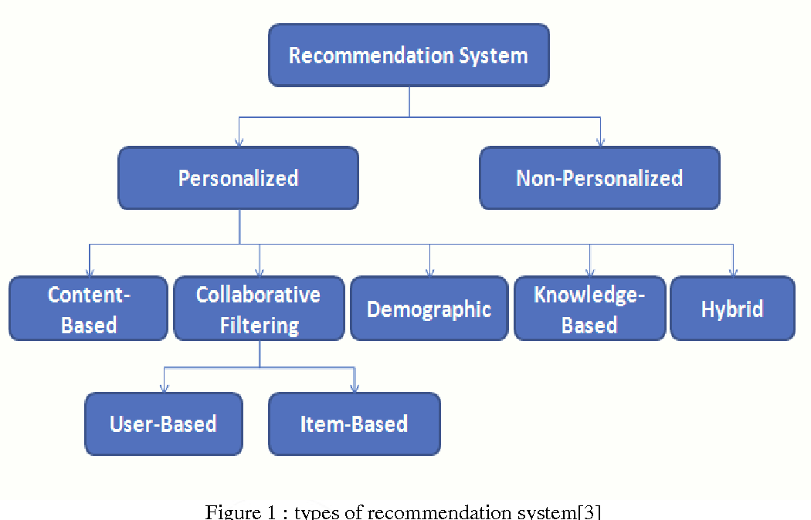
Types of Recommender Systems
There are mainly 6 types of recommender systems:
Content-Based
User-Based CF
Item-Based CF
Knowledge-Based
Demographic-based
Hybrid

Slide 6
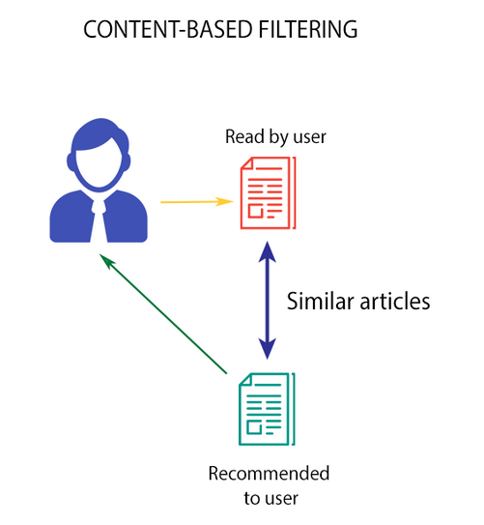
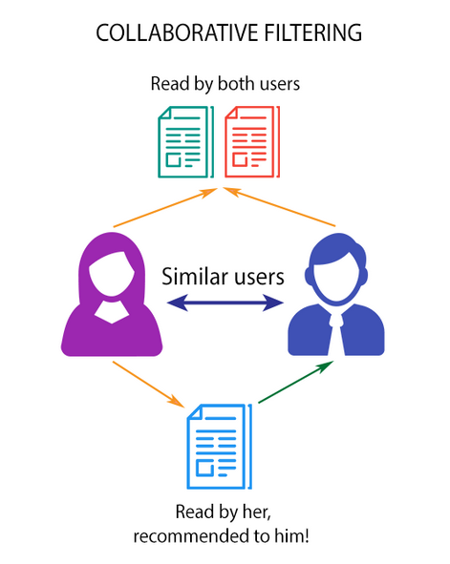

Slide 7
Dataset
The MovieLens-100K dataset is used for this project.
The user file contains a list of 943 users with features such as userid, age, sex, occupation & zip code.
The data file contains 1,00,000 ratings (1-5) given by the 943 users for 1682 movies. Each user has atleast 20 ratings. The layout contains userid, movieid, rating and timestamp.
The item file contains information about 1682 movies used. The layout contains movieid, movie title, movie release date, video release date, IMDb URL, followed by 19 genres, such as - Comedy, Action, Romance, Thriller etc. - in binary format.
Each movie can have multiple genres.

Slide 8
Proposed Approach
There are 2 hybrid based recommendation systems shown in this project.
Matrix Factorisation
It is a collaborative filtering approach established in 2006 in a Netflix contest.
Similarity measure between movie and user embeddings is used for movie recommendation.
The loss is regularized with common L2 regularization and a gravity term that pushes a pair rating prediction to 0.
Deep Neural Network
It is a fairly newer approach (2016).
The user features are the inputs and the outputs are the unique movies.
Last hidden layer represents user embeddings and the weights to output layer are the movie embeddings.
The weights of the NN are optimized to minimize the softmax cross-entropy loss between the probabilities and the actual ratings.

Slide 9
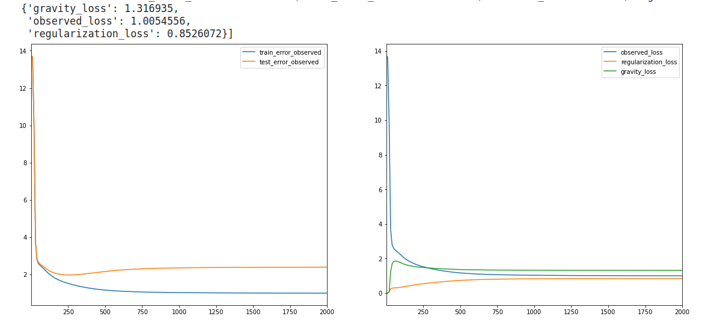
Results - Matrix Factorisation

Slide 10
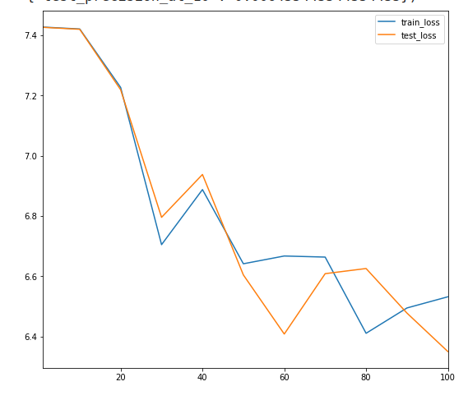
Results - Deep Neural Network

Slide 11
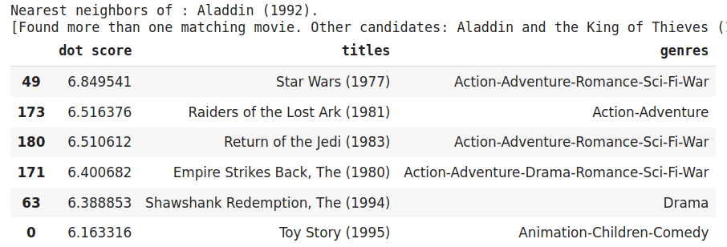
Example from DNN

Slide 12
Conclusion
Matrix Factorisation is a simple hybrid CF approach for recommender systems.
The model predicts using the dot product for a given user-item pair, which limits it from predicting for an item not seen during training.
The DNN model is capable of including extra user features such as age, location, gender which are useful for better recommendations.

Slide 13
Thank You

