Slide 1



Introduction To Linux Kernel Development Session 2
Part 2: Kernel configuration & Build
Mickaël Salaün, KY Srinivasan

Slide 2
Instructors
Dr. Mickaël Salaün
PhD on practical and effective security for users
Maintained a hardened Linux distribution for a while
Contributing to kernel developments
Maintainer of Landlock: the security sandboxing for Linux
Dr. K Y Srinivasan

Slide 3
Session Logistics
We will devote 15 minutes at the start of each session to answer questions or to deal with any spillover from the previous session.
There will be a 10-minute break at the 20th slide
Questions are welcome throughout the session​
Both on the Teams channel as well as live during the session​
All sessions are recorded​

Slide 4
Last week
Answer questions or deal with any spillover from the previous session.

Slide 5
Kernel Configuration & Build
Objectives:
Get the kernel source
Configure, build, install and boot a new kernel
Begin to walk through the source
It will be the only session where we build and install a kernel.
Other sessions will rely on kernel modules based on this kernel.
Notes:
Topics Covered:
Kernel configuration
Building the kernel
Installing the kernel
Lab:
~/class-projects/week2
Configuring the kernel
Building the kernel
Installing & booting the new kernel
Look at /proc/version

Slide 6
Prerequisites
Files specific to this session: ~/class-projects/week2
Main commands in the README file; all commands to ease copy-paste: https://aka.ms/AzureAdvanced/LKD/Part2/Commands
You should use Tmux right now to avoid connection issues and be able to get back to your shell:
tmux -u attach -d || tmux –u
Some colors might help too:
sudo tdnf install vim-extra
Notes:
Even if the slides are available, you might want to use a notepad to copy-paste commands while they are on screen.
I’ll regularly switch between my slides and my terminal to run commands.

Slide 7
Let’s get the source

Slide 8
Because this can take time, let’s start now
Not as root but as labuser!
cd
git clone --reference ~/linux.git \
https://git.kernel.org/pub/scm/linux/kernel/git/stable/linux.git
Notes:
git clone: 7m

Slide 9
Choosing the right branch
Rolling branches | Versioned branches
rolling-linux-stable | linux-5.16.y
rolling-linux-lts | linux-5.15.y

Slide 10
Source code origin
Where does it come from?
Preferably from kernel.org, a mirror or a source package from your Linux distro
Why check authenticity?
HTTPS is good but not enough
Maintainers are the source of truth
Trust models
Web of Trust (WOT)
Trust on First Use (TOFU)
Notes:
Supply chain

Slide 11
Trusted developers
Developer | Fingerprint
Linus Torvalds | ABAF 11C6 5A29 70B1 30AB E3C4 79BE 3E43 0041 1886
Greg Kroah-Hartman | 647F 2865 4894 E3BD 4571 99BE 38DB BDC8 6092 693E
Sasha Levin | E27E 5D8A 3403 A2EF 6687 3BBC DEA6 6FF7 9777 2CDC
Ben Hutchings | AC2B 29BD 34A6 AFDD B3F6 8F35 E7BF C8EC 9586 1109

Slide 12
Git tag verification
Import a maintainer public key:
gpg --import ~/pgpkeys/.keyring/openpgp/kernel.org/gregkh/default
Check a Git tag:
cd ~/linux
git checkout linux-5.16.y
git describe linux-5.16.y
git verify-tag v5.16.19
Advanced usage: https://www.kernel.org/doc/html/latest/process/maintainer-pgp-guide.html
Notes:
mkdir ~/.gnupg
chmod 0700 ~/.gnupg
vi ~/.gnupg/gpg.conf
auto-key-locate wkd,keyserver,dane,local
keyserver hkps://keys.openpgp.org
trust-model tofu+pgp
Get the signer public key:
gpg --locate-keys gregkh@kernel.org

Slide 13
Alternatively, archive file verification
(Files in ~/class-projects/week2)
curl -OL https://cdn.kernel.org/pub/linux/kernel/v5.x/linux-5.16.19.tar.sign
curl -OL https://cdn.kernel.org/pub/linux/kernel/v5.x/linux-5.16.19.tar.xz
unxz --keep linux-5.16.19.tar.xz
gpg --verify linux-5.16.19.tar.sign linux-5.16.19.tar
Notes:
No need to extract the archive here.

Slide 14
Why build our own kernel?
Pros: customization
Optimize for performance reasons: minimize size, tailor to a CPU family…
Increase security: disable useless features, sign kernel and modules, enable and customize security features
Develop additional features (before being in mainline 😉)
Hack for fun!
Cons: maintenance cost
Require to continuously keep this kernel up-to-date (as any other software)
May require additional testing and QA

Slide 15
Because this can take time, let’s configure it now
cd ~/linux
zcat /proc/config.gz > config-mariner
make KCONFIG_ALLCONFIG=config-mariner allnoconfig
make localmodconfig
make menuconfig

Slide 16
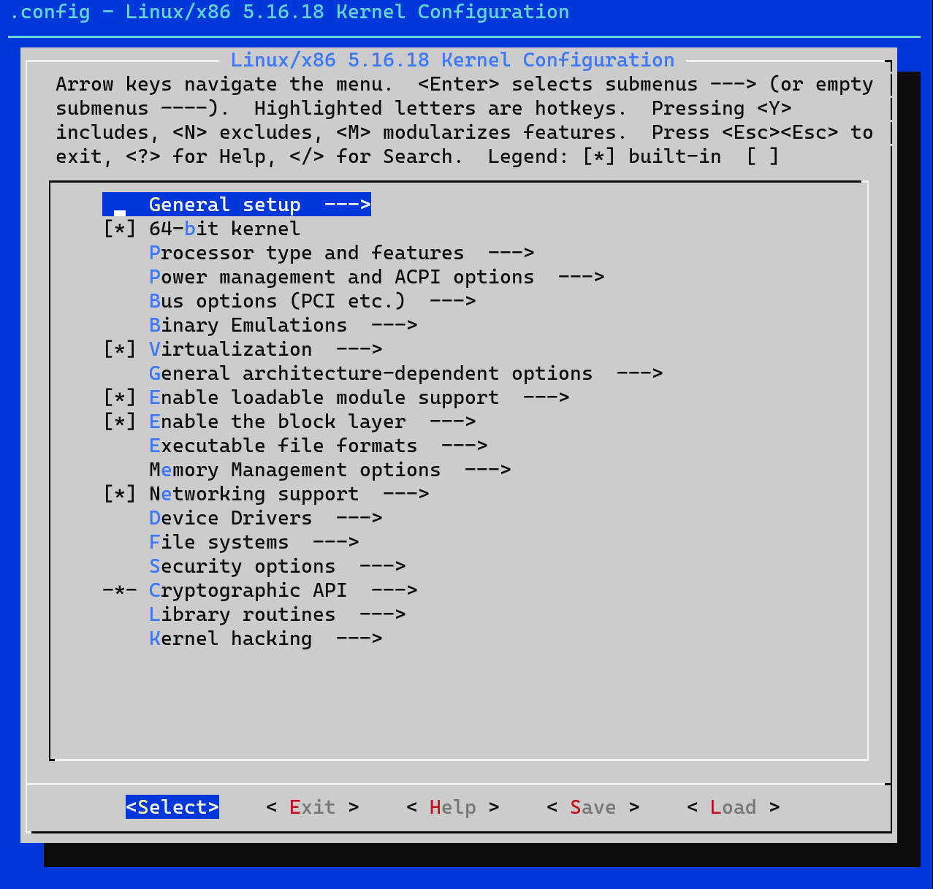
make menuconfig

Slide 17
Configuring our kernel
make menuconfig
Browsing the configuration tree: navigation keys (up, down, left, right)
Looking for a specific configuration: “/”
Showing description: “h”
Selecting an option: <space> (“*” in static, or “M” for a module)
Don’t forget to save your changes!
The configuration is stored in the .config file

Slide 18
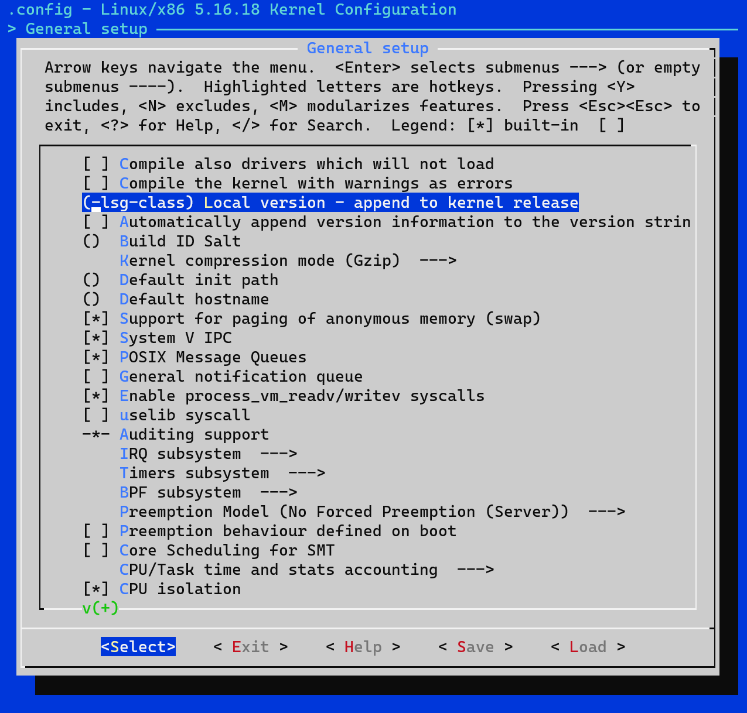
Custom kernel version

Slide 19
Because it takes time, let’s make it light for now
Remove some big options (low-hanging fruits):
Development: DEBUG_KERNEL (depends on EXPERT)
Graphic: DRM
Network: IPV6
Filesystem: XFS_FS
Security features: SECURITY_SELINUX, SECURITY_SMACK, SECURITY_APPARMOR, SECURITY_SAFESETID, SECURITY_LOCKDOWN_LSM and INTEGRITY
Obviously, we should tailor our kernel to our needs, and security features should be enabled by default.

Slide 20
Because it takes time, let’s prepare it now
make -j3
…and it’s time for a 10-minute break.
Notes:
make –j3 takes 25m34s on the lab VM (first time).

Slide 21
Kernel configuration

Slide 22
Kconfig files and language
Kernel configuration database:
Set of files
Configuration organized in a tree structure
Visible or hidden nodes
Contain a description and dependencies
May depend on user selection, architecture and compiler features
Used by kernel code and Makefile to select appropriate features
https://docs.kernel.org/kbuild/kconfig-language.html

Slide 23
Kconfig example #1
# SPDX-License-Identifier: GPL-2.0-only
config SECURITY_LANDLOCK
bool "Landlock support"
depends on SECURITY && !ARCH_EPHEMERAL_INODES
select SECURITY_PATH
help
Landlock is a sandboxing mechanism that enables processes to restrict
themselves (and their future children) by gradually enforcing
tailored access control policies. [...]
See Documentation/userspace-api/landlock.rst for further information.
If you are unsure how to answer this question, answer N. Otherwise,
you should also prepend "landlock," to the content of CONFIG_LSM to
enable Landlock at boot time.

Slide 24
Kconfig example #2
# SPDX-License-Identifier: GPL-2.0-only
menu "Microsoft Hyper-V guest support"
config HYPERV
tristate "Microsoft Hyper-V client drivers"
depends on ACPI && ((X86 && X86_LOCAL_APIC && HYPERVISOR_GUEST) \
|| (ARM64 && !CPU_BIG_ENDIAN))
select PARAVIRT
select X86_HV_CALLBACK_VECTOR if X86
select VMAP_PFN
help
Select this option to run Linux as a Hyper-V client operating
system.
[...]
endmenu

Slide 25
Actual kernel configuration with the .config file
Can be generated with make commands:
make menuconfig
make oldconfig
make localmodconfig
make allnoconfig
make randconfig
Can also get a configuration from files: KCONFIG_ALLCONFIG

Slide 26
Using configuration values in Makefile
obj-$(CONFIG_SECURITY_LANDLOCK) := landlock.o
landlock-y := setup.o syscalls.o object.o ruleset.o \
cred.o ptrace.o fs.o
security/landlock/Makefile

Slide 27
Using configuration values in kernel code #1
#ifdef CONFIG_HYPERV_TESTING
int hv_debug_init(void);
#else /* CONFIG_HYPERV_TESTING */
static inline int hv_debug_init(void)
{
return -1;
}
#endif /* CONFIG_HYPERV_TESTING */
drivers/hv/hyperv_vmbus.h

Slide 28
Using configuration values in kernel code #2
if (IS_ENABLED(CONFIG_POSIX_TIMERS))
update_rlimit_cpu(current, rlimit(RLIMIT_CPU));
security/selinux/hooks.c

Slide 29
Let’s create a custom kernel

Slide 30
Custom kernel
Goal: reuse the distro kernel configuration but with a newer kernel
Benefits:
Bleeding edge kernel
Minimal config tweaks: Mariner’s kernel configuration is already tailored to Azure
Drawbacks:
Bleeding edge kernel
No distro support

Slide 31
Patch, build and package our kernel
git checkout -b fix-rpm
git am ~/class-projects/week2/0001-LSG-CLASS-Fix-RPM-uninstallation-on-CBL-Mariner.patch
…but you first need to configure Git with an email address and a name.
git am ~/class-projects/week2/0001-LSG-CLASS-Fix-RPM-uninstallation-on-CBL-Mariner.patch
make -j3 RPMOPTS="--define '_topdir /home/labuser/rpmbuild'" binrpm-pkg
Notes:
We’ll look at the patch in a few slides.

Slide 32
Build the cscope database
./scripts/tags.sh cscope
Notes:
Cscope takes 1m32s

Slide 33
What’s in this patch?
vi ~/class-projects/week2/0001-LSG-CLASS-Fix-RPM-uninstallation-on-CBL-Mariner.patch

Slide 34
Install and boot our kernel
(Make sure there is no “lockdown=integrity” in /boot/mariner.cfg)
sudo rpm -i ~/rpmbuild/RPMS/x86_64/kernel-5.16.19_lsg_class+-2.x86_64.rpm
cat /proc/version
sudo reboot
cat /proc/version
Notes:
Tips: it is safer to use a dedicated SSH connection per user (and to disable sudo), but sudo is easier for this lab.

Slide 35
Uninstall our kernel
sudo rpm -e kernel-5.16.19_lsg_class+-2.x86_64

Slide 36
Dynamic kernel configurations

Slide 37
Boot options
cat /proc/cmdline
sudo cat /boot/grub2/grub.cfg
sudo cat /boot/mariner.cfg

Slide 38
sysctl
Viewing some values is restricted to the root user, but not most:
sysctl –a
find /proc/sys
Update a value, e.g., add more ptrace restrictions with Yama:
sudo sysctl kernel.yama.ptrace_scope=2
Can be made persistent thanks to /etc/sysctl.d/*

Slide 39
Tooling

Slide 40
Required build dependencies
A compiler: GCC or Clang
Some development libraries: configuration display (ncurses), compiler plugins
Cryptography: OpenSSL
Language parsing: Flex & Bison
Script interpreters: Bash, Perl, Python
Source code utility: cscope
Packaging tools

Slide 41
cscope
Build the database (already done): ./scripts/tags.sh cscope
Use cscope with Vim:
Action | Vim command
Load the database | :cs add cscope.out
Look for a declaration | :cs f g <name>
Look for function callers | :cs f c <name>

Slide 42
Wrap-up

Slide 43
What have we done?
Got the kernel source, verified its origin with cryptographic signatures
Patched, configured, built, packaged, installed and booted a new kernel
Explored static and dynamic kernel configurations
Walked through some source files to experiment with code search

Slide 44
Homework
Build and install a new kernel package with these options:
Use the default Mariner configuration (config-mariner, not the current /proc/config.gz) and don’t forget to run make localmodconfig
Change the local version to “-lsg-class-debug”
Enable SECURITY_LANDLOCK (read full help), LSM and SAMPLES
Check that it is enabled with sudo dmesg | grep landlock
Test with the samples/landlock/sandboxer binary
Get familiar with Vim and the cscope_maps plugin.
https://aka.ms/AzureAdvanced/feedback
Notes:
CONFIG_DEBUG might require to free some space in /boot for the package installation.
make takes 47m33s

