Slide 1
Simple Load Balancer
Kiran Kancheti
Siri Venkat Vemuri
Pranesh Vyas
Sandeep Batchu

Slide 2
Agenda
Objective
Technology Explored
Application Logic
Topology Implemented
Flow Diagram
Challenges
Execution Screen Shots
Conclusion

Slide 3
Objective
Design a mechanism to load balance network traffic over multiple links dynamically based on parameters like statistics gathered from interfaces of switches and nodes in the network.

Slide 4
Technology Explored
POX Controller:
It’s a framework to communicate between SDN switches using OpenFlow protocol.
Tasks Performed:
Integrated POX Mininet VM image.
Documentation and sample examples.
Challenges:
Setup issues on Windows using opendaylight, floodlight controller.

Slide 5
Application Logic
The Load balancer application basically calculates the average latency between each pair of nodes in the network, the path with the lowest latency is picked, and subsequently used for the payload to be sent.
We have primarily implemented this in a fixed topology fashion, however can be employed across different topologies.

Slide 6
Topology Implemented- Big Picture

Slide 7
Flow Diagram
START
Calculated best path based on minimum spanning tree
Generate HTTP Traffic
Calculate latency on each path
Update paths based on latency calculated

Slide 8
Challenges
In a scenario where multiple switches are present, it would be difficult to ping between two different hosts.
Reason: When ARP(Address Resolution Protocol) request gets broadcasted, it would generate heavy traffic leading to a bottleneck in the network.
Work Around: As and when a ARP request is received, MAC address is hardcoded, and sent to the requested host.

Slide 9
Challenges
POX controller provided a method which gives flow statistics which can be gathered by adding listener “FlowStatsReceived”. But this method doesn’t give enough information to handle flow statistics. So we wrote some scripts which can give latency in the network

Slide 10
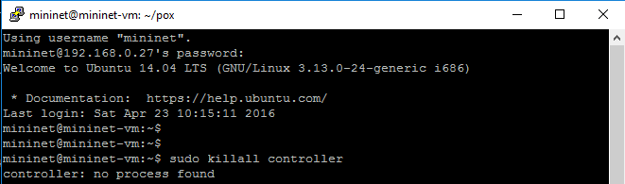
Execution Walkthrough
Step 1: Clean Up controller which are currently running
Note: Since, it’s the first time running, no process is found. In further iterations, this command will clear the controllers.

Slide 11
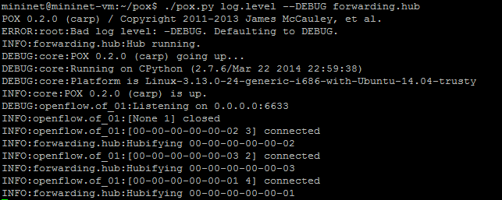
Execution Walkthrough: Contd…
Step 2: Start POX Controller

Slide 12
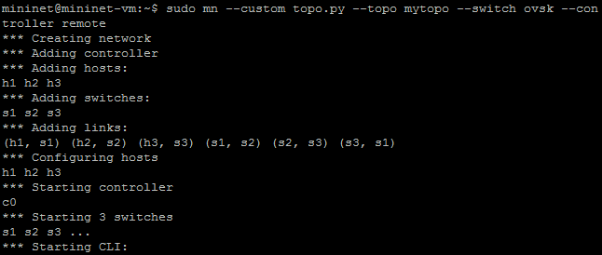
Execution Walkthrough: Contd…
Step 3: Create Custom Topology

Slide 13
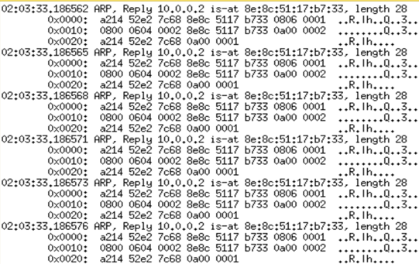
Execution Walkthrough: Contd…
Step 4: Generate HTTP traffic on Node H1
Command: h1 python –m SimpleHTTPServer 80 &

Slide 14
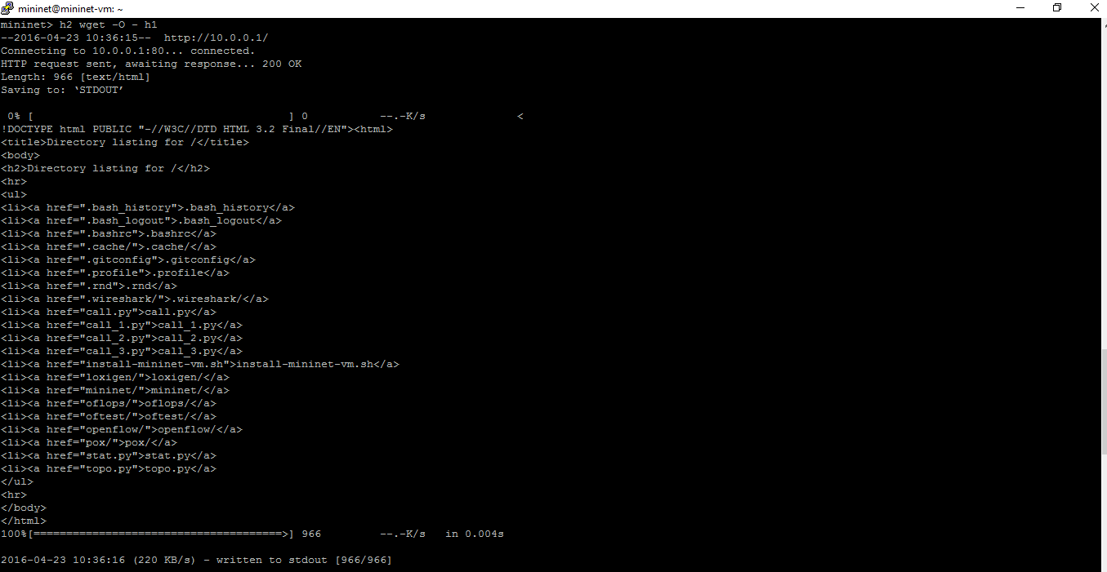
Execution Walkthrough: Contd…
Step 5: Making a wget request from H2

Slide 15
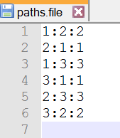
Execution Walkthrough: Contd…
Step 6: Initial path in paths.file

Slide 16
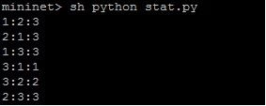
Execution Walkthrough: Contd…
Step 7: Paths based on Latency Calculation

Slide 17
Conclusion
We got hands on experience to use SDN Controller and build applications on top of it.
We have implemented the load balancing using POX controller on custom topology.
This can be extended to any topology.
We have learned about mininet ,pox controller, Open Network Protocol
We faced various obstacles in the integration and found various workarounds to get the desired functionality .

