Slide 1

Note: The data and information in this document is reflective of a hypothetical situation and client. This document is to be used for KPMG Virtual Internship purposes only.
Sprocket Central Pty Ltd
Data analytics approach
[Division Name] - [Engagement Manager], [Senior Consultant], [Junior Consultant]

Slide 2
Note: The data and information in this document is reflective of a hypothetical situation and client. This document is to be used for KPMG Virtual Internship purposes only.
Agenda
Introduction
Data Exploration
Model Development
Interpretation

Slide 3
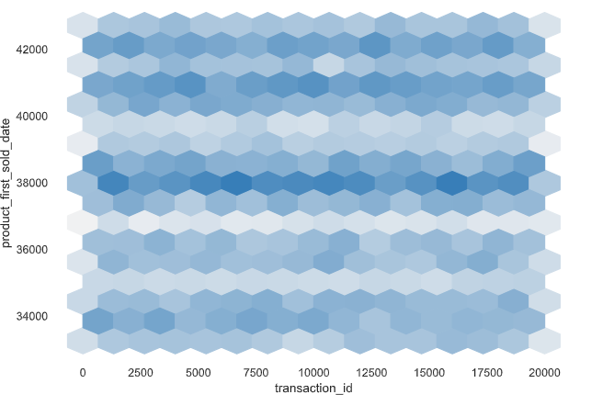
Note: The data and information in this document is reflective of a hypothetical situation and client. This document is to be used for KPMG Virtual Internship purposes only.
Introduction
DATA INSIGHTS
In the world of data analysis, three vital stages play a key role: Data Exploration, Model Development, and Interpretation.

Slide 4
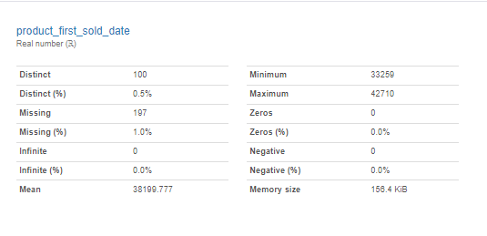
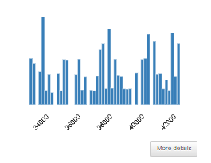
Note: The data and information in this document is reflective of a hypothetical situation and client. This document is to be used for KPMG Virtual Internship purposes only.
Data Exploration
"Unveiling Insights: Navigating Data Through Exploration"
Data Exploration involves delving into raw data to understand its structure, patterns, and potential issues. This phase includes tasks such as data cleaning, visualization, and basic statistical analysis. By visualizing data through plots, charts, and graphs, we can uncover trends, anomalies, and relationships within the dataset. Data Exploration not only aids in preparing the data for further analysis but also offers initial insights that guide subsequent steps.

Slide 5
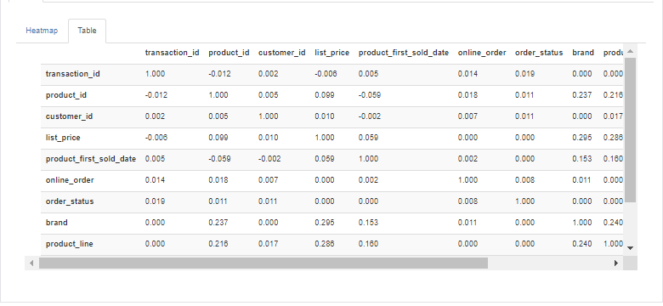
Note: The data and information in this document is reflective of a hypothetical situation and client. This document is to be used for KPMG Virtual Internship purposes only.
Model Development
"Forging Insights: Navigating the Crucial Phase of Model Development"
Model Development entails creating predictive or descriptive algorithms that learn patterns from data. In machine learning, this involves selecting appropriate algorithms, splitting data into training and testing sets, and tuning hyperparameters to optimize model performance. The model is "trained" on the training data to learn patterns, and then its effectiveness is evaluated on the testing data. The ultimate goal is to create a model that can generalize well to new, unseen data and make accurate predictions or classifications.

Slide 6
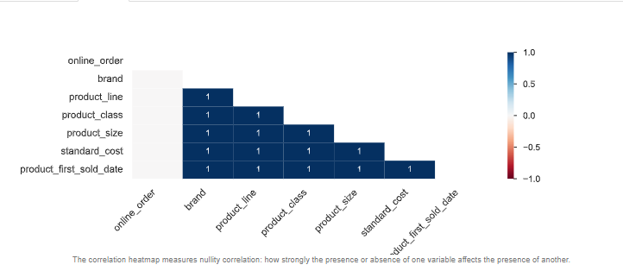
Note: The data and information in this document is reflective of a hypothetical situation and client. This document is to be used for KPMG Virtual Internship purposes only.
Interpretation
"Unveiling Insights: The Power of Model Interpretation in Data-driven Decisions"
Extracting insights from the model, understanding its strengths and limitations. Enhances trust, informs improvements, and guides decision-making.
These phases form a loop of insight: Exploration informs Development, which in turn aids Interpretation, enabling informed decisions based on data.
The mail regarding insights has been shared in previous task.

Slide 7
Note: The data and information in this document is reflective of a hypothetical situation and client. This document is to be used for KPMG Virtual Internship purposes only.
Appendix

Slide 8
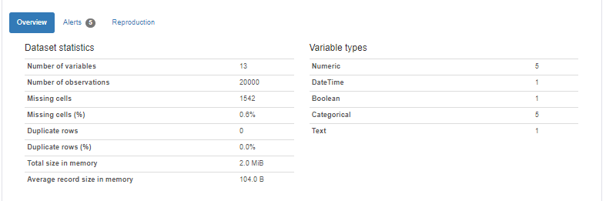
Note: The data and information in this document is reflective of a hypothetical situation and client. This document is to be used for KPMG Virtual Internship purposes only.
Appendix
The example overview oof one table:

