Slide 1
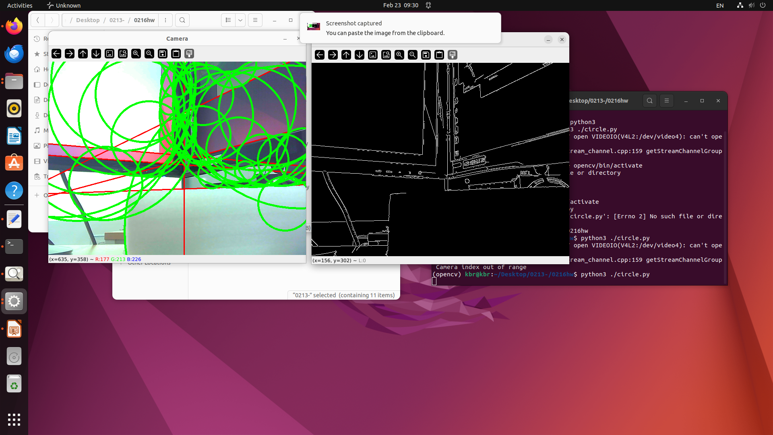
import numpy as np
import cv2
cap = cv2.VideoCapture(4)
width, height = 640, 480
cap.set(cv2.CAP_PROP_FRAME_WIDTH, width)
cap.set(cv2.CAP_PROP_FRAME_HEIGHT, height)
while(cap.isOpened()):
ret, frame = cap.read()
if ret is False:
print("Can't receive frame (stream end?). Exiting ...")
break
gray = cv2.cvtColor(frame, cv2.COLOR_BGR2GRAY)
edges = cv2.Canny(gray, 50, 150)
cv2.imshow("Edges", edges)
lines = cv2.HoughLines(edges, 1, np.pi/180, 200)
if lines is not None:
for line in lines:
rho, theta = line[0]
a = np.cos(theta)
b = np.sin(theta)
x0 = a * rho
y0 = b * rho
x1 = int(x0 + 1000 * (-b))
y1 = int(y0 + 1000 * (a))
x2 = int(x0 - 1000 * (-b))
y2 = int(y0 - 1000 * (a))
cv2.line(frame, (x1, y1), (x2, y2), (0, 0, 255), 2)
circles = cv2.HoughCircles(gray, cv2.HOUGH_GRADIENT, 1, 50,
param1=120, param2=30, minRadius=0, maxRadius=0)
if circles is not None:
circles = np.round(circles[0, :]).astype("int")
for (x, y, r) in circles:
cv2.circle(frame, (x, y), r, (0, 255, 0), 4)
cv2.imshow("Camera", frame)
key = cv2.waitKey(1)
if key & 0xFF == ord('q'):
break
cap.release()
cv2.destroyAllWindows()

Slide 2
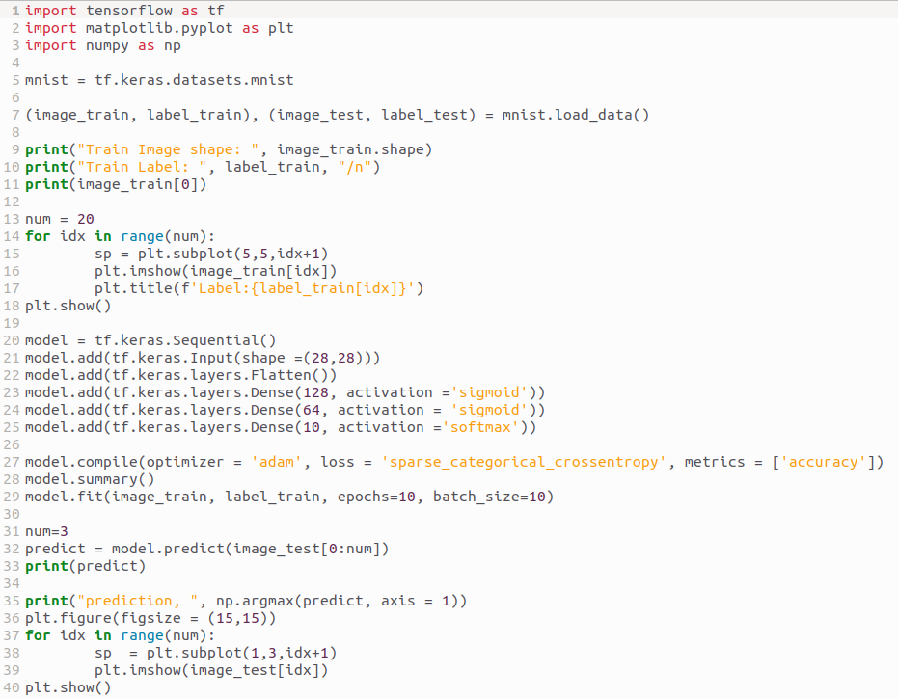
Project-2

Slide 3
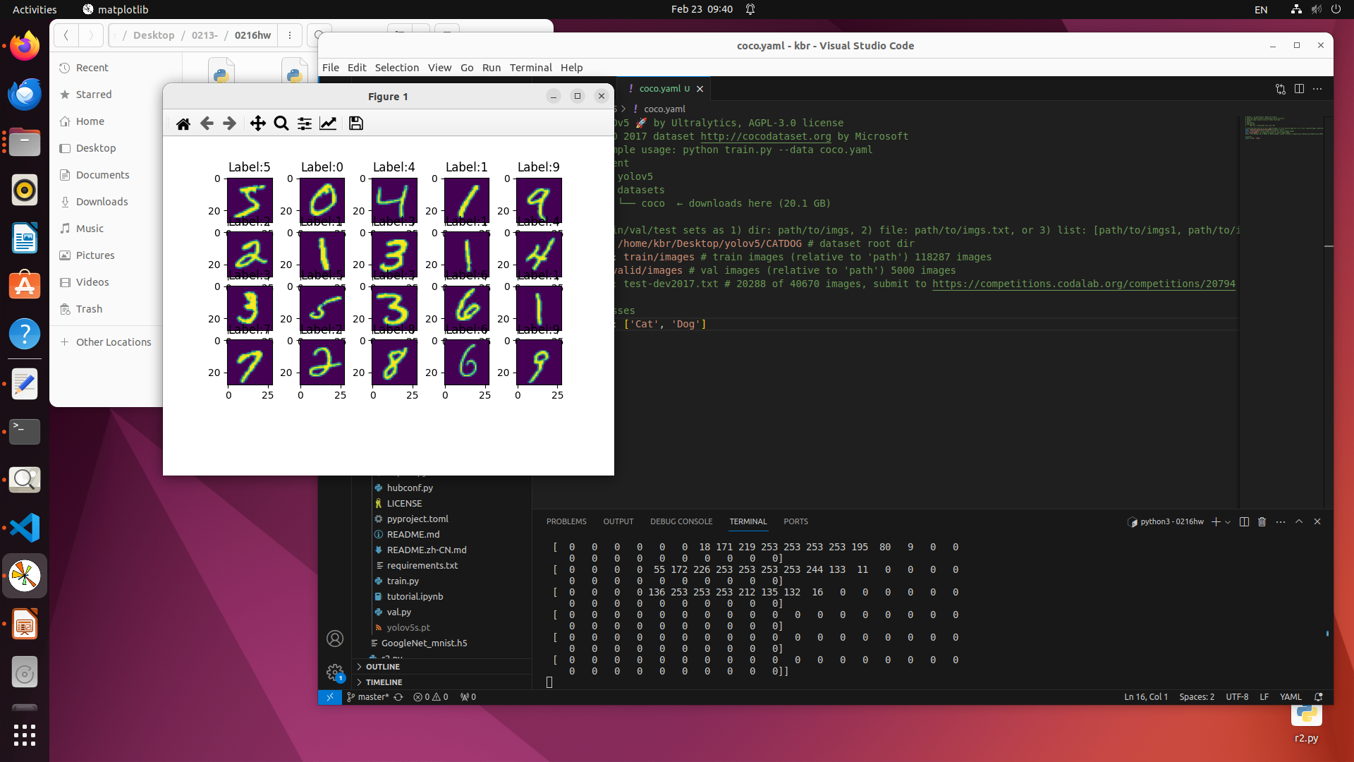
Project-2

