Slide 1
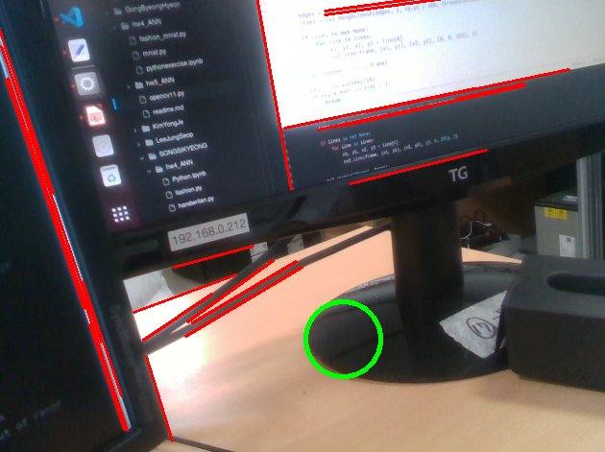
Project1

Slide 2
if circles is not None:
circles = circles[0, :].astype(int)
for x, y, r in circles:
cv2.circle(frame, (x, y), r, (0, 255, 0), 4)
edges = cv2.Canny(gray, 50, 150, apertureSize=3)
lines = cv2.HoughLinesP(edges, 1, np.pi / 180, threshold=100, minLineLength=50, maxLineGap=10)
if lines is not None:
for line in lines:
x1, y1, x2, y2 = line[0]
cv2.line(frame, (x1, y1), (x2, y2), (0, 0, 255), 2)if circles is not None:
circles = circles[0, :].astype(int)
for x, y, r in circles:
cv2.circle(frame, (x, y), r, (0, 255, 0), 4)
edges = cv2.Canny(gray, 50, 150, apertureSize=3)
lines = cv2.HoughLinesP(edges, 1, np.pi / 180, threshold=100, minLineLength=50, maxLineGap=10)
if lines is not None:
for line in lines:
x1, y1, x2, y2 = line[0]
cv2.line(frame, (x1, y1), (x2, y2), (0, 0, 255), 2)

Slide 3
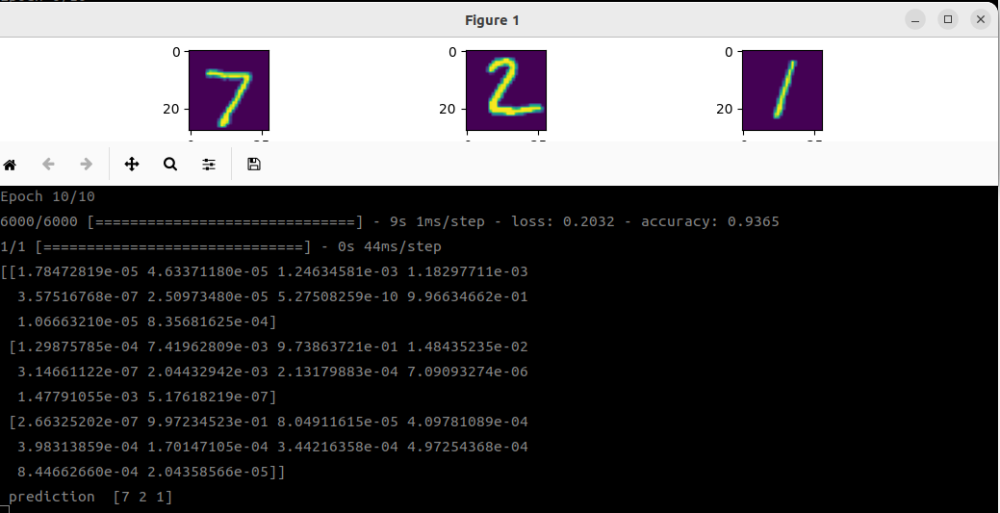
Project2

Slide 4
Project2
model = tf.keras.Sequential()
model.add(tf.keras.Input(shape=(28, 28))) # 28 x 28의 이미지 파일
model.add(tf.keras.layers.Flatten()) # 한 줄로 정렬
model.add(tf.keras.layers.Dense(128, activation='sigmoid'))
model.add(tf.keras.layers.Dense(64, activation='sigmoid'))
model.add(tf.keras.layers.Dense(10, activation='softmax'))
model.compile(optimizer='adam', loss='sparse_categorical_crossentropy',
metrics=['accuracy']) # 모델을 컴파일하여 최적화, 손실 함수, 평가 지표 정의
model.summary()
model.fit(image_train, label_train, epochs=10, batch_size=10) # 학습 실시

Slide 5
Project2
목표 설정
데이터 확보
데이터셋 레이블링
데이터 전처리 및 ANN 구성
학습/추론/피드백

