Slide 1
PH 1820 · APPLIED LINEAR REGRESSION · FINAL PROJECT
Predictors of Lymph Node Burden in Stage II/III Colon Cancer
A Multiple Linear Regression Analysis of Clinical and Tumor Characteristics with Model Diagnostics and Validation
Parminder Kooner
Spring 2026

Slide 2

INTRODUCTION
Research Question & Hypotheses
RESEARCH QUESTION
HYPOTHESES
Do markers of advanced local disease (obstruction, perforation, adherence, extent of invasion) independently predict the number of positive lymph nodes at diagnosis, after adjusting for clinical covariates?
Null Hypothesis:
$$H_{0}: β_{obstruct}=β_{perfor}=β_{adhere}=β_{extent}=0$$
Alternate Hypothesis
$$H_{A}:Atleast one of these β_{j}≠0$$
Why Use “Nodes” as the Outcome?
▸ Fully observed continuous measure
▸ Clinically relevant, forming a key component of TNM staging
▸ Measured at the time of surgery, before initiation of chemotherapy

Slide 3
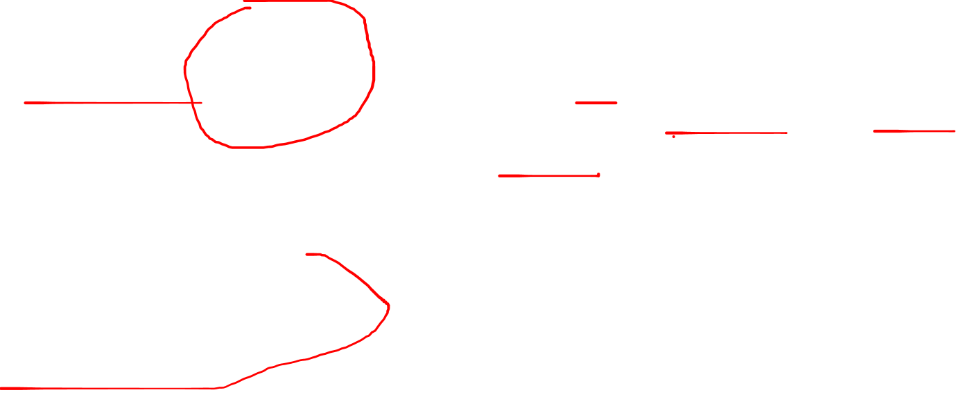
METHODS
Dataset & Variables
SAMPLE SELECTION
VARIABLES
888
Role | Variable | Type
Response (Outcome) | nodes | Count
Primary Predictors | obstruct, perfor, adhere | Binary
 | extent | Ordinal (4)
Adjustment (Covariates) | age | Continuous
 | sex, surg | Binary
 | rx | Nominal (3)
 | differ | Ordinal (3)
1,858
929
Total Observations
Unique Patients
Final Analytic sample
Data Source: NCTG randomized trial of adjuvant chemotherapy in Stage II/III colon cancer (Laurie et al., 1989)
Missing Data: nodes (1.9%) and tumor differentiation (2.5%); no missingness in other variables. A complete-case analysis was conducted.

Slide 4
METHODS
Data Structure, Study Design & Preprocessing
DATA STRUCTURE
STUDY DESIGN
Patient-level dataset with:
Demographic variables (Age, Sex)
Tumor Characteristics (Obstruction, perforation, adherence, extent)
Treatment (rx)
Data derived from a randomized clinical trial
No explicit variable indicating treatment assignment
Analysis conducted as observational
Total Observations
DATA PREPROCESSING
INTERPRETATION
Removed identifiers (id, study, rownames)
Excluded survival-related variables (time, status, etype)
Removed collinear variable (node4)
Results interpreted as associations, not causal effects
Dataset structure verified using PROC CONTENTS (SAS)

Slide 5

EXPLORATORY DATA ANALYSIS
KEY TAKEAWAY
We conducted six EDA stages: univariate distributions of each variable, bivariate associations with lymph node count, and redundancy checks among predictors.
OVERVIEW · EDA Framework: Six Stages and Key Findings
# | Stage | What we examined | PROC | Decision / finding
① | Univariate continuous | nodes, age center, spread, skew | UNIVARIATE | nodes right-skewed (skew = 2.55) → transformation evaluated via Box–Cox
② | Categorical frequencies | rx, sex, obstruct, perfor, adhere, differ, extent, surg | FREQ | perfor (n=27) and extent=1 (n=19) are rare cells
③ | Bivariate (continuous) | nodes vs age slope, R² | SGPLOT (REG) | slope = −0.025 / yr (p = 0.012); R² < 1%
④ | Bivariate (categorical) | nodes by each categorical predictor | SGPLOT (VBOX) | only extent and differ trend; six others flat
⑤ | Continuous correlations | nodes ↔ age | CORR | r = −0.09, ρ = −0.11; clinically negligible
⑥ | Cross-tabs (multicoll.) | each disease marker × extent | FREQ (CHISQ) | Cramér's V ≤ 0.20 no severe multicollinearity

Slide 6
RESULTS
Preliminary Linear Regression Model (Untransformed Outcome)
888
<.0001
0.046
3.48
Sample size
F Test p-value
R²
Root MSE
SIGNIFICANT PREDICTORS (Full Main Effects Model)
Predictor | Estimate (β) | 95% CI | p-value
differ_3 (poor vs. well) | +1.94 | (1.01, 2.87) | <0.0001
extent_4 (contiguous vs. submucosa) | +2.20 | (0.23, 4.17) | 0.029
extent_3 (serosa vs. submucosa) | +1.94 | (0.34, 3.55) | 0.018
differ_2 (moderate vs. well) | +0.79 | (0.02, 1.57) | 0.045
age | -0.025 | (-0.044, -0.005) | 0.012
Key Takeaways
Model is statistically significant but explains very little variability (R² = 0.046)
Of the four primary local-disease markers, only extent reached significance
Obstruction, perforation, and adherence were not significant
Results suggest limited explanatory power using the untransformed outcome

Slide 7
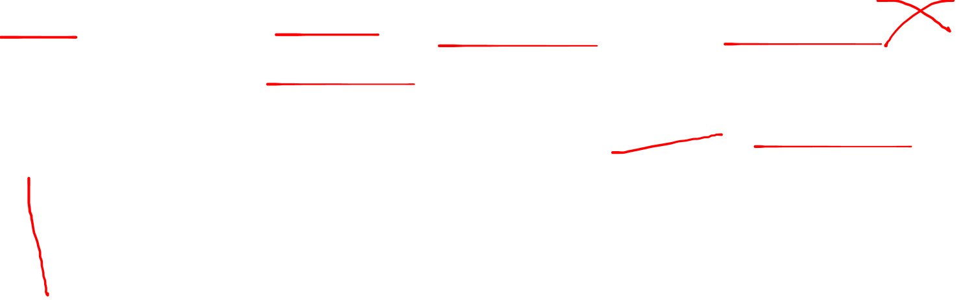
RESULTS
Model Diagnostics
ONE PRIMARY ASSUMPTION VIOLATED
Residuals are non-normal and heavily right skewed (Shapiro-Wilk W = 0.79) → evaluate transformation (via Box-Cox)
Evidence of heteroscedasticity from White’s Test (p < 0.0001), though Breusch-Pagan is not significant
Assumption | Test | Result | Status
Normality of residuals | Shapiro-Wilk | W = 0.79, p < 0.0001 | VIOLATED
Constant variance | Breusch-Pagan | p =0.1880 | OK
 | White's test | p <0.0001 | POSSIBLE VIOLATION (MIXED)
Linearity | Residual plots | No evidence of non-linearity (curvature) | OK
Independence | Cross-sectional design | Assumption satisfied by study design | OK
Multicollinearity | VIF | All VIF < 7.5 | OK
Detailed diagnostics provided in the Appendix

Slide 8

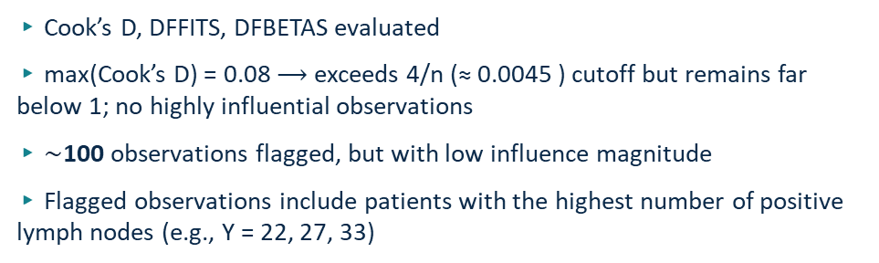
RESULTS
Influential Observations
FINDINGS
SENSITIVITY REFIT
▸ Cook’s D, DFFITS, DFBETAS evaluated
▸ max(Cook’s D) = 0.08 $⟶$exceeds 4/n (≈ 0.0045 ) cutoff but remains far below 1; no highly influential observations
▸ $\sim$100 observations flagged, but with low influence magnitude
▸ Flagged observations include patients with the highest number of positive lymph nodes (e.g., Y = 22, 27, 33)
 | Full N=888 | Excluded N=777
perfor levels | 2 | 1
extent levels | 4 | 3
Model Matrix (X’X) | Estimable | Singular
Excluding flagged observations eliminated entire predictor categories (perforation and submucosa-only extent), resulting in a degenerate (singular) model.
DECISION
Retain all observations and address skewness through outcome transformation (to be determined via Box–Cox analysis)

Slide 9
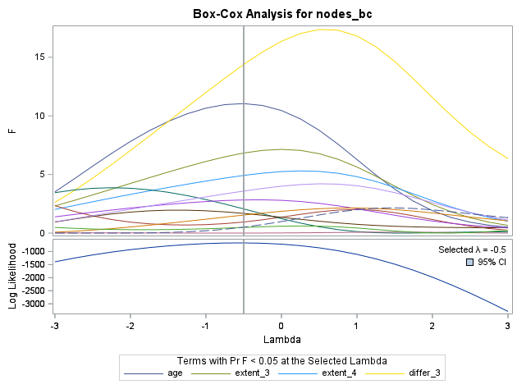
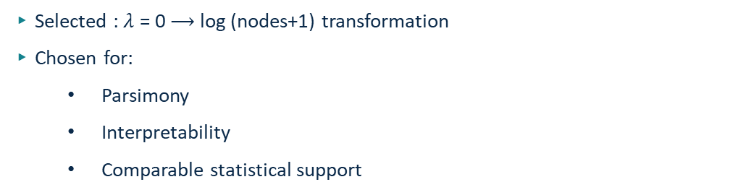


RESULTS
Final Transformation Selection
BOX-COX FINDINGS
▸ Maximum likelihood estimate: $λ$ = - 0.5
▸ Profile likelihood confidence interval: wide
▸ Indicates no strong evidence that $λ$ = - 0.5 outperforms simpler alternatives
DECISION
▸ Selected : $λ$ = 0 $⟶$ log (nodes+1) transformation
▸ Chosen for:
Parsimony
Interpretability
Comparable statistical support
INTERPRETATION ADVANTAGE
▸ Effects are interpreted on a relative (multiplicative) scale
▸Preserves clinical meaning of lymph node burden
▸Avoids overfitting from unnecessary transformation complexity
Key Takeaways
Although λ ≈ −0.5 maximized likelihood, the evidence was weak. We prioritized interpretability and selected a log transformation, which adequately stabilizes variance and improves normality.

Slide 10
RESULTS
Log-Transformed Linear Regression Model (Y = log(nodes + 1))
888
<.0001
0.052 (0.038)
0.0588
Sample size
F Test p-value
R² (Adjusted R²)
Root MSE
SIGNIFICANT PREDICTORS (Log-Transformed Linear Regression Model)
Predictor | Estimate (β) | 95% CI | p-value
extent_3 (serosa vs submucosa) | +0.37 | (0.08, 0.64) | 0.0077
differ_3 (poor vs well) | +0.32 | (0.16, 0.48) | <0.0001
differ_2 (moderate vs well) | +0.13 | (0.00, 0.26) | 0.0458
age | -0.005 | (-0.008, -0.002) | 0.0013
Key Takeaways
Model is statistically significant but explains limited variability (Adjusted R² = 0.038)
Extent of invasion and tumor differentiation remain significant predictors
Age is associated with a small decrease in lymph node burden
Effects are interpreted on a relative (multiplicative) scale

Slide 11
RESULTS
Transformation Impact and Model Improvement
0.63
−0.14
0.96
0.052
Residual skew (was 2.55)
Residual kurtosis (was 10.3)
Shapiro-Wilk W (was 0.79)
Model R² (was 0.046)
DIAGNOSTIC IMPROVEMENT log(nodes + 1)
Diagnostic | Untransformed nodes | log(nodes + 1) | Improvement
Skewness | +2.55 | +0.65 | ≈ 4× closer to symmetric
Kurtosis | +10.3 | −0.14 | near-normal
Shapiro-Wilk W | 0.79 (p < .0001) | 0.96 (p < .0001) | large improvement
Residual range | −11 to +28 | −1.6 to +2.2 | bounded by transform
Lack-of-fit p (later) |  | 0.72 (passes) | linear-in-log adequate
TRANSFORMATION IMPACT ON MODEL DIAGNOSTICS
▸ Residuals are more symmetric and closer to normal
▸ Extreme values have reduced influence
▸Model assumptions are better satisfied after transformation
▸Model fit is largely unchanged

Slide 12
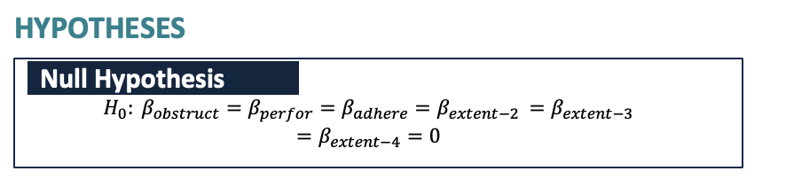
RESULTS
Partial F Test for Disease Marker Block
Degrees of Freedom: 6
307.64
303.03
2.22
0.040
Reduced Model SSE
Full Model SSE
Partial F (Block)
Block-test p-value
OBJECTIVE
Assess whether the primary disease markers (obstruction, perforation, adherence, extent) jointly improve model fit beyond covariates
MODELS COMPARED
HYPOTHESES
Reduced Model: age, sex, tumor differentiation (differ), treatment (rx), surgery (surg)
Full model: covariates + disease markers (obstruction, perforation, adherence, extent)
Null Hypothesis:
$$H_{0}: β_{obstruct}=β_{perfor}=β_{adhere}=β_{extent}=0$$
Test | df | Statistic | p | Decision
Partial F: full vs. reduced (drop 6 marker terms) | (6, 874) | F = 2.22 | 0.040 | Block kept; revisit at selection
Reduced model (covariates only) SSE |  | 307.64
Full model (with markers) SSE |  | 303.03
Alternate Hypothesis
$$H_{A}:Atleast one of these β_{j}≠0$$
INTERPRETATION
Disease markers are jointly significant (block p = 0.040)
Provide additional explanatory value beyond covariates
Justifies inclusion of the full disease marker set
Adding disease markers reduces unexplained variability

Slide 13
RESULTS
Interaction Effects Assessment
9
0.0608
1 / 9
Drop
Interaction terms tested
Model R² (with interactions)
Significant interactions
Decision on interactions
Do Disease Markers Contribute Beyond Covariates?
Test | df | Statistic | p | Decision
Block Test: Interactions (Full vs. Main Effects) | (9,868) | F = 2.96 | <0.0001 | Interactions improve model fit, but evaluate individually
Best individual interaction: adhere x extent_2 | 1 | β = +0.555 | 0.046 | 1 of 9 → likely chance
All other interactions (8 terms) |  | 303.03 | >0.05 | No interactions retained
Interaction block is statistically significant, but driven by weak and inconsistent effects
Only 1 of 9 interactions is significant → consistent with chance
No clear or interpretable interaction pattern
Final model excludes interactions to maintain parsimony and stability
Key Takeaways

Slide 14
RESULTS
Final Model Selection – Stepwise and Best Subsets
4
0.039
7.80
−932
Variables retained
Final Model R² (Adj 0.035)
Mallows C(p) – Final Model
AIC (best model)
Stepwise Selection (SLE = SLS = 0.05), Confirmed by Best-Subsets
Step | Variable entered | Cum. R² | C(p) | Partial p | Notes
1 | differ_3 (Poor vs Well) | 0.017 | 22.0 | <.0001 | strongest single predictor
2 | + age | 0.029 | 13.4 | 0.001 | continuous covariate enters
3 | + extent_3 (Serosa) | 0.034 | 10.4 | 0.027 | only disease-marker term to enter
4 | + differ_2 (Mod vs Well) | 0.039 | 7.80 | 0.033 | completes differ contrast
 | (no further entry) |  |  | > 0.05 | obstruct, perfor, adhere, extent_2/4 excluded
Stepwise selection retained 4 predictors: age, differ_2, differ_3, extent_3
Tumor differentiation (differ) is the strongest driver of node burden
Only one disease marker (extent_3) contributes after adjustment
Other markers (obstruct, perfor, adhere, extent_2, extent_4) do not improve fit
Model performance remains low (R² ≈ 0.04) despite selection
Key Takeaways

Slide 15
RESULTS
Final Log-Transformed Model and Key Effects
888
<.0001
0.039
0.72
Sample size
F-test p-value
R² (Adj 0.035)
Lack-of-fit p (passes)
log(nodes + 1) = β₀ + β₁ · age + β₂ · differ_2 + β₃ · differ_3 + β₄ · extent_3
Predictor | β | 95% CI | p | Effect on nodes
Intercept | +1.405 | (1.159, 1.652) | <.0001
age (per year) | −0.0054 | (−0.0086, −0.0021) | 0.001 | −0.5% per year
differ_2 (Mod vs. Well) | +0.142 | (+0.012, +0.272) | 0.033 | +15%
differ_3 (Poor vs. Well) | +0.329 | (+0.173, +0.484) | <.0001 | +39%
extent_3 (Serosa vs. ≤ Muscle) | +0.115 | (+0.013, +0.216) | 0.027 | +12%
Key Takeaways
Tumor differentiation is the strongest predictor of lymph node burden
Poorly differentiated tumors have substantially higher node involvement
Age has a small negative association
Extent of invasion contributes modestly after adjustment
Model fit is statistically significant but explains little variability (Adjusted R² = 0.04
Back-Transformed Interpretation
Each additional year of age → ~0.5% fewer nodes
Poorly differentiated tumors → +39% nodes (e^0.329) vs. well-differentiated
Serosa invasion → +12% more nodes vs. ≤ muscle
Lack-of-fit p = 0.72 supports the linear-in-log model

Slide 16
RESULTS
Model Validation and Inference Results
307.12
310.53
+1.1%
1 of 3
SSE (in-sample)
PRESS (LOOCV)
Out-of-sample increase
Significant extent contrasts (Bonferroni)
Cross-Validation and Adjusted Inference for Extent
Result | Value | Interpretation
SSE (in-sample, residual sum of squares) | 307.12 | Training-set fit
PRESS (leave-one-out CV residual sum of squares) | 310.53 | Out-of-sample fit
PRESS / SSE ratio | 1.011 | ≈ 1% degradation → no overfitting
Bonferroni: extent 3 vs 1 (Serosa vs Submucosa) | Δ = +0.369 | 95% sim. CI (0.007, 0.730) ✓ significant
All other extent pairwise comparisons |  | 95% sim. CIs cross 0 ✗ not significant
Key Takeaways
Model shows stable performance out-of-sample (PRESS ≈ SSE)
Minimal overfitting → good generalizability
Overall model fit remains low (R² ≈ 0.04)
After adjustment, only one extent contrast (serosa vs submucosa) is significant
Extent effect is driven by a single comparison, not a consistent pattern

Slide 17

DISCUSSION
Key Scientific Insights
$\sim$4%
Tumor Pathology
3 of 4
Real
Variance explained
Strongest signal
Disease markers not informative
Low R² reflects true
biological complexity
SCIENTIFIC IMPLICATIONS
Theme | Finding | Clinical interpretation
Histology beats macroscopic findings | differ + extent_3 retained at p < 0.05 | Microscopic features predict nodal burden better than gross findings.
Gross findings ≠ nodal disease | obstruct, perfor, adhere all p > 0.15 in selection | Bowel obstruction or perforation does not, by itself, signal more nodes.
Inverse age effect | β_age = −0.005 / year (p = 0.001) | Younger patients trend toward heavier nodal disease biology, not surveillance.
Limitation | R² ≈ 4%, count outcome with overdispersion | OLS on log scale workable; negative-binomial GLM more principled.
Future direction | Add molecular markers (KRAS, MSI, sidedness, location) | Patient-level biology likely dominates the unexplained 96%.
Key Takeaways
Lymph node burden is weakly predictable from standard clinical and pathological variables in this trial
Tumor differentiation grade and serosa-level invasion provide the only consistent signal
Gross local-disease markers (obstruction, perforation, adherence) do not add explanatory power once pathology is accounted for
Model generalizes well; low R² reflects true biological complexity, not overfitting
Stage II/III colon cancer context:
Standard clinical and pathological variables have limited predictive ability
Differentiation and serosa-level invasion drive the signal
Gross disease markers do not contribute additional explanatory value beyond pathology

Slide 18
Appendix
Appendix
Supplementary diagnostics

Slide 19
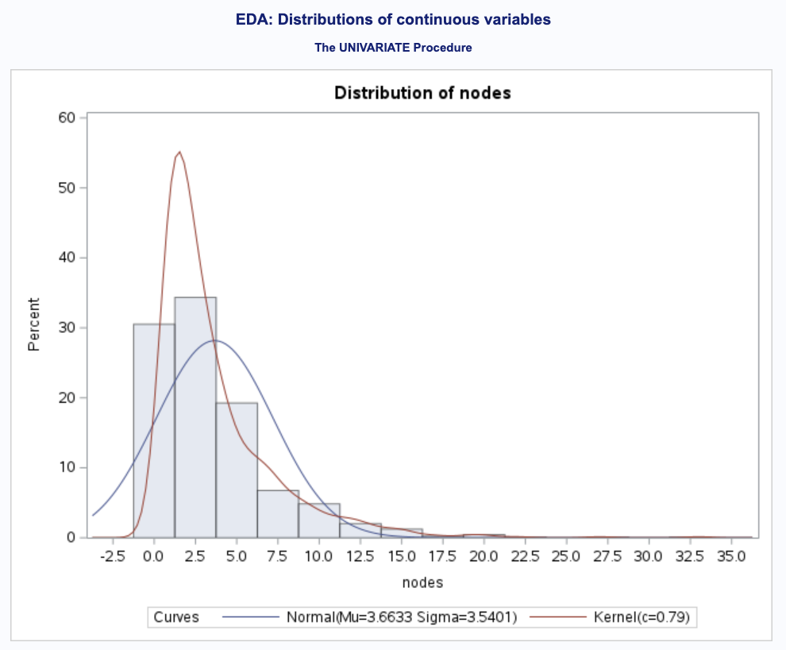
APPENDIX
Appendix A1 · Distribution of `nodes`
DISTRIBUTION
Metric | Value
Mean | 3.66
Median | 2.0
Range | 0–33
Skewness | +2.55
Kurtosis | +10.26
Shapiro-Wilk W | 0.79
Shapiro-Wilk p | <0.0001
PROC UNIVARIATE DATA=colon; VAR nodes; HISTOGRAM nodes / NORMAL KERNEL; RUN;

Slide 20
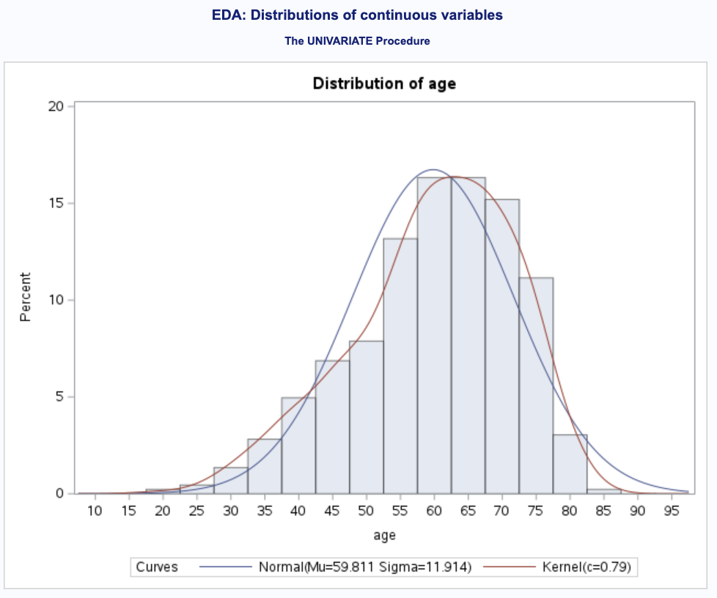
APPENDIX
Appendix A2 · Distribution of `age`
DISTRIBUTION
Metric | Value
Mean | 59.8
Median | 61
Range | 18–85
Skewness | -0.58
Kurtosis | -0.10
Q-Q plot | Near diagonal
Decision | No transform
PROC UNIVARIATE DATA=colon; VAR age; HISTOGRAM age / NORMAL; QQPLOT age / NORMAL(MU=EST SIGMA=EST); RUN;

Slide 21
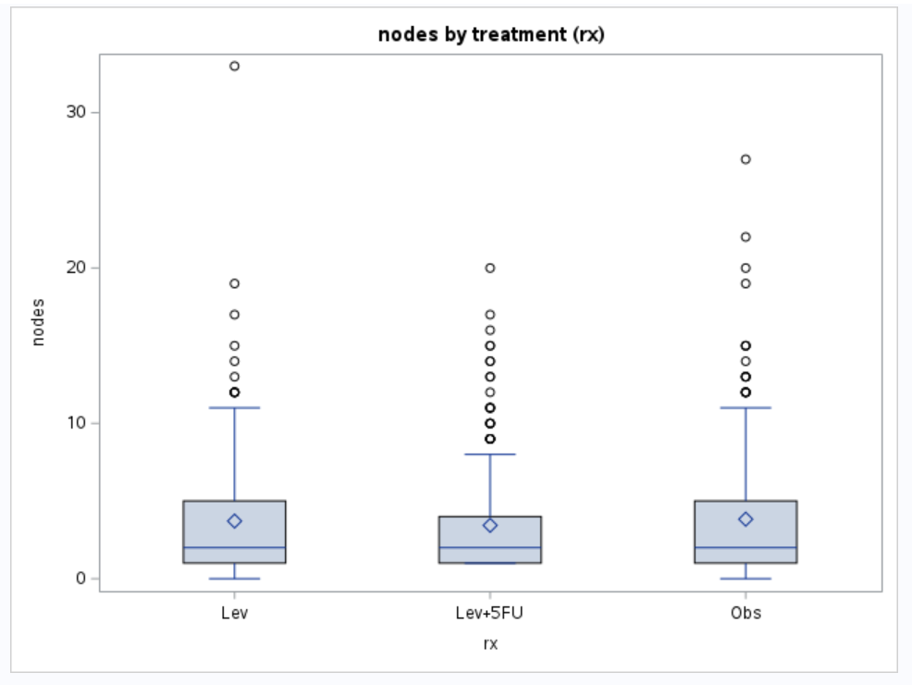
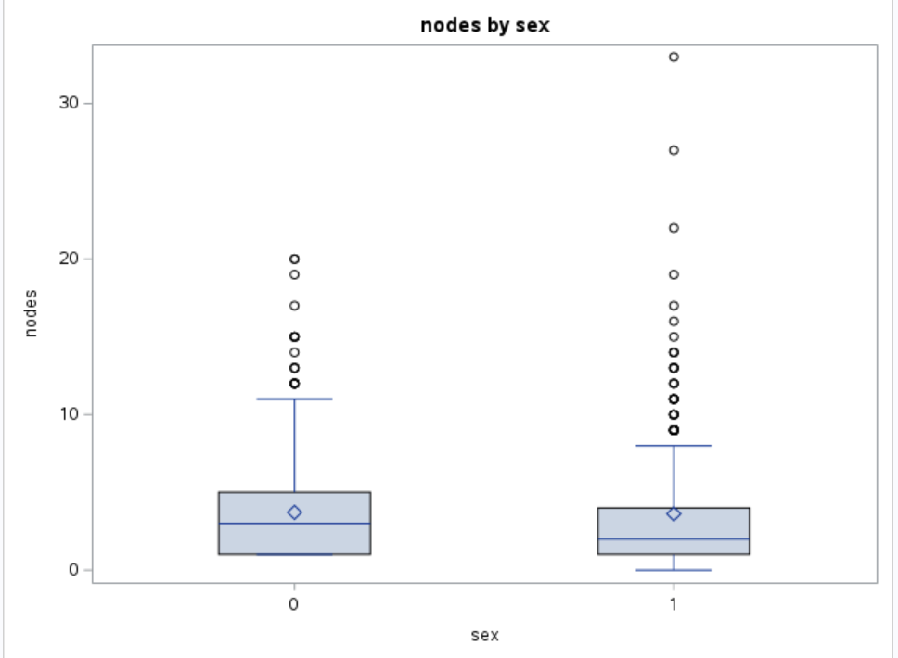
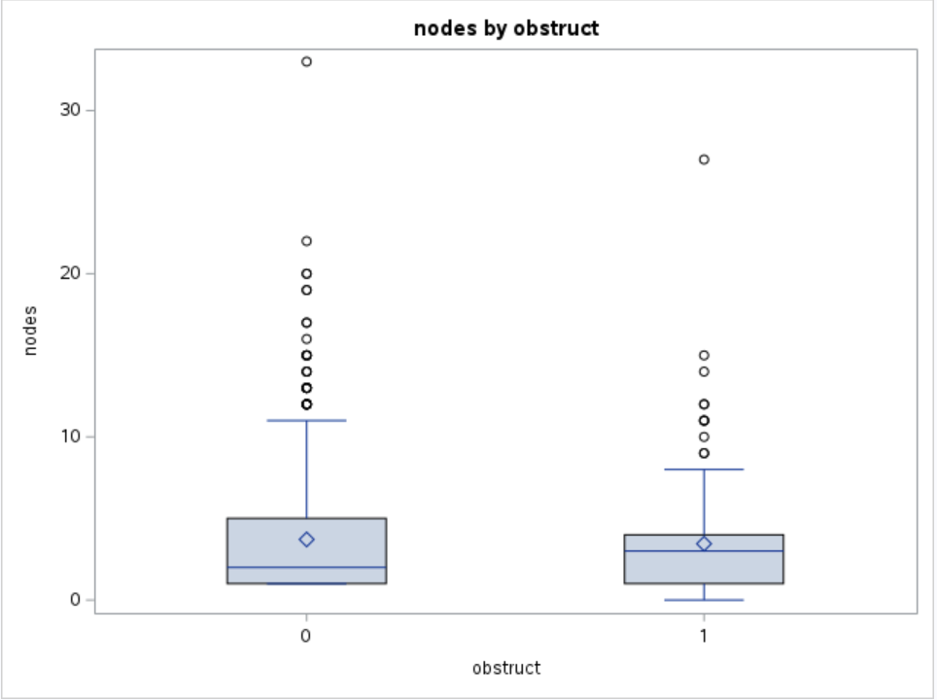
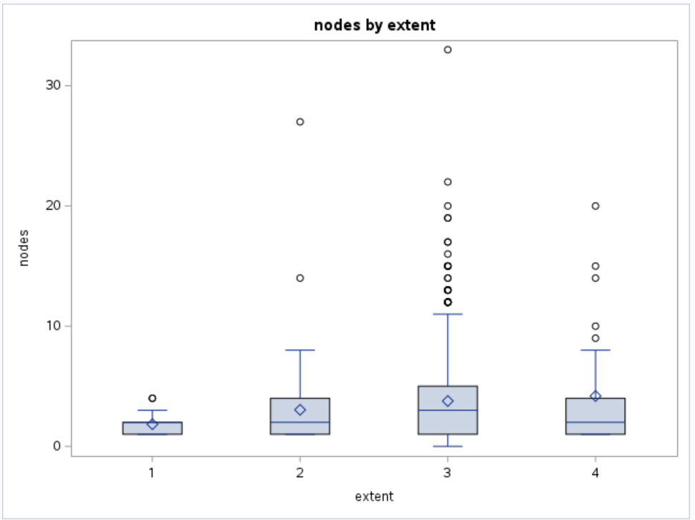
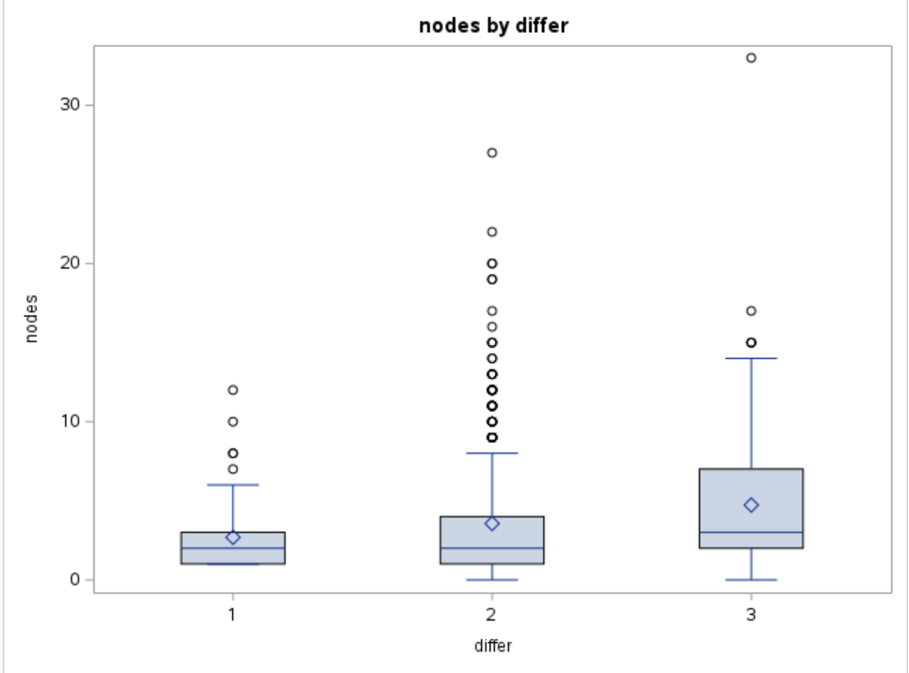
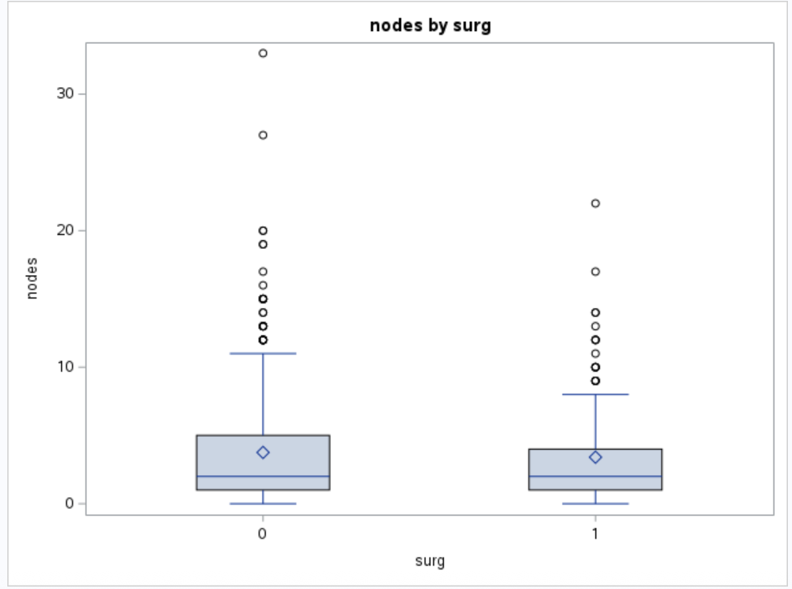
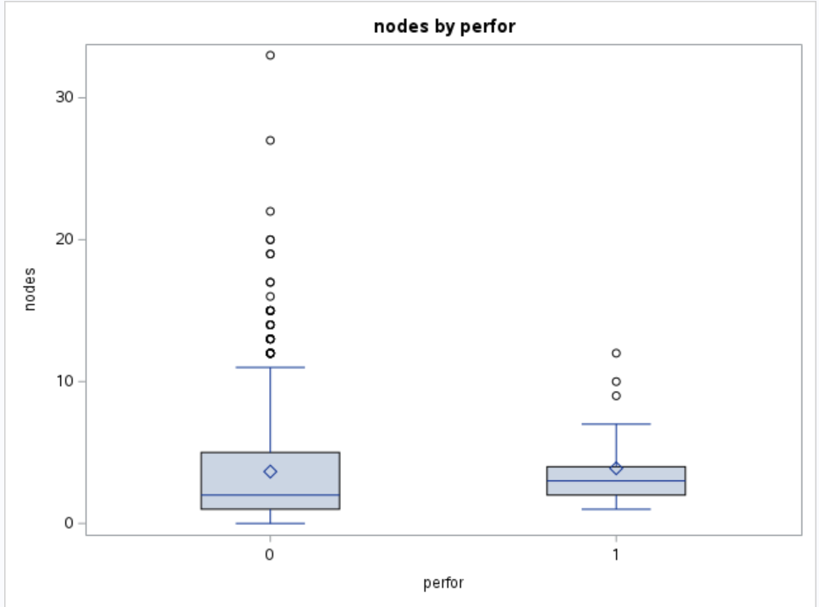
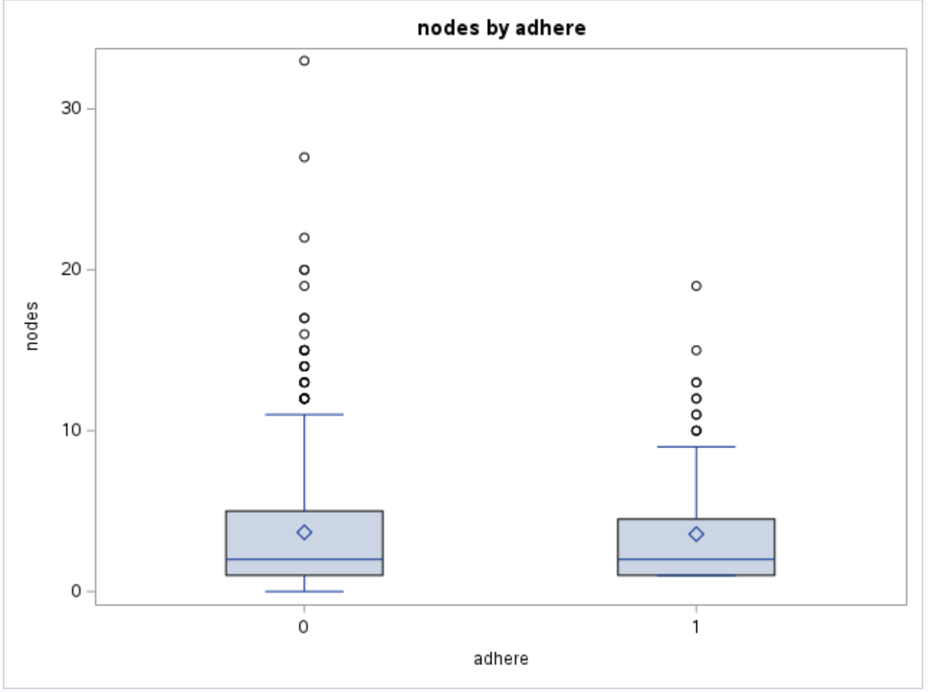
APPENDIX
Appendix A3 · Boxplots by Categorical Predictors
PROC SGPLOT DATA=colon; VBOX nodes / CATEGORY=<predictor>; RUN;

Slide 22
APPENDIX
Appendix A4 · Bivariate Associations
nodes vs. age (PROC CORR)
Local-disease markers vs. extent
 | r | p-value
Pearson | -0.087 | 0.0099
Spearman | -0.113 | 0.0007
Pair | χ² | p | Cramér's V
adhere × extent | 34.0 | <.0001 | 0.20
obstruct × extent | 9.5 | 0.024 | 0.10
perfor × extent | 5.3 | 0.150 | 0.08
Statistically significant due to large N but clinically negligible (|r| < 0.15; R² < 1%).
All Cramér's V ≤ 0.20 only modest associations; no severe multicollinearity.
PROC CORR DATA=colon PEARSON SPEARMAN; VAR nodes age; RUN;
PROC FREQ DATA=colon; TABLES (obstruct perfor adhere)*extent / CHISQ; RUN;

Slide 23
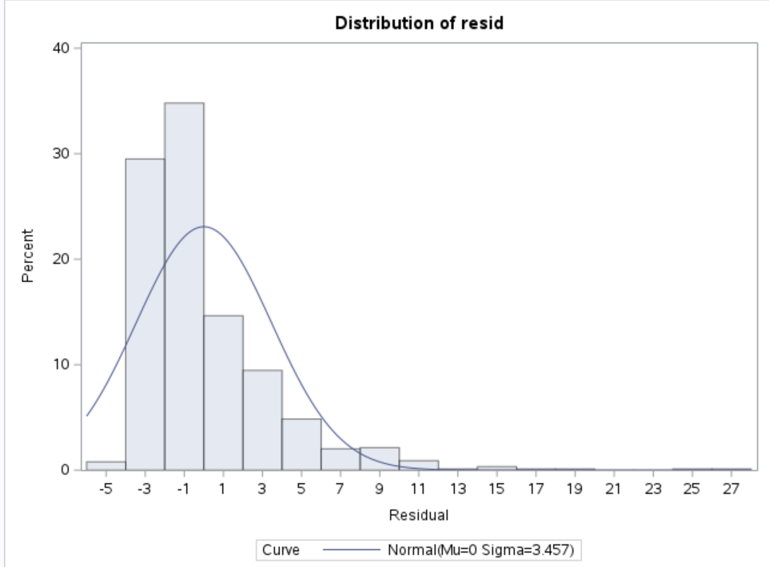
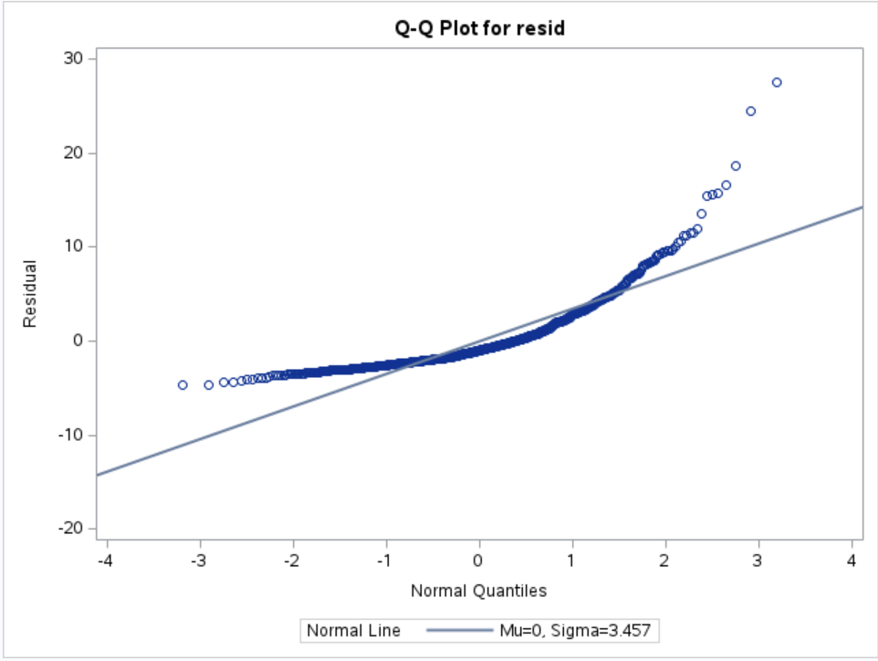
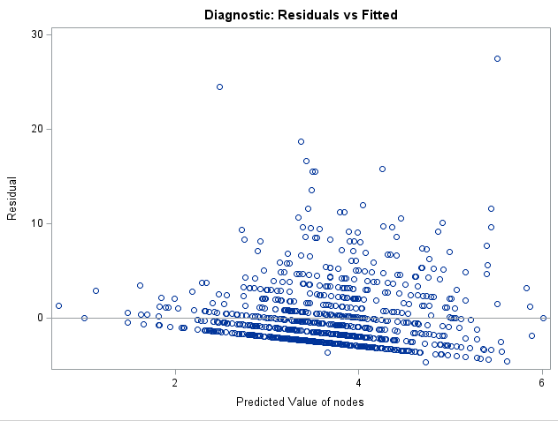
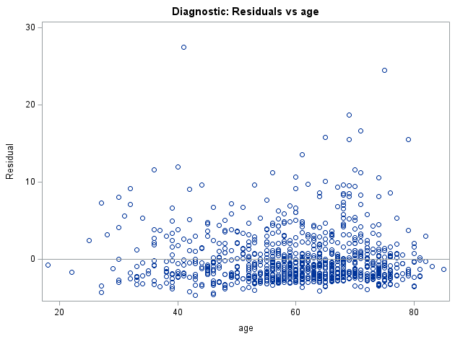
APPENDIX
Appendix A5 · Residual Diagnostics (Untransformed Outcome)
FORMAL TESTS
Test | Statistic | p
Shapiro-Wilk | W = 0.79 | <0.0001
Kolmogorov-Smirnov | D = 0.16 | <0.010
Cramer-von Mises | W² = 8.21 | <0.005
Anderson-Darling | A² = 46.05 | <0.005
PROC UNIVARIATE DATA=full_diag NORMAL; VAR resid; HISTOGRAM resid / NORMAL; QQPLOT resid; RUN;
PROC MODEL DATA=colon_reg; FIT nodes / WHITE BREUSCH=(age obstruct perfor adhere extent_2 extent_3 extent_4 rx_lev rx_5fu sex differ_2 differ_3 surg); RUN;

Slide 24
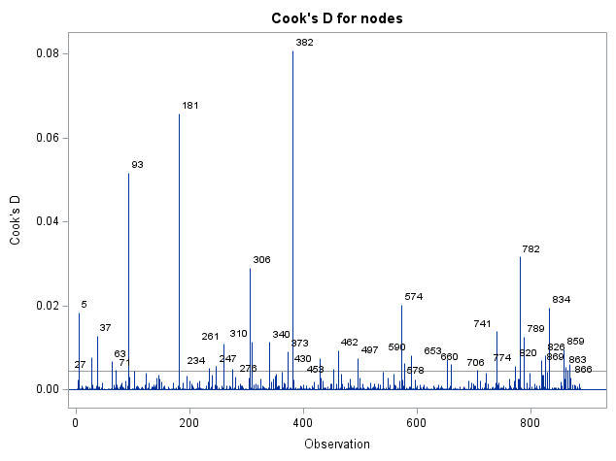
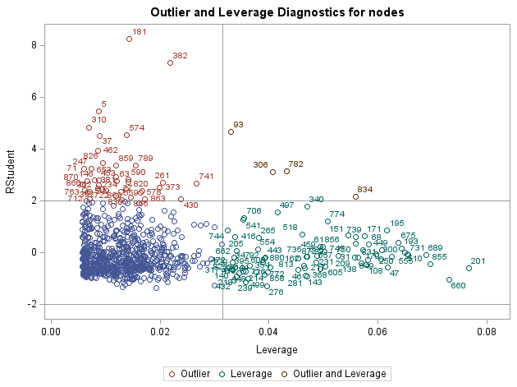
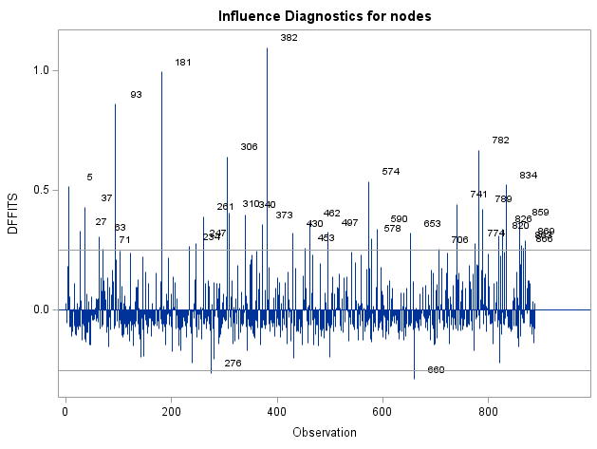
APPENDIX
Appendix A6 · Influence Diagnostics (Step 5)
PROC REG DATA=colon_num PLOTS(LABEL ONLY)=(COOKSD RSTUDENTBYLEVERAGE DFFITS DFBETAS);
MODEL nodes = age sex obstruct perfor adhere surg rx_lev rx_5fu differ_2 differ_3 extent_2 extent_3 extent_4 / INFLUENCE R; RUN; QUIT;

Slide 25
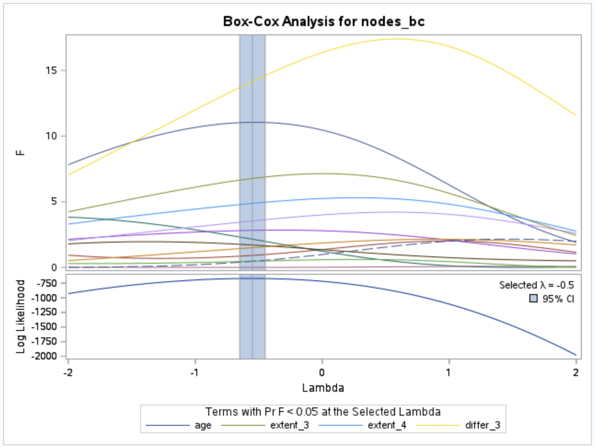
APPENDIX
Appendix A7 · Box-Cox Transformation Analysis
BOX-COX SPEC
Field | Value
Lambda Used | −0.50
Lambda (MLE) | −0.55
Log-Likelihood at MLE | −668.7
LL at convenient λ | −669.2
95% CI threshold (LL) | −670.6
Alpha | 0.05
λ = 0 inside CI? | No
Selected | λ = 0 (log)

Slide 26
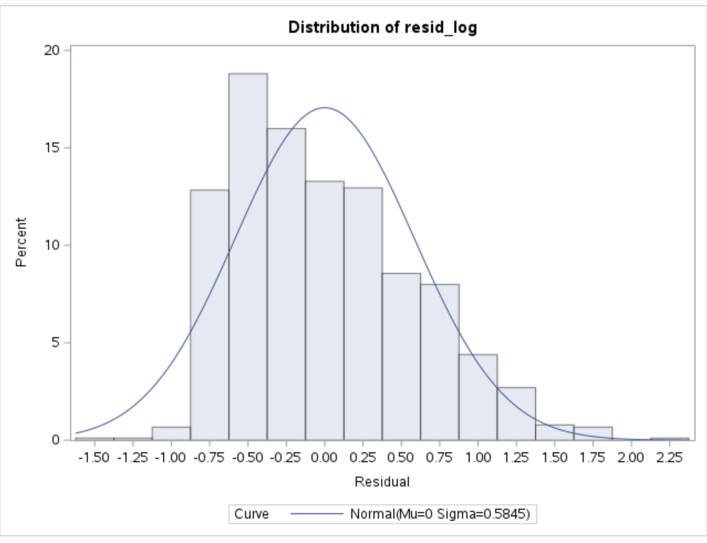
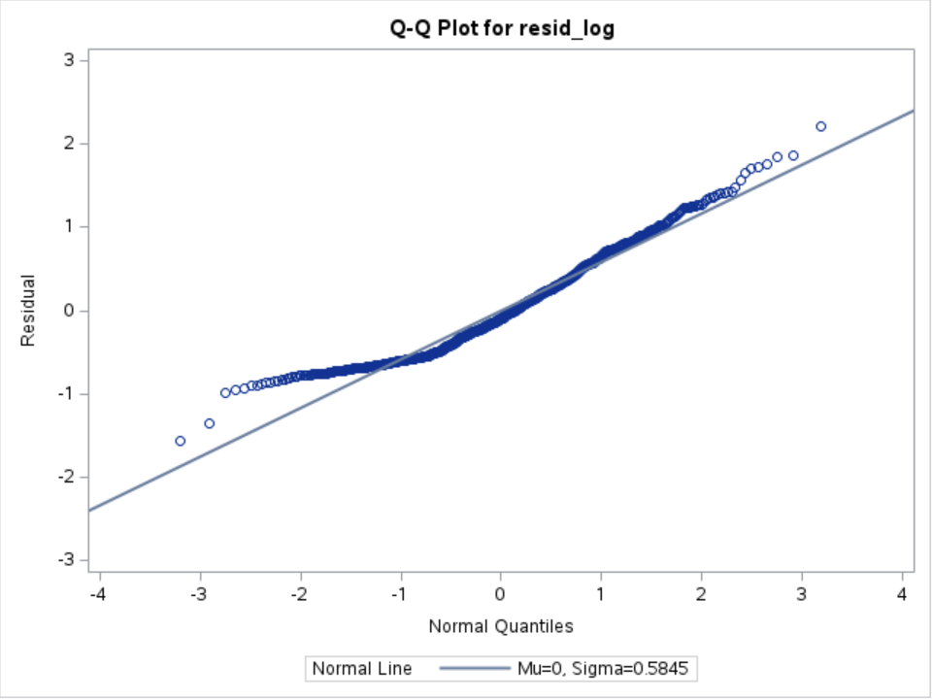
APPENDIX
Appendix A8 · Residual Diagnostics log(nodes + 1)
BEFORE vs. AFTER
Metric | Untransf. | log(+1)
Skewness | +2.55 | +0.63
Kurtosis | +10.3 | −0.14
Shapiro-Wilk W | 0.79 | 0.96
W p-value | <.0001 | <.0001
Resid. min | −11 | −1.6
Resid. max | +28 | +2.2
BP test p | 0.1880 | 0.0036
PROC UNIVARIATE DATA=full_diag NORMAL; VAR resid; HISTOGRAM resid / NORMAL; QQPLOT resid / NORMAL(MU=EST SIGMA=EST); RUN; repeat with resid_log.

Slide 27
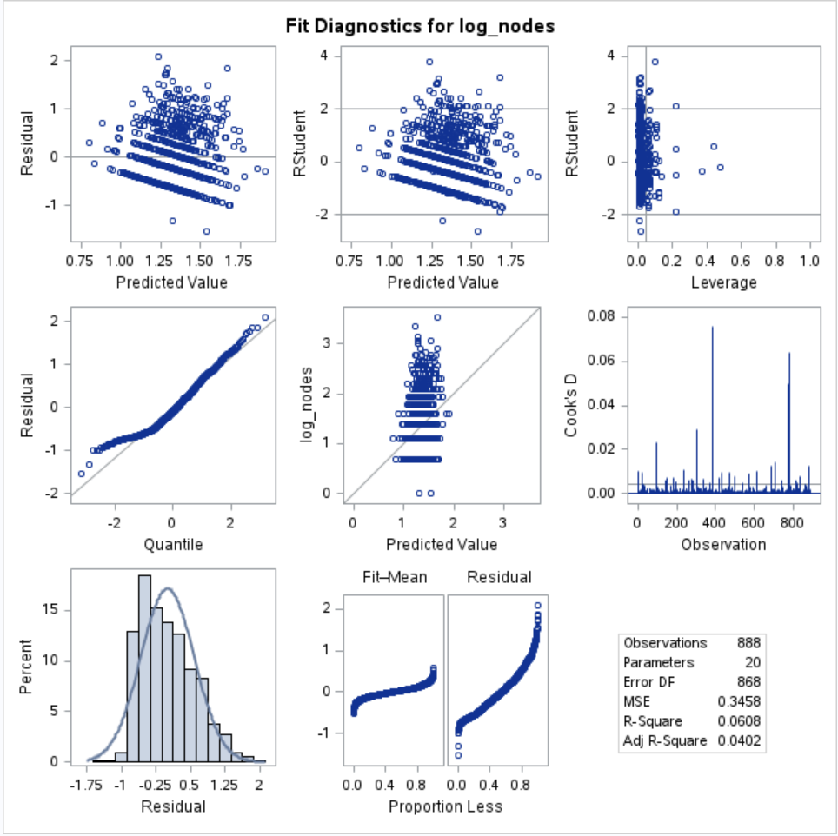
APPENDIX
Appendix A9 · Interaction Model Full Output
ALL 9 TERMS
Interaction term | β | p
adhere × extent_2 | +0.555 | 0.046
adhere × extent_3 | +0.325 | 0.125
obstruct × extent_2 | +0.001 | 0.997
obstruct × extent_3 | −0.203 | 0.500
perfor × extent_2 | +0.261 | 0.710
perfor × extent_3 | +0.330 | 0.396
Model R² | 0.061
Adj R² | 0.040
PROC REG DATA=colon_interact; MODEL log_nodes = ... + int_obstruct_extent2 ... int_adhere_extent3 / VIF; RUN;
Notes:
SPEAKER NOTES Appendix A9: Interaction Model
Supports Slide 13. Full coefficient table for the 19-term interaction model. Of the nine interaction terms tested, only adhere × extent_2 reaches p less than 0.05 coefficient plus 0.555, p equals 0.046. Every other interaction has p above 0.10. With nine tests, finding one significant at the 5% level is consistent with chance. Adjusted R-squared moves from 0.038 (main effects only) to 0.040 (with interactions) a negligible gain. We dropped all interactions.

Slide 28
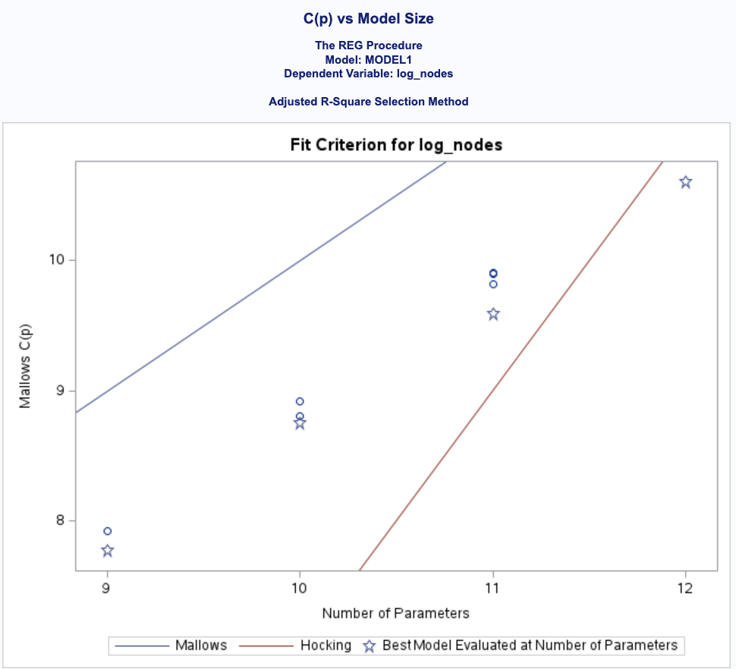
APPENDIX
Appendix A10 · Variable Selection Best 10 Models
TOP 10 (by Adj R²)
#vars | Adj R² | C(p) | AIC | Variables (after age, differ_3)
10 | 0.0394 | 9.59 | −931.12 | + rx_5fu obstruct perfor adhere ext_2/3/4
11 | 0.0393 | 10.61 | −930.12 | + surg + above
9 | 0.0392 | 8.75 | −931.94 | + rx_5fu adhere ext_2/3/4 + obstruct
8 | 0.0392 | 7.77 | −932.91 | + rx_5fu obstruct ext_2/3/4
9 | 0.0391 | 8.81 | −931.88 | + rx_5fu surg obstruct ext_2/3/4
10 | 0.0391 | 9.82 | −930.88 | + rx_5fu surg obstruct adhere ext_2/3/4
10 | 0.0390 | 9.00 | −930.80 | + rx_5fu surg perfor ext_2/3/4
8 | 0.0390 | 7.92 | −932.75 | + rx_5fu adhere ext_2/3/4

Slide 29
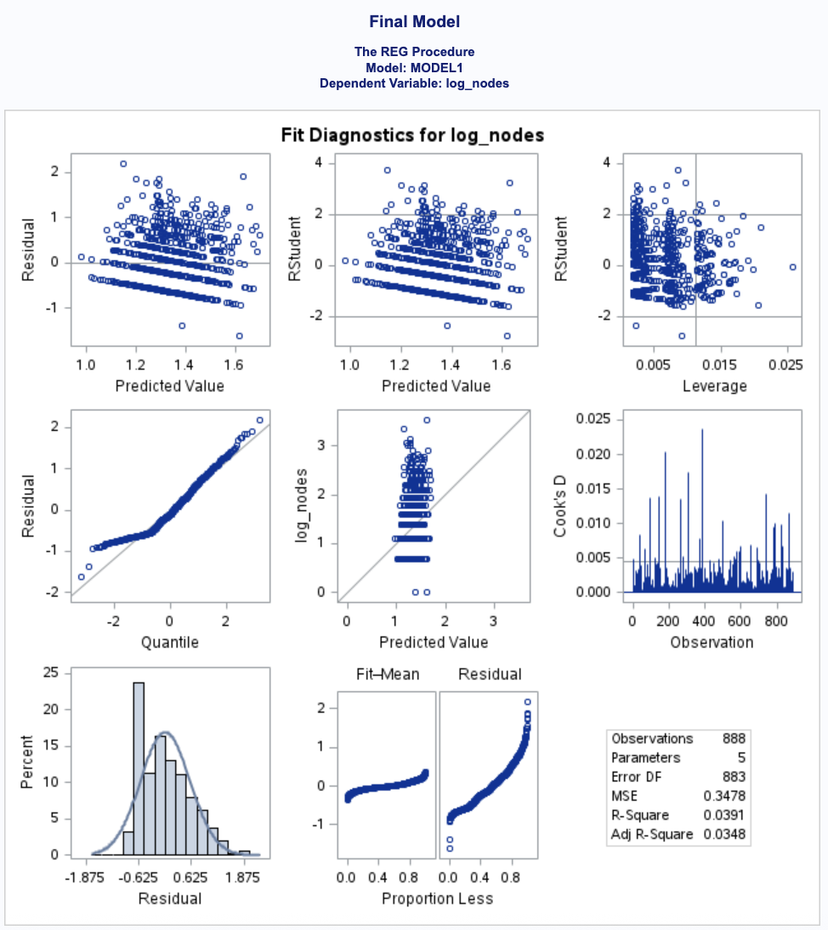
APPENDIX
Appendix A11 · Final Model Diagnostics log(nodes + 1)
LACK-OF-FIT ANOVA
Source | df | SS | MS | F | p
Model | 4 | 12.501 | 3.125 | 8.99 | <.0001
Lack of Fit | 209 | 68.953 | 0.330 | 0.93 | 0.722
Pure Error | 674 | 238.166 | 0.353
Corrected Total | 887 | 319.620
Root MSE | 0.590 | Adj R² | 0.035 | PRESS | 310.5
PROC REG DATA=colon_log; MODEL log_nodes = age differ_2 differ_3 extent_3 / LACKFIT CLB VIF; OUTPUT OUT=final_out P=yhat_final R=resid_final; RUN;

Slide 30
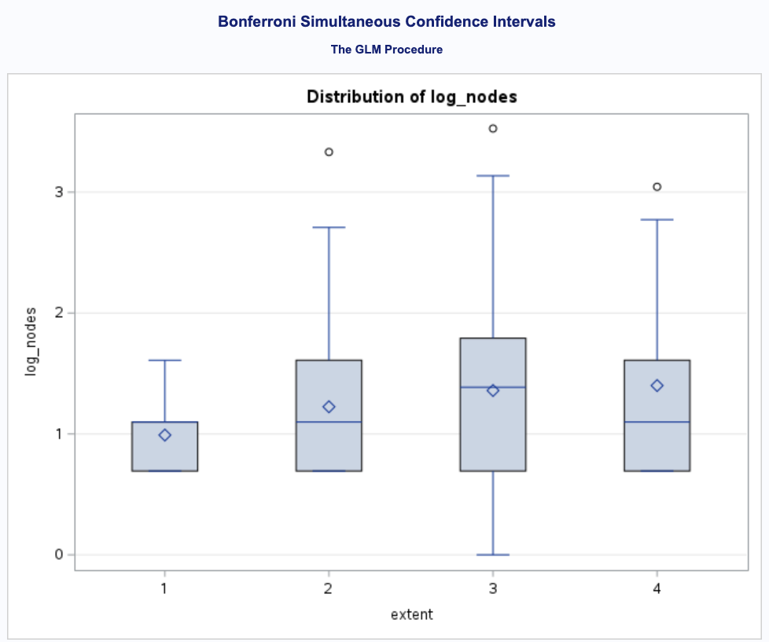
APPENDIX
Appendix A12 · Bonferroni Pairwise Comparisons extent
PAIRWISE (α = 0.05, 6 contrasts)
Contrast | Δ mean | Sim. 95% CI | Sig.
3 − 1 | +0.369 | (+0.007, +0.730) | ✓
3 − 2 | +0.135 | (−0.030, +0.299)
3 − 4 | −0.041 | (−0.303, +0.222)
4 − 1 | +0.410 | (−0.030, +0.849)
4 − 2 | +0.176 | (−0.123, +0.474)
2 − 1 | +0.234 | (−0.155, +0.623)
Notes:
SPEAKER NOTES
Supports Slide 16. All six pairwise extent contrasts after Bonferroni adjustment. Only contrast 3 − 1 (Serosa vs. Submucosa) is significant: Δ = +0.369, simultaneous 95% CI 0.007 to 0.730. Every other comparison crosses zero. So extent_3 in the final model is essentially picking up the serosa-vs-submucosa jump.

Slide 31
References
▸ Kutner, M. H., Nachtsheim, C. J., Neter, J., & Li, W. (2005). Applied Linear Statistical Models, 5th ed. McGraw-Hill.
▸ Laurie, J. A., et al. (1989). Surgical adjuvant therapy of large-bowel carcinoma: an evaluation of levamisole and the combination of levamisole and fluorouracil. Journal of Clinical Oncology.
▸ Therneau, T. The survival package, R Project. vincentarelbundock.github.io/Rdatasets/doc/survival/colon.html

