Slide 1
Factory Method Pattern
Fitchburg State University.
Prof |Nguyen Thai.
CSC 7400.
Object Oriented Analysis and Design.
By
Prashanthi Sudha Kosgi.

Slide 2
Factory Method Pattern:
Factory Method pattern comes under “creational pattern”
Factory Method pattern creates object without exposing the creation logic to the client and refer to newly created object using a common interface.
The Factory Method Pattern is also known as Virtual Constructor.

Slide 3
Factory pattern is most suitable where there is some complex object creation steps are involved. To ensure that these steps are centralized and not exposed to composing classes, factory pattern should be used.
We can see many examples of factory pattern in JDK itself :
Java.sql.DriverManager#getConnection()
Java.net.URL#openConnection()
Java.lang.Class#newInstance()
Java.lang.Class#forName()

Slide 4
Usage:
Factory method is used when Products don't need to know how they are created.
When a class doesn't know what sub-classes will be required to create
When the parent classes choose the creation of objects to its sub-classes.

Slide 5
Implementation:
I have created a mobile interface and concrete classes implementing the mobile interface.
A factory class mobileFactory is defined as a next step.
FactoryMethodPattern, class will use MobileFactory to get a Mobile object.
Pass parameter (Samsung / Nokia / IPhone) to MobileFactory to get the type of object it needs.

Slide 6
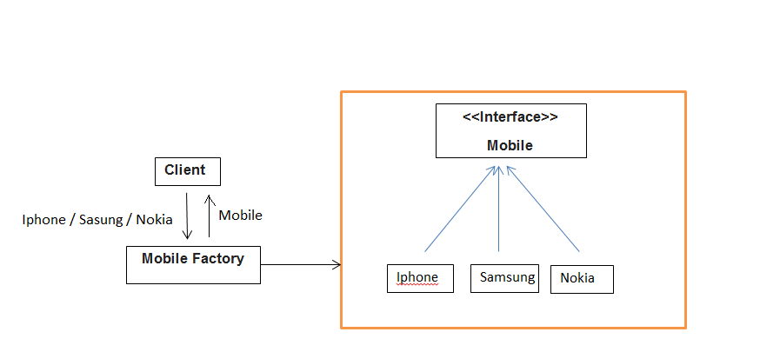
Factory Pattern Diagram

Slide 7
Capabilities:
Allows the sub-classes to choose the type of objects to create.
Promotes the loose-coupling by eliminating the need to bind application-specific classes into the code
The creation of an object precludes its reuse without significant duplication of code.

Slide 8
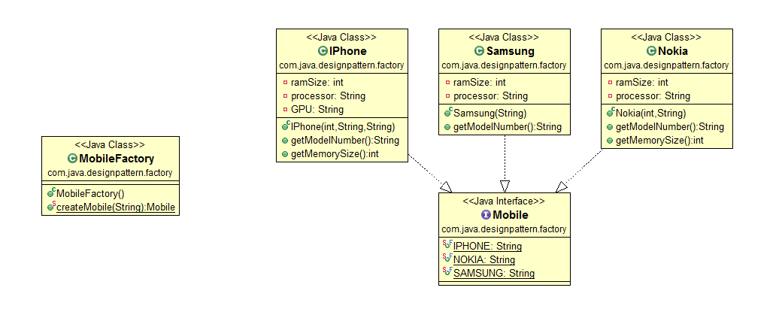
Class Diagram:

Slide 9
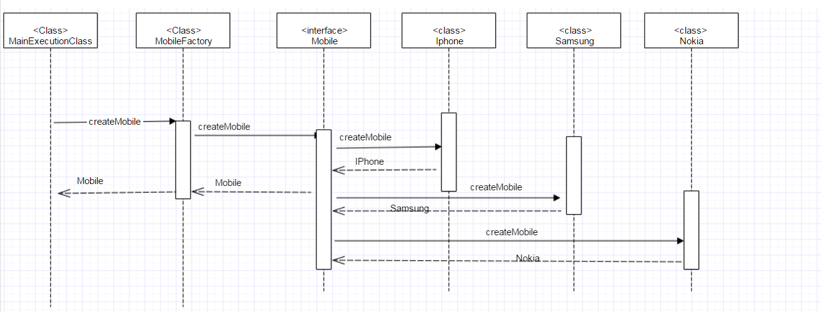
Sequence Diagram:

Slide 10
References:
wikipedia.com.
http://www.blackwasp.co.uk/gofpatterns.aspx.
https://www.tutorialspoint.com/design_pattern/design_pattern_overview.htm
https://www.javatpoint.com/design-patterns-in-java.

Slide 11
Thank you...

