Slide 1

Pac-man
Enhanced
CSC7014
Practice of Computer Programming
Prof |Nguyen Thai
By-
Prashanthi sudha Kosgi

Slide 2
Summery of project:
Pac-man is a game.
Pac-man move according to user’s input.
Pac-man have to collect all coins for winning.
Time constrain: Pac-man have to collect coins within time.
Powers: Pac-man will get different bonus points and penalties.
Enemies: collision with enemies decreases Pac-man’s life

Slide 3
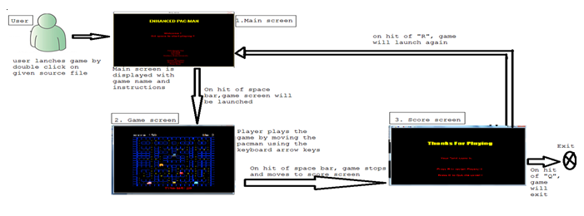
Flow of Project:

Slide 4
Capabilities:
Music.
Movement of Pac-man.
Movement of ghost’s.
Collision of pac-man with ghost.
Special powers to pac-man.
Display results(you win, you loose, time up).
Display score.

Slide 5
Powers: 1.Ghost Power: Its a destructive power. 2.Strawberry: gives extra points. 3.Apple: gives extra points. 4.Boosting : gives extra points and speed. 5.Clock: It’s a prepaid power. 6.Cherry: gives extra bonus time.
Enemies: Collision with any enemy leads to loose life.
Time Constrain: Limited time is allotted.
Coins: For winning Pac-man have to eat it all.

Slide 6
THANK YOU!!!

