Slide 1

HEALTH DOCUMENT CLASSIFICATION USING MACHINE LEARNING
OUR MENTOR:
SANDHYA
Presented by
G Sai Koushik - 17B81A05H7
M Prashanth Reddy - 17B81A05E7
P Sai Krishna – 17B81A05H8

Slide 2
ABSTRACT
Due to the massive increase in medical documents every day (including books, journals, blogs,
articles, doctors’ instructions and prescriptions, emails from patients, etc.), it is becoming very
challenging to handle and to categorize them manually. One of the most challenging projects in
information systems is extracting information from unstructured texts, including medical
document classification. The discovery of knowledge from medical datasets is important in order
to make effective medical diagnosis. Developing a classification algorithm that classifies a
medical document by analyzing its content and categorizing it under predefined topics is the
primary aim of this research. In this project work we were able to succeed in applying Natural
Language Processing which is a branch of Machine Learning to Classifying Health related
documents. We made use of the Open NLP Application Programming Interface which is an
API for training a model and classifying the documents. We make use of Materialize which is a
HTML5, CSS and JavaScript framework for building the user interface. The software is also
built using the Model-View-Controller (MVC) architecture. The algorithm classified the articles
correctly under the actual subject headings and got the total subject headings correct. This holds
promising solutions for the global health arena to index and classify medical
Documents expeditiously.

Slide 3
PROBLEM STATEMENT
With the explosion of information filled by the growth of the World Wide Web it is no longer feasible for a human observer to understand all the data coming in or even classify it into categories. Also in the health sector, numerous patient records are being collected everyday and are used for analysis.
How do we efficiently classify or categorize these health documents to complement easy retrieval.

Slide 4
INTRODUCTION
In the medical world, a lot of (digital) text documents from several specialties are generated, be it patient health records, letters, or documentation of clinical studies. In fact, text data, which is usually unstructured, contributes to the huge increase of data volume globally — social media alone. Hence, retrieving information from texts becomes a more and more important task.

Slide 5
PROPOSED SYSTEM
The aim of this project is to develop A System for Health Document Classification Using Machine Learning. Other objectives include: 1. Study the various machine learning classification algorithm. 2. Implement classification algorithm.
(NLP, Random Forest, Naive Bayes)

Slide 6
OBJECTIVE
Machine learning based Classification algorithm is used to classify the health documents.
Demonstrating methods for text mining and document classification used in Natural Language Processing (NLP).

Slide 7
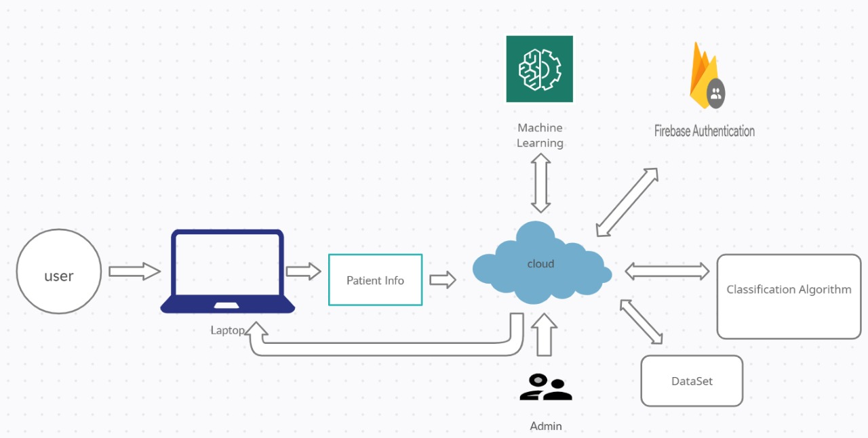
Architecture diagram

Slide 8
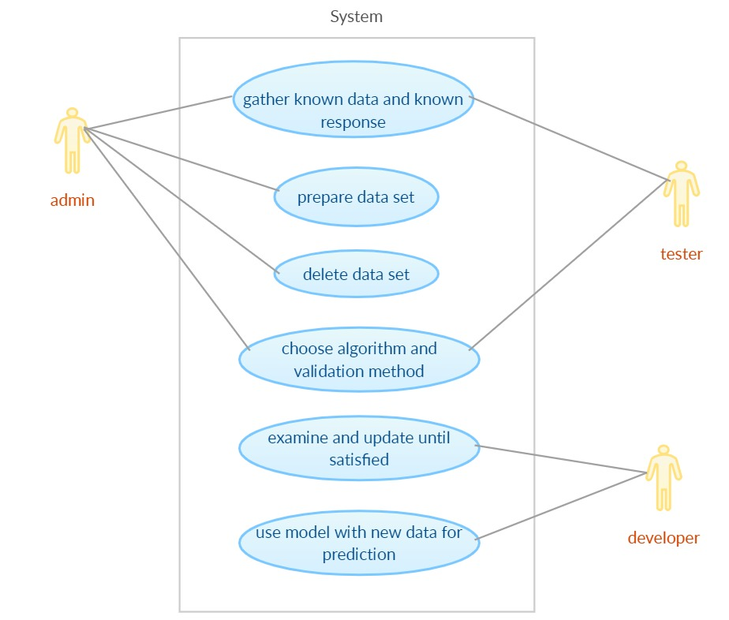
USECASE DIAGRAM

Slide 9
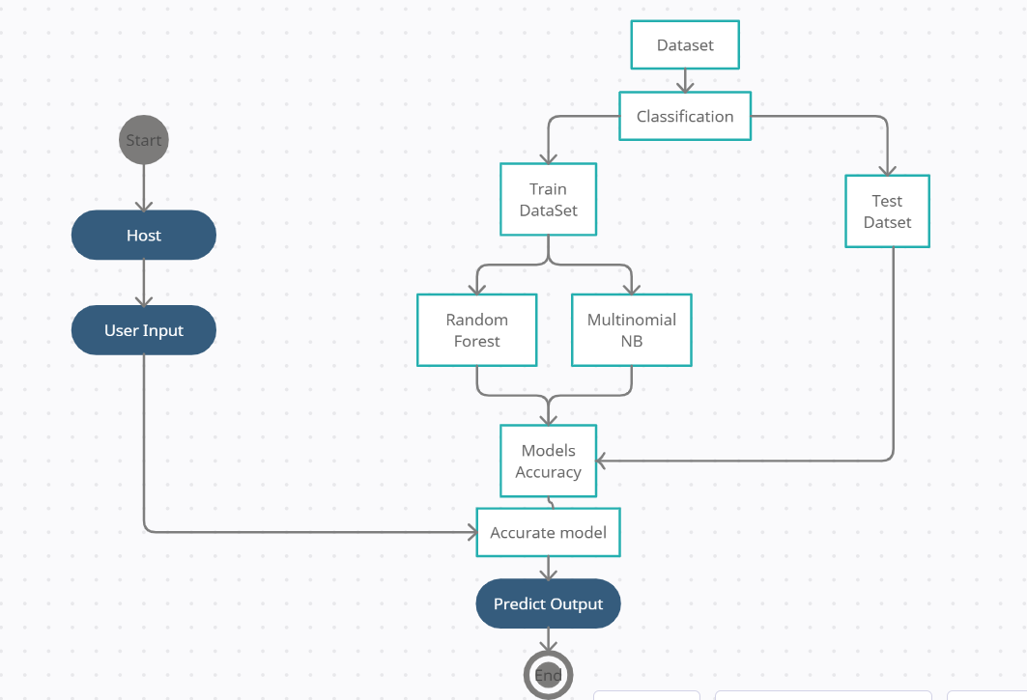
ACTIVITY DIAGRAM

Slide 10
ADVANTAGES
Automatically classify documents:
ML Document Classification can adapt and change as more data becomes available and ML Document Classification is able to adapt, there is less of a need for manual intervention.
Adapt to high variable content:
With advanced machine learning technology, AI Document Classification automatically classifies scanned and digital documents based on their content, even when the content is highly variable
Employee Time Savings
Automating document classification removes the need for human intervention and manual classification of documents.

Slide 11
Software and hardware requirements
Operating system : Windows ,Linux
Technology : Flask, Python Pickle, Jinja
Web technologies : Html,JS,CSS
Database : MySQL
Python Version :Python 3.7.9
Cloud Platform: Heroku (PaaS)
Hardware : Pentium based systems
RAM :256MB(min)
Storage :25GB

Slide 12
SCOPE OF THE STUDY
As stated earlier, statistical pattern recognition are used in classifying documents, this project work will concentrate on using machine learning algorithm to classify document. As of Now used algorithm is Random Forest and Mutlinomial Naïve Bayes.

Slide 13
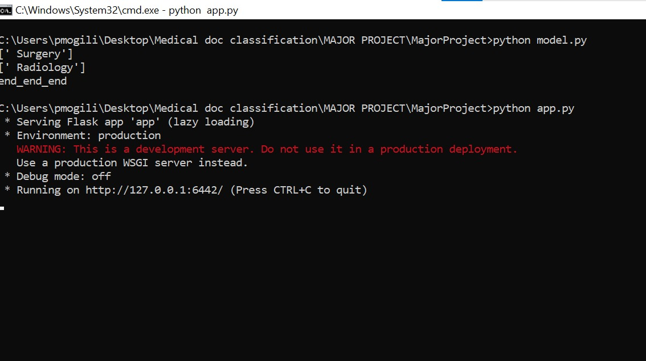
Screenshots

Slide 14
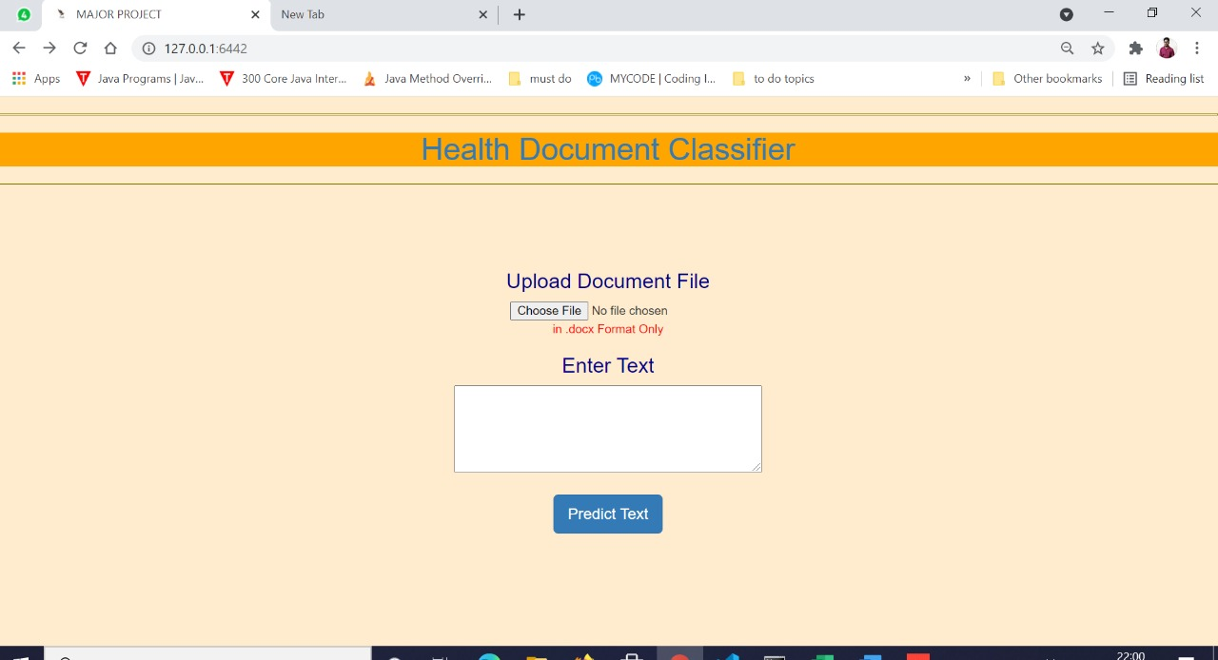
SCREENSHOTS

Slide 15
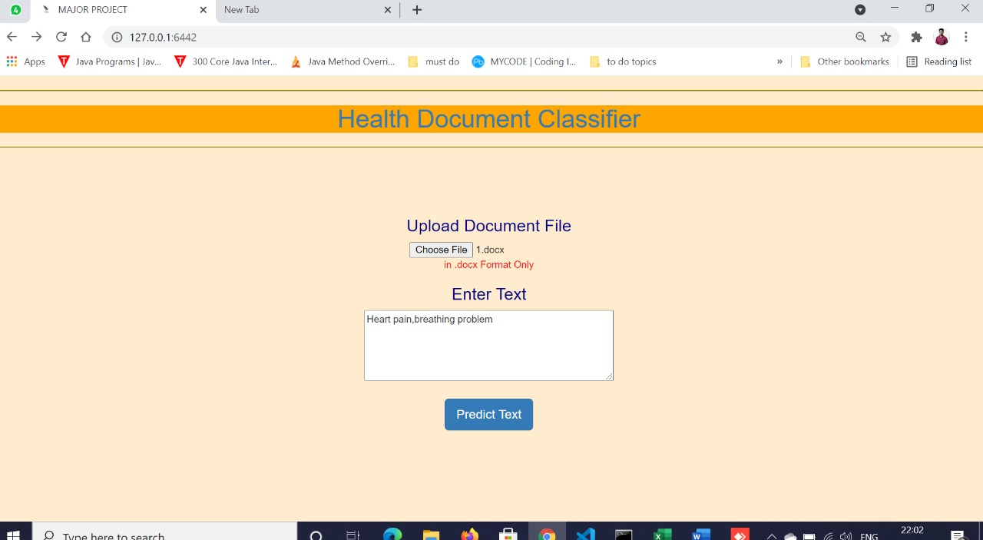
SCREENSHOTS

Slide 16
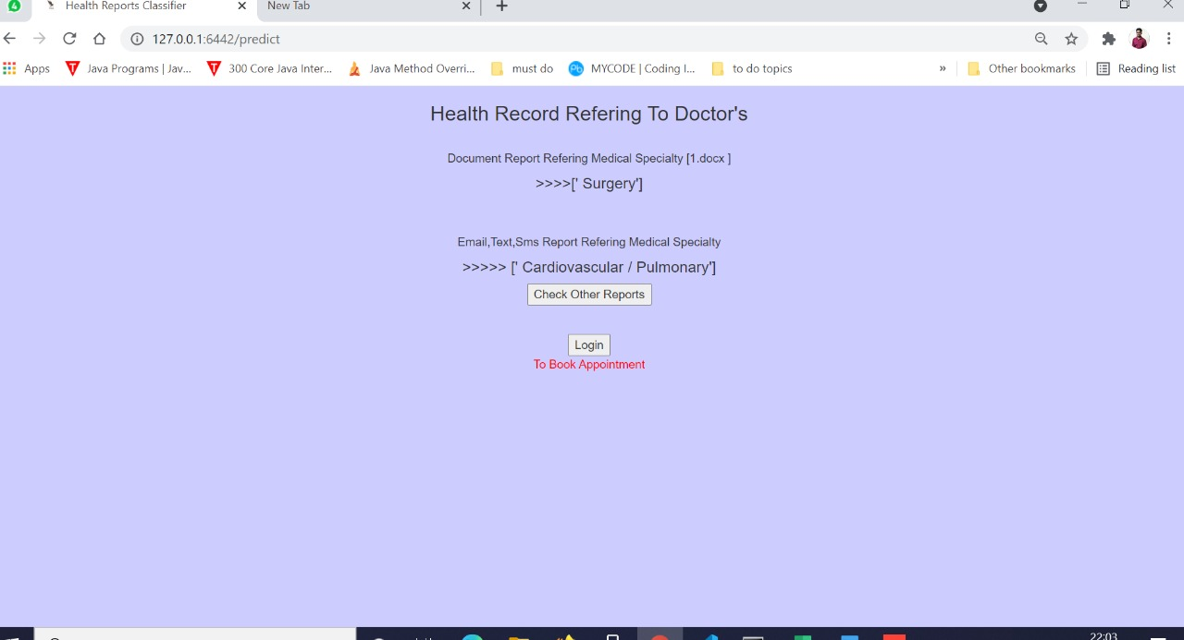
SCREENSHOTS

Slide 17

Conclusion
The software delivered from this project work will greatly reduce the time used by doctors, physicians and other health workers in searching and retrieving document. Also Useful for Patient for Finding Specialist Soon and Reduce Risk.
It will serve as source of materials for those interested in investigating the processes involved in developing a document classification system using machine learning.

Slide 18

Thank You

