Slide 1
BYTE</CODERS>
CLICK ANY BUTTON TO CONTINUE

Slide 2

SMART ENERGY MANAGEMENT

Slide 3
PROBLEM STATEMENT

Slide 4
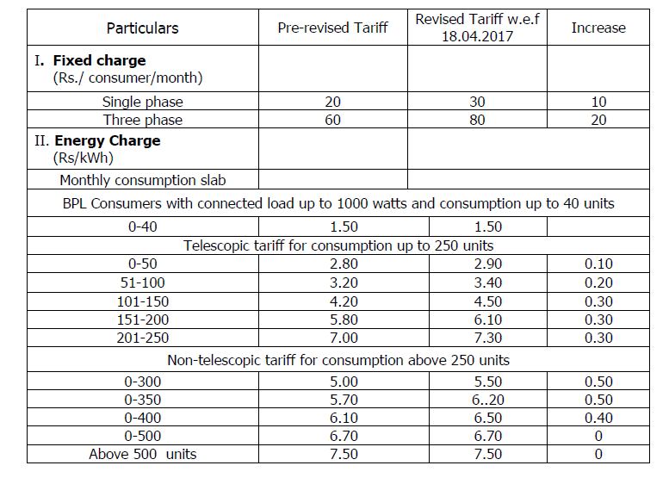

Slide 5

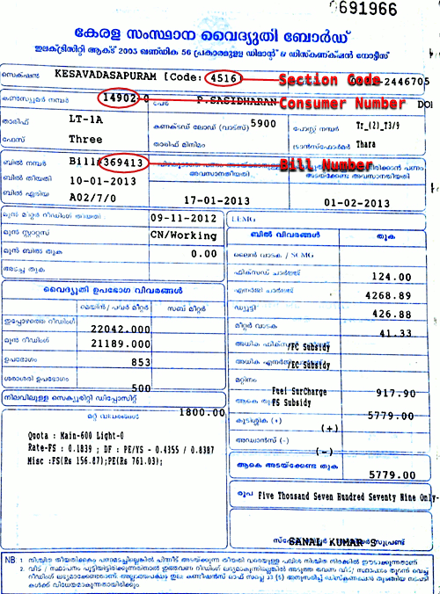
PROBLEM STILL EXSIST

Slide 7
SET YOUR LIMIT OF CONSUMPTION

Slide 8
UNDERSTAND YOUR MONTHLY CONSUMPTION

Slide 9
KNOW YOUR COST PER CONSUMPTION

Slide 10

OPTIMIZE YOUR GADGETS

Slide 11

PRIORITY BACKUP

Slide 12

SELL EXTRA ENERGY

Slide 13
THANK YOU!

