Slide 1
SVFRMS: from a 393-line god class to a maintainable, thread-safe system
SE301 Legacy Refactoring & Modernization
Group [__] · [Member 1] · [Member 2] · [Member 3]
Notes:
(~15 s) Hi, we are group __. We inherited the Singapore Vertical Farming system, one Java file written by an intern. In the next five minutes we'll cover what was wrong with it, how we restructured it with SOLID and design patterns, the concurrency bugs we found and fixed, and then we'll show it running, including adding a new crop live.

Slide 2
1 · The legacy system and what we found
One file · 15 responsibilities · 0 interfaces · everything public static
• God class: state, rules, devices, threads, printing and file I/O all in SVFRMS.java
• Crops hard-coded: one else-if block per crop × sensor in processSensor()
• Stringly-typed: handleEvent("CREATE_ALERT", ...), queue items "CH1|Cooling Fan"
• ControlThread extends Thread but swallows interrupts (breaks the Thread contract)
• Dead code and duplication: report header written twice, 2 locks never used
• Baseline first: legacy output captured as golden files (1,423 lines)
if(crop.equals("Tomato")){
if(value>28){
handleEvent("TRACK_ALERT",...);
handleEvent("CREATE_ALERT",...);
totalEnergyUsage+=10;
addControlRequest(chamber,
"Cooling Fan");}
...
} else if(crop.equals("Strawberry")){
... ×6 crops
Notes:
(~40 s) The program simulates four chambers, checks readings against crop thresholds, raises alerts, runs devices and writes a report. All of that lived in one class. processSensor alone was 65 lines of copy-pasted if-blocks, one per crop and sensor, so adding Kale meant editing core logic. Everything was public static, there were no interfaces, and messages between threads were strings like 'CH1|Cooling Fan'. Before touching anything we recorded the legacy output as golden files, so we could prove we did not change behaviour.

Slide 3
2 · Concurrency bugs (identified)
Reproduced on the untouched legacy code by our tests
Problem | Legacy code | Evidence
Check-then-act race on HashMap | getChamberState() L48 | NPE on first run; duplicate states in test
Lost updates | totalWaterUsage += 2 (4 threads) | 80,000,000 L expected → 11,368,500 L counted
Unsafe ArrayLists, racing counters | alerts.add, summary.alerts++ | lost alerts / counts
Locks writers never take | generateDailyReport() | stale, torn totals
Nested alertLock → reportLock | L208, L223 | latent lock-ordering deadlock
catch(Exception e){} around wait() | L134, L258 | producer ignores interrupt → program can hang
Archive & report threads race | main() L373-389 | 'Active Alerts' differs per run
Notes:
(~45 s) The intern added threads, but nothing shared was protected. Three bugs we can actually reproduce. First, our very first run crashed with a NullPointerException: getChamberState does check-then-put on a HashMap, so two threads race. Second, totals use plus-equals from four threads; our demo test expected 80 million litres and the legacy code counted about 11 million. Third, the queue code swallows InterruptedException; a blocked producer cannot be cancelled. If the control thread dies, every chamber waits forever on the full queue and main waits on join: a circular wait. There's also a latent lock-ordering deadlock: two methods nest alertLock then reportLock; any method taking them the other way deadlocks.

Slide 4
3 · SOLID refactoring
1 class, 393 lines → 14 packages, ~65 classes, all but the composition root under 100 lines
Principle | Legacy problem | What we did
S – Single Responsibility | one class does everything | ChamberMonitor only evaluates; printer, writer, reports separate
O – Open/Closed | new crop = edit processSensor() | crops.properties + CropRegistry; new rule/device/report = new class
L – Liskov | ControlThread breaks interrupt() | ChamberTask is a Runnable on an ExecutorService; honours interrupts
I – Interface Segregation | one fat handleEvent(type, ...) | AlertRule, Device, AlertListener, DeviceListener, ReportWriter, ...
D – Dependency Inversion | public static everywhere | constructor injection; one composition root (FacilityAssembler)
Notes:
(~45 s) We split by responsibility into 14 packages and around 65 small classes. S: printing, report content, file writing, rules and threading are separate classes. O: crops are data, and new devices, rules and reports are new classes, so we don't edit existing ones. L: we removed extends Thread; tasks are Runnables run by executors and respect interrupts. I: small role interfaces such as AlertRule, Device, AlertListener and ReportWriter. D: everything gets its dependencies through the constructor, and only FacilityAssembler creates concrete classes.

Slide 5
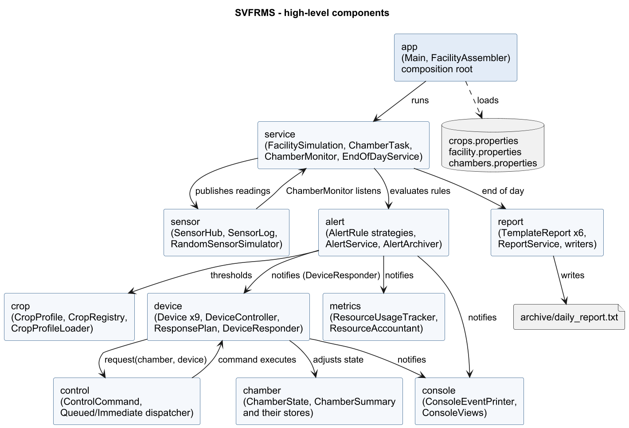
4 · Final architecture
Notes:
(~25 s) app wires everything. Chamber tasks publish readings to the SensorHub; the ChamberMonitor runs the alert rules; alerts fan out to listeners: printer, summaries, resource accounting, and the device responder, which puts a command on the control queue. Reports are built from one immutable snapshot at the end of the day.

Slide 6
5 · Design patterns, each solving a real problem
Pattern | Where | Legacy problem it solves
Strategy | AlertRule (crop, facility, sensor-failure) | 65-line if/else in processSensor()
Observer | SensorHub, AlertService, DeviceController | handleEvent() string switch coupling everything
Command | ActivateDeviceCommand in a BlockingQueue | "CH1|Cooling Fan" strings split across threads
Template Method | TemplateReport → 6 reports | report header/totals written twice
Registry + data config | CropRegistry, DeviceRegistry, ResponsePlan | crops & device choices hard-coded
DI / Composition Root | FacilityAssembler | public static globals, untestable
Not used on purpose: Singleton (global state was the problem), Builder, Abstract Factory
Notes:
(~35 s) We only used patterns where they removed a specific legacy problem. Strategy replaced the long if/else of checks. Observer replaced the handleEvent string switch. Command replaced the 'CH1|Cooling Fan' strings and lets us run commands either on the queue or immediately. Template Method removed the duplicated report code. The registry and properties files make crops data. We deliberately did NOT use Singleton, because global state was the original disease.

Slide 7
6 · Adding a crop = adding data
Before: code in processSensor()
After: data in crops.properties
else if(crop.equals("Lettuce")){
if(value>21){ handleEvent(...);
handleEvent(...);
addControlRequest(chamber,
"Cooling Fan"); }
if(value<15){ handleEvent(...);
handleEvent(...); }
}
kale.name=Kale
kale.temperature.min=15
kale.temperature.max=24
kale.humidity.min=60
kale.humidity.max=80
kale.soil.min=50
kale.soil.low.water=40
• 4 new crops added with 0 Java changes · java -jar run.jar --crops basil.properties adds one at runtime
Notes:
(~30 s) This is the Open/Closed principle in practice. On the left is how a crop looked in the legacy code; on the right is Kale now. We added Kale, Bell Pepper, Bok Choy and Eggplant without touching a single Java file. You can even add one at runtime with --crops, which we'll show in the demo. Removing a crop is deleting its block.

Slide 8
7 · Concurrency fixes
Bug | Fix | Test that proves it
HashMap check-then-act | ConcurrentHashMap.computeIfAbsent | 16 threads × 200 rounds → exactly 1 state
Lost updates | AtomicLong / single AlertService lock | 16 × 5,000 updates → exact totals
Racing read-modify-write | synchronized ChamberState.adjust(), immutable records | exact counts under contention
Nested locks (deadlock risk) | never hold 2 locks; notify outside lock; documented order | archive ∥ raise ∥ report, timeout guard
Swallowed interrupts / hang | ArrayBlockingQueue + restore interrupt + poison pill | blocked producer stops on interrupt
Raw threads, racing end-of-day | ExecutorService, timeouts, shutdownNow; fixed order | 8 chambers ×5 runs: totals add up
Lock order (if ever nested): ChamberState → ChamberSummary → AlertService → ReportLog · today: never nested
Notes:
(~40 s) Fixes map one-to-one to the bugs. computeIfAbsent makes check-and-insert atomic. Totals are AtomicLongs. Lists live behind a single lock inside AlertService. Readings, alerts and snapshots are immutable records. For deadlocks, our rule is simple: no method ever holds two locks at once, and we never call listeners while holding a lock. We still documented a global order in case that ever changes. The queue is an ArrayBlockingQueue that restores the interrupt flag, and executors with timeouts replace raw threads.

Slide 9
8 · Evidence: maintainable, extensible, reliable
Quality | Evidence
Behaviour preserved | Golden tests: console + sensor log + report identical to legacy (seeded + boundary runs)
Reliability | Stress tests (16 threads), deadlock-timeout test, 8-chamber concurrent run ×5
Extensibility | 4 new crops, 3 new devices, 4 new reports, sensor-failure alert: no edits to existing classes
Maintainability | ~65 classes, each with one job; one composition root; --seed/--sequential for reproducible bugs
Build | mvn clean package → 49 tests green → run.jar (java -jar run.jar, Java 25)
Notes:
(~25 s) How do we know we did not break anything? The golden tests run the new system on the same inputs as the legacy code and the console output, sensor log and report file are identical, byte for byte. 49 tests in total, including stress tests and three tests that reproduce the original bugs on the legacy code. mvn clean package runs everything and builds run.jar.

Slide 10
Live demo (2 min)
• java -jar run.jar → same output format as the legacy program
• java -jar run.jar --list-crops → Kale, Bell Pepper, Bok Choy, Eggplant
• java -jar run.jar --chambers demo/chambers.properties --seed 7 --sequential
• java -jar run.jar --crops demo/basil.properties --chambers demo/basil-chamber.properties
• mvn -q test -Dtest=LegacyConcurrencyDemoTest,ThreadSafetyStressTest
Notes:
(Switch to terminal; follow DEMO_SCRIPT.md.) 1) Run the jar: same output as the legacy program. 2) Show Kale in crops.properties and --list-crops. 3) Grow Kale in CH5 with a chambers file, deterministic run. 4) Add a brand-new crop, Basil, from a file at runtime. 5) Run the concurrency tests: the legacy demo shows lost updates, and the new code is exact.

Slide 11
Summary
• Behaviour preserved, proven byte-for-byte against the legacy output
• God class → 14 cohesive packages; SOLID applied with concrete before/after
• Patterns only where they fix a real problem: Strategy, Observer, Command, Template Method, Registry, DI
• Crops are data: add or remove a crop with no code change
• 12 concurrency issues identified; races, hangs and deadlock risk fixed and tested
• Questions?
Notes:
(~10 s) To wrap up: same behaviour, proven by golden tests; a SOLID, pattern-based structure; crops as data; and every concurrency bug identified, reproduced and fixed with tests. Thank you, happy to take questions.

