Slide 1
Intra State Route Optimisation Tool
Manipur

Slide 2
POINTS TO BE CONSIDERED
Upload Only motorable data for Fair Price Shops(FPS).
There should be NO Special Character(!,@,#,$,% etc.) or Blank Space in Warehouse and FPS ID’s.

Slide 3
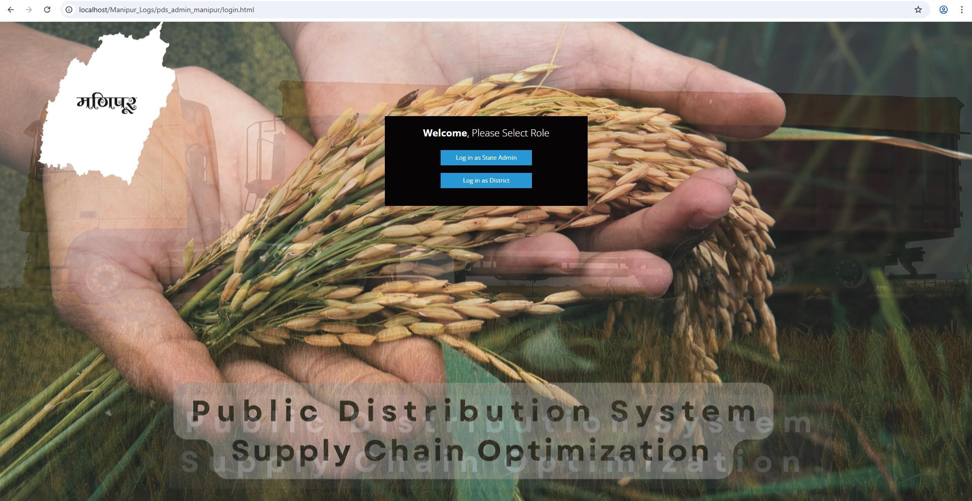
LOGIN PAGE
State Specific Login
This is common page for state admin and district admin.
State admin click on Log in as state Admin button and will be direct to state admin page.
Districts admin click on Log in as District button Admin and will be direct to district admin page.

Slide 4
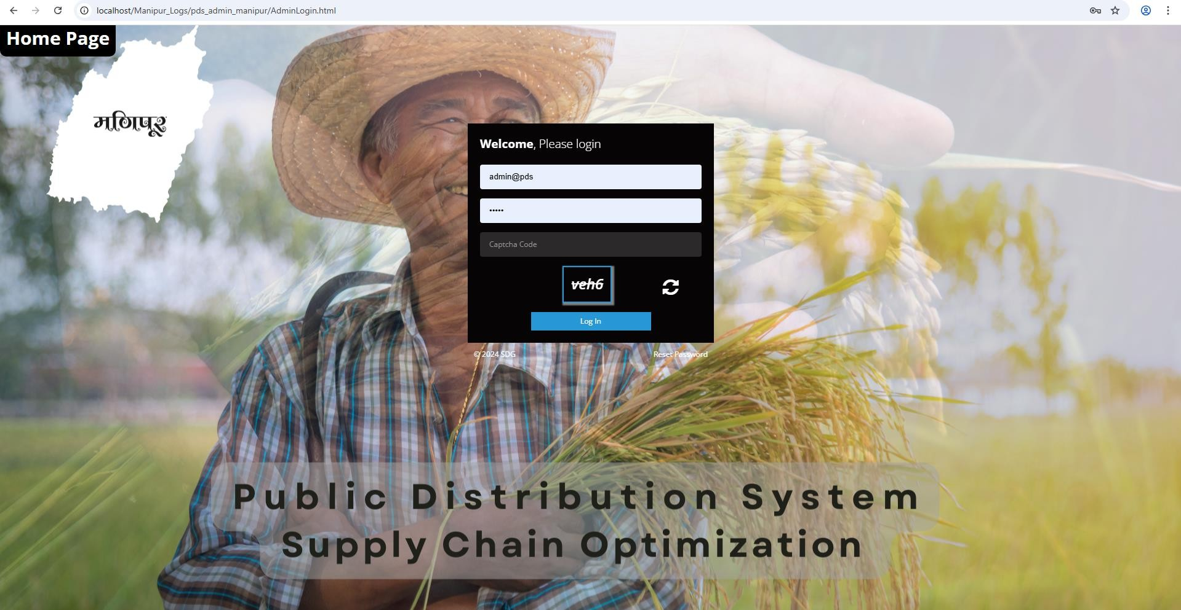
LOGIN PAGE
State Admin Specific Login
On clicking this Home Page, user will redirect to state specific Page
Every state has its own state specific login.
User login the system using the username and password.
User can reset the password as per
their requirement and choice.

Slide 5
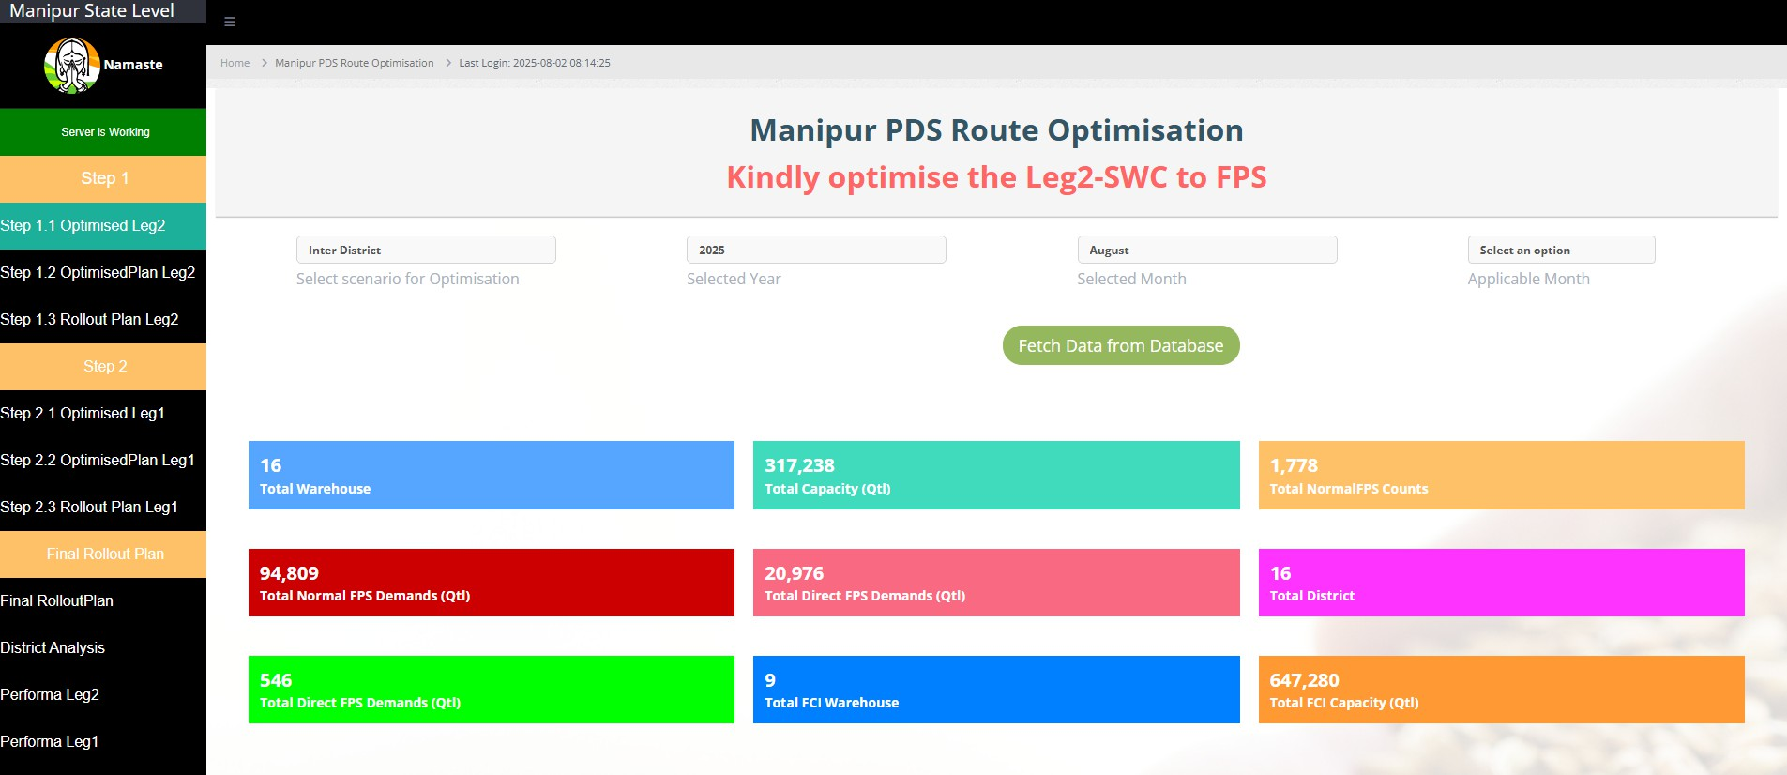
OPTIMISED LEG2
Post Login , this page will show the Number of warehouse, FPS, and Districts, Total state demand , Total state capacity
User can select the Months and Number of Months that this optimisation will be applicable for.
E.g. if Uttarakhand runs optimisation in February 2025 and it is applicable for March , April and May then the user will select these months
Consequently, the demand at FPS will be increased to cover the demand of these multiple months.
Users can select the scenario :
Inter District
Intra District
Year and Month of optimisation are automatically selected
No. of state warehouse
Total capacity of state warehouse
Number of Normal FPS in state
Total Normal Demand of FPS
Total Direct Demand of FPS
Number of Direct FPS in state
No. of FCI warehouse
Total capacity of FCI warehouse

Slide 6
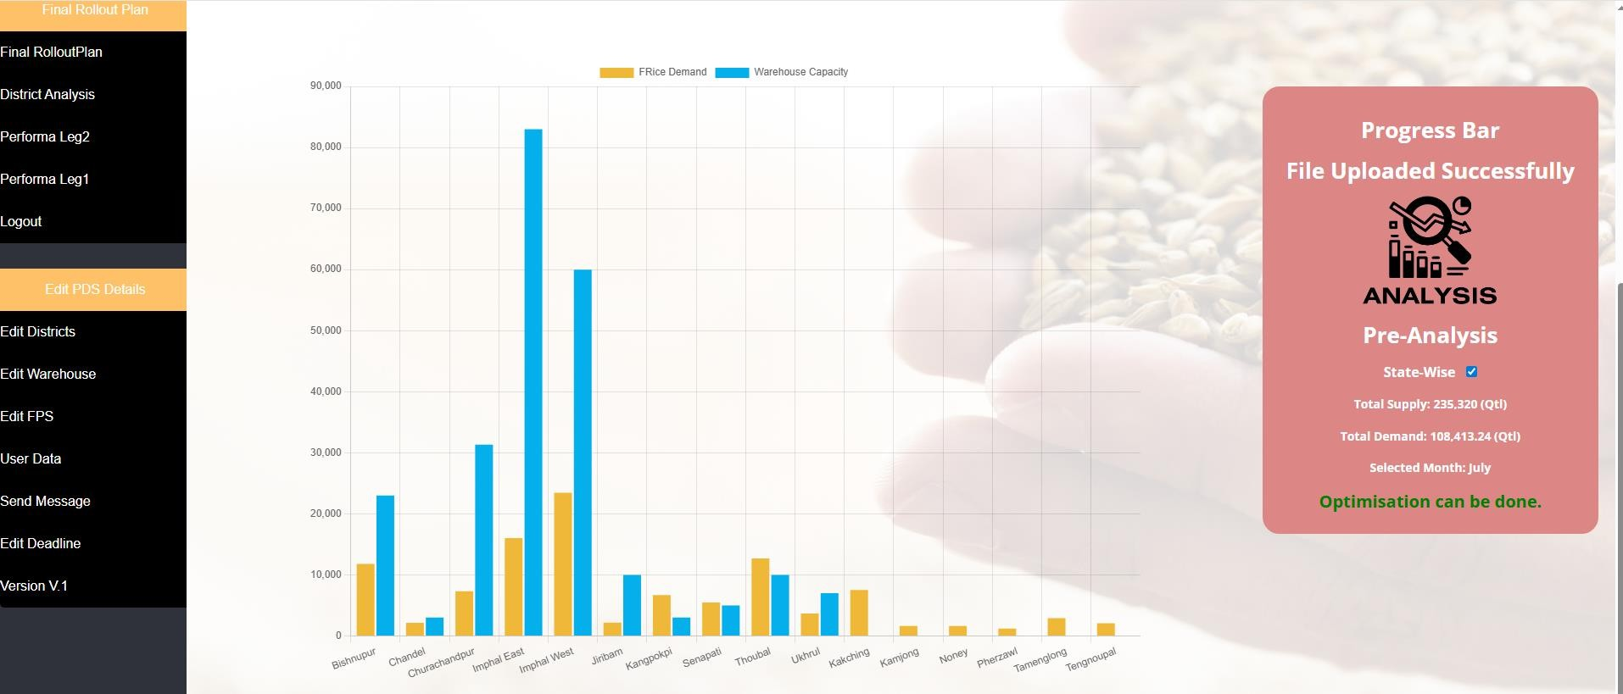
OPTIMISED LEG2
Below down the page you will see the District wise Supply and Demand .
The analysis here shows the Demand and Supply and whether Intra district scenario is possible in all Districts
If not , the districts where Intra district scenario is not possible will be mentioned here
The District wise Supply and Demand
will be displayed here

Slide 7
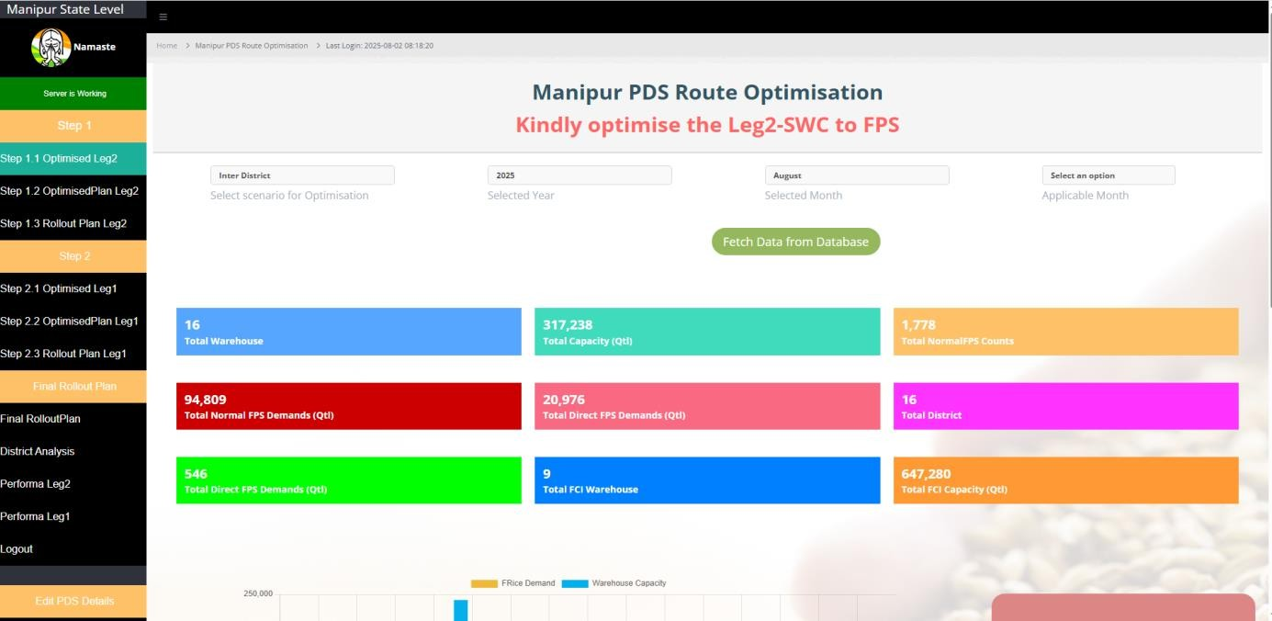
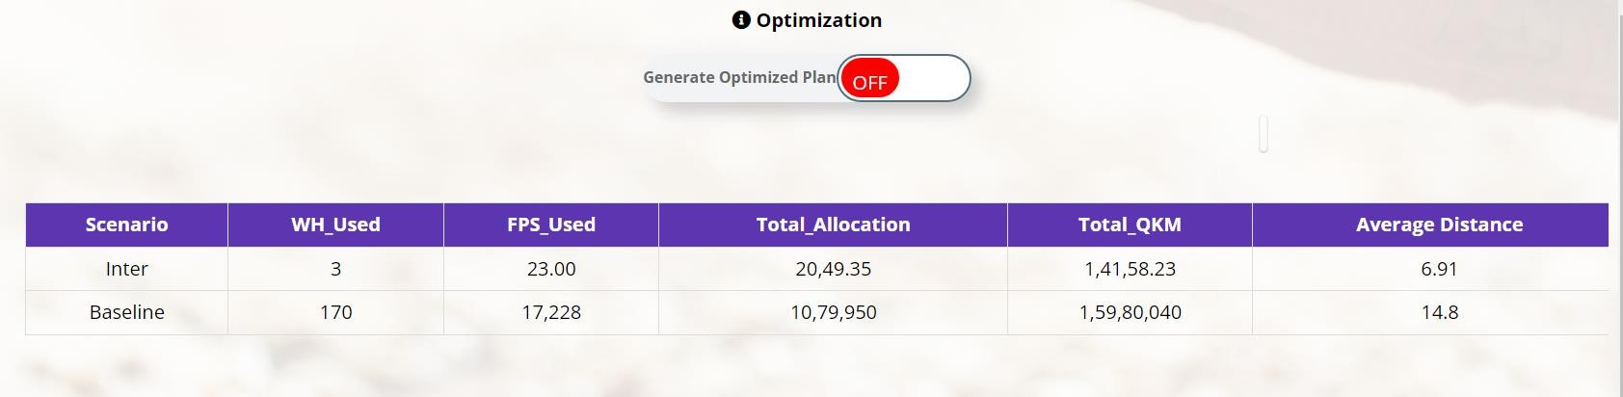
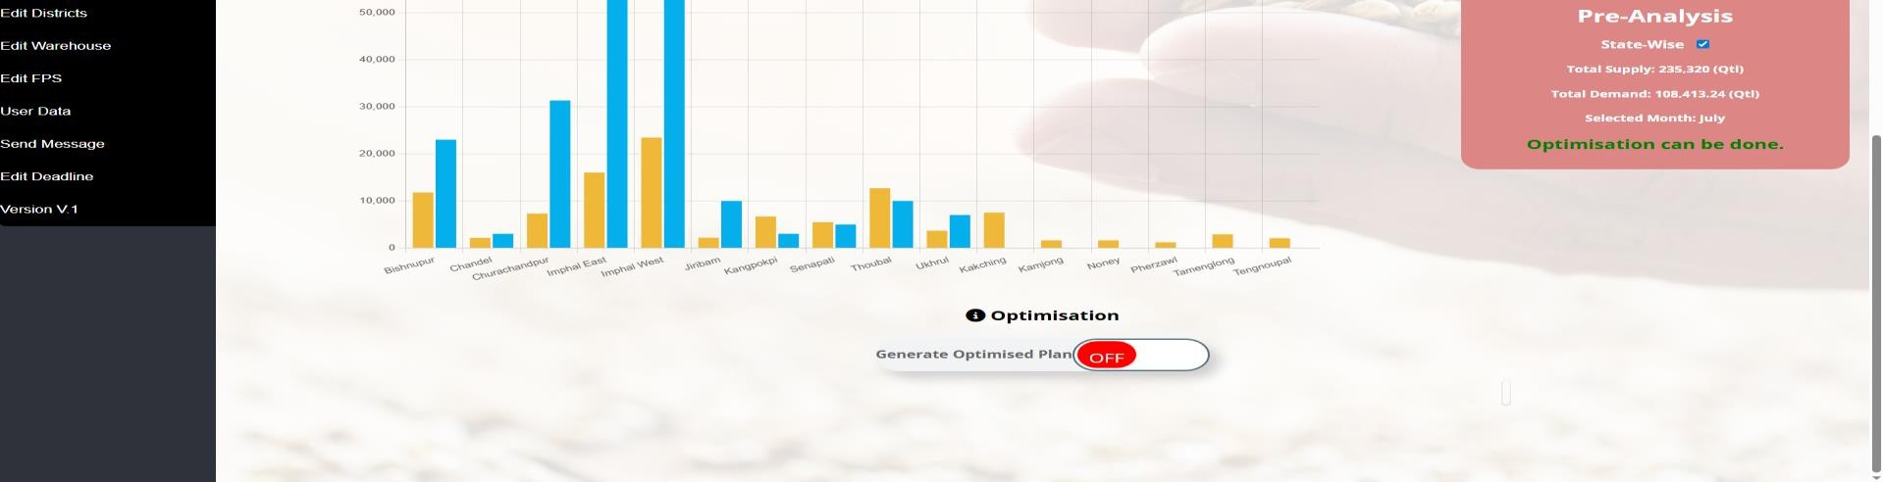
OPTIMISED LEG2
Post Login , Once the Pre-analysis done, user start the optimization. Once the optimization is done, user can use the summary table of the results. Please note that depending on the size of the supply chain , the generation of results may take a few hours
Once all the pre-analysis is competed ,the user can start the optimisation .The button turns green during optimization and turns red once optimization is done
Summary table showing the comparison results of
optimization and baseline.

Slide 8
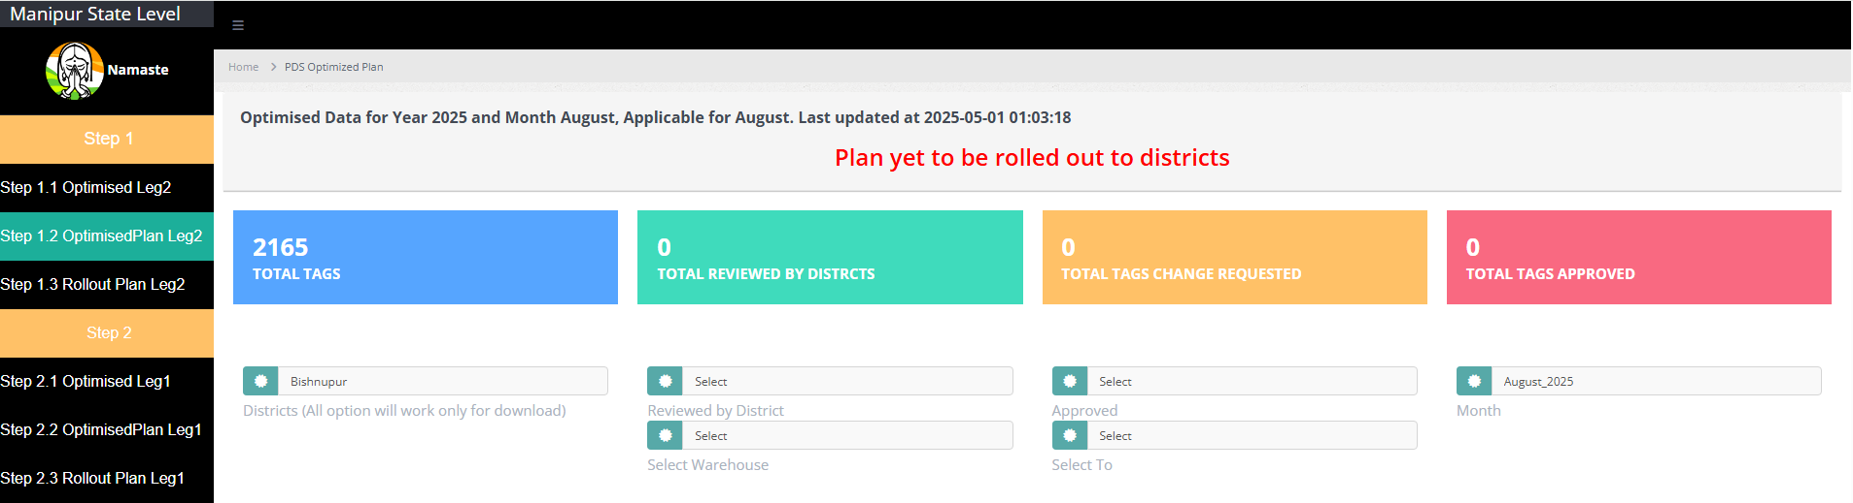
OPTIMISEDPLAN LEG2
Post optimization, user goes to optimization Planning, where user can full fledge plan of the state
User can select the tag which state has reviewed /Not
User can select the tag which state has approved /Not
reviewed
approved
User can select the district name to see the results of the district. Please note here that All option used here is just for downloading full sheet
User can select the FPS as per category
User can select the tag warehouse wise

Slide 9
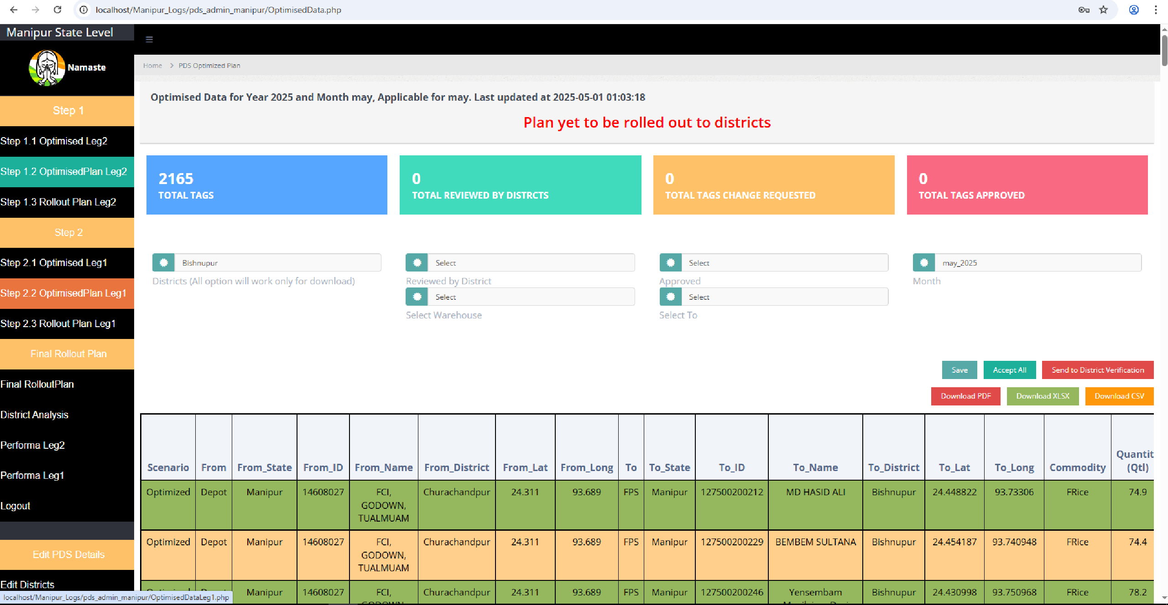
OPTIMISEDPLAN LEG2
Post optimization, user goes to optimization Planning, where user can full fledge plan of the state
Total number of tags in the state need to be tags
Total number of tags reviewed by districts
Total number of tags changes by districts
Total number of tags approved by districts
State can viewed the tags are
pending for district to view
Table show below have full optimized plan having column- From ID, From Name, From Lat, From Long, From District, To ID , To Name, To District , To Lat, To Long, Commodity, Quantity, Distance
Button to save data
Button to accept all tags
if state admin wants
Provisions for Editing the Proposed Optimised Tagging There are 4 additional columns here that need to be filled by State:
Tag accepted/ Not accepted, Reason for not approval, Suggest warehouse, Suggested Distance

Slide 10
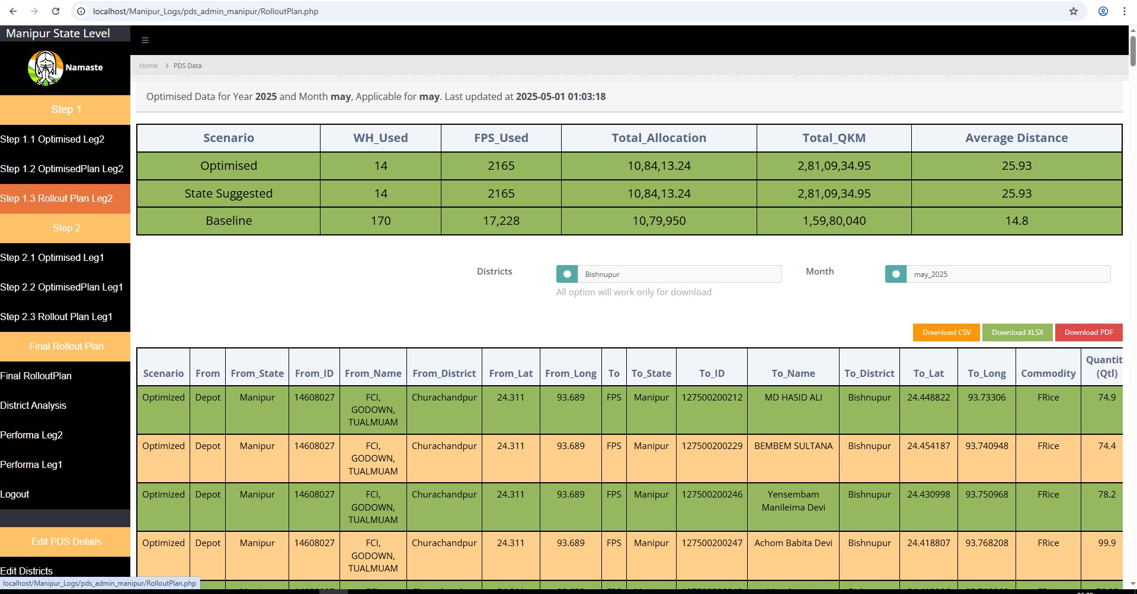
ROLL OUT PLAN LEG2
Post Optimization and correctios ,the Final implementation plan can be viewed here . Table show the comparison between what the QKM in baseline, what optimization suggested and what state final adopted
Summary table showing the QKM result and compare the QKM of Baseline, QKM of the optimisation and QKM after changes are made by the State in the optimisation plan
Filter to select the district to see the implementation plan of district

Slide 11
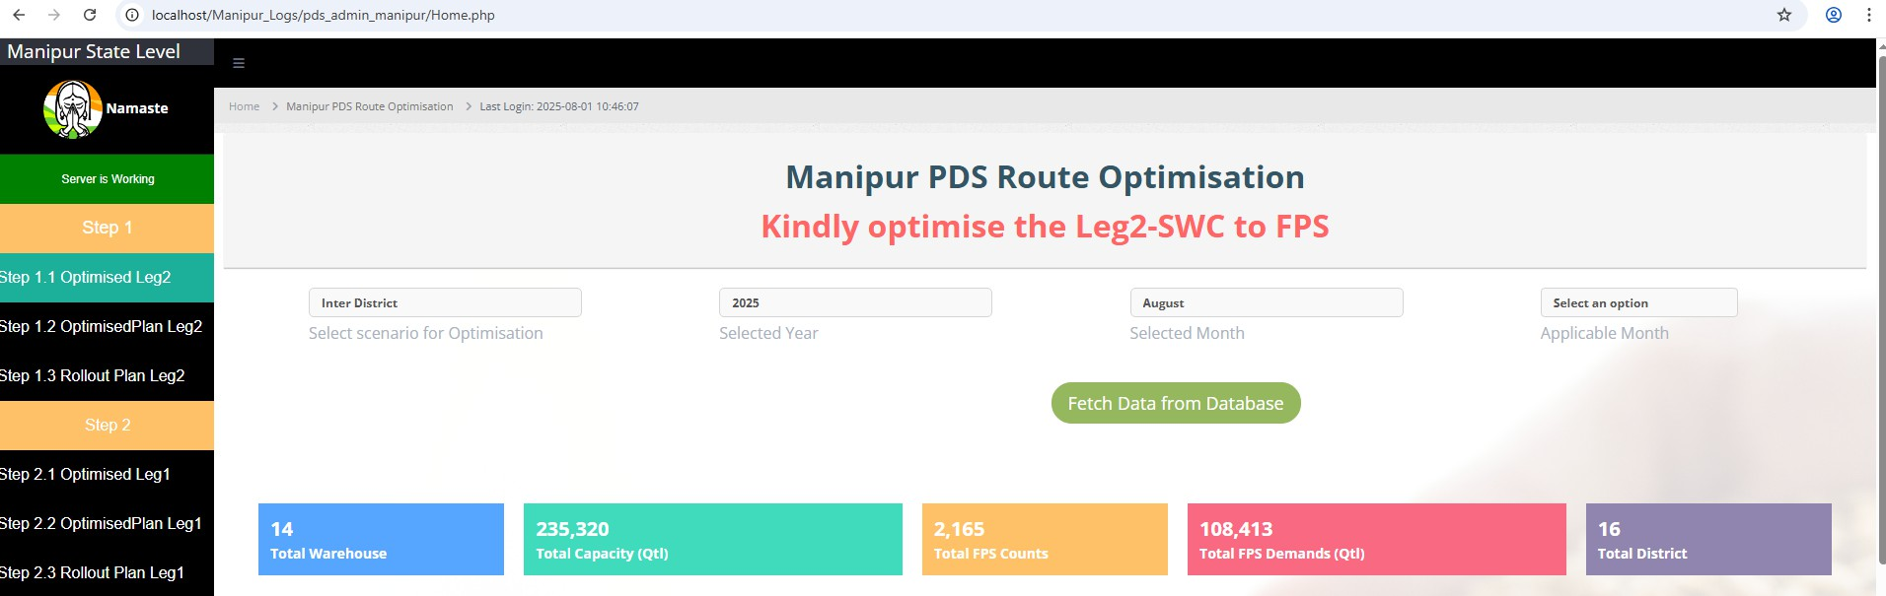
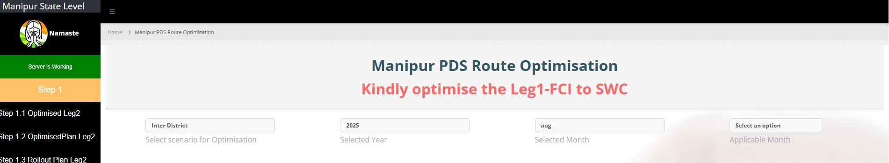
OPTIMISED LEG1
Post Optimization of Leg2 and all tags implemented in leg2 , this page will show the Number of FCI, Warehouses, and Districts, Total warehouse demand , Total FCI capacity
Users can select the scenario :
Inter District
Year and Month of optimisation are automatically selected

Slide 12
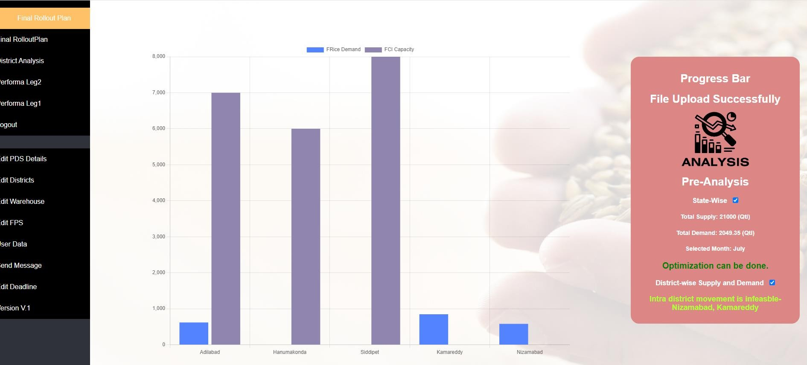
OPTIMISED LEG1
Post Login , this page will show district wise demand of the warehouse and capacity of the FCI
The District wise Supply and Demand will be displayed here

Slide 13

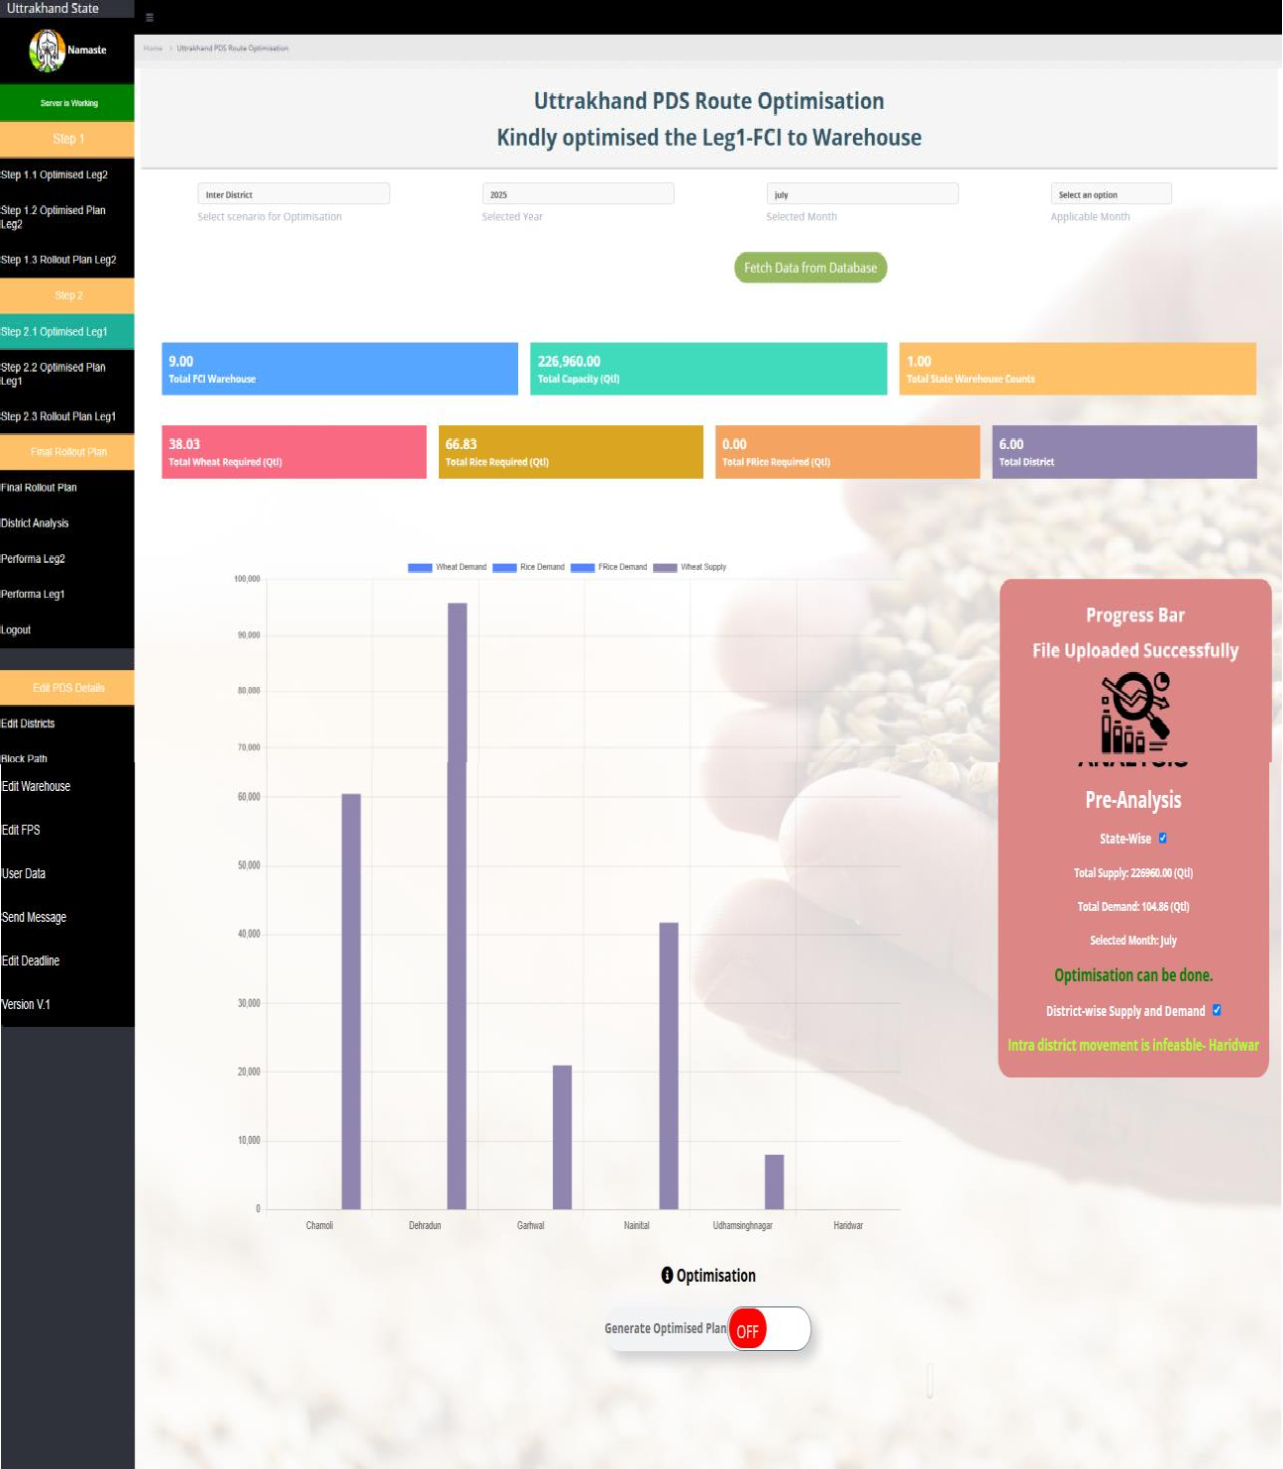
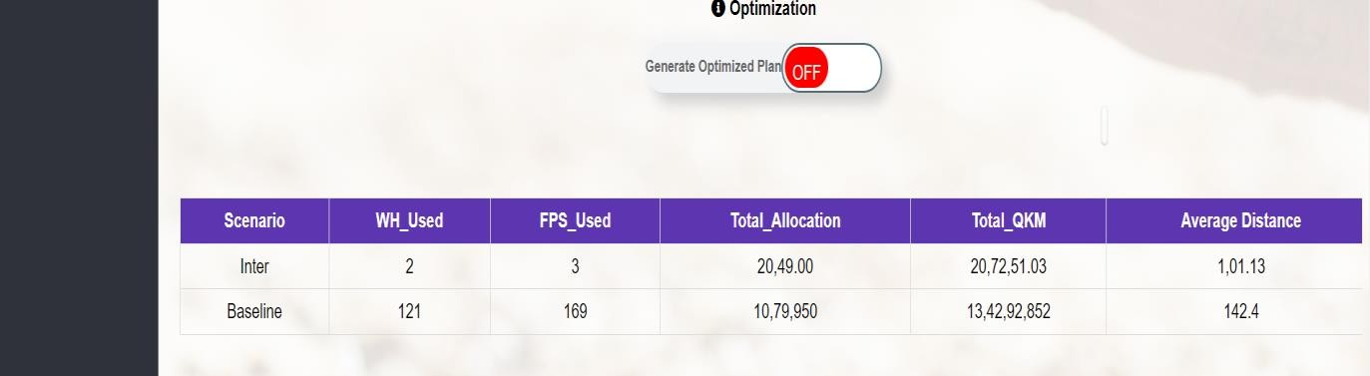
OPTIMISED LEG1
Post optimization of leg2 ,start the optimization. Once the optimization is done, user can use the summary table of the results. Please note that depending on the size of the supply chain , the generation of results may take a few hours
Summary table showing the comparison results of optimization and baseline.

Slide 14
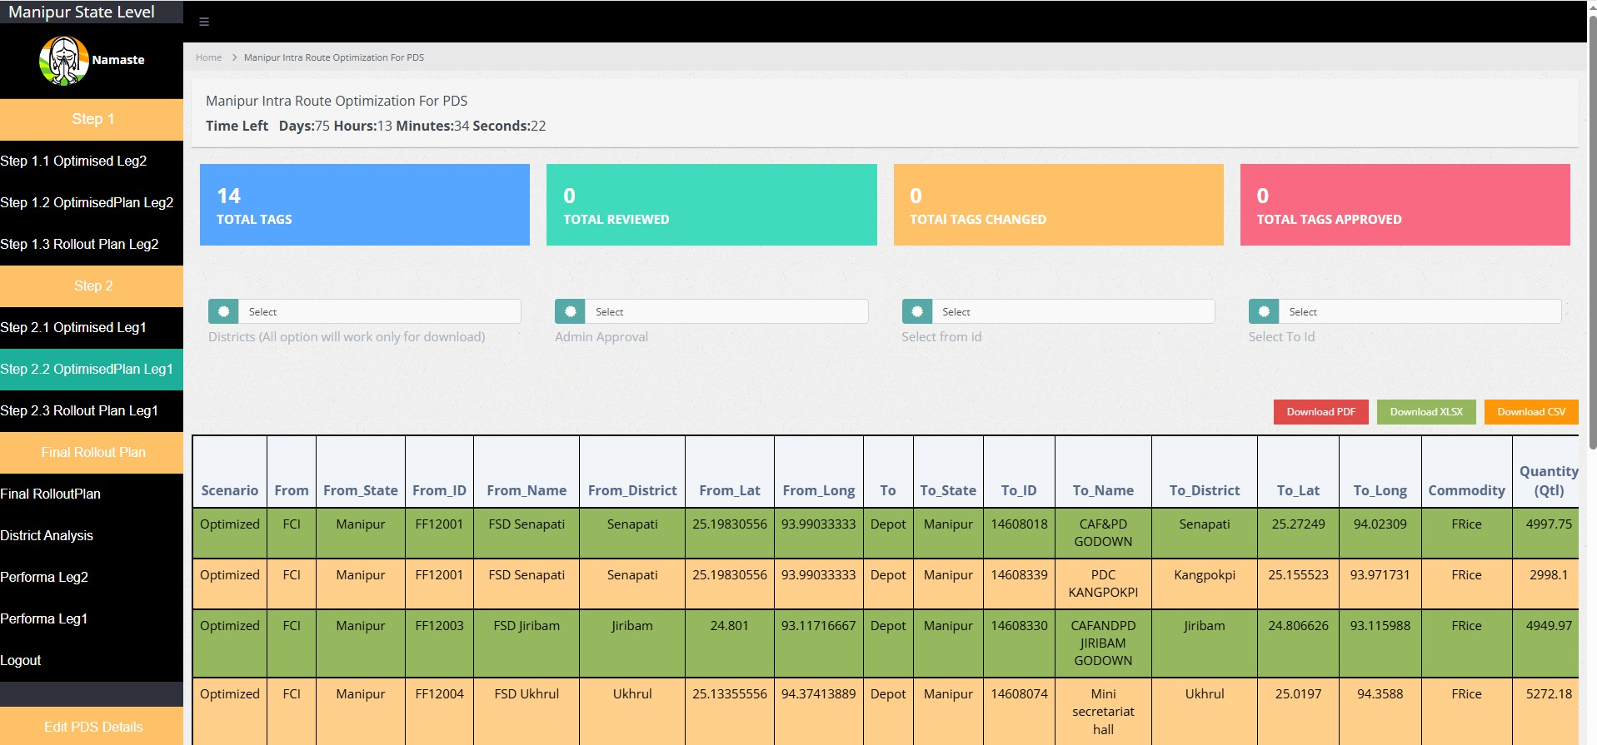
OPTIMISED PLAN LEG1
Post optimization, user goes to optimization Planning, where user can full fledge plan of the state
User can select the tag state warehouse
User can select the district name to see the results of the district. Please note here that All option used here is just for downloading full sheet
User can select the tag which state has reviewed /Not reviewed
User can select the tag FCI warehouse

Slide 15
OPTIMISED PLAN LEG1
Post optimization, user goes to optimization Planning, where user can full fledge plan of the state
Total number of tags in the state need to be tags
Total number of tags reviewed by
districts
Total number of RO changes by fci
Total number of tags approved by state
Provisions for Editing the Proposed Optimised Tagging
There are 4 additional columns here that need to be filled by State: RO accepted/ RO accepted, Reason for not approval, Suggest warehouse, Suggested Distance

Slide 16
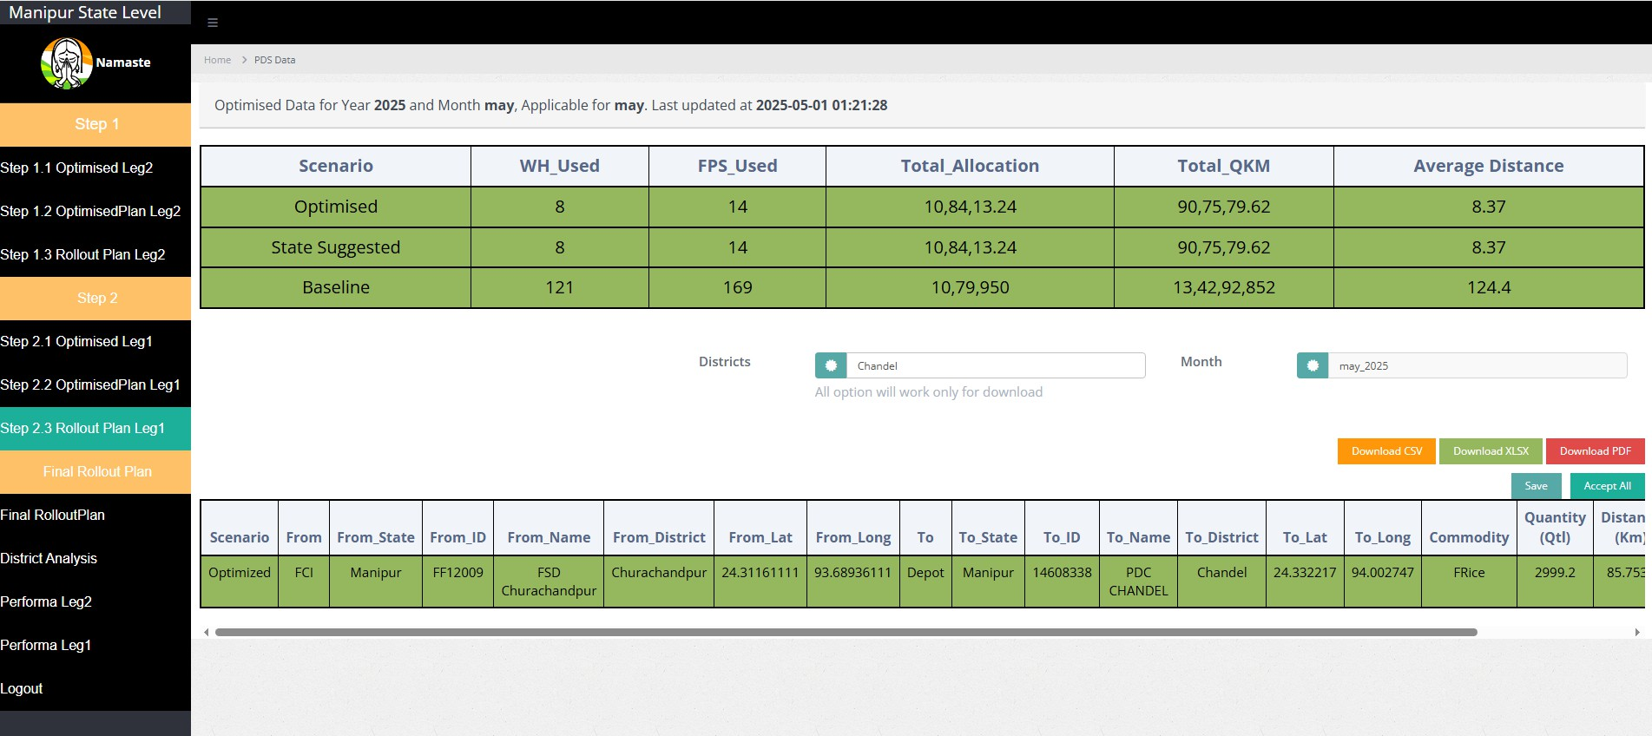
ROLL OUT PLAN LEG1
Post Optimization and correctios ,the Final implementation plan can be viewed here . Table show the comparison between what the QKM in baseline, what optimization suggested and what state final adopted
Summary table showing the QKM result and compare the QKM of Baseline, QKM of the optimisation and QKM after changes are made by the State in the optimisation plan
Filter to select the district to see the implementation plan of district
User can download the sheet district wise and state wise in xlsx and csv format

Slide 17
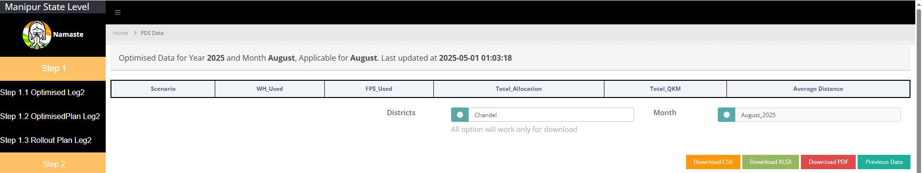
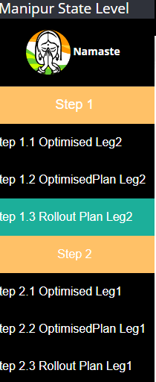
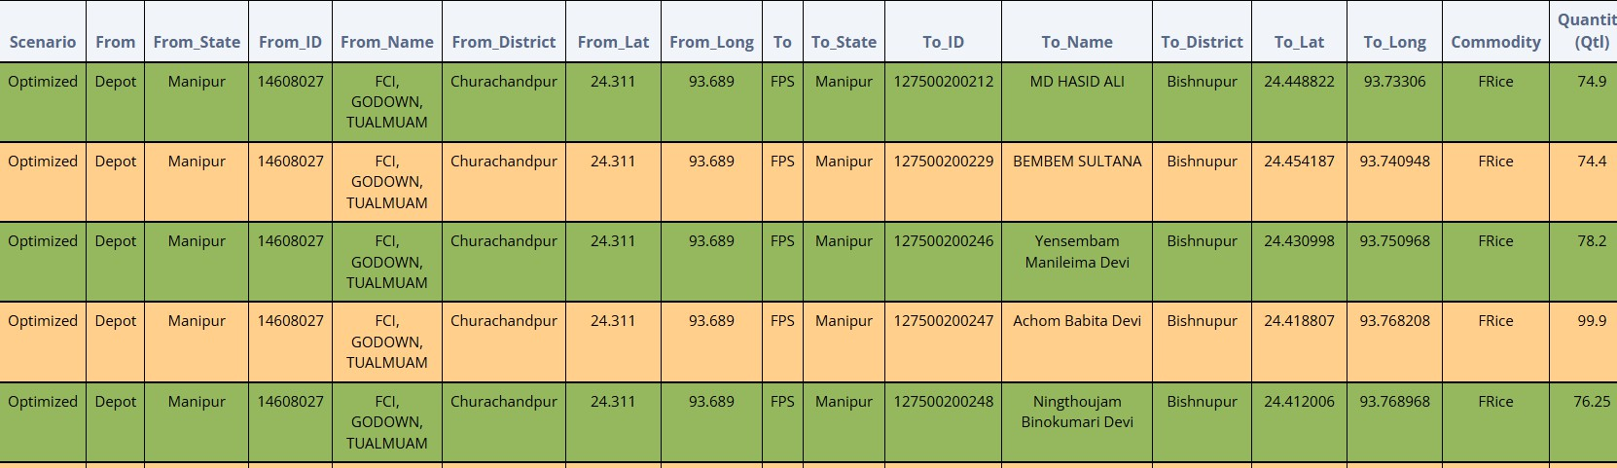
FINAL ROLL OUT PLAN
The Final implementation plan can be viewed here . Table show the comparison between what the QKM in baseline, what optimization suggested and what state final adopted for both leg1 and leg2
Summary table showing the QKM result and compare the QKM of Baseline, QKM of the optimisation and QKM after changes are made by the State in the optimisation plan. This also give the percentage reduction in QKM.
Filter to select the district to see the final plan of district
User can download the sheet district wise and state wise in xlsx and csv format

Slide 18
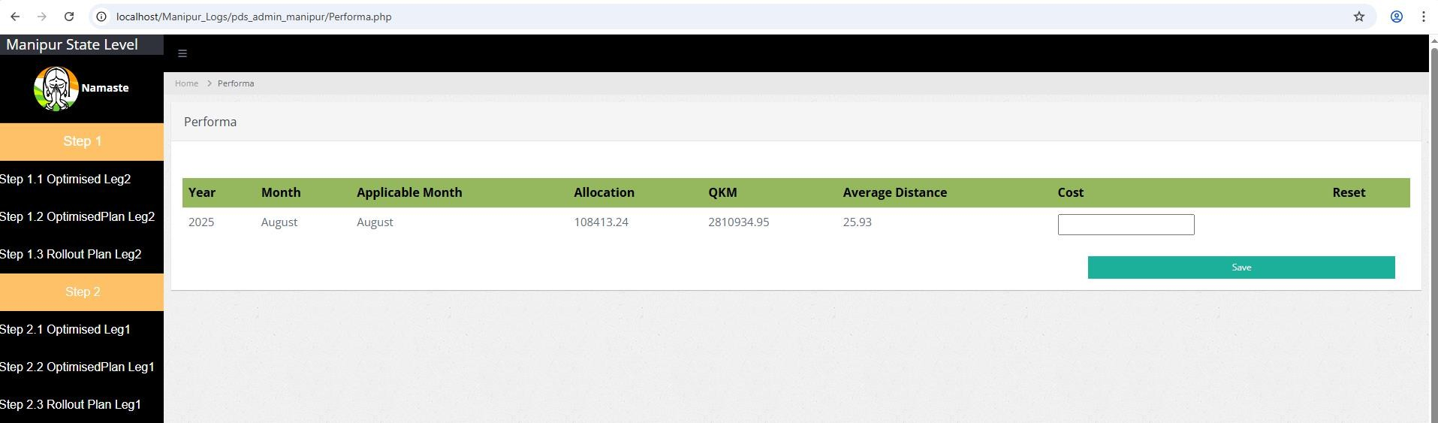
PERFORMA LEG2
Post Optimization and corrections and the Final implementation plan done, state has to fill the Performa . The only filed state has to fill here is cost for leg2.
Apart from cost, all the rest column will be filled automatically depending
upon time state optimized.
Cost has to be filled by the state for leg2.

Slide 19
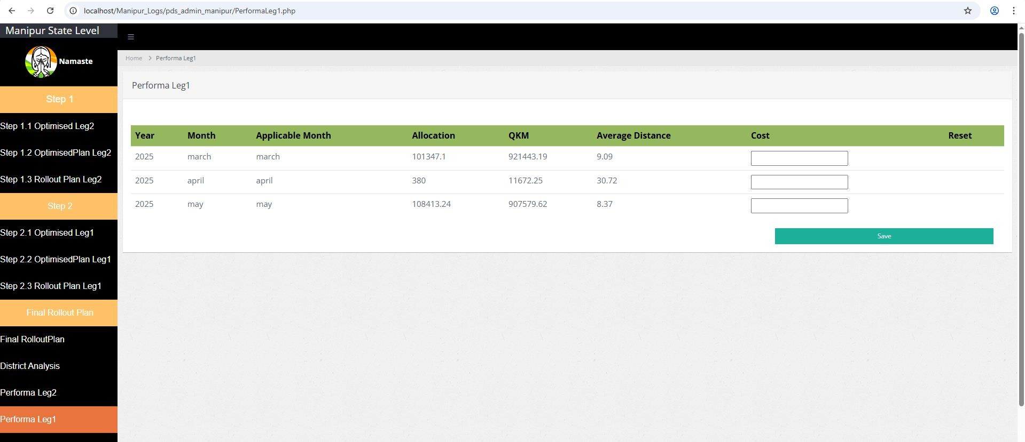
PERFORMA LEG1
Post Optimization and corrections and the Final implementation plan done, state has to fill the Performa . The only filed state has to fill here is cost for leg2.
Apart from cost, all the rest column will be filled automatically depending upon time state optimized.
Cost has to be filled by the state for leg1.

Slide 20
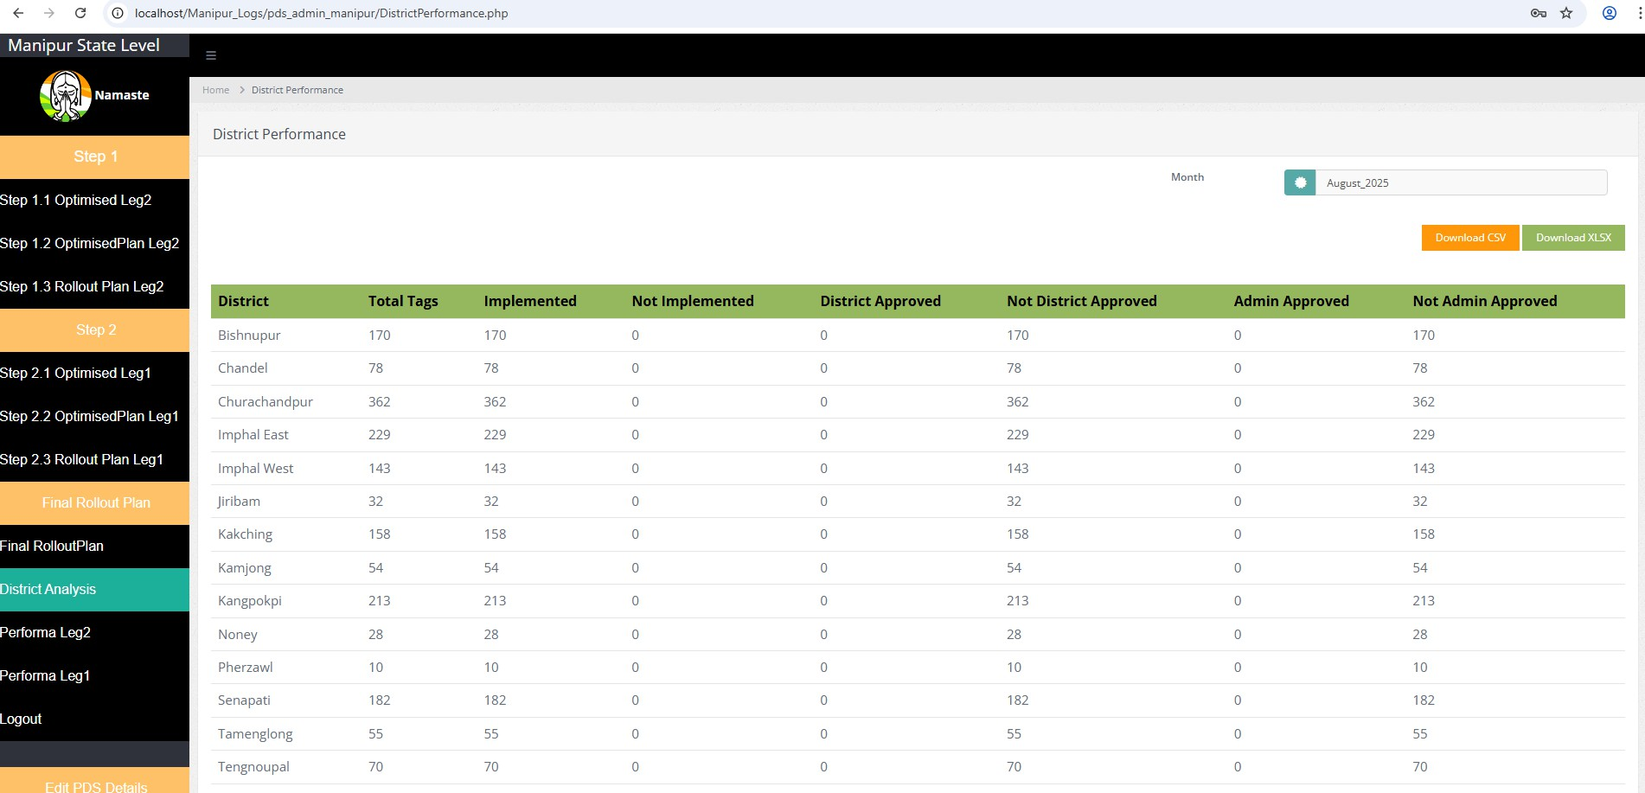
DISTRICT ANLAYSIS PERFORMANCE
Here state can see the performance of all district
The table above describes the count of
Total tags in the district
Total tags implemented by district
Total tags approved by district
Total tags approved by state with respect to districts

Slide 21
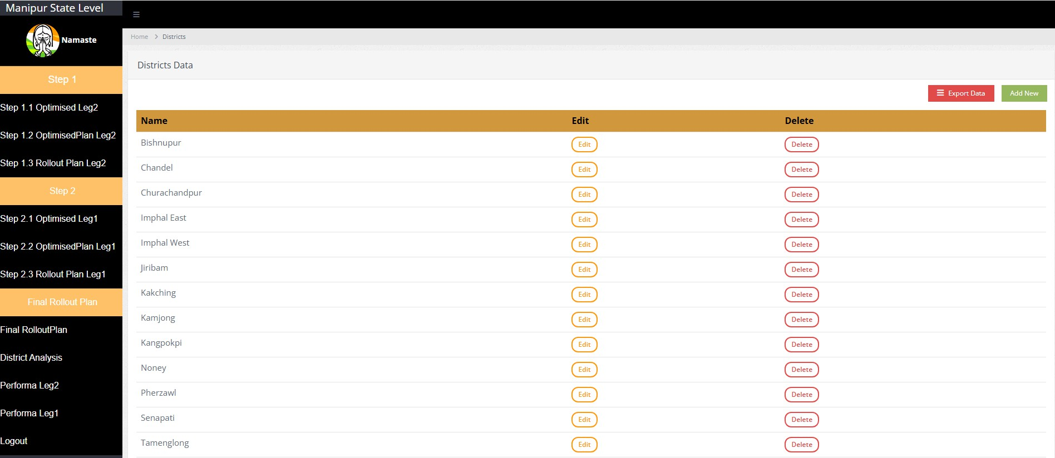
EDIT PDS DETAILS
Edit Districts
Show features- State can edit, delete and add the district name
Export Button to
download list of district
User can add district name
User can edit the
district name
User can delete the district name

Slide 22
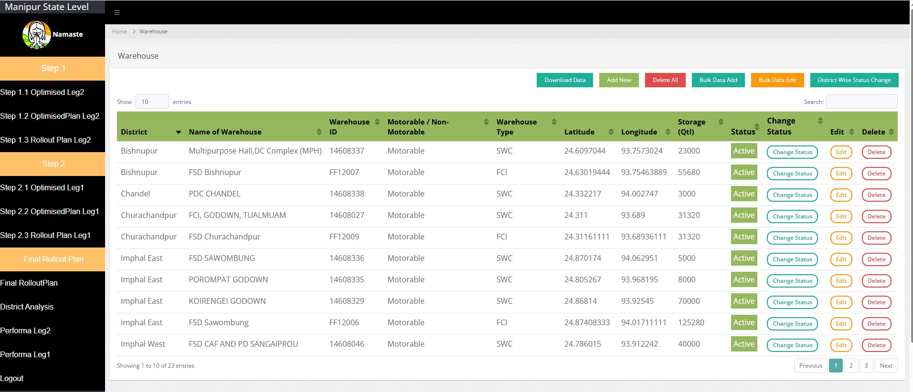
EDIT PDS DETAILS
Edit Warehouse
State can edit, delete and add the warehouse name. Along with this bulk data can be added, edit and delete. There is provision of active
/In active warehouse in case state don’t want to delete
User can download the data in excel
Delete All
Edit in bulk
User can add new data
Add in Bulk
User can change the status of warehouse:
Active meaning that they are being used and should be considered in optimisation
Inactive meaning those that may be temporarily out of use and not to be considered in optimisation

Slide 23
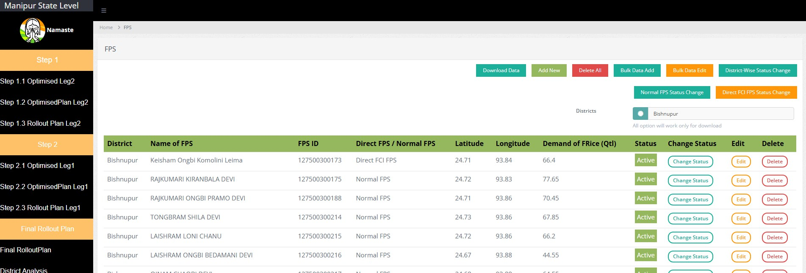
EDIT PDS DETAILS
Edit FPS
Show features- State can edit, delete and add the warehouse name. Along with this bulk data can be added, edit and delete. There is
provision of active /In active warehouse in case state don’t want to delete
FPS Has two categories:
Normal FPS : these FPS will be served only from State
Warehouse
Direct FCI FPS : These FPS will be served by FCI only.
User can download the data in excel
Delete All
Add in Bulk
Edit in bulk
User can add
new data
Status of FPS can be changed based on type of FPS
User can change the status of FPS:
Active meaning that they are being used and should be considered in optimisation
Inactive meaning those that may be temporarily out of use and not to be considered in optimisation

Slide 24
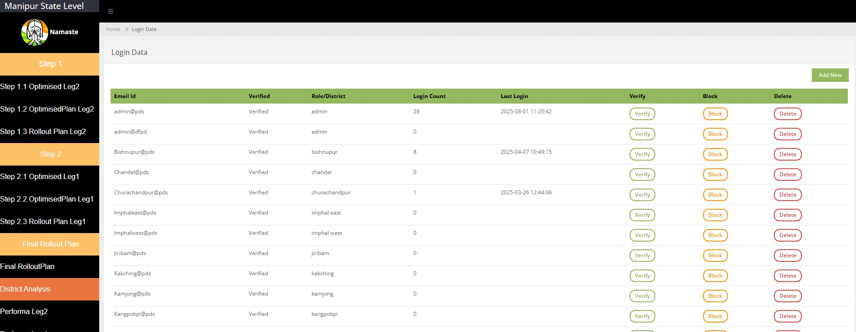
EDI PDS DETAILS
User Data
Show features- State can create , verify, delete and block the user name as per the requirement
New login
creation
No of times account is login
Last –Login when
is done
Block Button
Verify Button
Delete Button

Slide 25
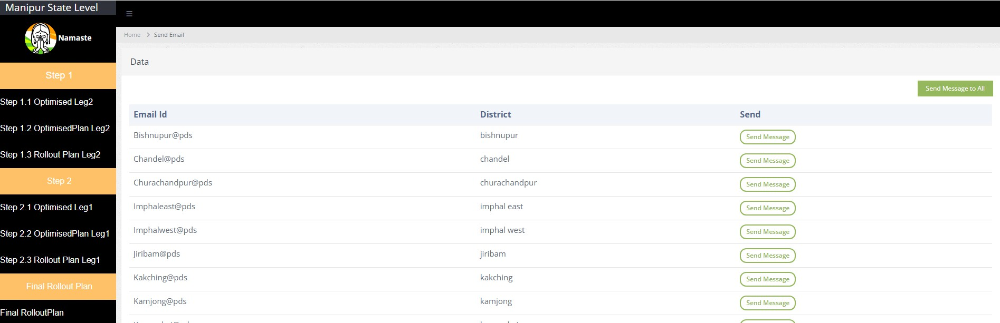
EDIT PDS DETAILS
Send Message
Show features- State can send the message to all district or district specific. This is admin dashboard to district dashboard message
Send Message to specific
state
Send message to all users

Slide 26
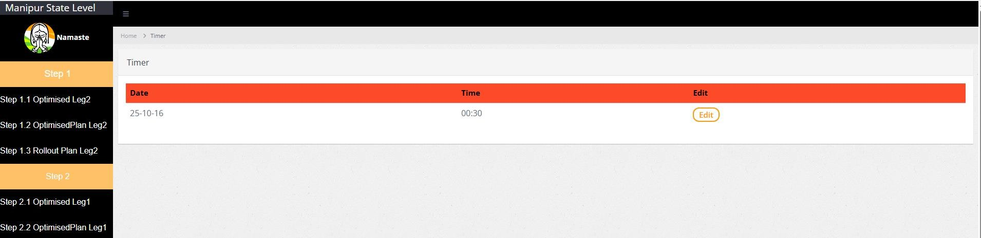
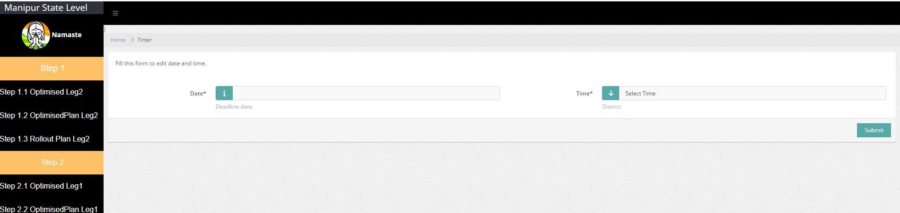
EDIT PDS DETAILS
Edit Deadline
Show features- State can set the time given to the district for their review and feedback
Edit button
for editing
the timeline
Edit the date
Edit the time

Slide 27
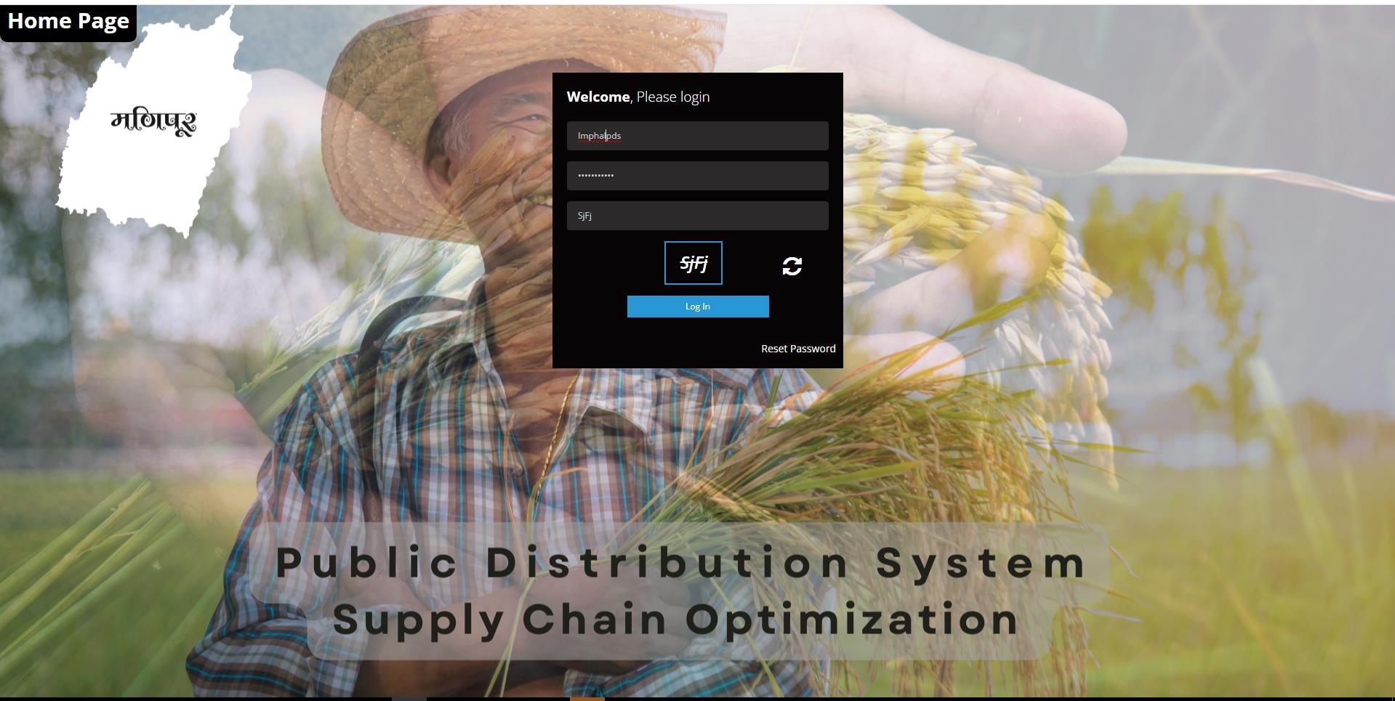
DISTRICT LOGIN PAGE
Every district has its own state specific login.
User login the system using the username and password.
User can reset the password as
per their requirement and choice.

Slide 28
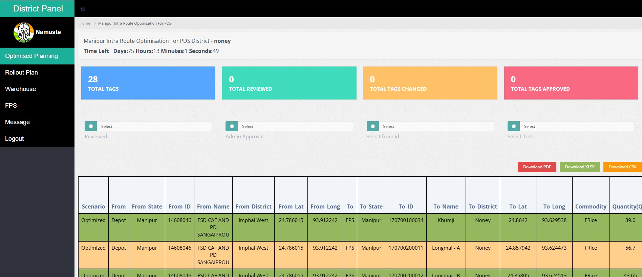
OPTIMIZED PLAN
Post optimization, district can see the results of optimization with respect to their district
Total Tags in the state
Total Tags reviewed by district
Total Tags changed by district
Total Tags approved by district
User can select the tag which
district has reviewed /Not
User can select the tag which
district has approved /Not
User can select the
Smart/NonSmart FPS
User can select the warehouse
reviewed
approved
District will select whether to approved the tag or change it
District will select warehouse ID if district not accept the opt tag
District will select reason for not accepting the
tag
District will write the distance for new tags

Slide 29
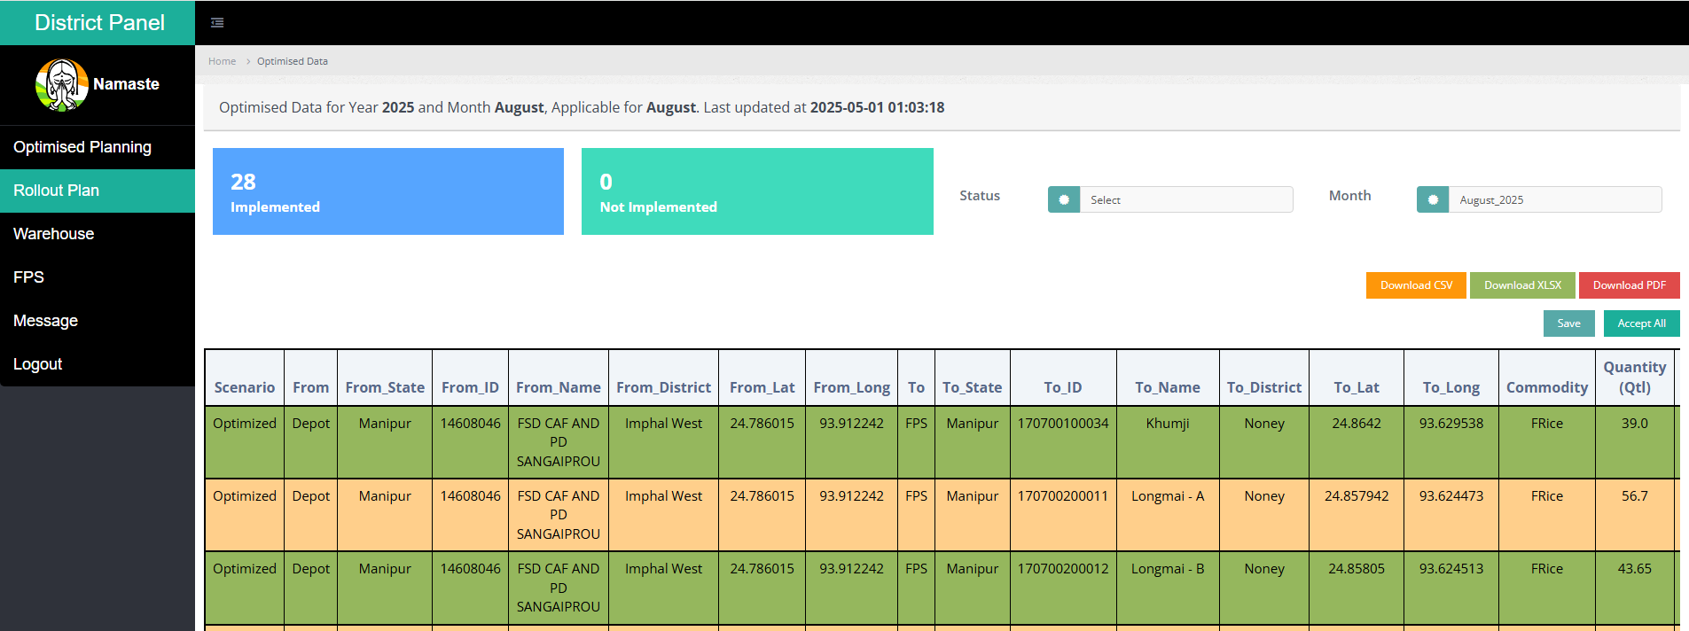
ROLL OUT PLAN
Post Optimization and correctios ,the Final implementation plan can be viewed here
Filter to select implemented/not implemneted
User can see number of tagging are implemented and not implemented
User can download the sheet district wise and state wise in xlsx and csv format

Slide 30
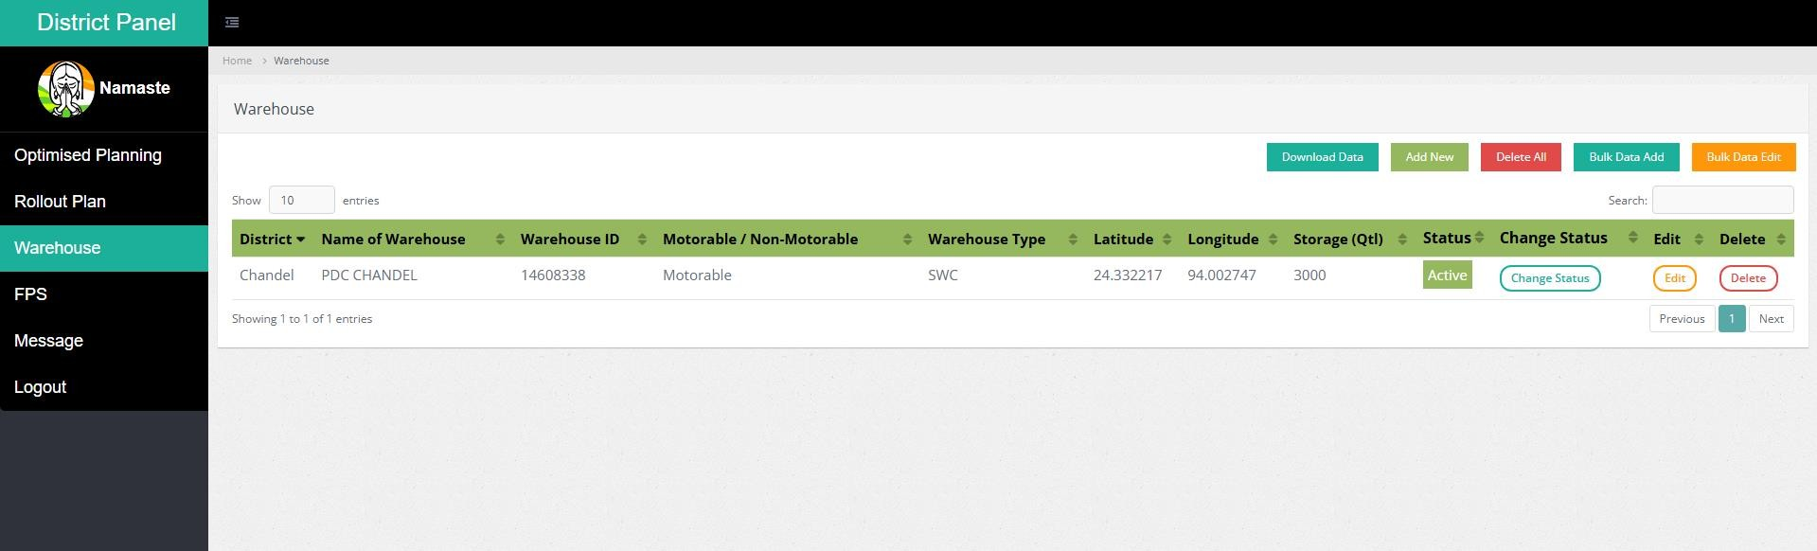
EDIT PDS DETAILS
Edit Warehouse
District can edit, delete and add the warehouse name. Along with this bulk data can be added, edit and delete. There is provision of
active /In active warehouse in case state don’t want to delete
User can add new data
Add in Bulk
User can download the data in excel
Delete All
Edit in bulk
User can change the status of warehouse:
Active meaning that they are being used and should be considered in optimisation
Inactive meaning those that may be temporarily out of use and not to be considered in optimisation

Slide 31
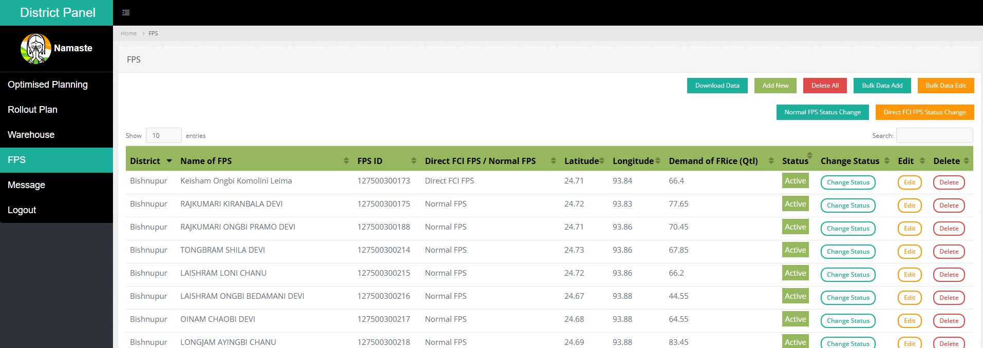
EDIT PDS DETAILS
Edit FPS
Show features- District can edit, delete and add the warehouse name. Along with this bulk data can be added, edit and delete. There is
provision of active /In active warehouse in case state don’t want to delete .
FPS Has two categories:
Normal FPS : these FPS will be served only from State
Warehouse
Direct FCI FPS : These FPS will be served by FCI only.
User can download the data in excel
Delete All
Add in Bulk
User can add new data
Edit in Bulk
Status of FPS can be changed based on type of FPS
User can change the status of FPS:
Active meaning that they are being used and should be considered in optimisation
Inactive meaning those that may be temporarily out of use and not to be considered in optimisation

Slide 32
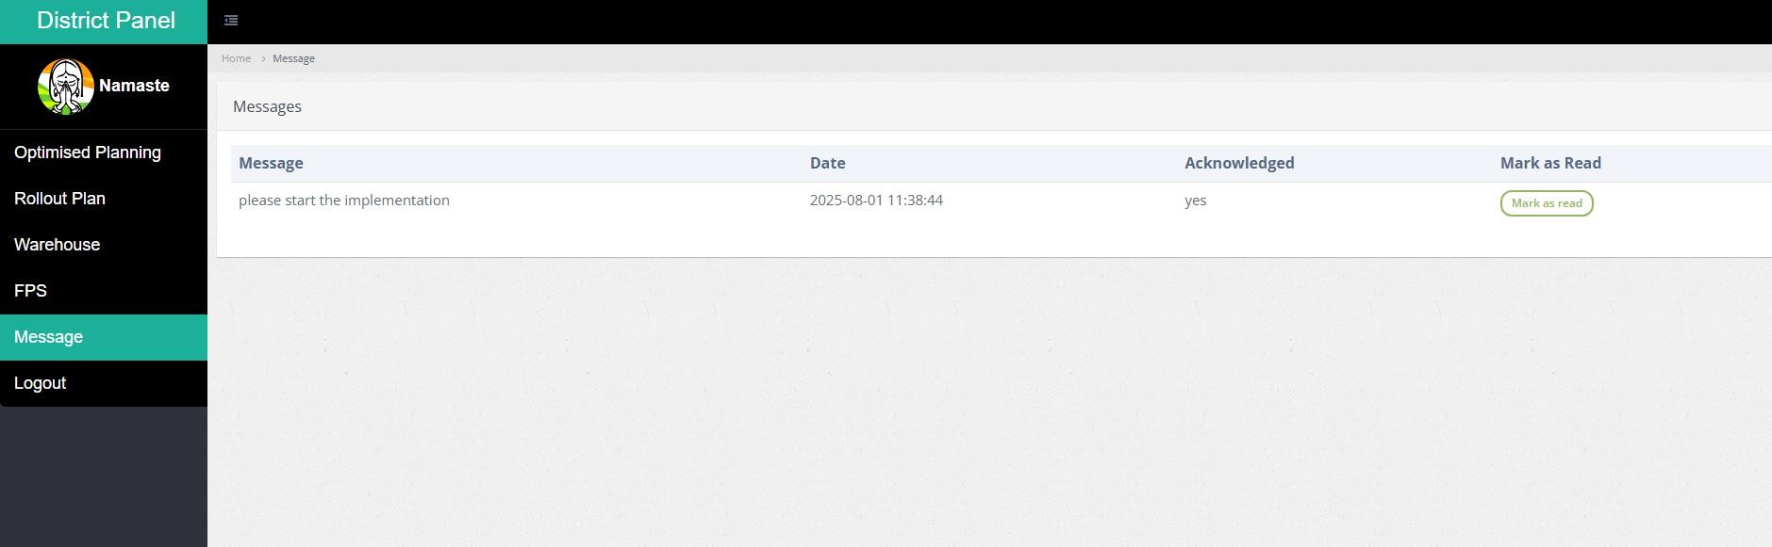
EDIT PDS DETAILS
Message
Show features- District review the message received from state admin and mark as read so that message is acknowledged
Button to mark as read

